Slide 1
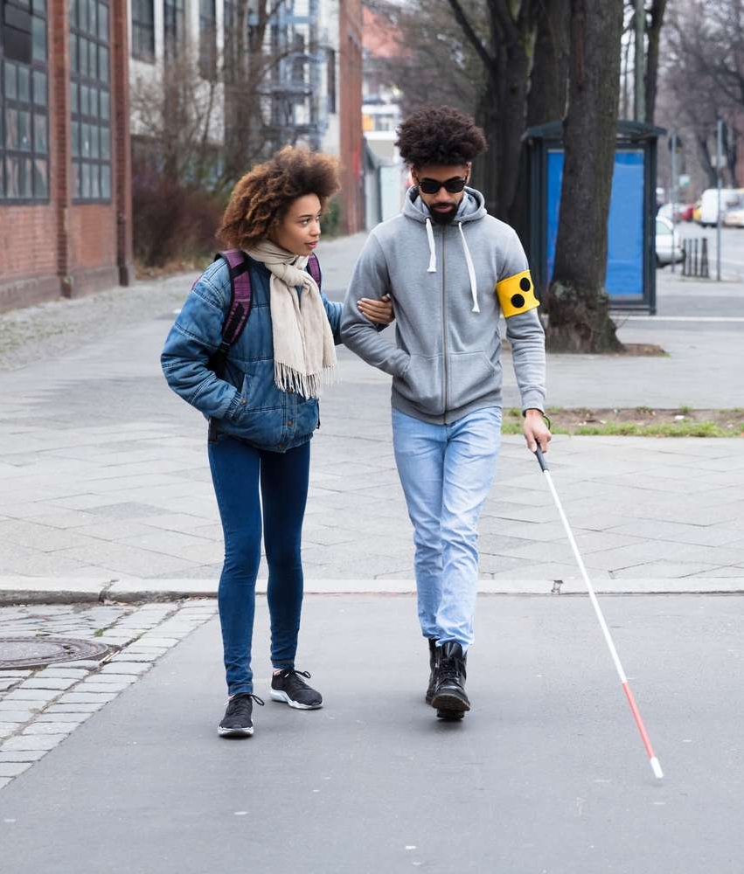
VisualEASE
BLIND ASSISTANCE USING IMAGE PROCESSING
Presented By,
Abhijith M (KGR19CS001)
Haripriya P M (KGR19CS041)
Neha B Karunattu (KGR19CS055)
Asisha Rajan (LKGR19CS088)
Project Guide ,
Gayathri Mohan
Assistant Professor
Dept. of CSE

Slide 2
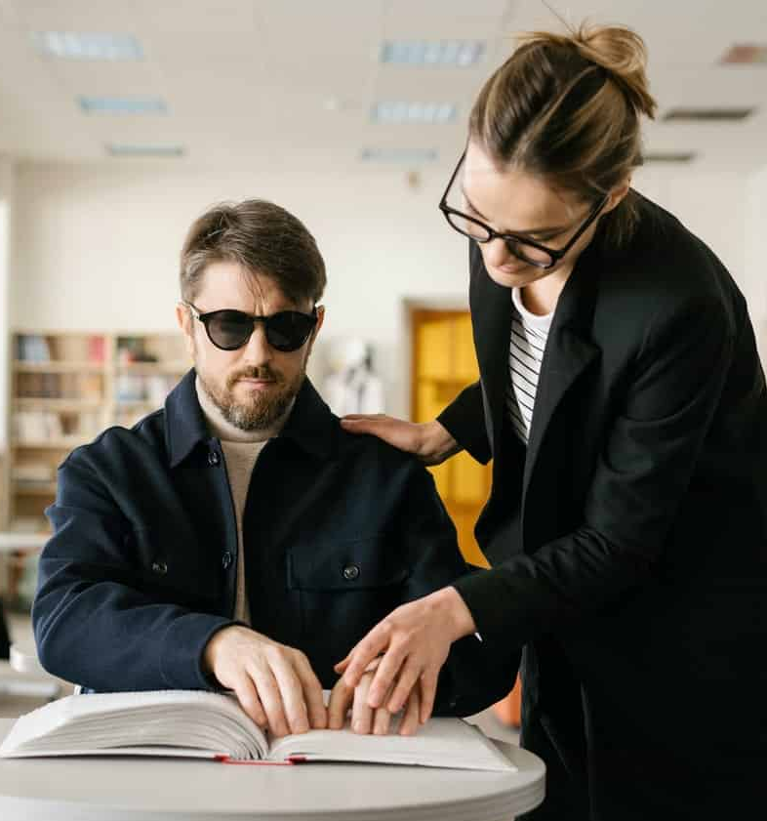

01
INTRODUCTION
02
ABSTRACT
03
PHASE 1
LITERATURE REVIEW
EXISTING SYSTEM
BLIND ASSISTANCE USING IMAGE PROCESSING
PROPOSED SYSTEM
ANALYSIS MODELS
HARDWARE AND SOFTWARE REQUIREMENTS
CONTENTS
04
PHASE 2
SYSTEM ARCHITECTURE
MODULES AND FUNCTIONALITIES
STUDY PHASE
IMPLEMENTATION
PUBLICATION
SCHEDULE
05
CONCLUSION
06
REFERENCES

Slide 3
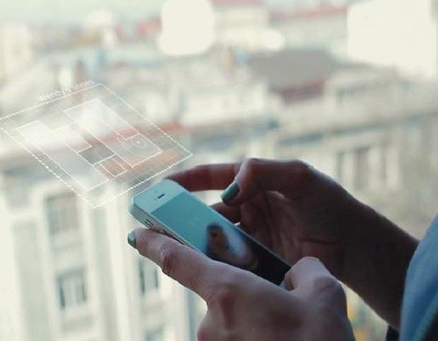
Introduction
According to the World Health Organization, around 40 million people are blind, while another 250 million have some form of visual impairment.
While navigating from one place to another on their own or to satisfy their day-to-day needs they often depend on others for help.
So, it is a very challenging task to make a mechanical arrangement for them which is most significant.
Our project's goals is to create a mobile applications to assist the blind person.
This will allow visually impaired persons to recognize and classify daily things with voice help.
This application detect objects and also recognize persons.

Slide 4
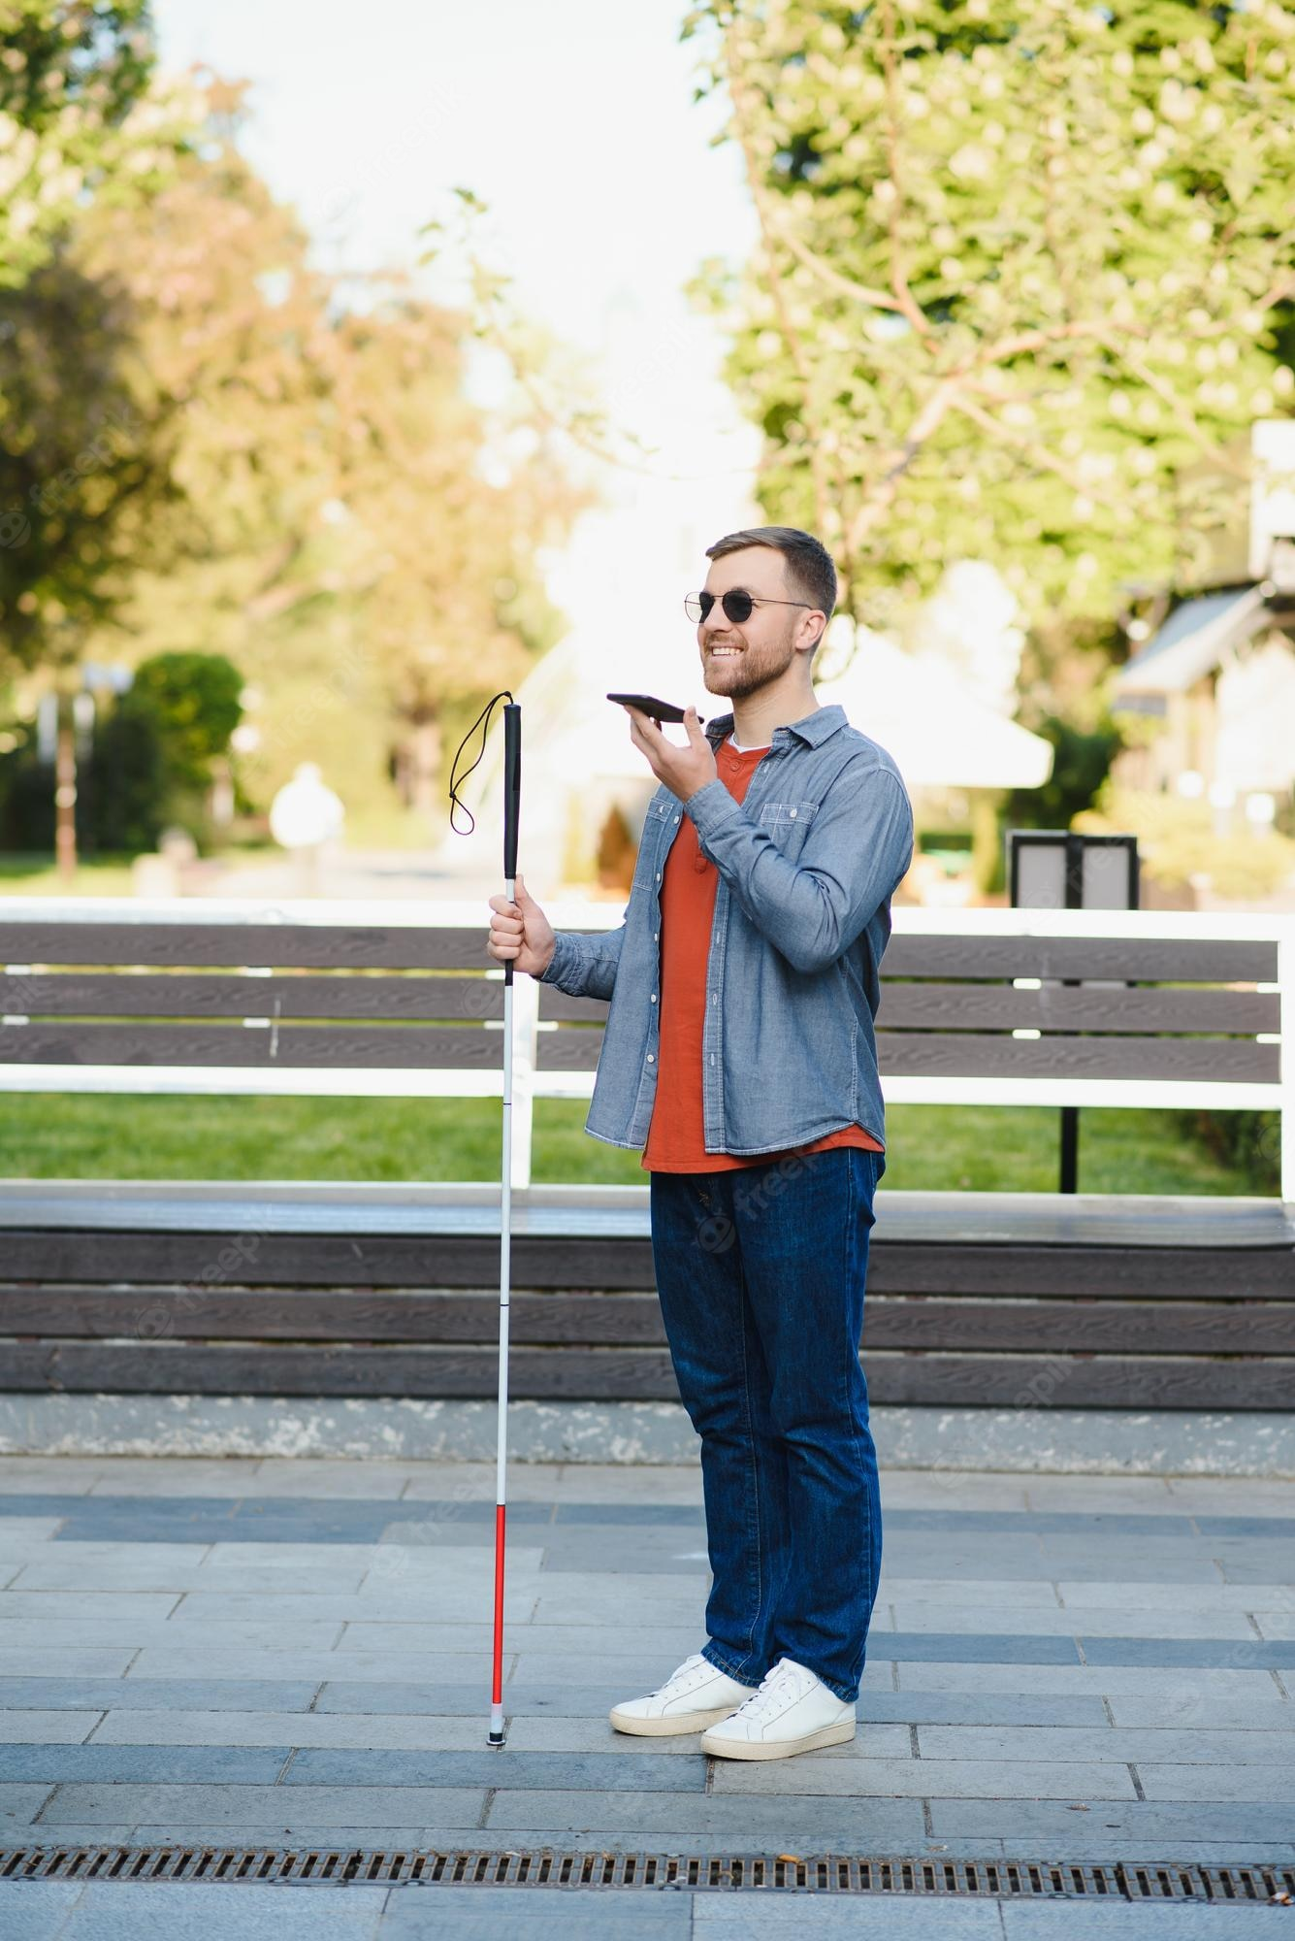
Abstract
Eye diseases usually cause blindness and visual impairment.
Visually Impaired people come across many troubles in their daily life, especially while navigating from one place to another on their own.
We would wish to make a mobile application that allows the blind victims to detect and identify real-time objects and recognize persons and generating voice feedback.
This project update the location of blind to the bystander.

Slide 5
PHASE I

Slide 6
Literature Review
No. | Authors | Function | Method Used | Parameters Measured | Equipements Used | Sensors
1. | P.Rama Devi, K. Sahaja, S. Santrupth, M.P. Tony Harsha, K Balasubramanyam Reddy | Object Detection, Distance Calculation | Machine Learning- Tensor Flow | Real-world Objects | Mobile Camera | Device Camera
2. | Akhilesh Salunkhe, Manthan Raut, Shayantan Santri, Mrs. Sumedha Bhagawat | Detecting objects in real-time and converting them into an audio output. | SSD algorithm trained TensorFlow Model | Real-world objects | System Camera | System Camera
3. | Navneet Dalal and Bill Triggs | Person to person classification | Histogram of Oriented Gradient(HOG) | Images | Device Camera | Device Camera
4 | Rajeshvaree Ravindra karmarkar | Object detection system for the blind with voice guidance. | TTS Technology, YOLO algoriths | image | Device camera | Device camera
5 | Russakovsky.o,Jia Deng,Jonathan Krause | ImageNet Large scale visual recognition challenge. | Annotation Methodology, Evalution Matrics, CNNs. | Image | System camera | System camera

Slide 7
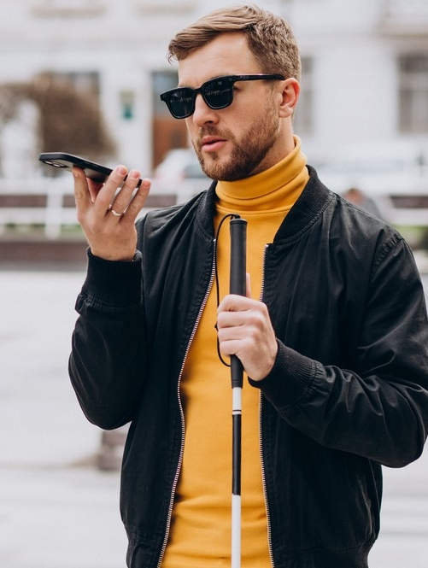
Existing System
In order to advance computer vision frameworks, efficient and precise object recognition is essential.
The project aims to integrate an Android application for object recognition and localization to achieve high accuracy and real-time performance.
Its functionality addresses the identification of objects and signs.
Disadvantage : Tracking of user’s location is not possible.

Slide 8
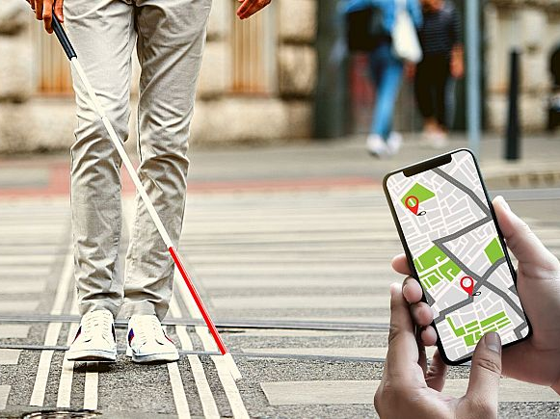
Proposed System
The introduction of machine learning and deep learning methods has dramatically increased the precision for object location.
The proposed system aims to create a visual aid image processing system for visually impaired people in which the user accepts speech commands.
The proposed system will help the visually impaired person manage day-to-day activities.
It also aid them to navigate their surroundings.
The proposed system detect and recognize the persons and able to locate the blind user by bystander.

Slide 9

ANALYSIS MODELS

Slide 10
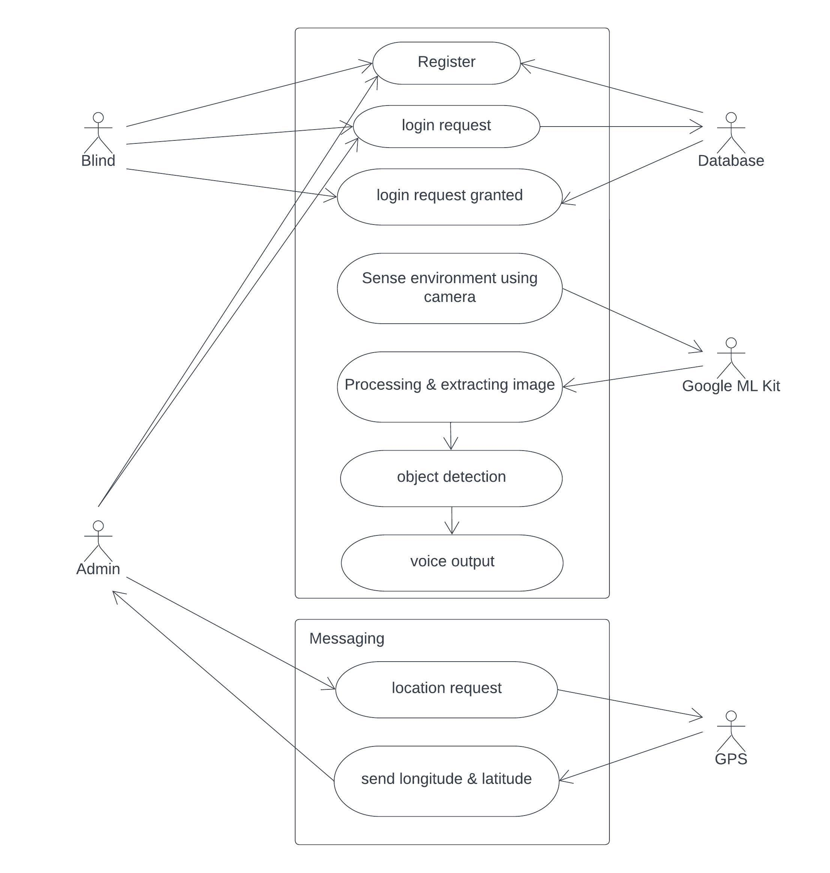
1.USE CASE DIAGRAM
update location

Slide 11
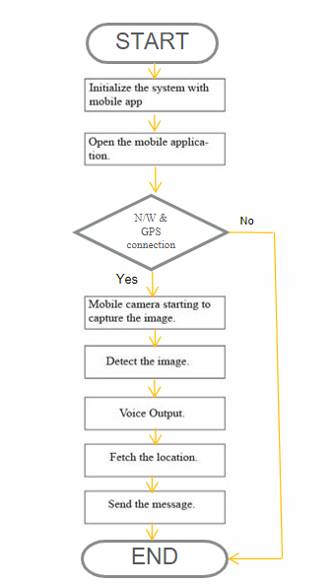
2. WORKFLOW DIAGRAM
Mobile camera starting to
capture the image
Detect the Image
voice output
Request location
Update Location

Slide 12
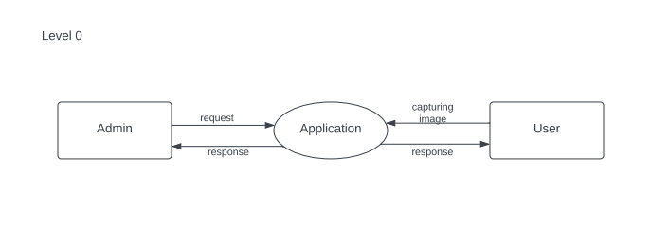
LEVEL 0
3. DATAFLOW DIAGRAM

Slide 13
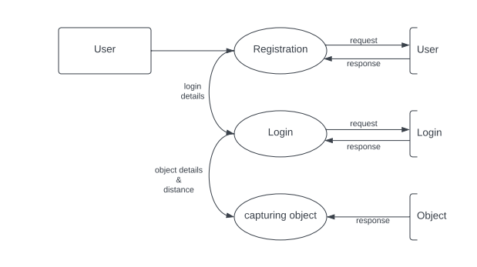
LEVEL 1 USER

Slide 14
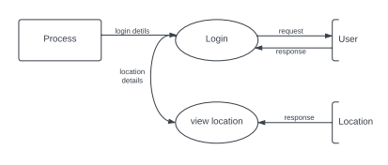
LEVEL 1 admin

Slide 15
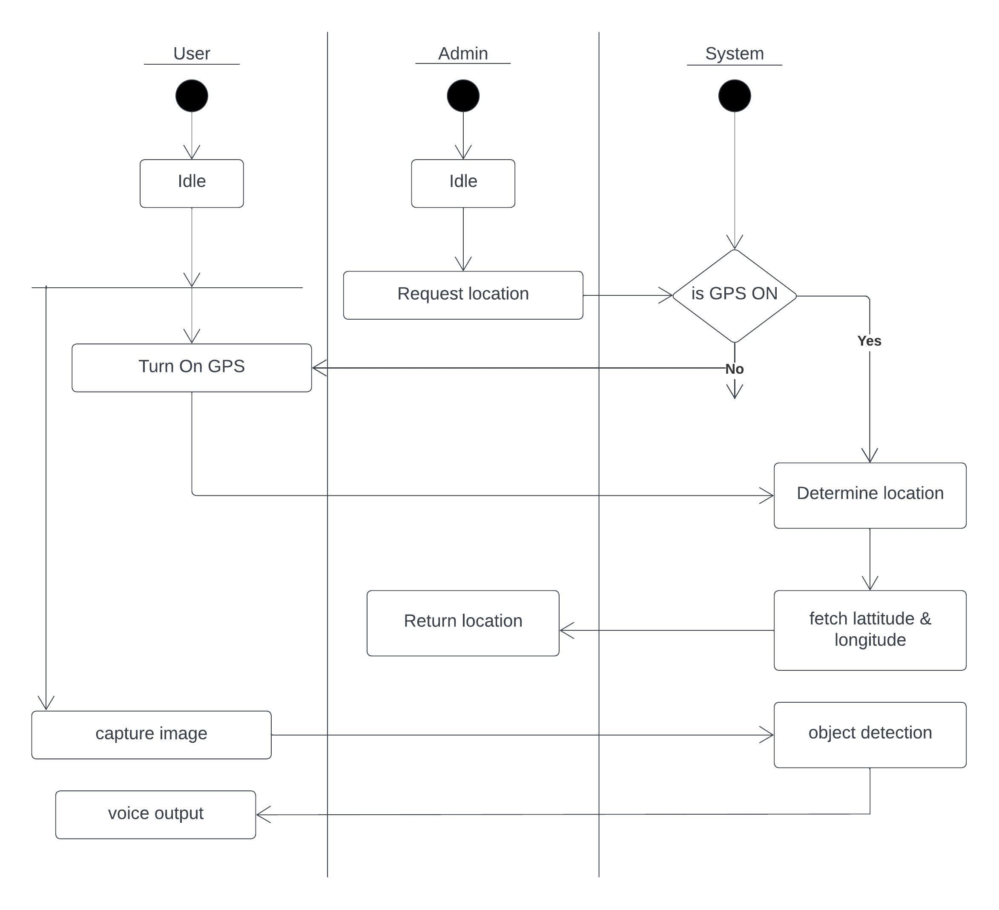
4. ACTIVITY DIAGRAM
Update
location

Slide 16
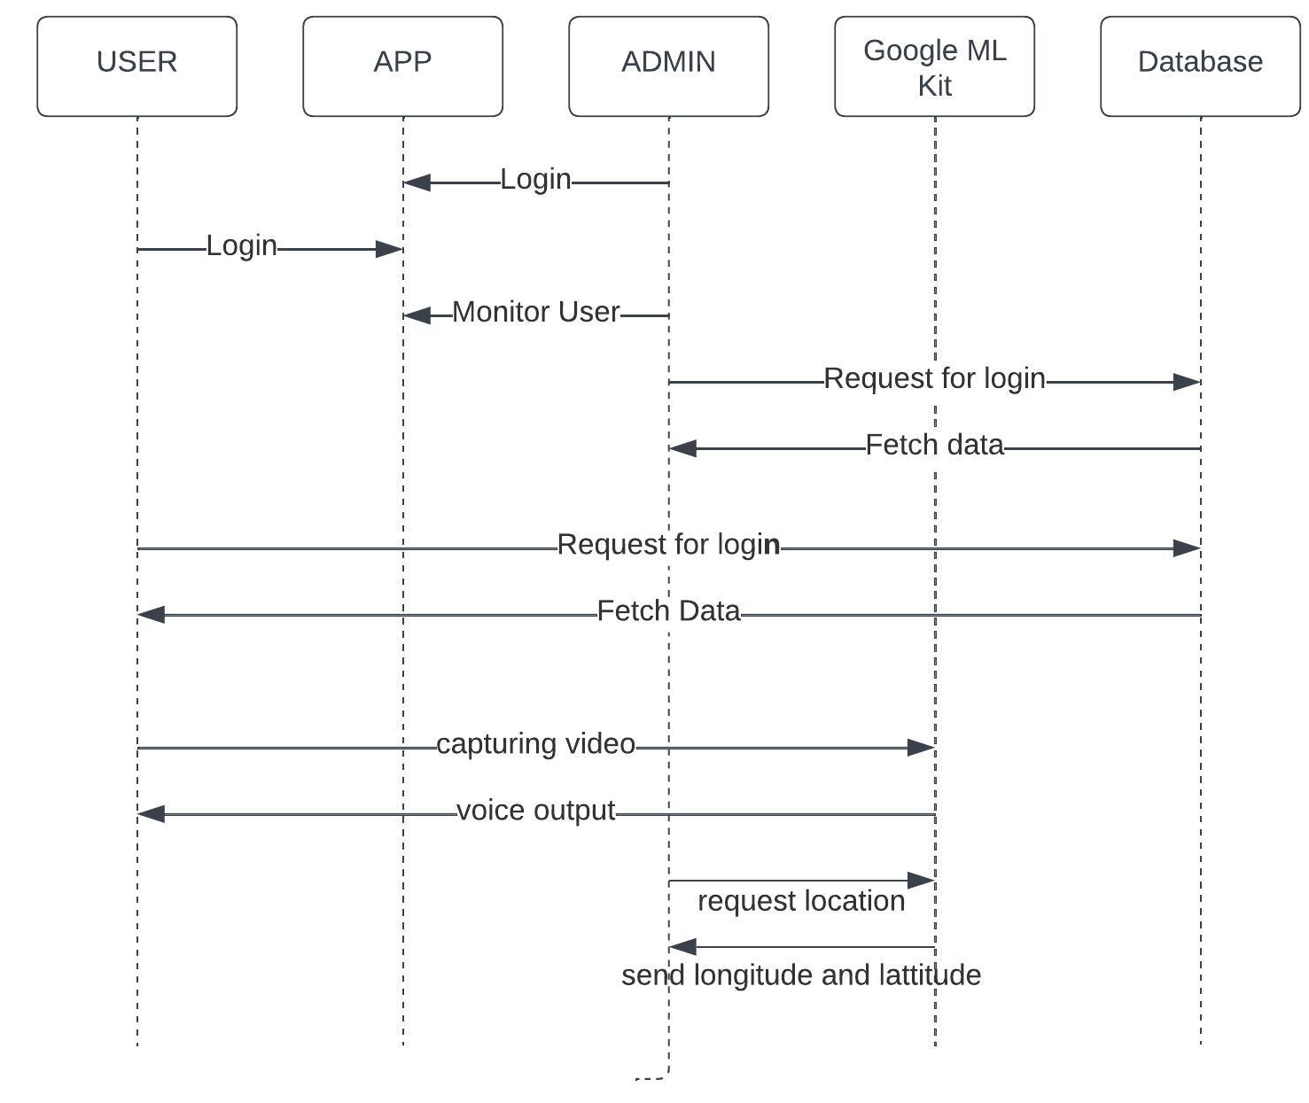
5. SEQUENCE DIAGRAM

Slide 17
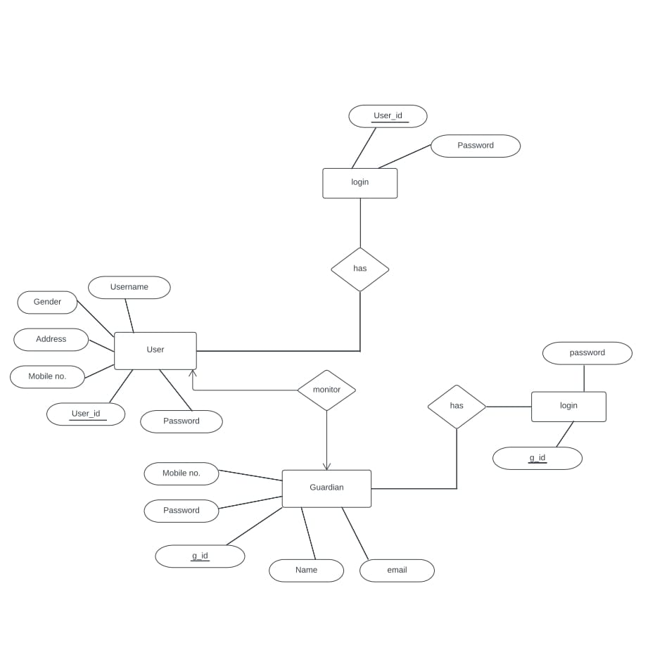
6. ER DIAGRAM

Slide 18
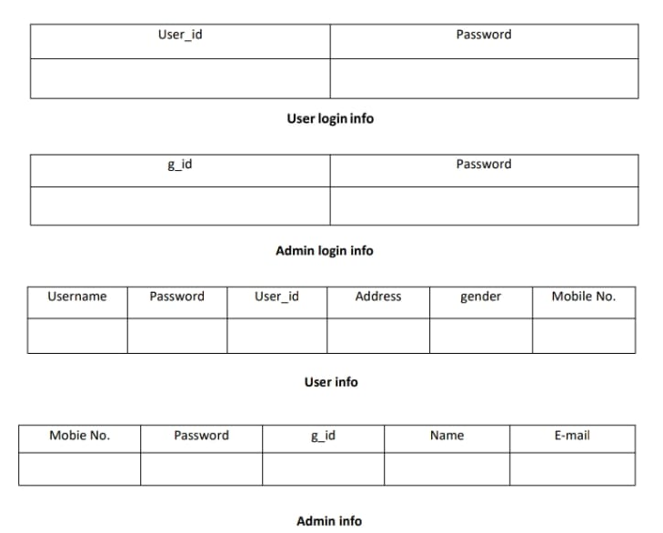
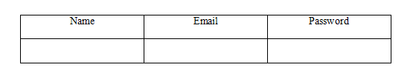
7. DATABASE DESIGN
Email
Email

Slide 19
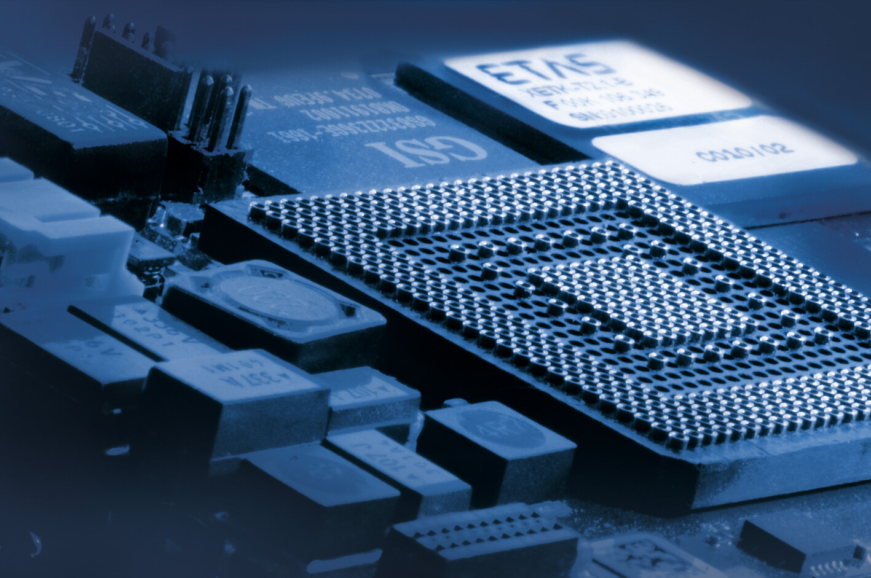

Software Requirements
Hardware Requirements
Android device with storage minimum 4gb RAM.
Camera Sensor Size : Minimum 8 megapixels
PC with minimum 6gb RAM
Android Studio
Visual Studio Code
Flutter

Slide 20
PHASE II

Slide 21
SYSTEM ARCHITECTURE

Slide 22
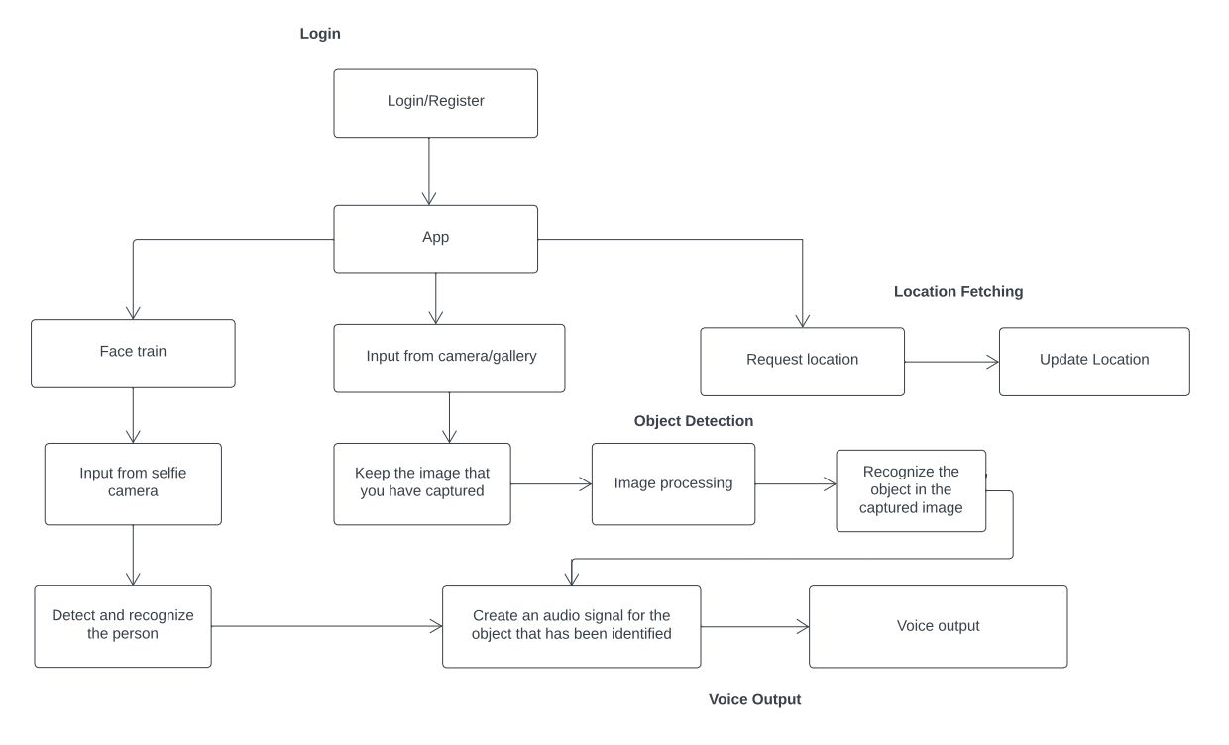
Face Train

Slide 23
MODULES
Login/ Register
Object Detection
Face Train
Voice Output
Location Updating

Slide 24
1. Login and Register
MODULES AND FUNCTIONALITIES
Blind user and admin register in the application.
Then login using id and password.

Slide 25
2. Object Detection
MODULES AND FUNCTIONALITIES
Input is taken using the device's camera.
Keep the images captured.
Preprocess the image captured.
Recognise the object in the captured image.

Slide 26
3. Face Train
MODULES AND FUNCTIONALITIES
Capture an image of person using selfie camera and save the image with name.
Detect and Recognize the person.
4. Voice Output
Create audio signal for the object that has been identified.
Create voice output for the person that has been recognized.

Slide 27
5. Location Updating
MODULES AND FUNCTIONALITIES
When bystander login using user id and password, the location of blind person would be updated.

Slide 28
STUDY PHASE
Study of blind victims and their requirements.
Studying blind victims involves understanding their challenges in mobility, accessing information, social inclusion, and emotional support. The goal is to develop inclusive solutions that improve their independence and well-being.
Study of Google ML kit
Google ML Kit is a mobile machine learning framework by Google that provides pre-trained models and APIs for easy implementation of object detection and tracking in images and real- time camera feeds.
Study of Google FireBase
Google Firebase is a platform that simplifies backend development for web and mobile applications. It offers real-time database, authentication, cloud storage, and push notifications features.

Slide 29
IMPLEMENTATION
Hardware
Software
Testing
Demonstration
Publication

Slide 30
1. HARDWARE
Mobile phone
Minimum 64 gb storage
Minimum 4 gb ram
Minimum 8 mp camera
Internet connection

Slide 31
2. SOFTWARE
Google ML toolkit for firebase
Android studio - 4.1.1
Visual studio - 1.76.2
3.TESTING
Testing is done using device camera.

Slide 32
4.DEMONSTRATION

Slide 33
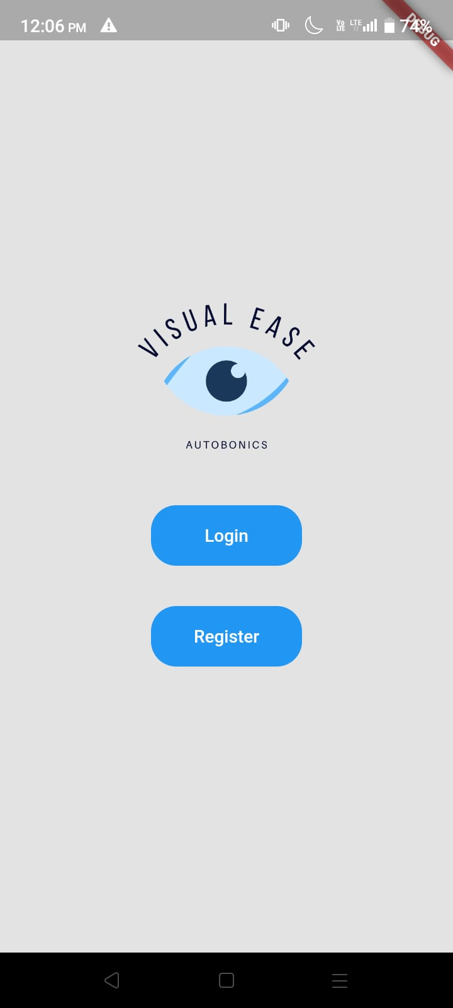
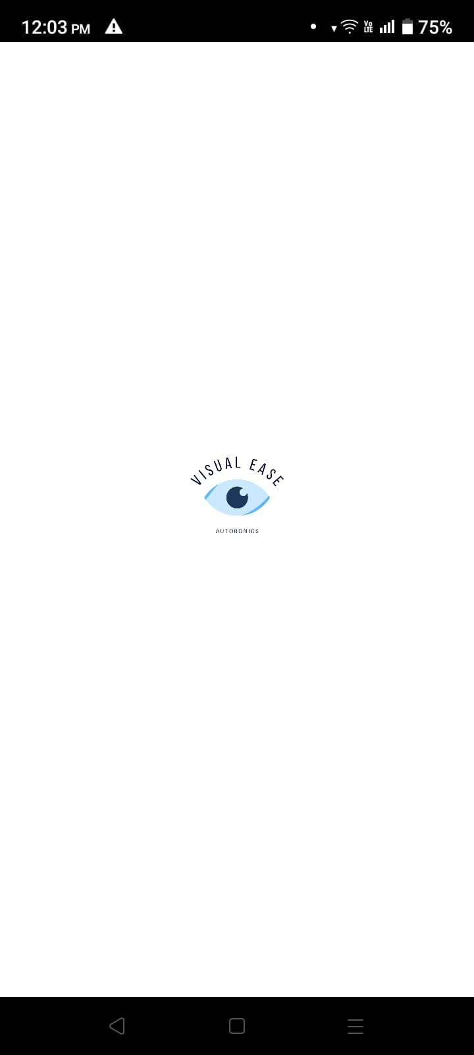
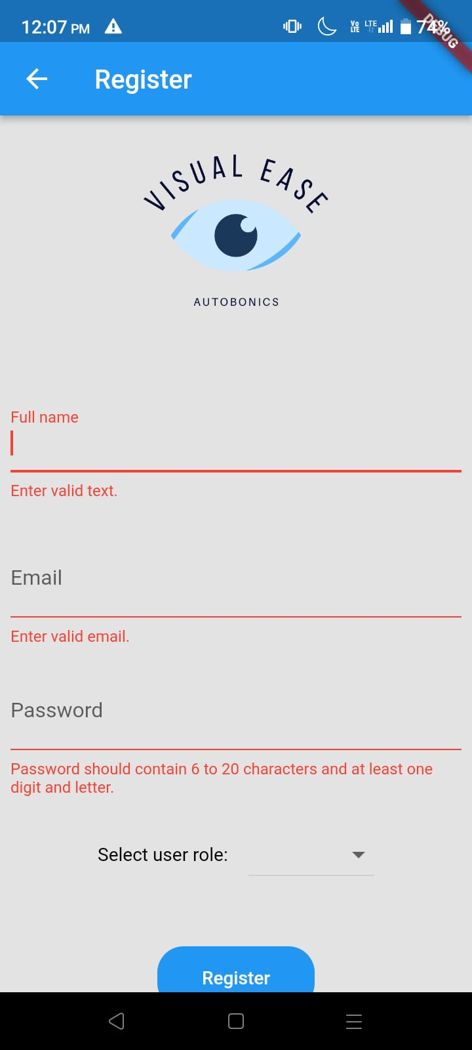

Slide 34
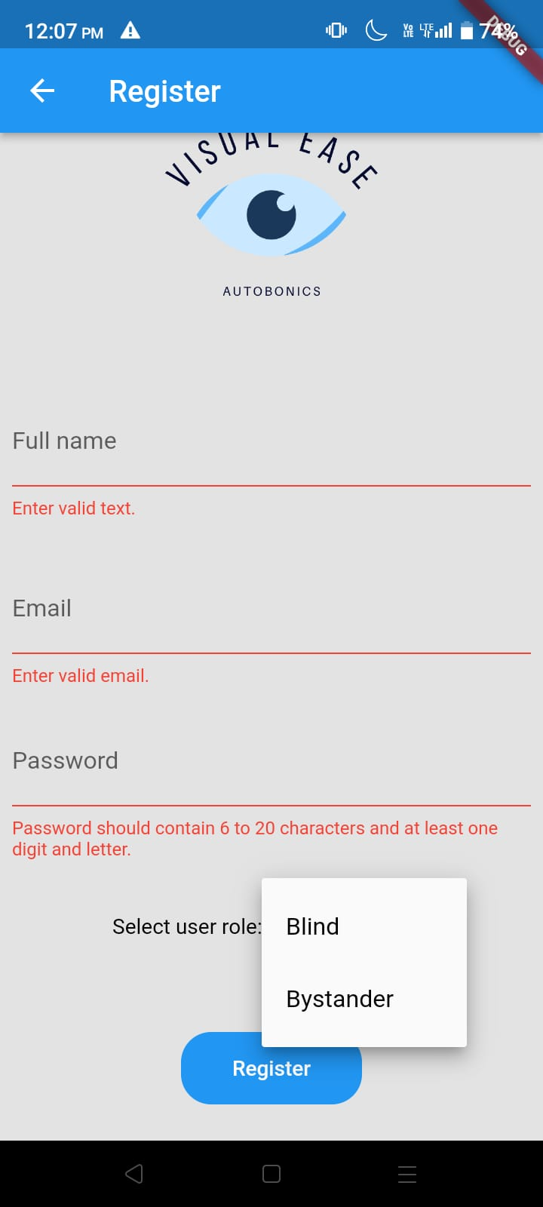
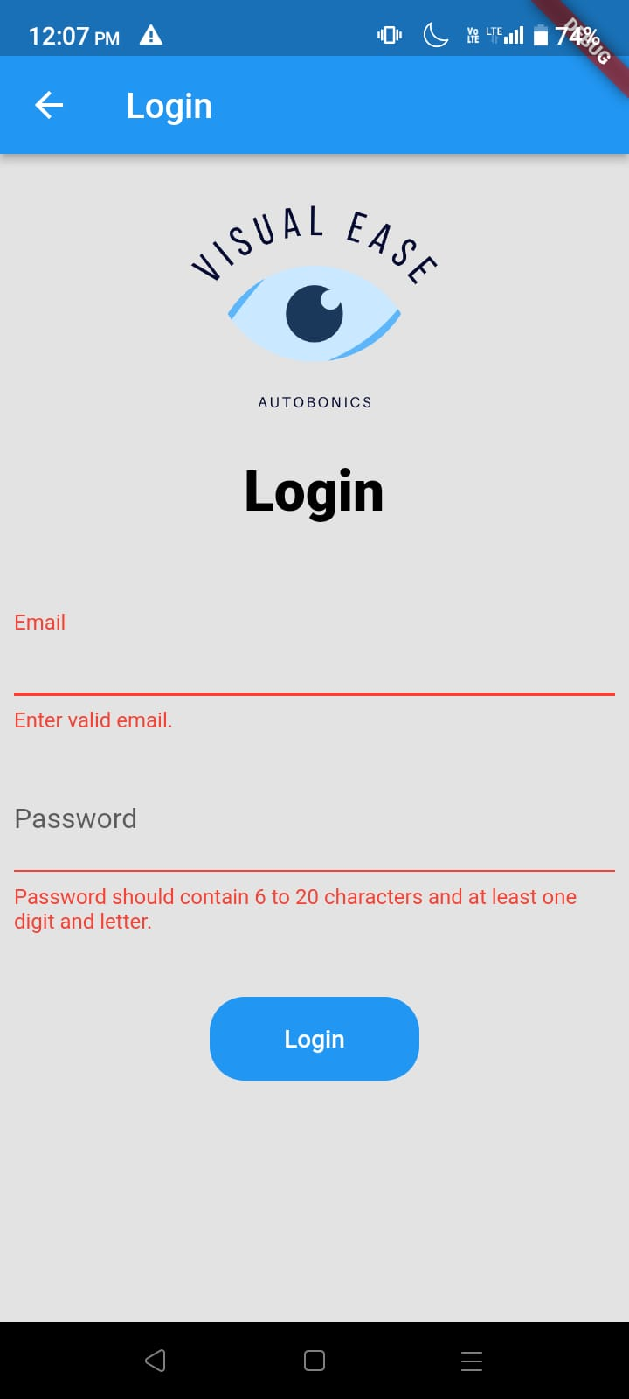
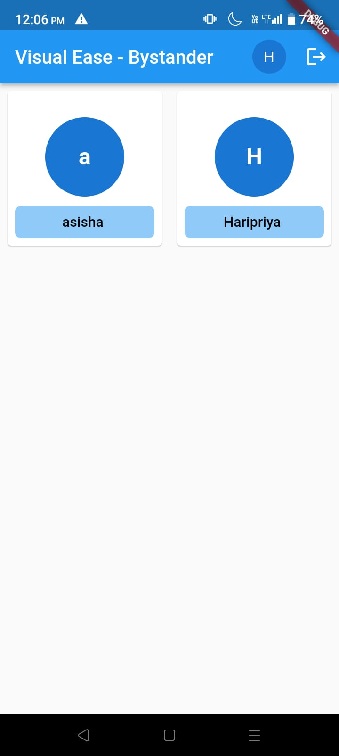

Slide 35
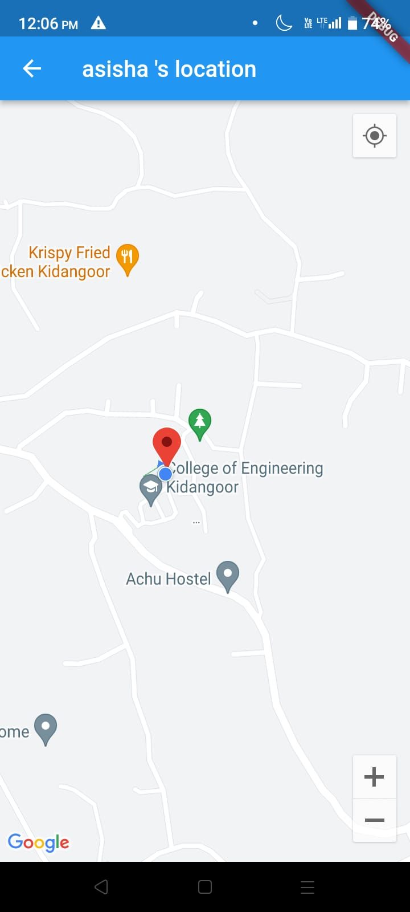
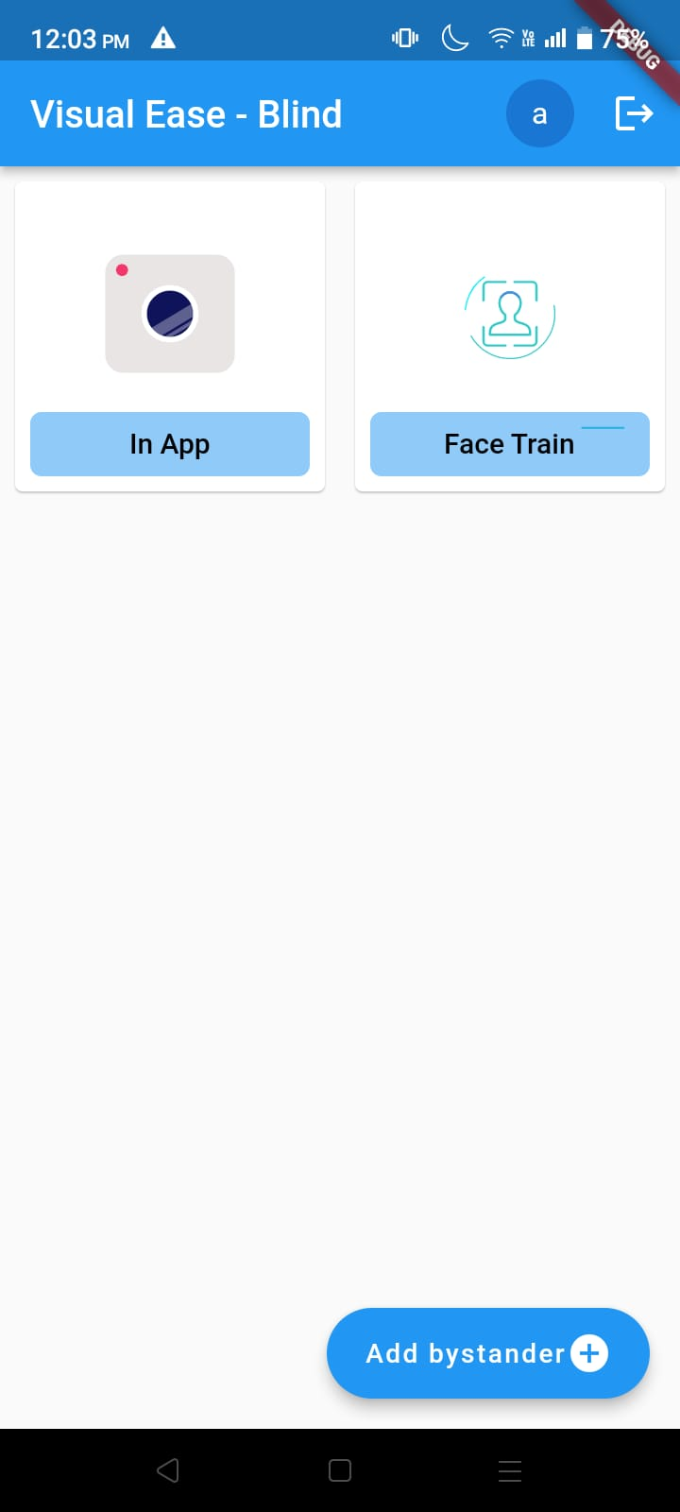
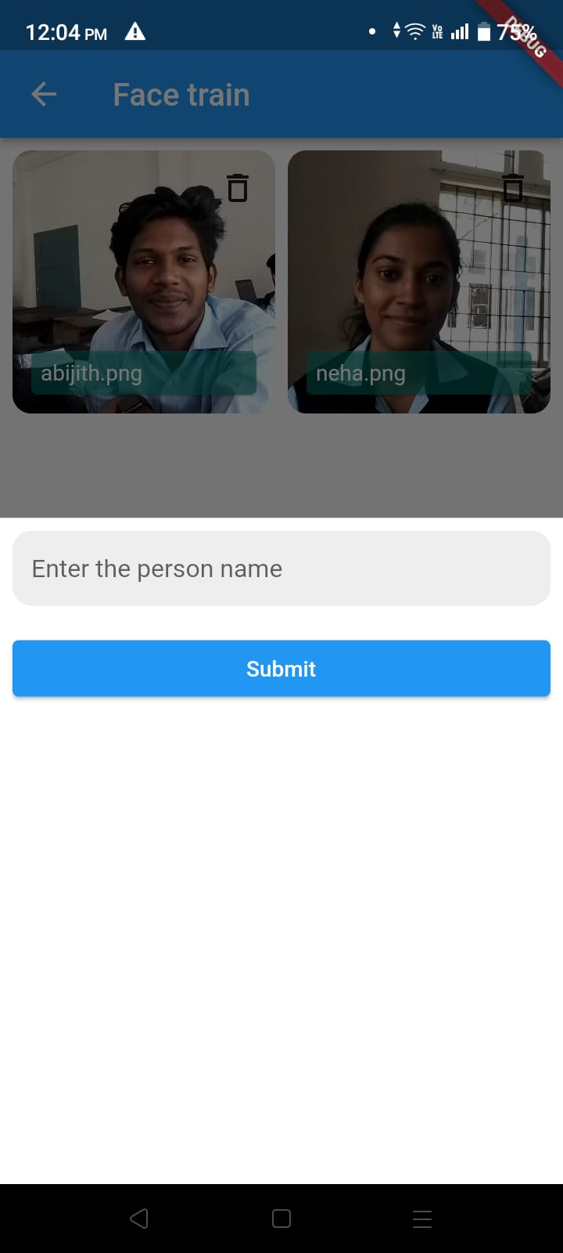

Slide 36
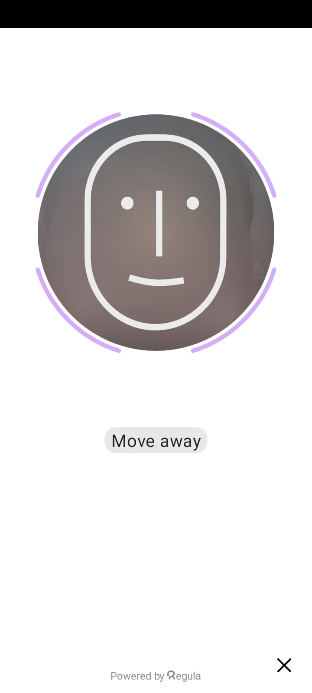
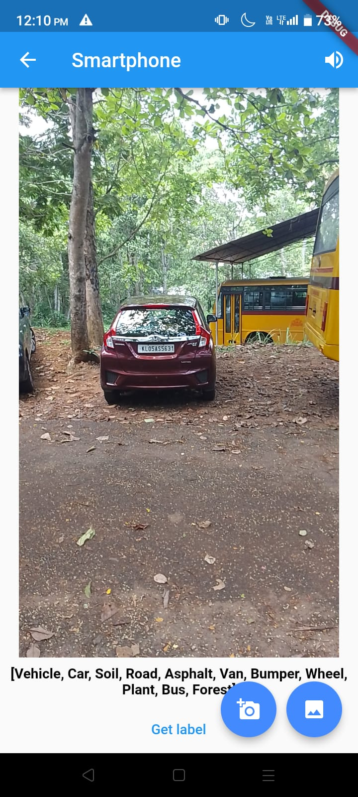
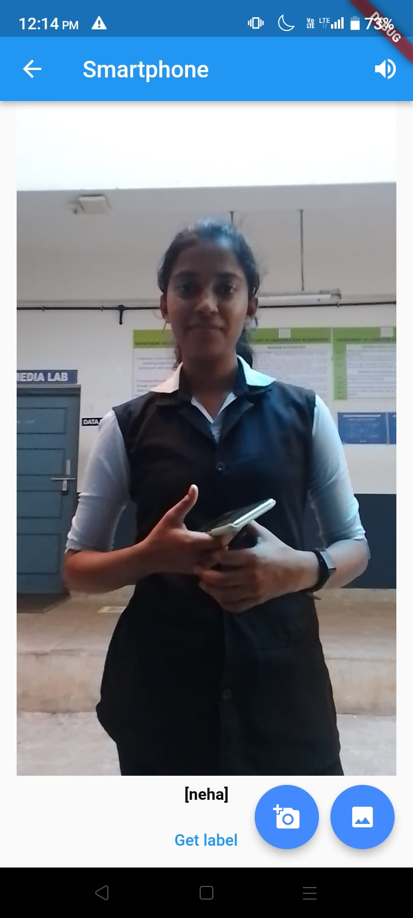

Slide 37
PUBLICATION
Publishing the existing idea as research paper in IRJMETS.

Slide 38
SCHEDULE
Serial No. | Modues or tasks | Completion date
1 | Base paper selection | 22-11-2022
2 | Study phase | 09-12-2022
3 | Literature survey | 15-12-2022
4 | Phase 1 | 21-12-2022
5 | Phase 2 | 10-01-2023
6 | Phase 3 | 24-04-2023
7 | Testing | 30-05-2023

Slide 39
CONCLUSION
Several technologies have been created to aid visually impaired persons. ​
One such attempt is that we would wish to make an Integrated Machine Learning System that allows the blind victims to identify and classify real-time objects generating voice feedback and distance. ​
This also produces warnings whether they are very close or far away from the thing. ​
This technique has been introduced specifically to assist blind individuals. ​
​
Furthermore, the current system is based on the Android operating system; it can be altered to work with any device that is convenient.

Slide 40

REFERENCES
[1] Choi D., and Kim M. (2018). Trends on Object DetectionTechniques Based on Deep Learning, Electronics and Telecommunications Trends, 33(4): 23-32.
[2] Dai Jet al., (2016). R-FCN: Object Detection via Region-based Fully Convolutional Networks. Conf. NeuralInform. Process. Syst.,Barcelona,Spain,Dec. 4-6, p.379-387.
[3] Dalal N. and Triggs B., Histograms of oriented gradients for Human Detection (2015). IEEE Comput. Soc.Conf. Comput. Vision Pattern Recogn.,San Diego, CA, USA, June 20-25, p. 886-893.
[4] Russakovsky O et al., (2015). ImageNet Large Scale Visual Recognition Challenge, Int..J.Comput. Vision, 115(3): 211-252.
[5] Rajeshvaree Ravindra Karmarkar (2021). Object Detection System for the Blind with Voice Guidance, International Journal of Engineering Applied Sciences and Technology,6(2): 67-70.

Slide 41
THANK YOU ...

