Slide 1

Advanced Reliability and Safety Analysis
RAVEN Workshop

Slide 2
Outline
Dynamic Probabilistic Risk/Safety Analysis
Classic vs. Dynamic PRA
Adaptive Sampling
Limit Surface

Slide 3
Reliability and Safety Analysis
Safety Analysis: determine the likelihood a system will not perform its functions in a specified time period
Reliability Analysis: determine the ability of a system to perform its functions in a specified time period

Slide 4
Dynamic Probabilistic Risk/Safety Analysis
Classic Probabilistic Risk/Safety Analysis
Static boolean logic structures
Event-Trees / Fault-Trees
Accident sequence set by the analyst
Timing of events partially considered
Dynamic Probabilistic Risk/Safety Analysis
Direct use of system simulation codes
Coupled with stochastic analysis tools (e.g., RAVEN)
Accident sequence set by the system control logic
Timing of events fully considered

Slide 5
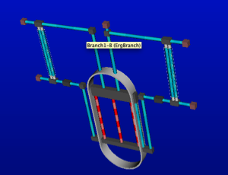
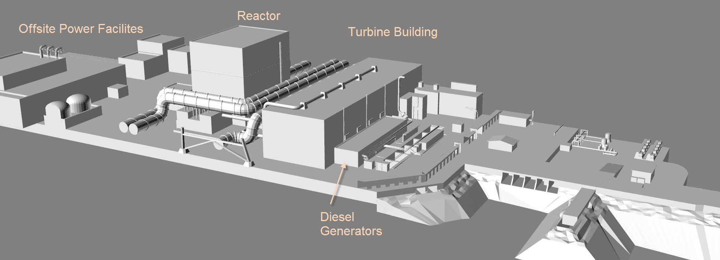
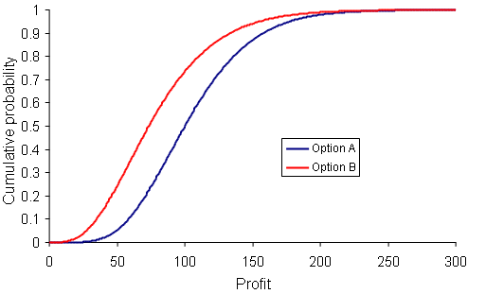
Dynamic Probabilistic Risk/Safety Analysis
Stochastic analysis
Sample the pdfs
Run N times system simulation code(s)
Evaluate desired FOMs
Deterministic modeling
Plant modeling
External event modeling
Stochastic modeling
Identify uncertain parameters and associate a pdf

Slide 6
ROMs: Classifiers
ROMs as mathematical models designed approximate an input-output relationship
Classifiers: output variable is boolean
i.e., 0 or 1
e.g., OK or Failure

Slide 7
Adaptive Sampling
Computational costs might be impractical
Computationally expensive codes
Many simulation runs are often required
Reduced Order Modeling can be a solution
Objective: reduce the complexity of the problem
Search of the limit surface: boundaries in the input space between failure and success
Ω

Slide 8
Reliability Analysis: Limit Surface Search
Generate a set of training simulations to sample the plant response
Train a surrogate model
Use the surrogate model to determine an approximation of the limit surface
Choose a set of samples on the approximated limit surface
Run the “real” model to verify the approximation
No
Reach convergence
Yes
Stop

Slide 9
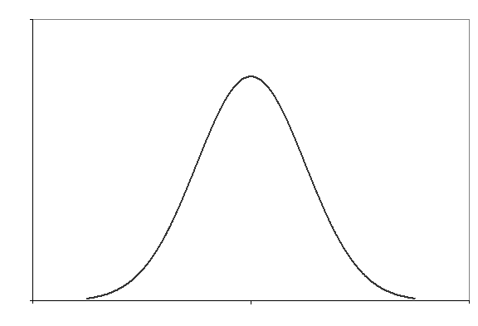

Failure Probability Calculation From LS
Limit surface has a pure deterministic information
Probabilistic information is contained in the integral within the limit surface weighted by the set of distributions
For a new set of distributions the integral needs to be recalculated but the limit surface is unchanged
Ω

Slide 10
Advanced Reliability and Safety Analysis: Hands on
RAVEN Workshop

Slide 11
Objectives
Run and Write your first reliability analysis input file
Understand how RAVEN performs reliability analysis using the LimitSurfaceSearch Sampler
Perform the adaptive sampling
Compute the probability of failure

Slide 12
Getting on the same page
This workshop will include interactive examples
paths given starting at raven (raven/)
Slides are provided as well:
~> cd projects/raven
~/projects/raven> git checkout workshop_2018
~/projects/raven> git pull
raven/doc/workshop/advancedReliability

Slide 13
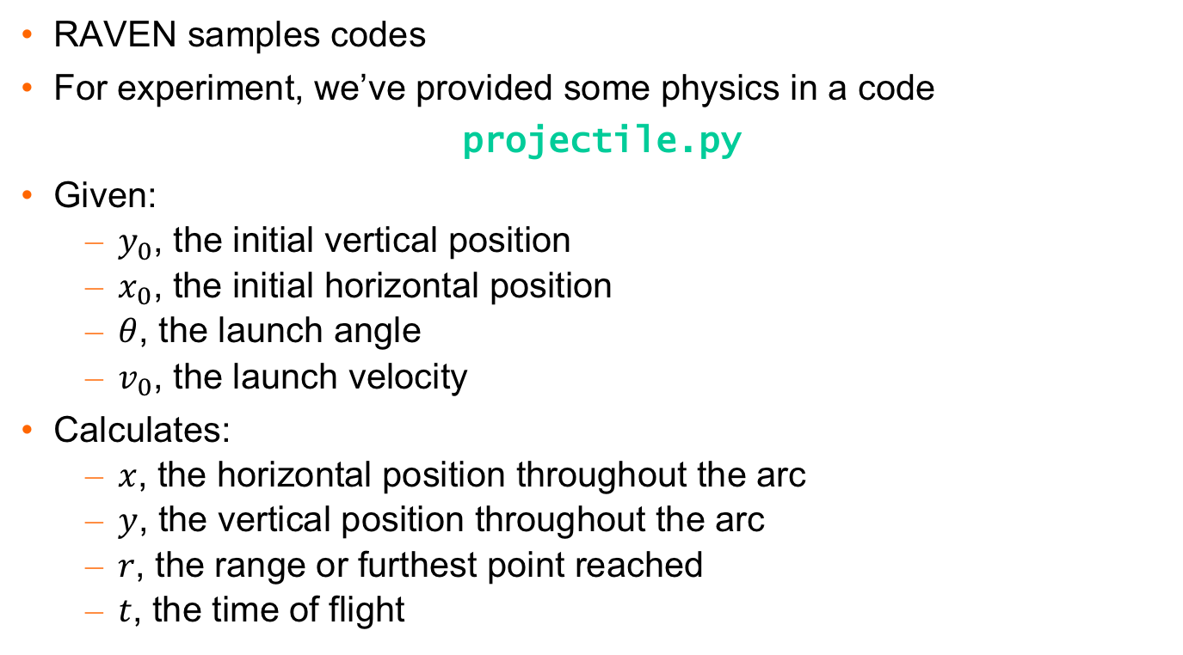
Example Code
RAVEN samples codes
For experiment, we’ve provided some physics in a code
projectile.py
Given:
$y_{0}$, the initial vertical position
$x_{0}$, the initial horizontal position
$θ$, the launch angle
$v_{0}$, the launch velocity
Calculates:
$x$, the horizontal position throughout the arc
$y$, the vertical position throughout the arc
$r$, the range or furthest point reached
$t$, the time of flight

Slide 14
Exercise 1: Dynamic PRA Analysis

Slide 15
Excercise1: Model Sampling
Model
Simplified PWR model
Scenario
Station Blackout Analysis
Steps
Sample the model response N times
Determine failure probability

Slide 16
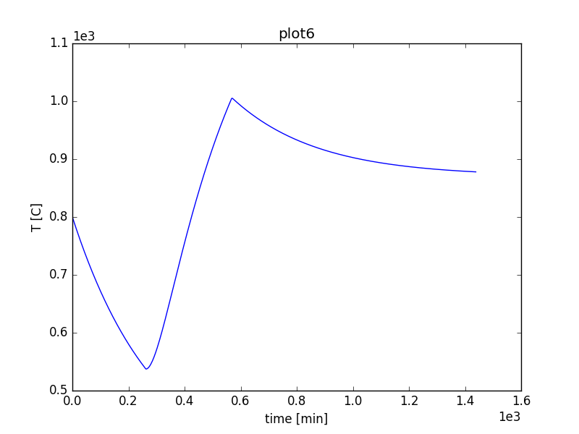
Excercise1: Model Sampling
t_REC
Cooling recovered
Initial cooling
t_SBO
Cooling failure

Slide 17
Excercise1: Model Sampling
Distributions
Models
Samplers
Databases
DataObjects
Steps
<Steps>
<MultiRun name="MCRun">
<Input class="DataObjects" type="PointSet" >inputPlaceHolder</Input>
<Model class="Models" type="ExternalModel" >PythonModule</Model>
<Sampler class="Samplers" type="MonteCarlo" >MC</Sampler>
<Output class="DataObjects" type="PointSet" >outPS</Output>
<Output class="DataObjects" type="HistorySet" >outHS</Output>
</MultiRun>
...
<PostProcess name="PP">
<Input class="DataObjects" type="PointSet" >outPS</Input>
<Model class="Models" type="PostProcessor" >integral</Model>
<Output class="Files" type="" >integral.xml</Output>
</PostProcess>
</Steps>
Input file name: dynamicPRA.xml

Slide 18
Exercise 2: Limit Surface Analysis

Slide 19
Adaptive Sampling
Computational costs might be impractical
Computationally expensive codes
Many simulation runs are often required
Reduced Order Modeling can be a solution
Objective: reduce the complexity of the problem
Search of the limit surface: boundaries in the input space between failure and success
Ω

Slide 20
Reliability Analysis: Limit Surface Search
Generate a set of training simulations to sample the plant response
Train a surrogate model
Use the surrogate model to determine an approximation of the limit surface
Choose a set of samples on the approximated limit surface
Run the “real” model to verify the approximation
No
Reach convergence
Yes
Stop

Slide 21
Reliability Analysis: Limit Surface Workflow
Define the distributions:
Weigh the error estimation
Generate a probability-weighted metric for grid construction
Determine the probability of being inside one of the regions identified by the limit surface
Define the surrogate model (acceleration ROM) to be used as the adaptive sampler
Define the adaptive sampler:
Convergence control and grid
Import the acceleration ROM
Associate the distribution with the variables
Define the adaptive sampling step

Slide 22
Exercise 2: Limit Surface Analysis
Distributions
Models
Samplers
Functions
DataObjects
Steps
<Models>
...
<ROM name="ROM" subType="SciKitLearn">
<Features>tREC,tSBO</Features>
<Target>goalFunction</Target>
<SKLtype>svm|SVC</SKLtype>
<kernel>rbf</kernel>
<gamma>0.25</gamma>
<C>25</C>
</ROM>
</Models>
Input file name: runLS.xml

Slide 23
Exercise 2: Limit Surface Analysis
Distributions
Models
Samplers
Functions
DataObjects
Steps
<Functions>
<External name="goalFunction" file="goalFunction">
<variable>outcome</variable>
</External>
</Functions>
def __residuumSign(self):
if self.outcome == 0:
return -1
else: return 1
File: goalFunction.py
Input file name: runLS.xml

Slide 24
Exercise 2: Limit Surface Analysis
Distributions
Models
Samplers
Functions
DataObjects
Steps
<Samplers>
...
<LimitSurfaceSearch name="Adaptive">
<ROM class="Models" type="ROM" >ROM</ROM>
<Function class="Functions" type="External" >goalFunction</Function>
<TargetEvaluation class="DataObjects" type="PointSet" >outPS
</TargetEvaluation>
<Convergence limit="250" forceIteration="False" weight="value"
persistence="10">1.0e-5</Convergence>
<variable name="tREC">
<distribution>tREC_dist</distribution>
</variable>
<variable name="tSBO">
<distribution>tSBO_dist</distribution>
</variable>
</LimitSurfaceSearch>
</Samplers>
Input file name: runLS.xml

Slide 25
Exercise 2: Limit Surface Analysis
Distributions
Models
Samplers
Functions
DataObjects
Steps
<Steps>
<MultiRun name="MCRun" pauseAtEnd="True">
<Input class="DataObjects" type="PointSet" >inputPlaceHolder</Input>
<Model class="Models" type="ExternalModel" >PythonModule</Model>
<Sampler class="Samplers" type="MonteCarlo" >MC</Sampler>
<Output class="DataObjects" type="PointSet" >outPS</Output>
</MultiRun>
<MultiRun name="adaptive" pauseAtEnd="True">
<Input class="DataObjects" type="PointSet" >inputPlaceHolder</Input>
<Model class="Models" type="ExternalModel" >PythonModule</Model>
<Sampler class="Samplers" type="LimitSurfaceSearch">Adaptive</Sampler>
<SolutionExport class="DataObjects" type="PointSet" >limitSurface
</SolutionExport>
<Output class="DataObjects" type="PointSet" >outPS</Output>
</MultiRun>
</Steps>
Input file name: runLS.xml

Slide 26
Exercise 3: Failure Probability Calculation from LS

Slide 27
Exercise 3: Failure Probability Calculation From LS
Limit surface has a pure deterministic information
Probabilistic information is contained in the integral within the limit surface weighted by the set of distributions
For a new set of distributions the integral needs to be recalculated but the limit surface is unchanged
Ω

Slide 28
Exercise 3: Failure Probability Calculation From LS
Distributions
Models
Samplers
Databases
DataObjects
Steps
<Models>
<PostProcessor name="LS_Integral" subType="LimitSurfaceIntegral">
<tolerance>0.001</tolerance>
<integralType>MonteCarlo</integralType>
<target>goalFunction</target>
<variable name="tREC">
<distribution>tREC_dist</distribution>
</variable>
<variable name="tSBO">
<distribution>tSBO_dist</distribution>
</variable>
</PostProcessor>
</Models>
Input file name: pbFromLS.xml

Slide 29
Exercise 3: Failure Probability Calculation From LS
Distributions
Models
Samplers
Databases
DataObjects
Steps
<Steps>
<IOStep name="extract_data_adapt">
<Input class="Databases" type="HDF5" >out_db_adaptive</Input>
<Output class="DataObjects” type="PointSet" >outAdapt_failure</Output>
</IOStep>
<PostProcess name="integral">
<Input class="DataObjects” type="PointSet" >outAdapt_failure</Input>
<Model class="Models" type="PostProcessor" >LS_Integral</Model>
<Output class="DataObjects” type="PointSet" >LSintegral_PS</Output>
<Output class="Files" type="" >integral.csv</Output>
</PostProcess>
</Steps>
Input file name: pbFromLS.xml

