Slide 1

Reduced Order Models (ROMs)
RAVEN Workshop

Slide 2
Outline
Brief introduction on ROMs
Application examples of ROMs
ROMs and RAVEN
Available ROMs
RAVEN ROM workflow
RAVEN examples
Create ROMs
Perform sampling of ROMs

Slide 3
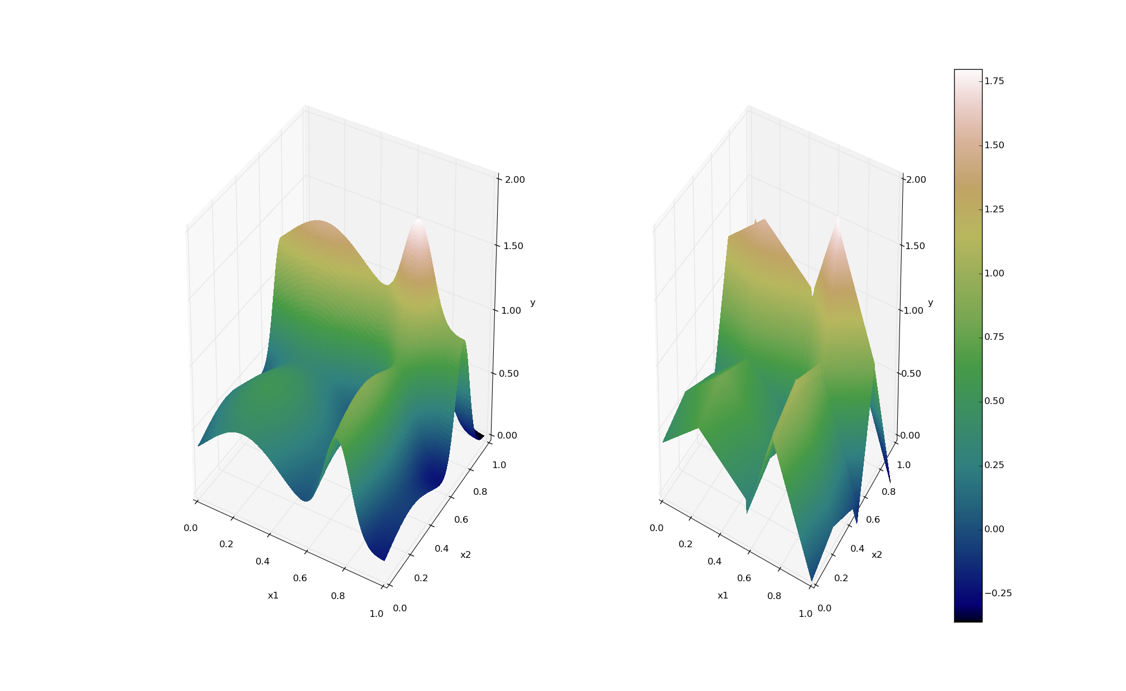
ROMs: a Quick Introduction
Output: Simulation outcome (success/failure, max clad temperature)
Consider a set of N data points
Build a surrogate model
Reduced Order Model
DataObjects
(PointSet)
Inputs: Initial and boundary conditions
≅

Slide 4
ROMs: a Quick Introduction
Basically we are trying to reduce the complexity of the original model
Pros:
Much faster computation of the output variable
Cons:
Presence of error in the ROM computed values
ROM (e.g., quadratic regressor)
≅
Original data (e.g., RELAP5)

Slide 5
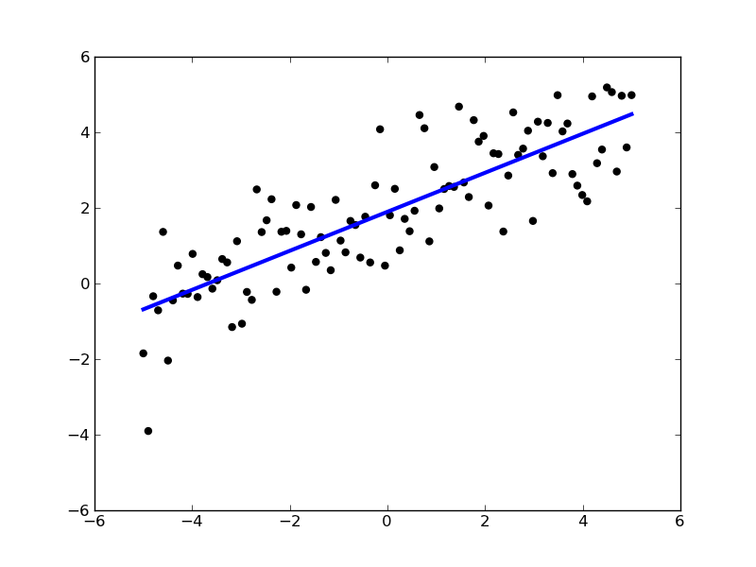
ROMs: Applications
Basic steps:
Sample original model
Train the ROM
Perform desired analysis with the ROM
instead of the original model
Range of applications:
Uncertainty quantification / Sensitivity analysis
Probabilistic Risk Analysis (PRA)
Accelerator for stochastic analysis (adaptive sampling)
Prediction models
Output y
Input x

Slide 6
ROM Modeling Within RAVEN
All modeling steps that involve ROMs are available in RAVEN
Create ROMs from a database
Perform statistical analysis using ROMs

Slide 7
ROM Modeling Within RAVEN
Create a Database (PointSet)

Slide 8
ROM Modeling Within RAVEN
Create and train a ROM from a Database

Slide 9
ROM Modeling Within RAVEN
Perform statistical analysis using the ROM

Slide 10
ROM Pickle
Compression/serialization scheme
Pickled object contains all the information necessary to reconstruct the object in another python script
Pickled object can be saved as a file
RAVEN Scikit-Learn ROMs can be pickled
Applications:
Perform statistical analysis on a ROM after they have been generated and/or on a different machine
Use pickled ROMs on separate python script (external model for RAVEN)
Stochastic analysis for different distributions

Slide 11
ROMs Available in RAVEN
NDspline/NDinvDistWeight: Multi-dimensional interpolators
GaussPolynomialRom/HDMRRom: Stochastic collocation
SciKitLearn (External library)
Linear Models
Support Vector Machines
Multi Class
Naïve Bayes
Neighbors
Tree
Gaussian process
Neural Network Models
ARMA: Autoregressive moving average time series model
MSR: Perform topological decomposition
PolyExponential: polynomial sum of exponentials for time-dependent
DMD: dynamic mode decomposition for time-dependent ROM

Slide 12
RAVEN Examples

Slide 13
Getting on the same page
This workshop will include interactive examples
paths given starting at raven
Slides are provided as well:
~> cd projects/raven
~/projects/raven> git checkout workshop_2018
~/projects/raven> git pull
raven/doc/workshop/reducedOrderModeling

Slide 14
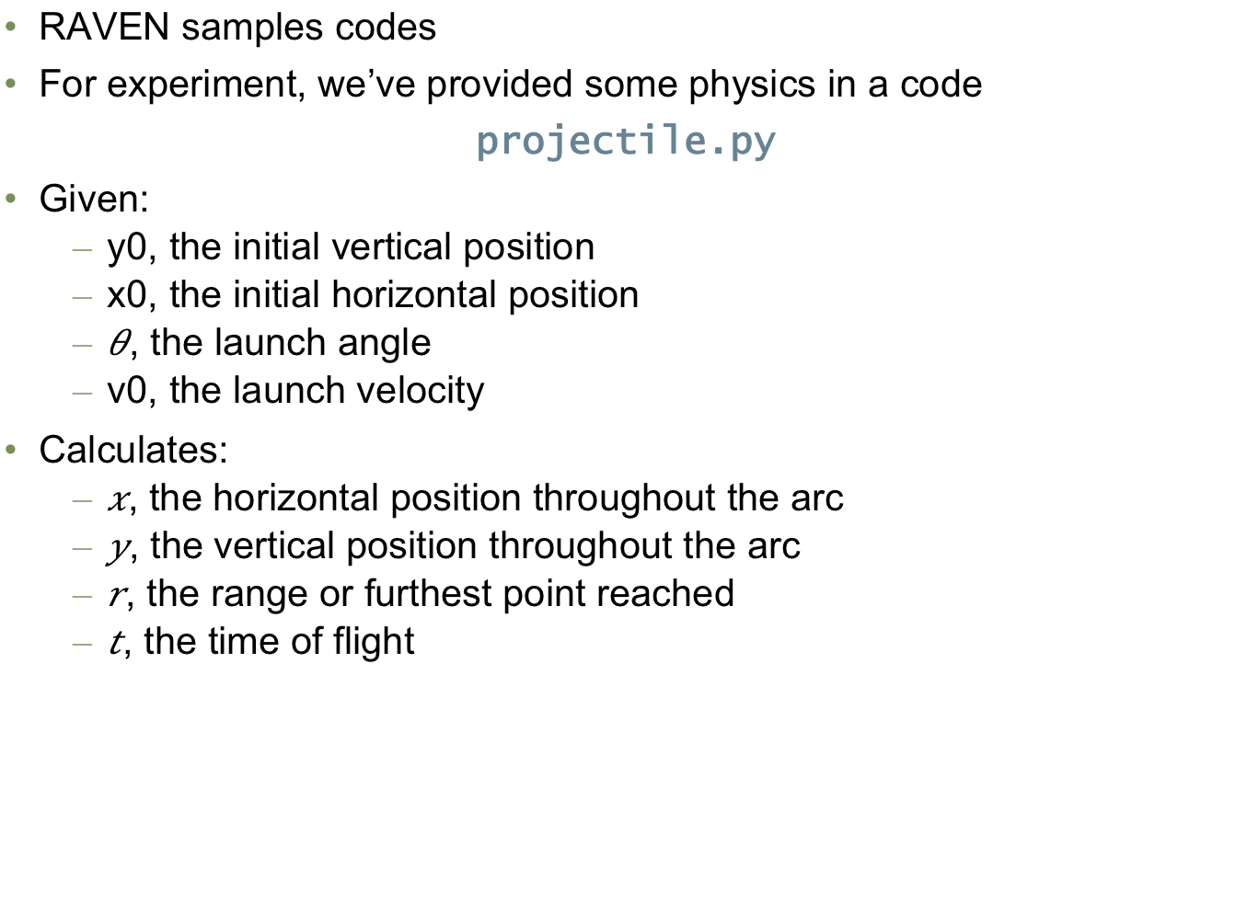
Example Code
RAVEN samples codes
For experiment, we’ve provided some physics in a code
projectile.py
Given:
y0, the initial vertical position
x0, the initial horizontal position
, the launch angle
v0, the launch velocity
Calculates:
, the horizontal position throughout the arc
, the vertical position throughout the arc
, the range or furthest point reached
, the time of flight

Slide 15
Workflow
External model employed:
projectile.py
Sample model Create database
sample_Function.xml
Train a ROM
Pickle ROM
Train a ROM
Sample ROM
rom_trainer.xml
sample_ROM.xml
Load ROM
Sample ROM
sample_pROM.xml

Slide 16
Workflow
Sample model Create database
sample_Function.xml
Train a ROM
Pickle ROM
Train a ROM
Sample ROM
rom_trainer.xml
sample_ROM.xml
Load ROM
Sample ROM
sample_pROM.xml

Slide 17
Sample a Model and Create a Database
Distributions
Models
Samplers
Databases
DataObjects
Steps
<Steps>
<MultiRun name="FirstMRun">
<Input class="DataObjects" type="PointSet" >inputPlaceHolder</Input>
<Model class="Models" type="ExternalModel”>projectile</Model>
<Sampler class="Samplers" type="Grid" >grid</Sampler>
<Output class="DataObjects" type="PointSet" >outGRID</Output>
<Output class="Databases" type="HDF5" >out_db</Output>
<Output class="OutStreams" type="Print" >out_dump</Output>
</MultiRun>
</Steps>
Model file
Step
Database
Model info
Sampler
DataObjects
Input file name: sample_Function.xml

Slide 18
Workflow
Sample model Create database
sample_Function.xml
Train a ROM
Pickle ROM
Train a ROM
Sample ROM
rom_trainer.xml
sample_ROM.xml
Load ROM
Sample ROM
sample_pROM.xml

Slide 19
Train and Sample a ROM
Distributions
Models
Samplers
Databases
DataObjects
Steps
<Models>
<ROM name="ROM4" subType="NDinvDistWeight">
<Features>v0,angle</Features>
<Target>t,x,y,r</Target>
<p>3</p>
</ROM>
</Models>
Multi-dimensional interpolator (CROW)
Input file name: sample_ROM.xml

Slide 20
Train and Sample a ROM
Distributions
Models
Samplers
Databases
DataObjects
Steps
<Samplers>
<Grid name="Grid_ROM">
<variable name=”v0">
<distribution>v0_d</distribution>
<grid type=”CDF" construction="equal" steps="10">0.1 0.9</grid>
</variable>
<variable name=”angle">
<distribution>angle_d</distribution>
<grid type=”CDF" construction="equal" steps="10”>0.1 0.9</grid>
</variable>
</Grid>
</Samplers>
Finer grid
Input file name: sample_ROM.xml

Slide 21
Train and Sample a ROM
Distributions
Models
Samplers
Databases
DataObjects
Steps
<Steps>
<IOStep name="extract_data4">
<Input class="Databases" type="HDF5" >out_db</Input>
<Output class="DataObjects" type="PointSet" >outGRID_y4</Output>
</IOStep>
<RomTrainer name="rom_trainer4">
<Input class="DataObjects" type="PointSet" >outGRID_y4</Input>
<Output class="Models" type="ROM" >ROM4</Output>
</RomTrainer>
<MultiRun name="RunRom4">
<Input class="DataObjects" type="PointSet" >Data1</Input>
<Model class="Models" type="ROM" >ROM4</Model>
<Sampler class="Samplers" type="Grid" >grid</Sampler>
<Output class="DataObjects" type="PointSet" >outROM_y4</Output>
</MultiRun>
...
</Steps>
Input file name: sample_ROM.xml

Slide 22
Workflow
Sample model Create database
sample_Function.xml
Train a ROM
Pickle ROM
Train a ROM
Sample ROM
rom_trainer.xml
sample_ROM.xml
Load ROM
Sample ROM
sample_pROM.xml

Slide 23
Train and Pickle a ROM
Models
Databases
DataObjects
Steps
<Models>
<ROM name="ROM3" subType="SciKitLearn">
<Features>v0,angle</Features>
<Target>t,x,y,r</Target>
<SKLtype>linear_model|LinearRegression</SKLtype>
<fit_intercept>True</fit_intercept>
<normalize>False</normalize>
</ROM>
</Models>
Inputs / Output
ROM type and parameters
Input file name: rom_trainer.xml
Notes:
Add multi target ROM

Slide 24
Train and Pickle a ROM
Models
Databases
DataObjects
Steps
Create a DataObject from the Dababase
<Steps>
<IOStep name="extract_data3">
<Input class="Databases" type="HDF5" >out_db</Input>
<Output class="DataObjects" type="PointSet" >outGRID_y3</Output>
</IOStep>
<RomTrainer name="rom_trainer3">
<Input class="DataObjects" type="PointSet" >outGRID_y3</Input>
<Output class="Models" type="ROM" >ROM3</Output>
</RomTrainer>
<IOStep name="pkDump3">
<Input class="Models" type="ROM" >ROM3</Input>
<Output class="Files" type="" >ROM3pk</Output>
</IOStep>
</Steps>
Create and train a ROM from the DataObject
Pickle the ROM and save it as a file
Input file name: rom_trainer.xml

Slide 25
Workflow
Sample model Create database
sample_Function.xml
Train a ROM
Pickle ROM
Train a ROM
Sample ROM
rom_trainer.xml
sample_ROM.xml
Load ROM
Sample ROM
sample_pROM.xml

Slide 26
Load and Sample a Pickled ROM
Distributions
Models
Samplers
DataObjects
Steps
<Models>
<ROM name="ROM3" subType="SciKitLearn">
<Features>v0,angle</Features>
<Target>t,x,y,r</Target>
<SKLtype>linear_model|LinearRegression</SKLtype>
<fit_intercept>True</fit_intercept>
<normalize>False</normalize>
</ROM>
</Models>
Inputs / Output
ROM type and parameters
Input file name: sample_pROM.xml

Slide 27
Load and Sample a Pickled ROM
Distributions
Models
Samplers
DataObjects
Steps
Load the pickled ROM
<Steps>
...
<IOStep name="pk3Load">
<Input class="Files" type="" >ROM3pk</Input>
<Output class="Models" type="ROM" >pROM3</Output>
</IOStep>
<MultiRun name="RunPROM3">
<Input class="DataObjects" type="PointSet" >Data1</Input>
<Model class="Models" type="ROM" >pROM3</Model>
<Sampler class="Samplers" type="Grid" >grid</Sampler>
<Output class="DataObjects" type="PointSet" >outPROM_y3</Output>
<Output class="Databases" type="HDF5" >out_ROM3_db</Output>
</MultiRun>
...
</Steps>
Input file name: sample_pROM.xml

Slide 28
Multi-Dimensional Interpolators
CROW: Internally developed C++ library
Interpolation on any dimension
Response surface is created as an interpolation function given a set of data points defined on:
Sparse grid
Cartesian grid
Extension of the known 1-D interpolation schemes

Slide 29
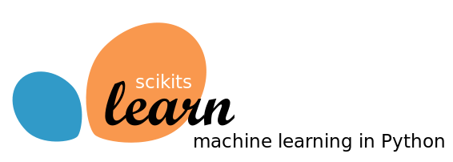
Scikit-Learn Library
Available:
Classification: identifying to which category an object belongs
Regression: predicting a continuous-valued attribute
Data clustering: grouping similar objects into sets
Dimensionality reduction: reducing the number of random variables
Data pre-processing: feature extraction and normalization
Examples:
Linear regression models
Support Vector Machines
Multi-Class classifiers
Naïve Bayes
Neighbors classifiers
Tree classifiers
Notes:
Add backup slides for some algorithms GPM and SVM

Slide 30
Scikit-Learn Library
Starting point: set of data points
[features]_{i}
Cardinality reduction
Objective: identify the most relevant features that keep data points unique
Outcome: Location of the points on the reduced space (e.g., line)
Regression
Objective: estimate the relationships among variables via a statistical process
Outcome: coefficients of the reduced space (e.g., m and c for linear interpolator )
Source: scikit-learn.org
Notes:
Add backup slides for some algorithms GPM and SVM

Slide 31
Generalized Polynomial Chaos
Objective: overcome limitations of Monte-Carlo sampling
High number of samples
Computationally expensive
Polynomial representation of an output variable
Simpler to evaluate
Easy to get statistical moments
Less effort and more accurate than Monte Carlo
index set of all desired polynomial orders up to order L

