Slide 1

Ensemble and Hybrid Modeling
RAVEN Workshop

Slide 2
Outline
RAVEN models: brief overview
Ensemble Modeling
Overview
Characteristics and limitations
Hands-on
Hybrid Modeling
Overview
Characteristics
Hands-on

Slide 3
RAVEN models: overview

Slide 4
RAVEN models: a quick introduction
RAVEN categorizes in its Models entity the following sub-entities:
Codes:
Aimed to interface with physical codes (e.g. RELAP5-3D, etc.)
ROMs:
Aimed to emulate the response of a system based on a simplified mathematical representation
External Models:
Aimed to provide to the user an easy way to implement sets of equations directly in RAVEN
Post-Processors:
Aimed to analyze the generated datasets (e.g. Statistical moments, Data Mining, etc.)
Ensemble Models:
Aimed to assemble multiple models

Slide 5
RAVEN ensemble modeling

Slide 6
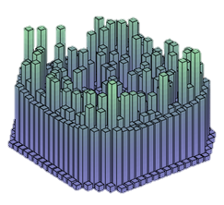
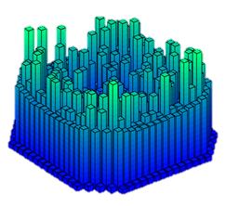
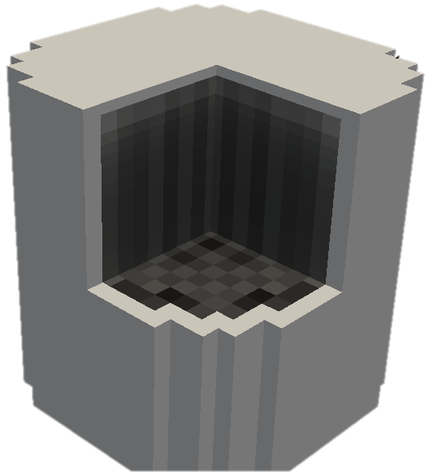
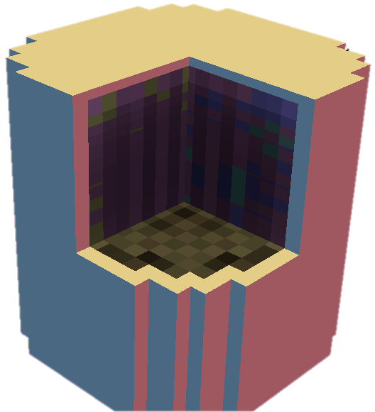
Ensemble Modeling Motivations
In several cases multiple models need to interface with each other since the initial conditions of some are dependent on the outcomes of others
In order to face this “problem” in the RAVEN framework, a new model category (e.g. class), named EnsembleModel, has been designed
This class is able to assemble multiple models of other categories (i.e. Code, External Model, ROM), identifying:
the input/output connections
the order of execution
the parallel execution strategy for each sub-model
Physics 1
EnsembleModel
Physics 2

Slide 7
Ensemble Model
A new model entity (e.g., class), named EnsembleModel, has been developed:
Assemble multiple models of other categories, identifying the input/output connections and the order of execution
Notes:
Sometimes, multiple models need to interface with each other since the initial conditions of some are dependent on the outcomes of others

Slide 8
Ensemble Model: Main Characteristics
The EnsembleModel entity has the following main characteristics:
Ability to link all the RAVEN Models:
Codes, ROMs, ExternalModels
Practical no limit on the number of Models in the Ensemble configuration
Capability to link the different Models through both scalar and vector variables (e.g. Max Cladding Temperature (scalar) or Power history (vector))
Capability to transfer meta-data from the different models (e.g. restart files, etc.)
The current EnsembleModel entity is not indicated to handle high-density field data

Slide 9
Ensemble Model: Chain of Models
Model 1
Model N-1
Model N
Model 2
Model 1
Model 3
Notes:
Sometimes, multiple models need to interface with each other since the initial conditions of some are dependent on the outcomes of others

Slide 10
Ensemble Model: Non Linear
Notes:
Sometimes, multiple models need to interface with each other since the initial conditions of some are dependent on the outcomes of others

Slide 11
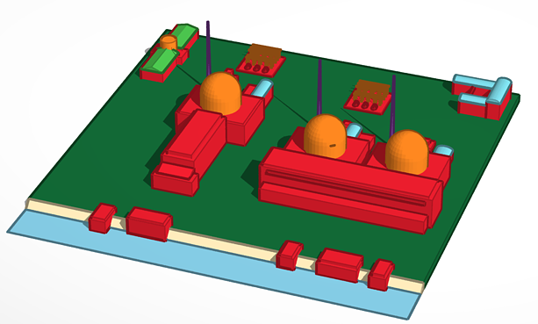
Ensemble model for Multi-Unit Power Plant: 1st Configuration
Dynamic PRA for a Station Black Out Multi-Unit scenario
RAVEN ensemble model
PWR1
Unit 1
SFP1
Plant Logic Model
PWR2
Unit 2
SFP2
PWR3
Unit 3
SFP3

Slide 12
Employing Ensemble modeling in RAVEN

Slide 13
Getting on the same page
This workshop will include interactive examples
paths given starting at raven
Slides are provided as well:
~> cd projects/raven
~/projects/raven> git checkout workshop_2018
~/projects/raven> git pull
raven/doc/workshop/ensembleModels

Slide 14
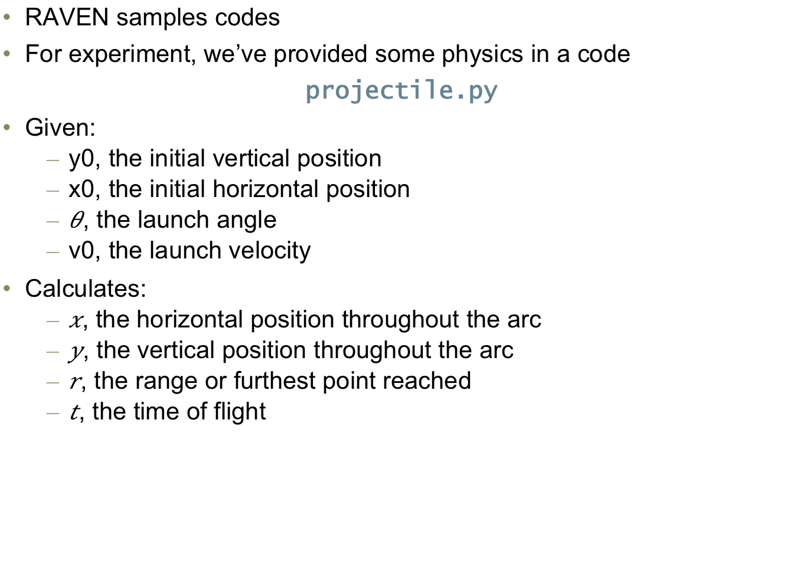
Example: External Model A
RAVEN samples codes
For experiment, we’ve provided some physics in a code
projectile.py
Given:
y0, the initial vertical position
x0, the initial horizontal position
, the launch angle
v0, the launch velocity
Calculates:
, the horizontal position throughout the arc
, the vertical position throughout the arc
, the range or furthest point reached
, the time of flight

Slide 15
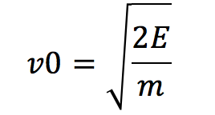
Example: External Model B
Model: kineticEnergy.py
Input: energy (E), and mass (m)
Output: v0
v0
Model B
Model A

Slide 16
Workflow
Create EnsembleModel
Sample the model
Plot results

Slide 17
Create an Ensemble model
Distributions
Models
Samplers
Databases
DataObjects
OutStreams
Steps
<Distributions>
<Normal name=’angle_d'>
<mean>45</mean>
<sigma>5</sigma>
<upperBound>5</upperBound>
<lowerBound>85</lowerBound>
</Normal>
</Distributions>
Distribution specifications
Add distributions for mass and energy

Slide 18
Create an Ensemble model
Distributions
Models
Samplers
Databases
DataObjects
OutStreams
Steps
<Models>
...
<ExternalModel name=’projectile' subType=’’ ModuleToLoad=’../../projectile’>
<variables>x0,v0,y0,angle,x,y,r,t</variables>
</ExternalModel>
<ExternalModel name=’kineticEnergy’ subType=’’ ModuleToLoad=’../../kineticEnergy’>
<variables>energy,mass,v0</variables>
</ExternalModel>
...
</Models>
List of Models we are going to use

Slide 19
Create an Ensemble model
Distributions
Models
Samplers
Databases
DataObjects
OutStreams
Steps
<Models>
...
<EnsembleModel name=’ensembleModel' subType=’’>
<Model class=’Models' type=’ExternalModel’>
projectile
<Input class=“DataObjects” type=“PointSet”>inputHolder</Input >
<TargetEvaluation class=’DataObjects’
type=’PointSet’>projectileContainer
</TargetEvaluation>
</Model>
<Model class=’Models' type=’ExternalModel’>
kineticEnergy
<Input class=“DataObjects” type=“PointSet”>inputHolder</Input >
<TargetEvaluation class=’DataObjects’ type=’PointSet’>
KEnergyContainer</TargetEvaluation>
</Model>
</EnsembleModel>
...
</Models>
Inputs of this model
Exclusive output

Slide 20
Create an Ensemble model
Distributions
Models
Samplers
Databases
DataObjects
OutStreams
Steps
<DataObjects>
<PointSet name=’projectileContainer'>
<Input>x0,y0,v0,angle</Input>
<Output>r,t</Output>
</PointSet>
<PointSet
name=’KEnergyContainer'>
<Input>mass,energy</Input>
<Output>v0</Output>
</PointSet>
</DataObjects>
Link

Slide 21
Create an Ensemble model
Create EnsembleModel
Add DataObjects for TargetEvaluation
Plot using OutStreams
r ~ f(v0, angle, t)

Slide 22
Let’s run the code…

Slide 23
Hybrid Model

Slide 24
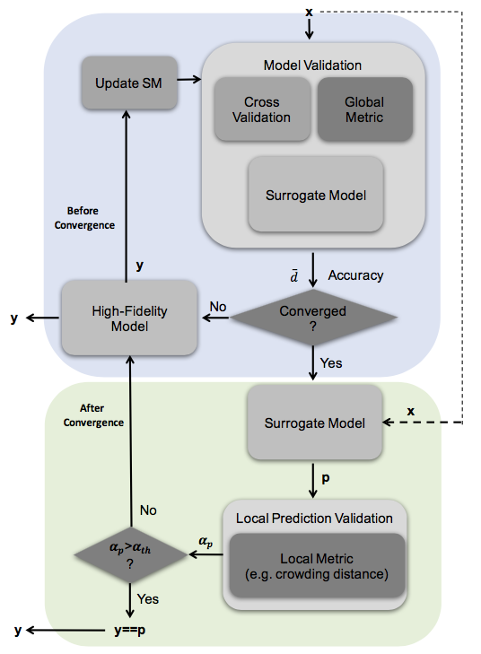
Hybrid-Model (automatic selection ROM/physical model)
The HybridModel is designed to combine multiple surrogate models and any other Model (i.e. high-fidelity model) leveraging the EnsembleModel infrastructure, deciding which of the Model needs to be evaluated based on the model validation score.

Slide 25
Cross-Validation for assessing Surrogate Models validity
Take out some of the training set
Train on the remaining training set
Test on the excluded instances
Cross-validation
Cross Validation
Compute a score (e.g. R²)
Dataset
Train
Test

Slide 26
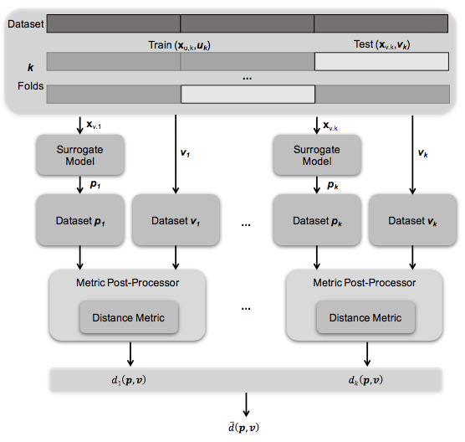
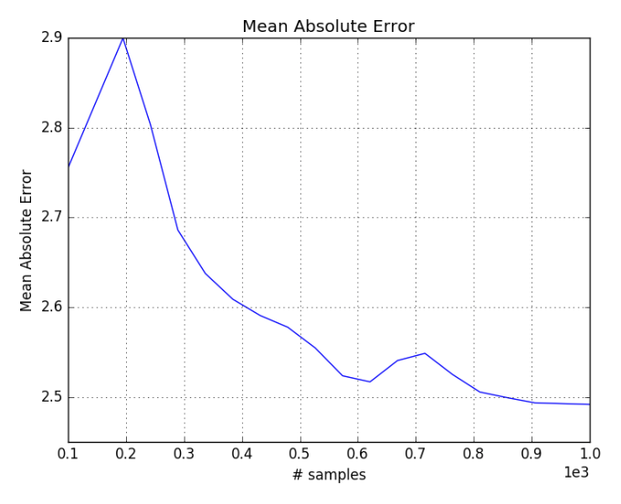
Model validation RAVEN scheme
Mean Absolute Error score (Cross-validation) as function of # samples

Slide 27
Projectile Model
RAVEN samples codes
For experiment, we’ve provided some physics in a code
projectile.py
Given:
y0, the initial vertical position
x0, the initial horizontal position
, the launch angle
v0, the launch velocity
Calculates:
, the horizontal position throughout the arc
, the vertical position throughout the arc
, the range or furthest point reached
, the time of flight

Slide 28
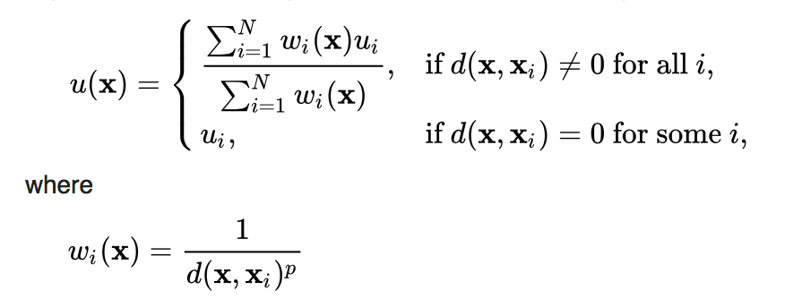
ROM: Inverse Distance Weight
See section 17.3.6 NDinvDistWeight
Interpolating function

Slide 29
Workflow
Create HybridModel
Sample the model
Plot results

Slide 30
Create a Hybrid model
Distributions
Models
Samplers
Databases
DataObjects
OutStreams
Steps
<Models>
...
<ExternalModel name=’projectile' subType=’’ ModuleToLoad=’../../projectile’>
<variables>angle,x,y,r,t</variables>
</ExternalModel>
<ROM name=’IDW’ subType=’’>
<Features>angle</Features>
<Target>r</Target>
<p>3</p>
</ROM>
...
</Models>
List of Models we are going to use

Slide 31
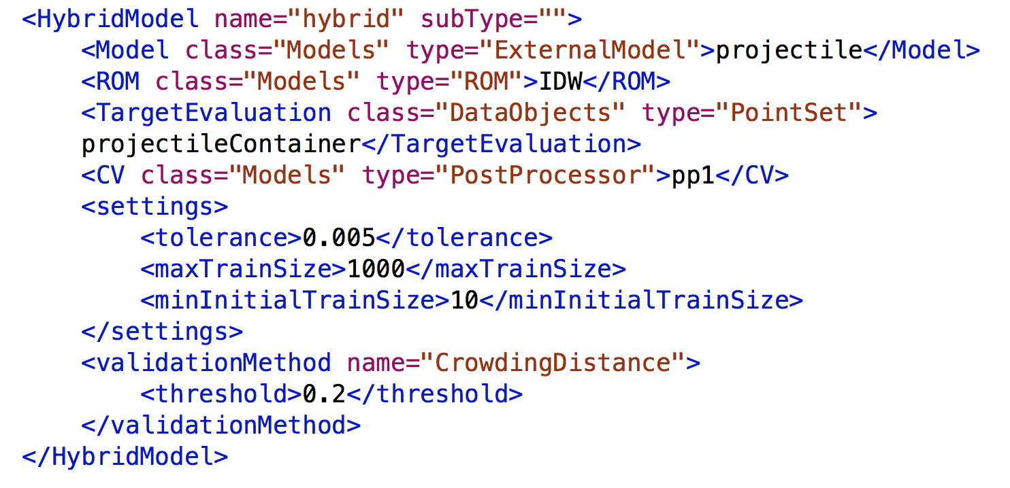
Create a Hybrid model
Distributions
Models
Samplers
Databases
DataObjects
OutStreams
Steps

Slide 32
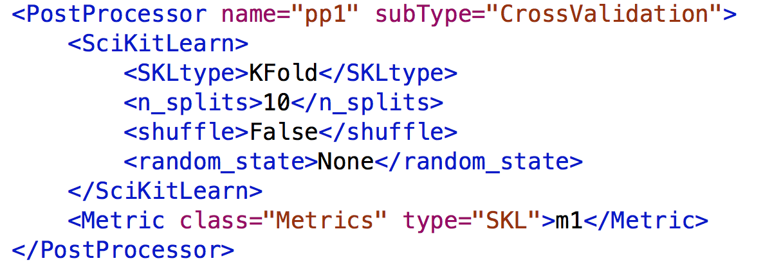
Create a Hybrid model
Distributions
Models
Samplers
Databases
DataObjects
OutStreams
Steps

Slide 33
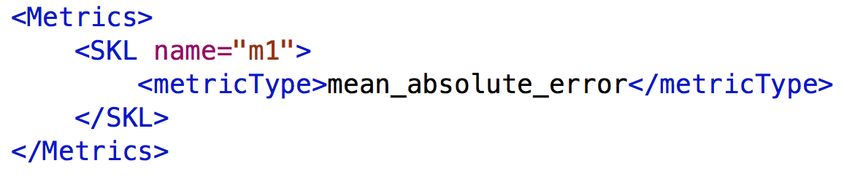
Create a Hybrid model
Distributions
Models
Samplers
Databases
DataObjects
OutStreams
Steps
Metrics

Slide 34
Create a Hybrid model
Distributions
Models
Samplers
Databases
DataObjects
OutStreams
Steps
<DataObjects>
<PointSet name=’outMC'>
<Input>angle</Input>
<Output>r</Output>
</PointSet>
<PointSet
name=’projectileContainer'>
<Input>angle</Input>
<Output>r</Output>
</PointSet>
</DataObjects>
Link

Slide 35
Create A Hybrid Model
/raven/doc/workshop/ensembleModels/inputs/exercises/2_hybrid_model.xml
Create a hybrid model: section 17.7
Create a cross validation PostProcessor: section 17.5.14
Create a metric: section 19
Update DataObjects and Steps

Slide 36
Let’s run the code…

Slide 37
Thank you Questions?

