Slide 1

Ensemble Modeling
RAVEN Workshop

Slide 2
Outline
RAVEN models: brief overview
Ensemble Modeling
Overview
Characteristics and limitations
Application examples of Ensemble Modeling
Hands-on:
Example using 2 external models
Example using the Code Interface we previously created

Slide 3
RAVEN models: overview

Slide 4
RAVEN models: a quick introduction
RAVEN categorizes in its Models entity the following sub-entities:
Codes:
Aimed to interface with physical codes (e.g. RELAP5-3D, etc.)
ROMs:
Aimed to emulate the response of a system based on a simplified mathematical representation
External Models:
Aimed to provide to the user an easy way to implement sets of equations directly in RAVEN
Post-Processors:
Aimed to analyze the generated datasets (e.g. Statistical moments, Data Mining, etc.)
Ensemble Models:
Aimed to assemble multiple models

Slide 5
RAVEN ensemble modeling

Slide 6
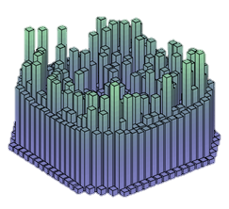
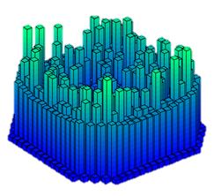
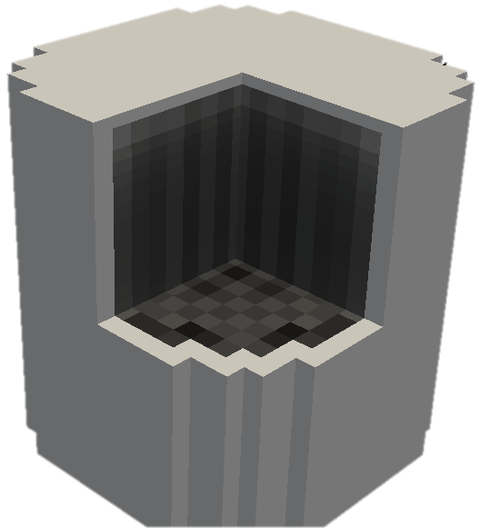
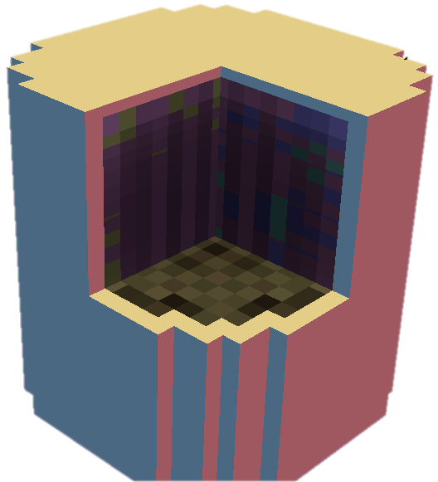
Ensemble Modeling Motivations
In several cases multiple models need to interface with each other since the initial conditions of some are dependent on the outcomes of others
In order to face this “problem” in the RAVEN framework, a new model category (e.g. class), named EnsembleModel, has been designed
This class is able to assemble multiple models of other categories (i.e. Code, External Model, ROM), identifying:
the input/output connections
the order of execution
the parallel execution strategy for each sub-model
Physics 1
EnsembleModel
Physics 2

Slide 7
Ensemble Model
A new model entity (e.g., class), named EnsembleModel, has been developed:
Assemble multiple models of other categories, identifying the input/output connections and the order of execution
Notes:
Sometimes, multiple models need to interface with each other since the initial conditions of some are dependent on the outcomes of others

Slide 8
Ensemble Model: Main Characteristics
The EnsembleModel entity has the following main characteristics:
Ability to link all the RAVEN Models:
Codes, ROMs, ExternalModels
Practical no limit on the number of Models in the Ensemble configuration
Capability to link the different Models through both scalar and vector variables (e.g. Max Cladding Temperature (scalar) or Power history (vector))
Capability to transfer meta-data from the different models (e.g. restart files, etc.)
The current EnsembleModel entity is not indicated to handle high-density field data

Slide 9
Ensemble Model: Chain of Models
Model 1
Model N-1
Model N
Model 2
Model 1
Model 3
Notes:
Sometimes, multiple models need to interface with each other since the initial conditions of some are dependent on the outcomes of others

Slide 10
Ensemble Model: Non Linear
Notes:
Sometimes, multiple models need to interface with each other since the initial conditions of some are dependent on the outcomes of others

Slide 11
Employing Ensemble Modeling in real applications

Slide 12
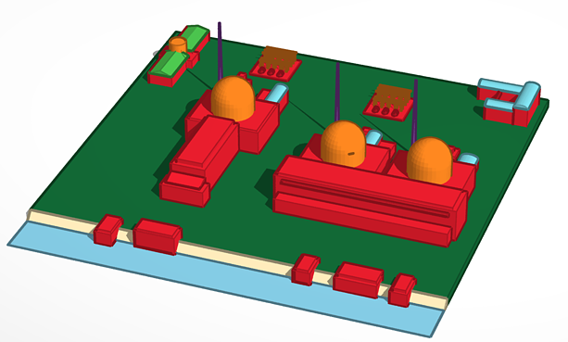
Ensemble model for Multi-Unit Power Plant: 1st Configuration
Dynamic PRA for a Station Black Out Multi-Unit scenario
RAVEN ensemble model
PWR1
Unit 1
SFP1
Plant Logic Model
PWR2
Unit 2
SFP2
PWR3
Unit 3
SFP3

Slide 13
Ensemble model for Multi-Unit Power Plant: 2nd Configuration
Exploiting the restart capability of the driven code, the EnsembleModel can be constructed through a chain of basic units that can be repeated, for example, over time
10 minutes
RAVEN ensemble model
RAVEN ensemble model
Unit 1
PWR1
Unit 1
PWR1
SFP1
Human Actions
SFP1
over time
Plant Logic Model
Unit 2
PWR2
Plant Logic Model
Unit 2
PWR2
SFP2
SFP2
Unit 3
PWR3
Unit 3
PWR3
SFP3
SFP3

Slide 14
Employing Ensemble modeling in RAVEN

Slide 15
Getting on the same page
This workshop will include interactive examples
paths given starting at raven
Slides are provided as well:
~> cd projects/raven
~/projects/raven> git checkout workshop_2018
~/projects/raven> git pull
raven/doc/workshop/ensembleModels

Slide 16

Ensemble Model: Example 1 specifications
1-Dimensional heat conduction transient (in a slab of thickness L=1 m):
EM1, heat conduction partial differential equation:
EM2, thermal conductivity (input of EM1) as function of the average temperature in the slab boundary conditions:
EM2
EM1

Slide 17
Workflow
Create EnsembleModel
Sample the model
Plot results
Input File name: ensemble_model_ext_models.xml

Slide 18
Create an Ensemble model of a code and an ExternalModel
Distributions
Models
Samplers
Databases
DataObjects
OutStreams
Steps
<Distributions>
<Uniform name=’leftTemperatureDist'>
<upperBound>500</upperBound>
<lowerBound>1700</lowerBound>
</Uniform>
<Uniform name=’rightTemperatureDist'>
<upperBound>500</upperBound>
<lowerBound>1700</lowerBound>
</Uniform>
</Distributions>
Distribution specifications

Slide 19
Create an Ensemble model of a code and an ExternalModel
Distributions
Models
Samplers
Databases
DataObjects
OutStreams
Steps
<Models>
...
<ExternalModel name=’heatTransfer' subType=’’ ModuleToLoad=’EM1linear’>
<variables>leftTemperature,rightTemperature,k,solution</variables>
</ExternalModel>
<ExternalModel name=’thermalConductivityCompuation’ subType=’’ ModuleToLoad=’EM2linear’>
<variables>leftTemperature,rightTemperature,k,averageTemperature</variables>
</ExternalModel>
...
</Models>
List of Models we are going to use

Slide 20
Create an Ensemble model of a code and an ExternalModel
Distributions
Models
Samplers
Databases
DataObjects
OutStreams
Steps
<Models>
...
<EnsembleModel name=’heatTransferEnsembleModel' subType=’’>
<Model class=’Models' type=’ExternalModel’>
thermalConductivityComputation
<Input class=“DataObjects” type=“PointSet”>inputHolder</Input >
<TargetEvaluation class=’DataObjects’
type=’PointSet’>thermalConductivityComputationContainer
</TargetEvaluation>
</Model>
<Model class=’Models' type=’ExternalModel’>
heatTransfer
<Input class=“DataObjects” type=“PointSet”>inputHolder</Input >
<TargetEvaluation class=’DataObjects’ type=’PointSet’>
heatTransferContainer</TargetEvaluation>
</Model>
</EnsembleModel>
...
</Models>
Inputs of this model
Exclusive output

Slide 21
Create an Ensemble model of a code and an ExternalModel
Distributions
Models
Samplers
Databases
DataObjects
OutStreams
Steps
<DataObjects>
<PointSet name=’heatTransferContainer'>
<Input>leftTemperature,rightTemperature,k</Input>
<Output>solution</Output>
</PointSet>
<PointSet
name=’thermalConductivityComputationContainer'>
<Input>leftTemperature,rightTemperature</Input>
<Output>k</Output>
</PointSet>
<PointSet name=’metaModelOutputTest'>
<Input>leftTemperature,rightTemperature</Input>
<Output>k,solution</Output>
</PointSet>
</DataObjects>
Link

Slide 22
Create an Ensemble model of two model
Let’s run the code…

Slide 23
Exercise 2: Create an EnsembleModel of a Code and an ExternalModel

Slide 24
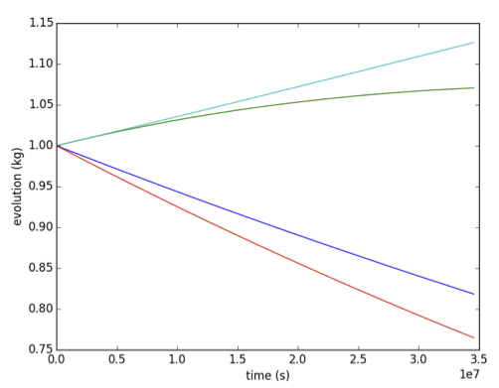
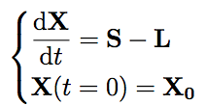
Ensemble Model: Example 2 specifications
Also codes can be used in the Ensemble modeling.
EM1: Code, Analytical Bateman
Transmutation
EM2: External Model, convert final outcomes of EM1 into atom densities
EM1
EM2

Slide 25
Workflow
Create EnsembleModel
Sample the model
Plot results
Input File name: ensamble_model_example.xml

Slide 26
Create an Ensemble model of a code and an ExternalModel
Distributions
Models
Samplers
Databases
DataObjects
OutStreams
Steps
<Distributions>
<Uniform name=’sigma'>
<upperBound>1000</upperBound>
<lowerBound>0.0</lowerBound>
</Uniform>
<Uniform name=’decayConstant'>
<upperBound>1.e-7</upperBound>
<lowerBound>1.e-8</lowerBound>
</Uniform>
</Distributions>
Distribution specifications

Slide 27
Create an Ensemble model of a code and an ExternalModel
Distributions
Models
Samplers
Databases
DataObjects
OutStreams
Steps
<Models>
...
<ExternalModel name=’convertToAtomDensity' subType=’’ ModuleToLoad=’toAtomDens’>
<variables>A,B,C,D,densA,densB,densC,densD</variables>
</ExternalModel>
<Code name=’testModel' subType=’GenericCode’>
<executables>ensembleModelWithCode/AnalyticalDplMain.py</executables>
<clargs arg=”” extension=’.xml’ type=’input’ />
<clargs arg=”” extension=’.csv’ type=’output’ />
<prepend>python</prepend>
</Code>
...
</Models>
List of Models we are going to use

Slide 28
Create an Ensemble model of a code and an ExternalModel
Distributions
Models
Samplers
Databases
DataObjects
OutStreams
Steps
<Models>
...
<EnsembleModel name=’codeAndExtModel' subType=’’>
<Model class=’Models' type=’ExternalModel’ inputNames=’inPlaceHolder’>
convertToAtomDensity
<Input class=“Files” type=“”>referenceInput.xml</Input >
<TargetEvaluation class=’DataObjects’ type=’PointSet’>convertedData
</TargetEvaluation>
</Model>
<Model class=’Models' type=’Code’>
testModel
<Input class=“Files” type=“”>inputHolder</Input >
<TargetEvaluation class=’DataObjects’ type=’PointSet’>sampleMC</TargetEvaluation>
</Model>
</EnsembleModel>
...
</Models>
Inputs of this model
Exclusive output

Slide 29
Create an Ensemble model of a code and an ExternalModel
Distributions
Models
Samplers
Databases
DataObjects
OutStreams
Steps
<DataObjects>
<PointSet name=’convertData'>
<Input>A,B,C,D</Input>
<Output>densA,densB,densC,densD</Output>
</PointSet>
<PointSet name=’sampleMC'>
<Input>sigma-A,sigma-B,decay-A,decay-B</Input>
<Output>A,B,C,D</Output>
</PointSet>
<PointSet name=’finalResponses'>
<Input>sigma-A,sigma-B,decay-A,decay-B</Input>
<Output>A,B,C,D,densA,densB,densC,densD</Output>
</PointSet>
</DataObjects>
Link

Slide 30
Create an Ensemble model of two model
Let’s run the code…

Slide 31
Hybrid Model

Slide 32
Cross-Validation for assessing Surrogate Models validity
Take out some of the training set
Train on the remaining training set
Test on the excluded instances
Cross-validation
Cross Validation
Compute a score (e.g. R²)
Dataset
Train
Test

Slide 33
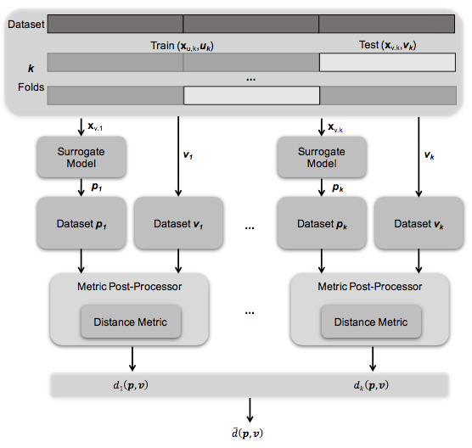
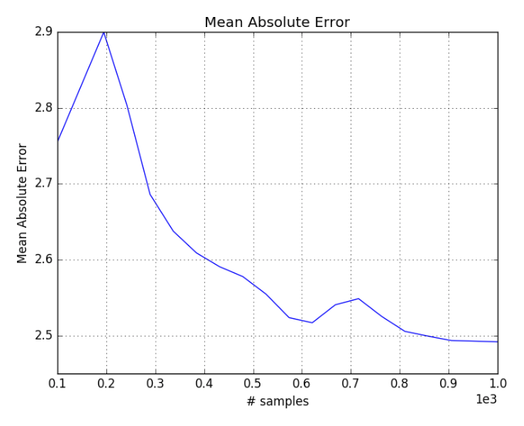
Model validation RAVEN scheme
Mean Absolute Error score (Cross-validation) as function of # samples

Slide 34
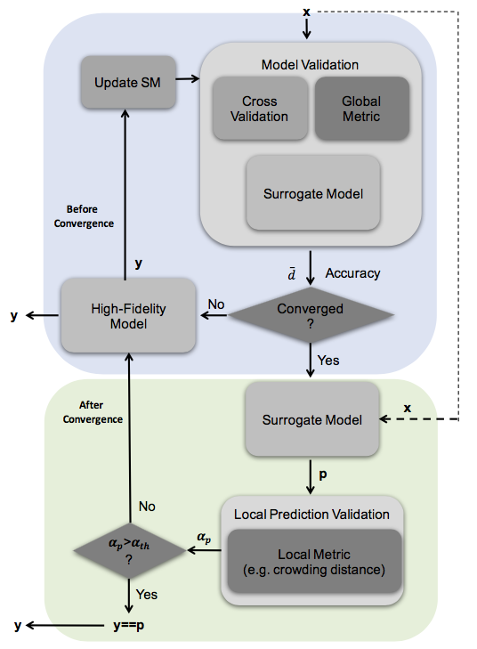
Hybrid-Model (automatic selection ROM/physical model)
The HybridModel is designed to combine multiple surrogate models and any other Model (i.e. high-fidelity model) leveraging the EnsembleModel infrastructure, deciding which of the Model needs to be evaluated based on the model validation score.

Slide 35
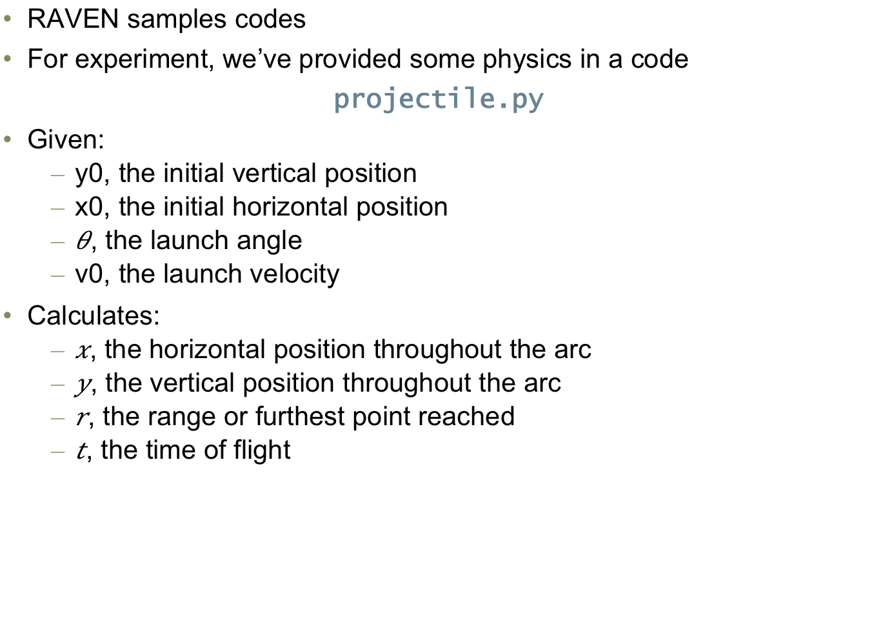
Example Code
RAVEN samples codes
For experiment, we’ve provided some physics in a code
projectile.py
Given:
y0, the initial vertical position
x0, the initial horizontal position
, the launch angle
v0, the launch velocity
Calculates:
, the horizontal position throughout the arc
, the vertical position throughout the arc
, the range or furthest point reached
, the time of flight

Slide 36
Workflow
Create EnsembleModel
Sample the model
Plot results
Input File name: ensemble_model_ext_models.xml

Slide 37
Create an Ensemble model of a code and an ExternalModel
Distributions
Models
Samplers
Databases
DataObjects
OutStreams
Steps
<Distributions>
<Uniform name=’leftTemperatureDist'>
<upperBound>500</upperBound>
<lowerBound>1700</lowerBound>
</Uniform>
<Uniform name=’rightTemperatureDist'>
<upperBound>500</upperBound>
<lowerBound>1700</lowerBound>
</Uniform>
</Distributions>
Distribution specifications

Slide 38
Create an Ensemble model of a code and an ExternalModel
Distributions
Models
Samplers
Databases
DataObjects
OutStreams
Steps
<Models>
...
<ExternalModel name=’heatTransfer' subType=’’ ModuleToLoad=’EM1linear’>
<variables>leftTemperature,rightTemperature,k,solution</variables>
</ExternalModel>
<ExternalModel name=’thermalConductivityCompuation’ subType=’’ ModuleToLoad=’EM2linear’>
<variables>leftTemperature,rightTemperature,k,averageTemperature</variables>
</ExternalModel>
...
</Models>
List of Models we are going to use

Slide 39
Create an Ensemble model of a code and an ExternalModel
Distributions
Models
Samplers
Databases
DataObjects
OutStreams
Steps
<Models>
...
<EnsembleModel name=’heatTransferEnsembleModel' subType=’’>
<Model class=’Models' type=’ExternalModel’>
thermalConductivityComputation
<Input class=“DataObjects” type=“PointSet”>inputHolder</Input >
<TargetEvaluation class=’DataObjects’
type=’PointSet’>thermalConductivityComputationContainer
</TargetEvaluation>
</Model>
<Model class=’Models' type=’ExternalModel’>
heatTransfer
<Input class=“DataObjects” type=“PointSet”>inputHolder</Input >
<TargetEvaluation class=’DataObjects’ type=’PointSet’>
heatTransferContainer</TargetEvaluation>
</Model>
</EnsembleModel>
...
</Models>
Inputs of this model
Exclusive output

Slide 40
Create an Ensemble model of a code and an ExternalModel
Distributions
Models
Samplers
Databases
DataObjects
OutStreams
Steps
<DataObjects>
<PointSet name=’heatTransferContainer'>
<Input>leftTemperature,rightTemperature,k</Input>
<Output>solution</Output>
</PointSet>
<PointSet
name=’thermalConductivityComputationContainer'>
<Input>leftTemperature,rightTemperature</Input>
<Output>k</Output>
</PointSet>
<PointSet name=’metaModelOutputTest'>
<Input>leftTemperature,rightTemperature</Input>
<Output>k,solution</Output>
</PointSet>
</DataObjects>
Link

Slide 41
Thank you Questions?

