Slide 1
Toptal
David Bonilla

Slide 2


Requirements
3
The architecture needs to be broken down into the relevant tiers (application, database, etc.).
The architecture should be completely provisioned via Chef/Puppet/Ansible/similar.
The deployment of new code and execution of tests should be completely automated. (Bonus points if you can catch performance regressions).
The database and any mutable storage need to be backed up at least daily.
All relevant logs for all tiers need to be easily accessible (having them on the hosts is not an option)
Implement monitoring and logging using self-provisioned tools. Usage of managed services for monitoring/logging is not permitted.
You should fork the repository and use it as the base for your system
You should be able to deploy it on one larger Cloud provider: AWS / Google Cloud / Azure / DigitalOcean / RackSpace.
The system should present relevant historical metrics to spot and debug bottlenecks.
{

Slide 3
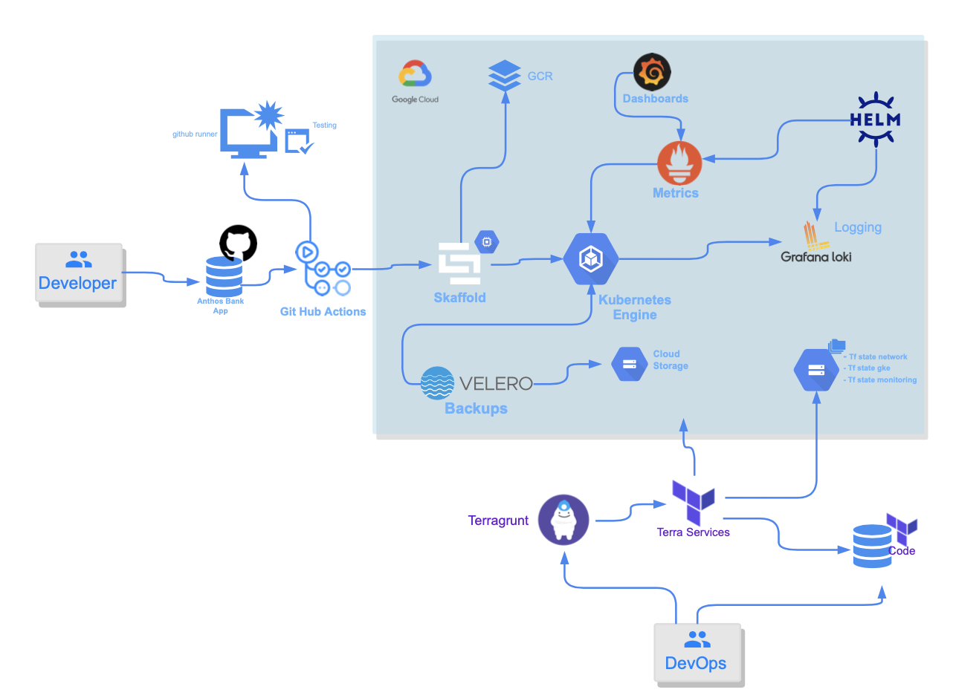
Deployment
Diagram
3
{
}

Slide 4
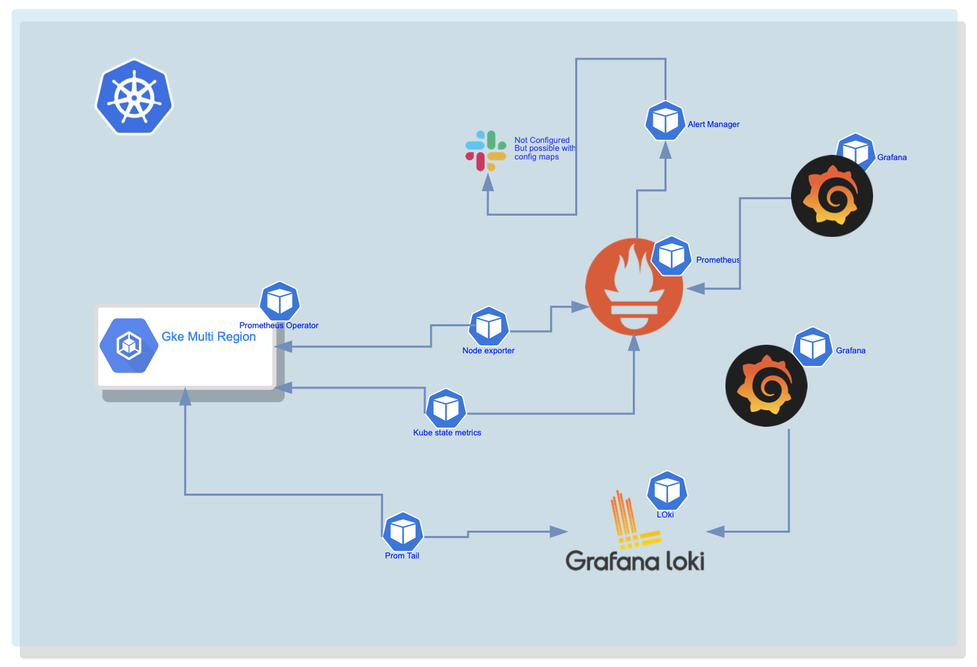
Monitoring
3
{
{

Slide 5
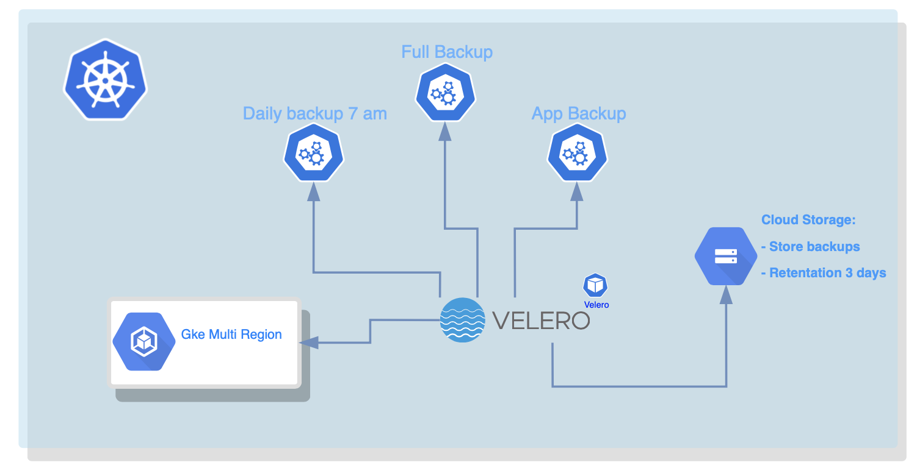
Backups
3
{
{

