Slide 1
Sentiment Analysis for customer feedback in software products
CAPSTONE PROJECT
Presented By:
1.Boni Pujitha–GVPCEW – CSM Department

Slide 2
OUTLINE
Problem Statement (Should not include solution)
Proposed System/Solution
System Development Approach (Technology Used)
Result
Conclusion
Future Scope
References

Slide 3
Problem Statement
Understanding and analyzing customer sentiment from various feedback sources to improve software products and customer satisfaction.

Slide 4
Proposed Solution
Developing a Sentiment Analysis Application:
The proposed system involves developing a robust sentiment analysis application designed to analyze large volumes of customer feedback data in CSV format. The application's key functionalities include:
Sentiment Analysis Engines: Utilization of NLTK's VADER for English sentiment analysis and TextBlob for multi-language sentiment analysis. This allows the application to handle feedback in various languages effectively.
Categorization of Sentiments: The application categorizes sentiments into three main categories: positive, negative, or neutral. This categorization helps in understanding customer sentiment trends and reactions.
Real-Time Sentiment Tracking: Support for real-time analysis enables immediate feedback processing and monitoring of sentiment changes as new data is received. This feature is crucial for timely responses and proactive management of customer sentiment.
Advanced Visualization: Visualization tools provide insightful graphs and charts to depict sentiment trends over time. This visual representation aids in identifying patterns, outliers, and overall sentiment distribution.
Export and Integration Capabilities :Ability to export analyzed results into various formats (e.g., CSV) for further analysis or integration with other systems. This flexibility enhances usability and enables deeper insights from the sentiment data.

Slide 5
System Approach
System requirements : windows 11 operating system , 8GB RAM, I3 Processor
Python Libraries: NLTK, TextBlob, pandas, Streamlit
Concurrency: ThreadPoolExecutor for efficient parallel processing
Visualization: Streamlit's built-in visualization capabilities (bar charts for sentiment distribution)
Deployment: Deployable as a web application, suitable for internal use within software companies

Slide 6
Result
The application provides:
Real-Time Sentiment Analysis: Enables software companies to monitor and track sentiment changes in real time, allowing prompt responses to customer feedback.
Advanced Visualization: Charts and graphs visualize sentiment trends over time and comparative analysis, aiding in identifying patterns and areas for improvement.
Export Functionality: Allows exporting of sentiment analysis results as CSV for further analysis or integration with other systems.

Slide 7
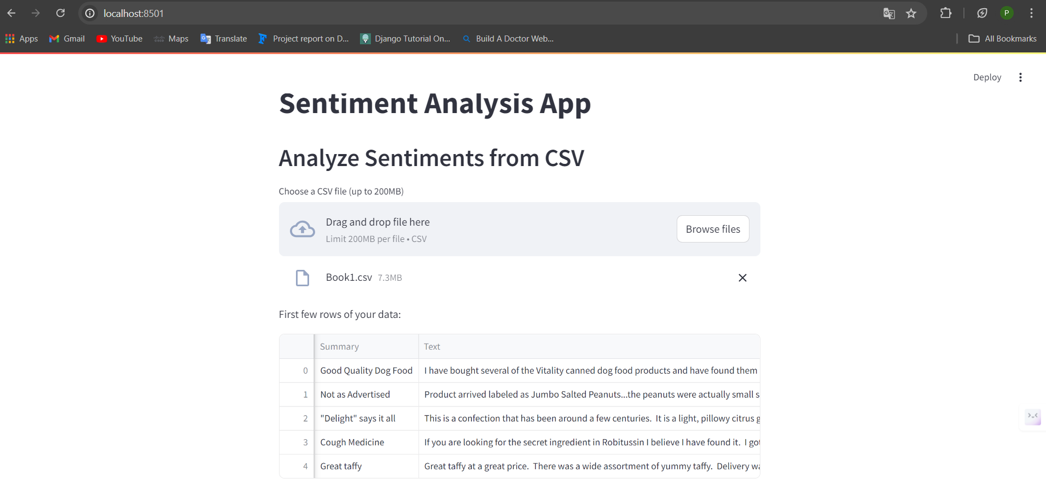
Result

Slide 8
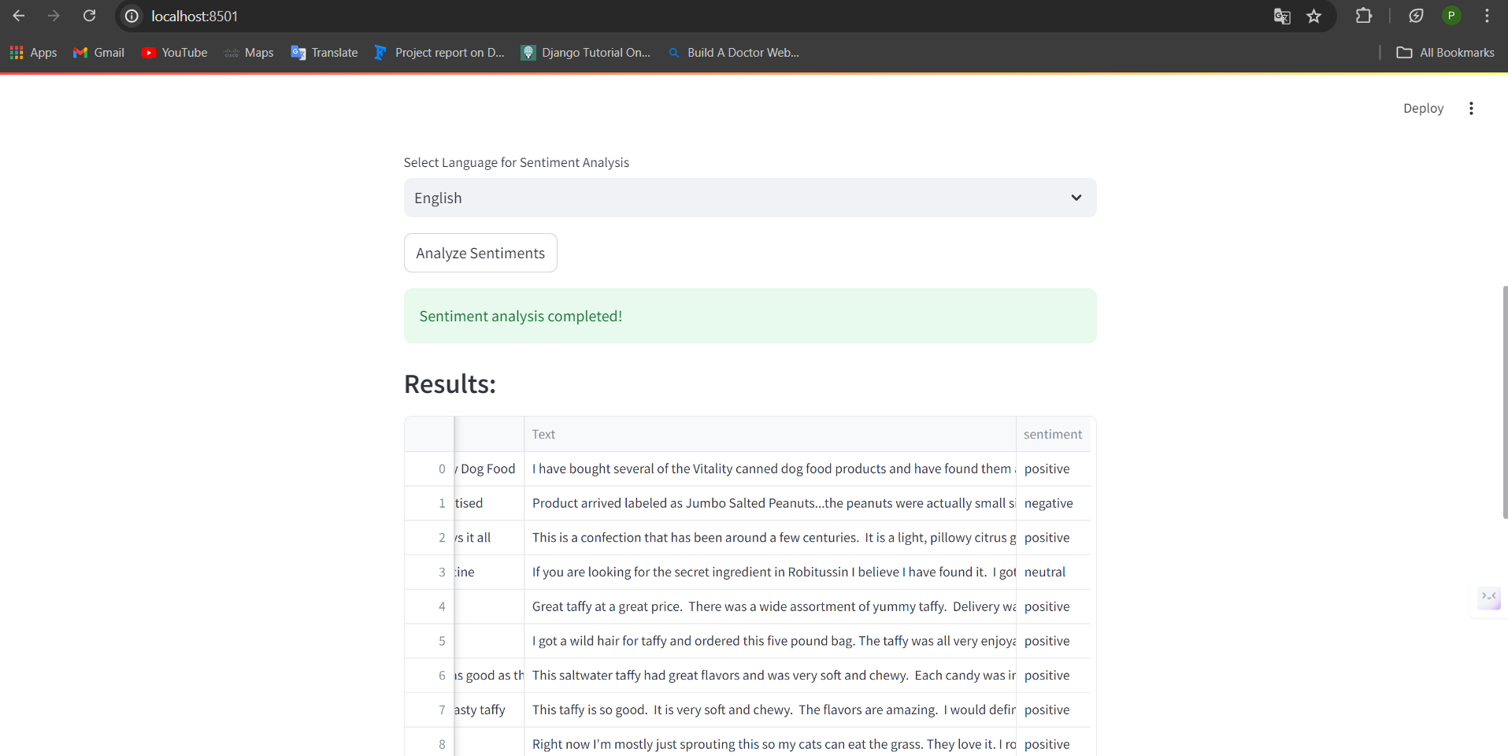

Slide 9
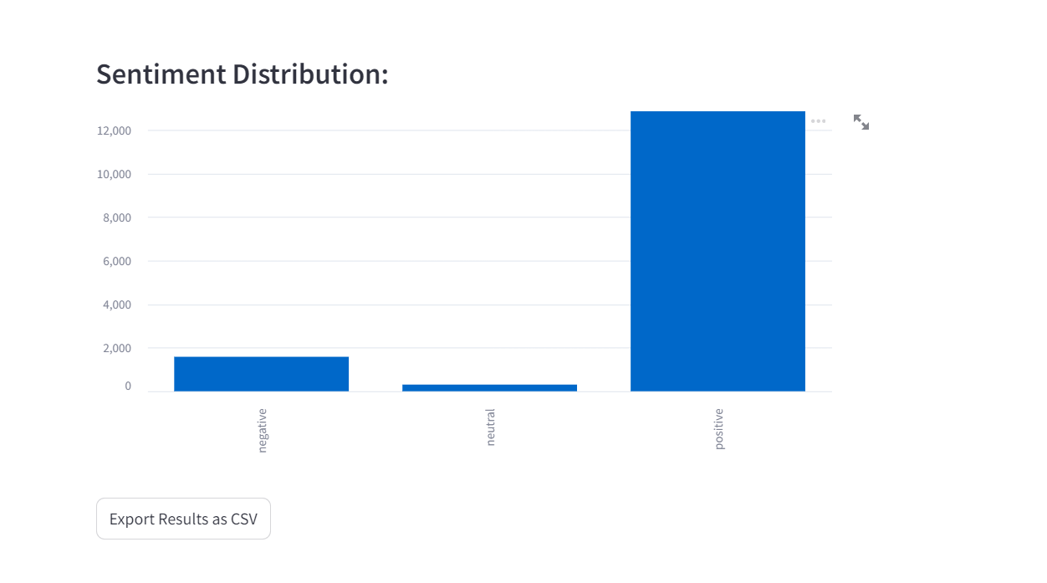

Slide 10
Project Link(GitHub, Google drive link)
GITHUB LINK: https://github.com/bonipujitha/AICTE-Project

Slide 11
Conclusion
Implementing this sentiment analysis application helps software companies enhance their understanding of customer sentiment, leading to:
Improved product development by addressing specific pain points highlighted by customers.
Enhanced customer satisfaction and loyalty through timely responses and improvements.
Better decision-making based on data-driven insights from sentiment analysis.

Slide 12
Future scope
Future enhancements could include:
Integration with CRM Systems: Automating data ingestion from customer relationship management (CRM) systems for continuous sentiment analysis.
AI-driven Insights: Implementing machine learning models for predictive sentiment analysis and sentiment-based recommendation systems.
Multi-lingual Support: Expanding language support beyond English and exploring sentiment analysis for various languages.

Slide 13
References
NLTK Documentation: https://www.nltk.org/
TextBlob Documentation: https://textblob.readthedocs.io/
Streamlit Documentation: https://docs.streamlit.io/

Slide 14
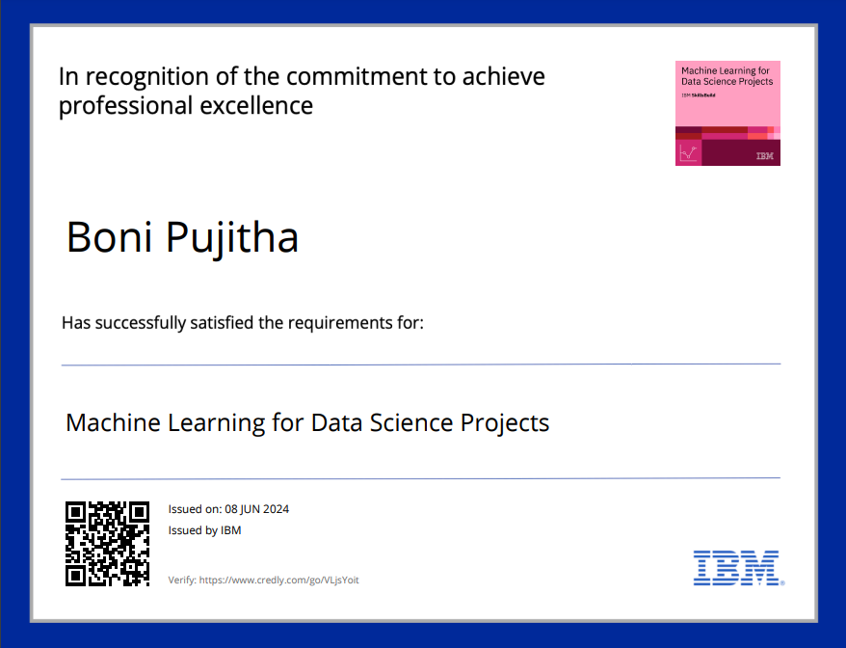
course certificate 1

Slide 15
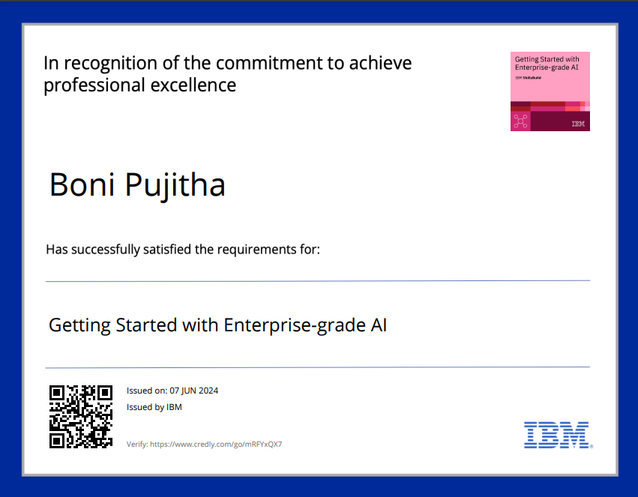
course certificate 2

Slide 16
THANK YOU

