Slide 1
Capstone Two
Final Presentation
by Sheik Mohammad Boni Sadar
10-May, 2025

Slide 2
Defective Jar Lid Identification Using CNN

Slide 3
Project overview
In modern manufacturing, automation plays a critical role in enhancing efficiency, consistency, and quality control.
One key area where automation can add significant value is in defect detection during the production process.
This project focuses on automating the inspection of jar lids by developing a Convolutional Neural Network (CNN) model to classify defective versus non-defective jar lids.

Slide 4
Data overview
Dataset: Labeled images of damaged vs. intact jar lids obtained from Kaggle.
Images converted to 128×128 grayscale.
Original + Augmented images for better generalization.

Slide 5
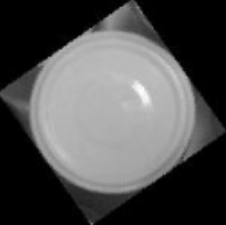
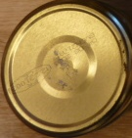
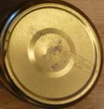
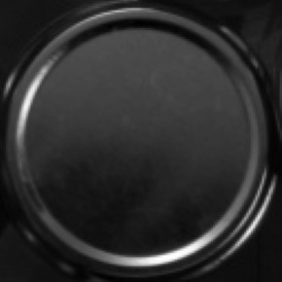
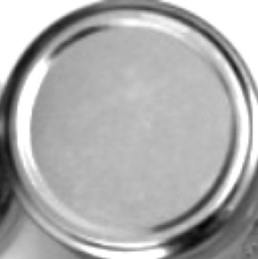
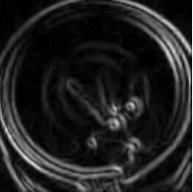
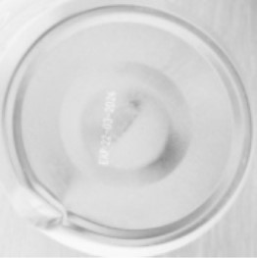
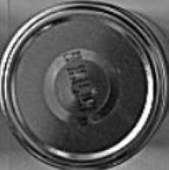
Data augmentation
Rotations (±35°, 90°)
Flipping (horizontal)
Brightness adjustments
Edge detection (Sobel)
X-ray style inversion
Sharpening

Slide 6
Training Strategy
Hyperparameter tuning:
Find the optimal batch size (128/256).
Selecting the optimal filter number combination.
Finding most optimal learning rate.
Finding most effective Activation Functions.
Epochs: up to 50
Early Stopping on validation accuracy

Slide 7
Final Model Architecture
Input Layer: (128, 128, 1)
↓
Conv2D: 32 filters, 5x5, 'same' padding → initializer 'he_normal' → LeakyReLU(0.1) → MaxPooling2D (2x2)
Output: (64, 64, 32)
↓
Conv2D: 64 filters, 5x5, 'same' padding → initializer 'he_normal' → LeakyReLU(0.1) → MaxPooling2D (2x2)
Output: (32, 32, 64)
↓
Conv2D: 128 filters, 5x5, 'same' padding → initializer 'he_normal' → LeakyReLU(0.1) → MaxPooling2D (2x2)
Output: (16, 16, 128)
↓
Flatten
Output: 32768
↓
Dense Layer: 256 units, ReLU, initializer 'he_normal'
↓
Dropout (rate=0.3)
↓
Dense Layer: 2 units (logits for binary classification)
Optimizer: Adam | Loss: Sparse Categorical Crossentropy

Slide 8
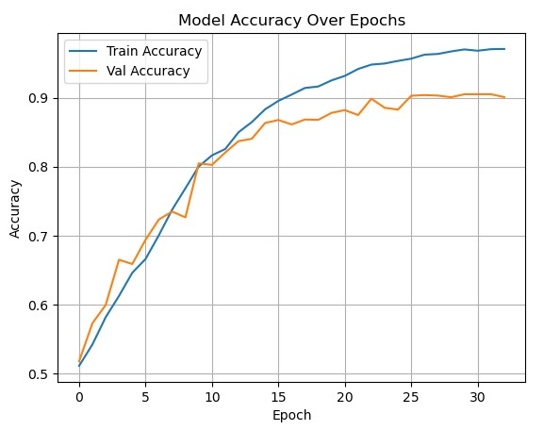
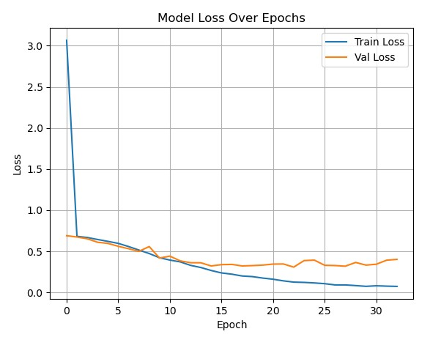
Training Curves
Training accuracy: ↑ to ~96%
Validation accuracy: Plateaus ~90%
Train Loss shows a steep drop early on, decreasing consistently to ~0.05.
Validation Loss decreases initially but plateaus and slightly fluctuates around ~0.35 after epoch 10–15.
A widening gap emerges between train and validation loss in later epochs.

Slide 9
Insights
The pattern for training curve is typical of overfitting, where the model performs significantly better on training data than on unseen validation data.
However, the validation accuracy remains fairly high and stable, suggesting moderate rather than severe overfitting.
The divergence in loss curves, with validation loss no longer decreasing while training loss continues to drop, reinforces the overfitting indication.
The model continues to optimize on training data but fails to generalize better to validation data beyond a certain point.
High final accuracy (~90%) on validation data indicates a well-performing model.

Slide 10
CNN Classification Performance Report
Performance is consistent with both sets.
Slightly better at classifying intact images.
The accuracy drop for damaged may suggest more intra-class variation.

Slide 11
Precision, Recall and F1 score
The model is slightly better at identifying intact lids (high recall).
It's more conservative when labeling damaged lids—prioritizing precision, possibly to avoid false alarms.
The balanced F1 scores (~0.90–0.91) indicate the model performs very well on both classes, though improving recall on the “Damaged” class could further enhance defect detection reliability.

Slide 12
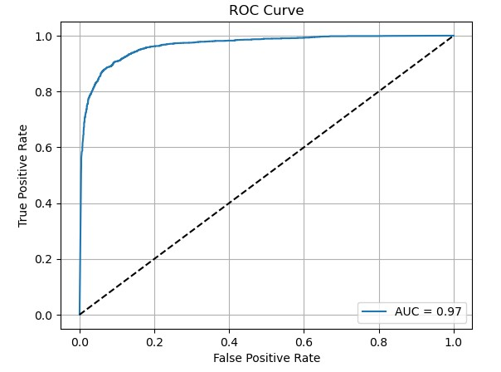
ROC Curve & AUC
AUC = 0.97 → A high AUC implies good generalization to unseen data.
Confirms robustness across thresholds.
The steep initial rise and long plateau suggest the model confidently classifies many positives before significant false positives occur.

Slide 13
Summary
High performance across both validation and test sets (≈ 90% accuracy).
AUC of 0.97 demonstrates strong capability to distinguish defective vs. intact jar lids.
Slight overfitting after ~20 epochs, but not performance-breaking.
This evaluation confirms the CNN model is reliable, generalizes well, and is well-suited for deployment in an automated defect detection pipeline.

Slide 14
Future Improvements
Leverage Pre-trained Models
Utilize transfer learning with well-established architectures such as VGG16, ResNet50 or EfficientNet.
Deeper Architectures
Experimenting with deeper CNNs that include additional convolutional and pooling layers. This may help the model capture more abstract, high-level features crucial for identifying subtle defects.
Data Augmentation Strategies
Continue expanding the dataset with advanced augmentation (e.g., elastic deformation, random occlusion, noise injection) to simulate real-world variability and further improve generalization.

Slide 15
Incorporating into an industrial automation pipeline
Model Serving via REST API
Packaging the model using TensorFlow Serving, FastAPI, or Flask.
Creating a lightweight REST API that the factory control system can query with images for real-time results.
Real-time Inference Integration
Deploying the model on edge devices (e.g., NVIDIA Jetson, Raspberry Pi with Coral TPU) near the production line. Creating a lightweight REST API that the factory control system can query with images for real-time results.
Use a real-time video feed or frame-based capture to inspect jar lids on a conveyor belt.
Automatically flag or sort defective items via mechanical actuators (e.g., robotic arms, air nozzles).
Integration with PLC Systems
Connecting the model's output to a Programmable Logic Controller (PLC) using middleware like MQTT or OPC UA.
Automate reject mechanisms or stop production if defect thresholds are exceeded.

Slide 16
Thank You All

