Slide 1
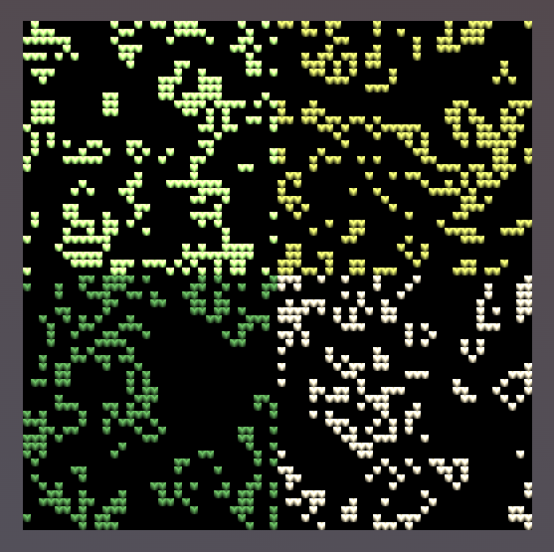

CHUNK_ACROSS = 2
CHUNK_SIZE = 32
PARTS_ACROSS = 8
CELL_SIZE = 8
(8px side length for one cell)

