Slide 1
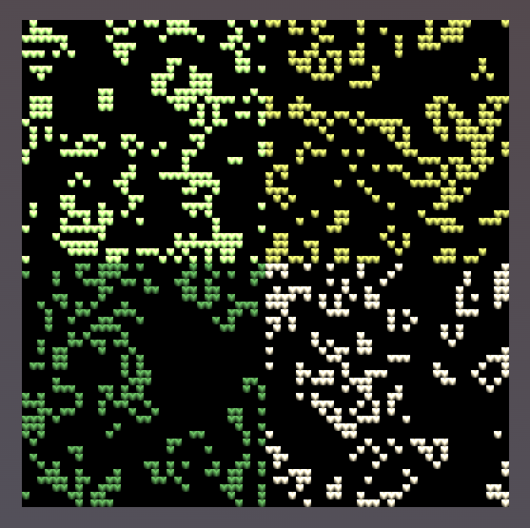

CHUNKS_ACROSS = 2
PARTS_ACROSS = 8
CHUNK_SIZE = 32
1 / PARTS_ACROSS
CELL_SIZE = 8
= cell has 8px side length

