Slide 1
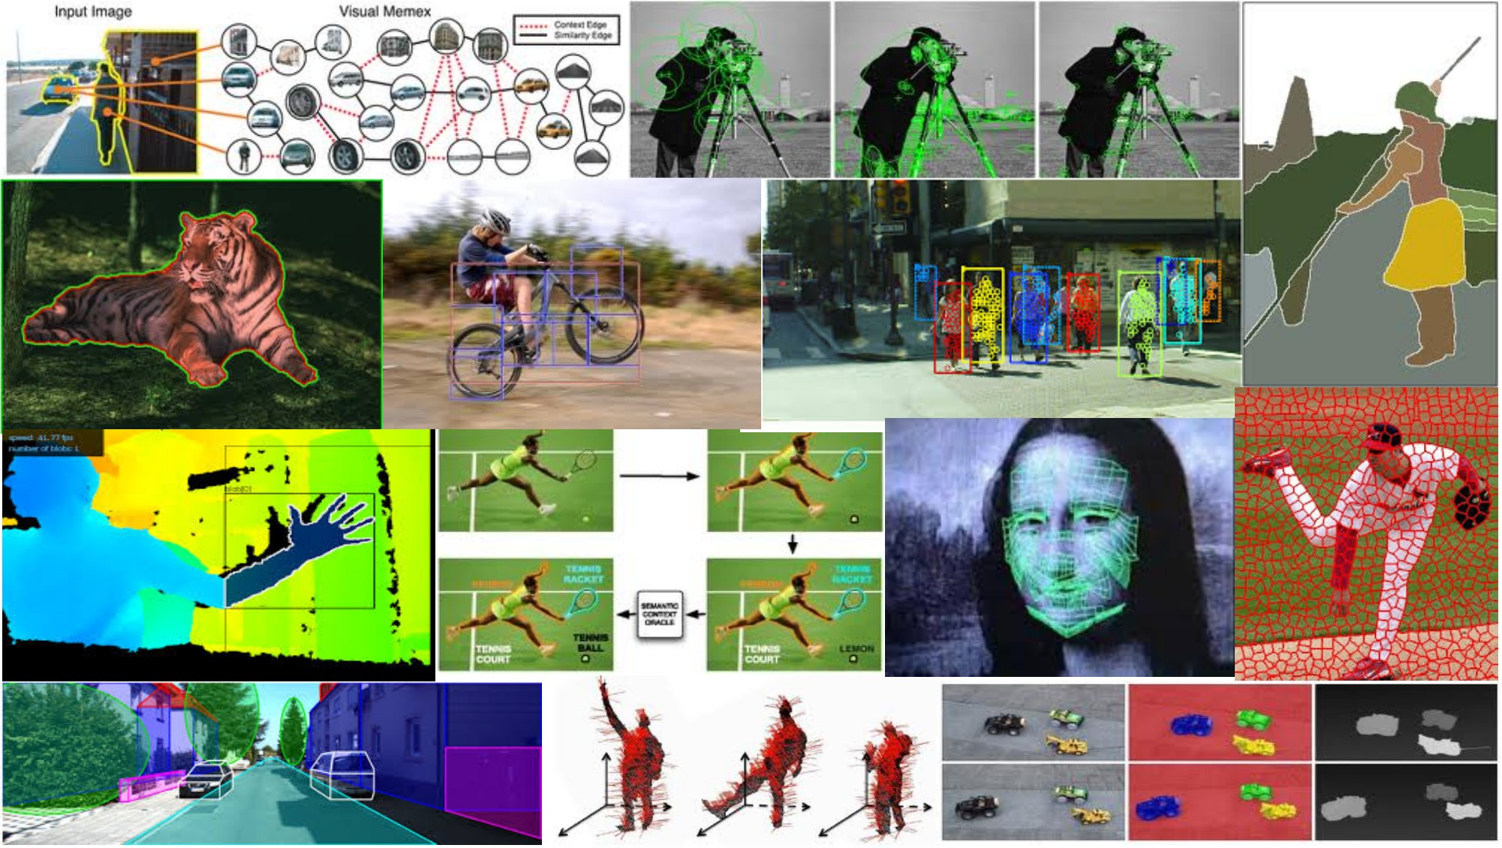
Deep neural networks Part 2 June 6th, 2017
Yong Jae Lee
UC Davis

Slide 2
Announcements
PS2 grades are out
Mean / STD = 87.89 / 29.08
Attendance sheet

Slide 3
Outline
Deep convolutional neural networks for
- Weakly-supervised object localization
- Animal facial keypoint detection

Slide 4
Questions?
See you Tuesday!

