Slide 1

Compilers
Principles, Techniques, & Tools
Taught by Jing Zhang
(jzhang@njust.edu.cn)

Slide 2
Syntax Analysis – Bottom UP Method

Slide 3
Outlines
Bottom-Up Parsing
Introduction to LR Parsing: Simple LR
The LR-Parsing Algorithm
canonical-LR: LR(1)

Slide 4
5.1 Bottom-Up Parsing – the first example
A bottom-up parse corresponds to the construction of a parse tree for an input string beginning at the leaves (the bottom) and working up towards the root (the top) .

Slide 5
5.1 Bottom-Up Parsing – Reduction
We can think of bottom-up parsing as the process of "reducing" a string w to the start symbol of the grammar. At each reduction step, a specific substring matching the body of a production is replaced by the nonterminal at the head of that production. The key decisions during bottom-up parsing are about when to reduce and about what production to apply, as the parse proceeds.
Eg.
By definition, a reduction is the reverse of a step in a derivation
This derivation is in fact a rightmost derivation.

Slide 6
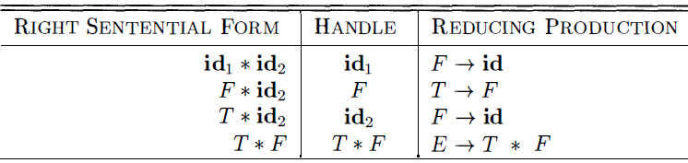
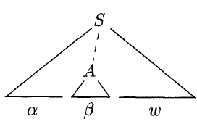
5.1 Bottom-Up Parsing – Handle Pruning
Bottom-up parsing during a left-to-right scan of the input constructs a rightmost derivation in reverse. Informally, a "handle" is a substring that matches the body of a production, and whose reduction represents one step along the reverse of a rightmost derivation.
rm
rm
rm
rm
rm
Formally, if then the production in the position following is a handle of . Notice that the string to the right of the handle must contain only terminal symbols. For convenience, we refer to the body rather than as a handle.
A rightmost derivation in reverse can be obtained by "handle pruning”.

Slide 7
5.1 Bottom-Up Parsing – More Explanations on “Handle”
Right-most derivation is also called “normal derivation”, which guarantees
Proof. if has a handle , i.e, and , then under the rightmost derivation should not be derived out before .
If has the form and , we do not call “handle”, because for right-sentential form then last rightmost derivation is , i.e., is previously derived out to . Thus, the reverse of the last rightmost derivation should take place on .
Thus, a handle is at the leftmost position of a right-sentential form.
Note we say "a handle" rather than "the handle," because the grammar could be ambiguous, with more than one rightmost derivation of . If a grammar is unambiguous, then every right-sentential form of the grammar has exactly one handle.
No handle

Slide 8
5.1 Bottom-Up Parsing – More Explanations on “Handle”
Normal Reduction is a reverse of a Normal derivation (rightmost derivation).
Specifically, is a sentence of grammar G, we call the sequence of sentential forms is a Normal Reduction of , if the sequence satisfies:
(1)
(2) (start symbol of a grammar)
(3) For , can be obtained by replacing the handle of with the left part of its corresponding production.
Thus, Normal Reduction is also called leftmost reduction !

Slide 9


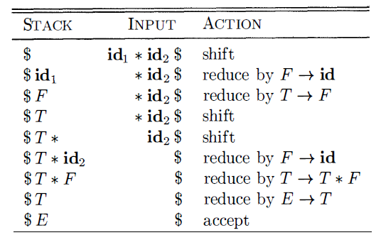
5.1 Bottom-Up Parsing – Shift-Reduce Parsing
Shift-reduce parsing is a form of bottom-up parsing in which a stack holds grammar symbols and an input buffer holds the rest of the string to be parsed.

Slide 10
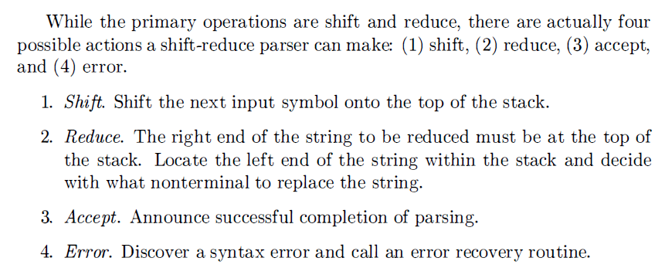
5.1 Bottom-Up Parsing – Shift-Reduce Parsing

Slide 11
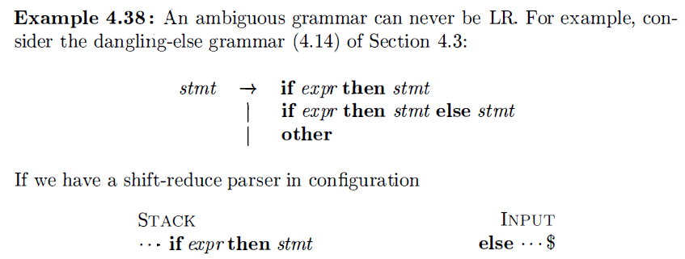
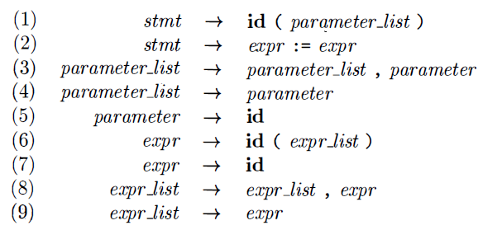


5.1 Bottom-Up Parsing – Conflicts During Shift-Reduce Parsing
Shift/reduce conflict
Reduce/reduce conflict

Slide 12
5.2 Introduction to LR Parsing: Simple LR
The 'most prevalent type of bottom-up parser today is based on a concept called LR(k) parsing; the "L" is for left-to-right scanning of the input, the "R" for constructing a rightmost derivation in reverse, and the k for the number of input symbols of lookahead that are used in making parsing decisions. The cases k = 0 or k = 1 are of practical interest, and we shall only consider LR parsers with k ≤1 here. When (k) is omitted, k is assumed to be 1 .
LR parsing is attractive for a variety of reasons:
LR parsers can be constructed to recognize virtually all programming language constructs for which context-free grammars can be written. Non LR context-free grammars exist, but these can generally be avoided for typical programming-language constructs.
The LR-parsing method is the most general nonbacktracking shift-reduce parsing method known, yet it can be implemented as efficiently as other, more primitive shift-reduce methods
An LR parser can detect a syntactic error as soon as it is possible to do so on a left-to-right scan of the input.
The class of grammars that can be parsed using LR methods is a proper superset of the class of grammars that can be parsed with predictive or LL methods.
The principal drawback of the LR method is that it is too much work to construct an LR parser by hand for a typical programming-language grammar.

Slide 13
5.2 Introduction to LR Parsing: Simple LR
Items and the LR(0) Automaton
An LR parser makes shift-reduce decisions by maintaining states to keep track of where we are in a parse. States represent sets of "items." An LR(0) item (item for short) of a grammar G is a production of G with a dot at some position of the body. Thus, production yields the four items
For , we only have .
The item indicates that we hope to see a string derivable from XYZ next on the input. Item indicates that we have just seen on the input a string derivable from X and that we hope next to see a string derivable from YZ. Item indicates that we have seen the body XYZ and that it may be time to reduce XYZ to A.
One collection of sets of LR(0) items, called the canonical LR(0) collection,
provides the basis for constructing a deterministic finite automaton that is used
to make parsing decisions.

Slide 14
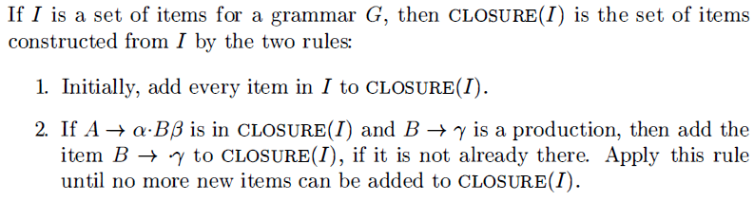
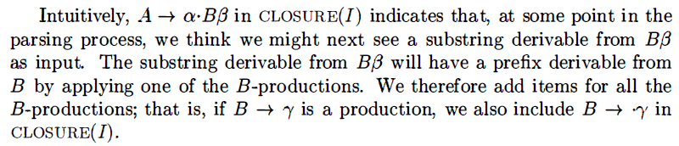
5.2 Introduction to LR Parsing: Simple LR
To construct the canonical LR(0) collection for a grammar, we define an augmented grammar and two functions, CLOSURE and GOTO . If G is a grammar with start symbol S, then G' , the augmented grammar for G, is G with a new start symbol S' and production . The purpose of this new starting production is to indicate to the parser when it should stop parsing and announce acceptance of the input. That is, acceptance occurs when and only when the parser is about to reduce by .
Closure of Item Sets

Slide 15
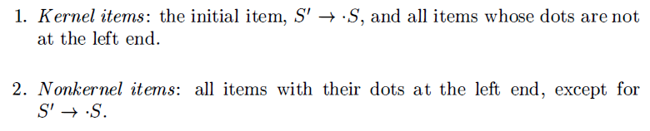
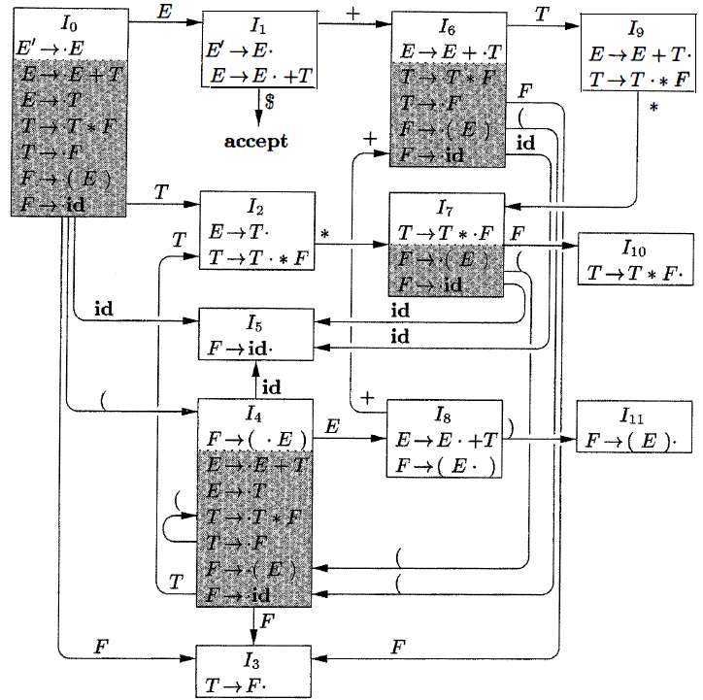
5.2 Introduction to LR Parsing: Simple LR

Slide 16
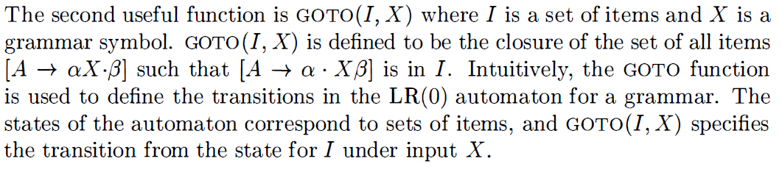
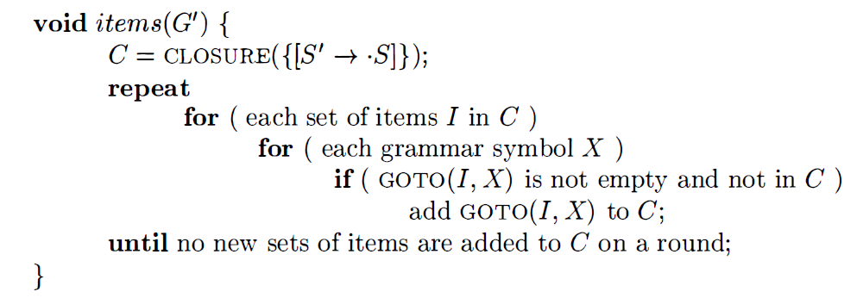
5.2 Introduction to LR Parsing: Simple LR
The Function GOTO

Slide 17
5.2 Introduction to LR Parsing: Simple LR
Use of the LR(0) Automaton
The central idea behind "Simple LR," or SLR, parsing is the construction from the grammar of the LR(0) automaton. The states of this automaton are the sets of items from the canonical LR(0) collection, and the transitions are given by the GOTO function.
Shift-reduce decisions can be made as follows. Suppose that the string “γ” of grammar symbols takes the LR(0) automaton from the start state 0 to some state j . Then, shift on next input symbol a if state j has a transition on a. Otherwise, we choose to reduce; the items in state j will tell us which production to use.

Slide 18
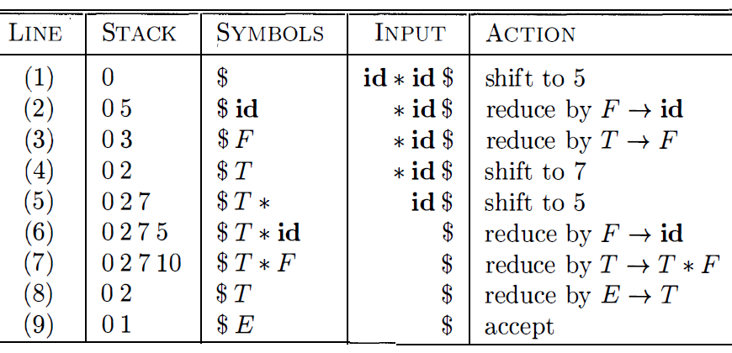
5.2 Introduction to LR Parsing: Simple LR
0
$
id
05
$id
05
$F
X
0
$F
03
$F
X
$T
03
0
$T
02
$T

Slide 19
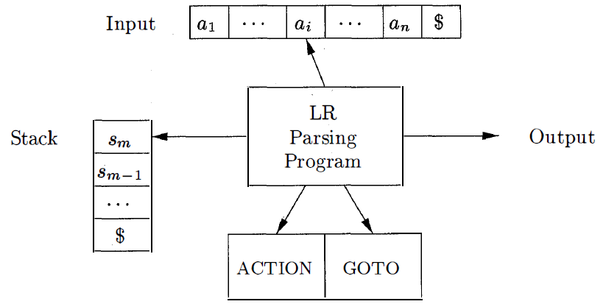
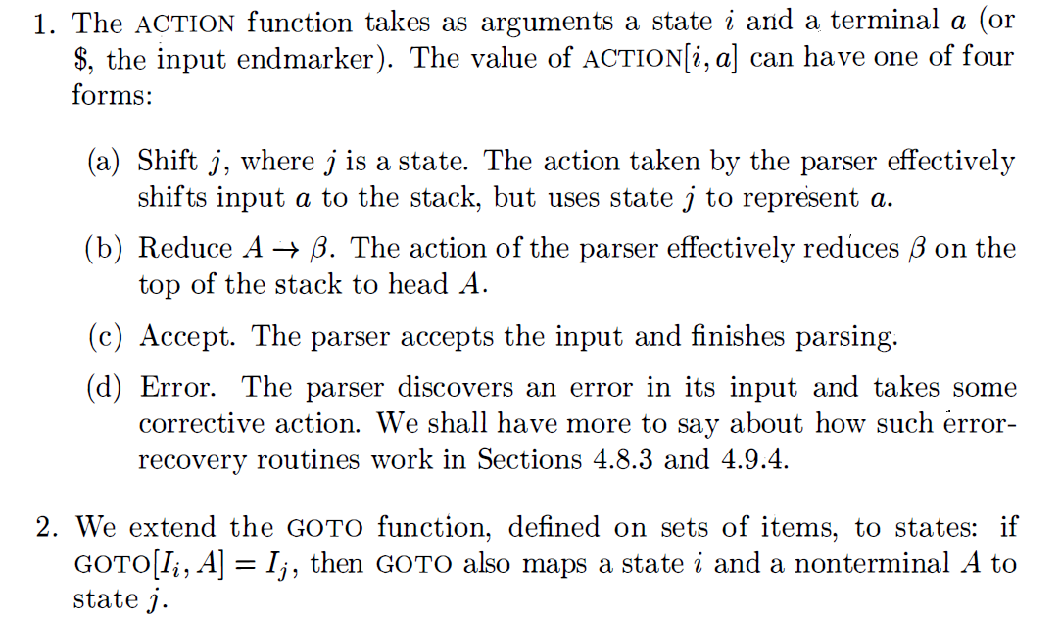
5.3 The LR-Parsing Algorithm
The model of LR Parser

Slide 20
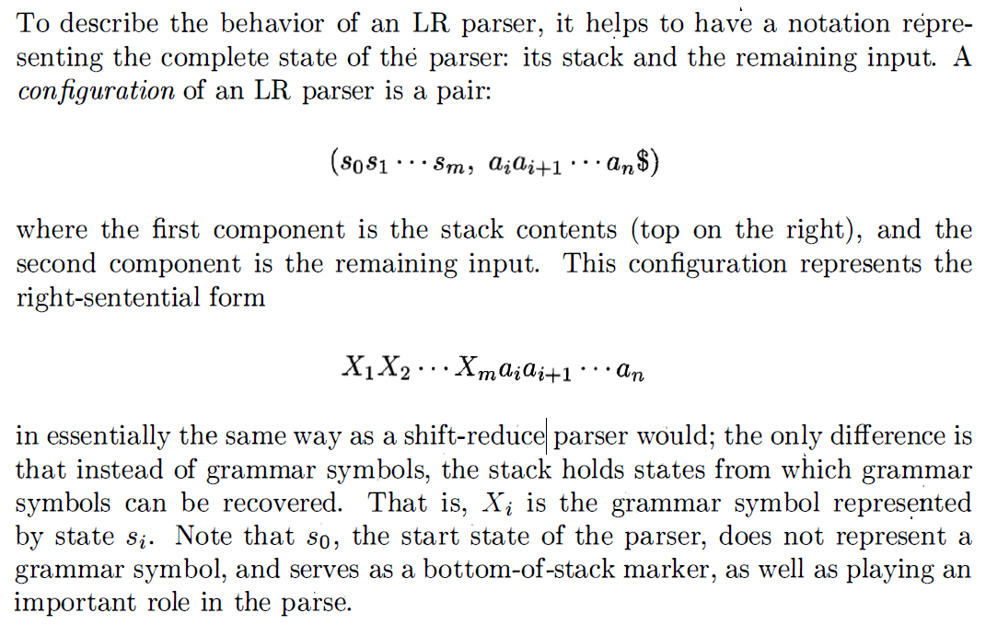
5.3 The LR-Parsing Algorithm
LR-Parser Configurations
Stack
Input

Slide 21
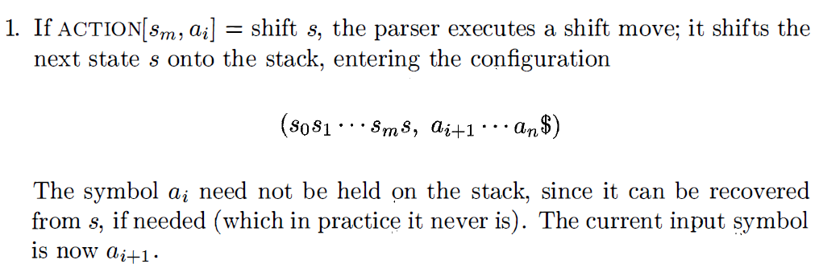
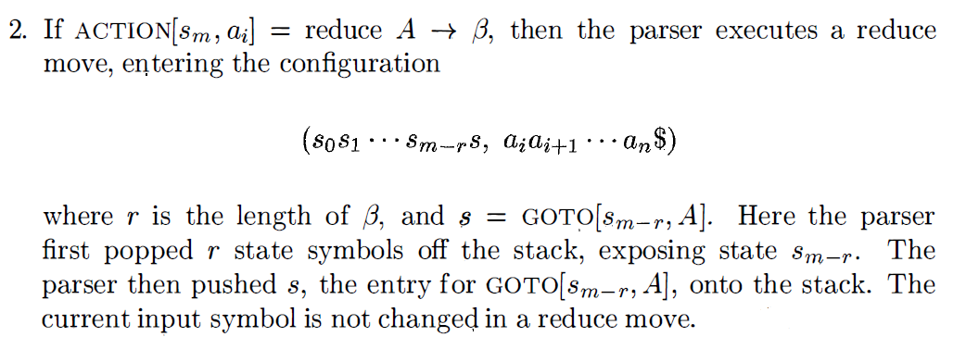
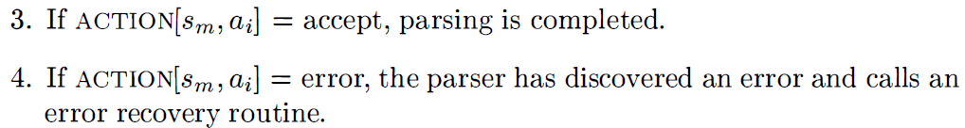
5.3 The LR-Parsing Algorithm
Behavior of the LR Parser

Slide 22
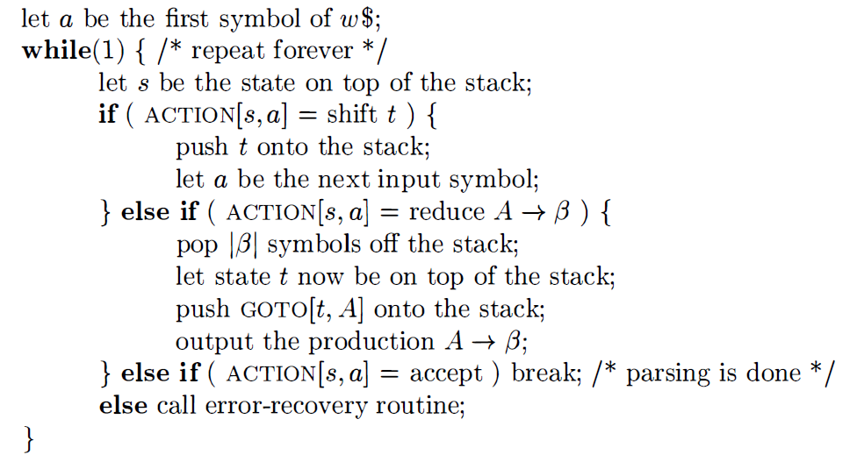
5.3 The LR-Parsing Algorithm

Slide 23
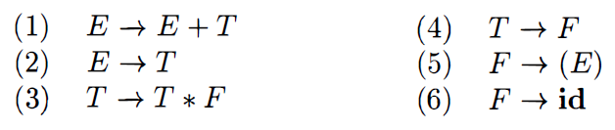
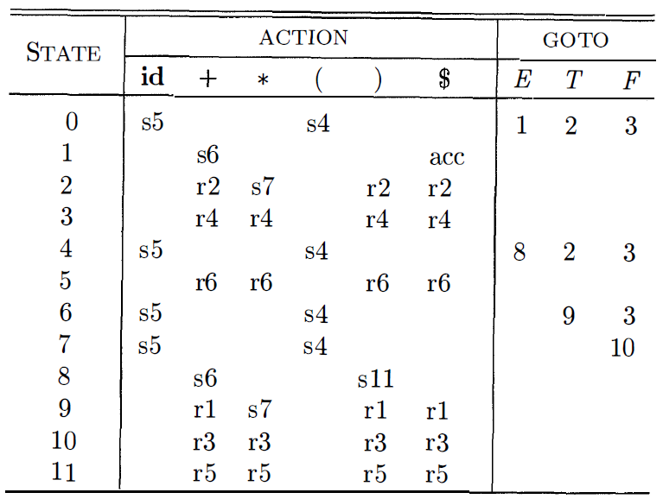
5.3 The LR-Parsing Algorithm

Slide 24
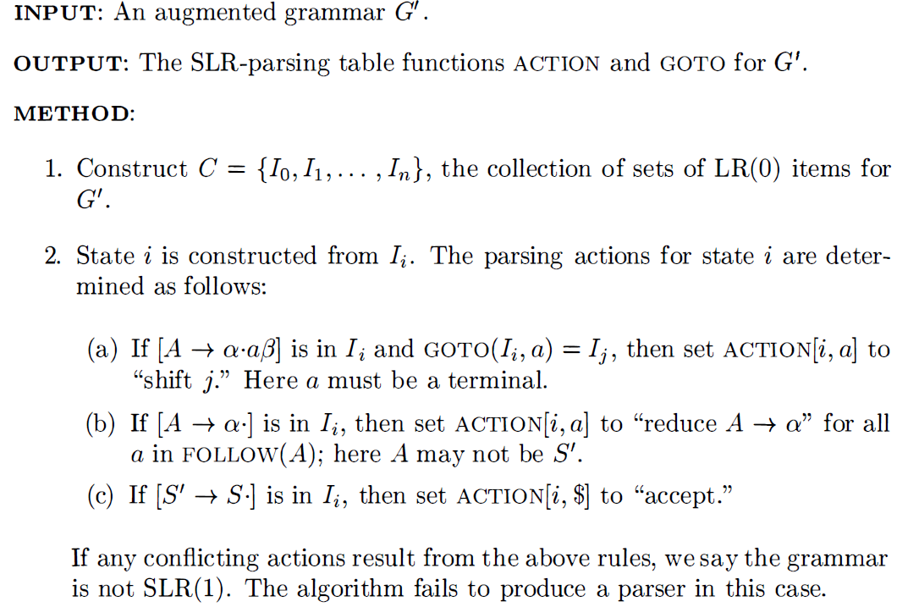
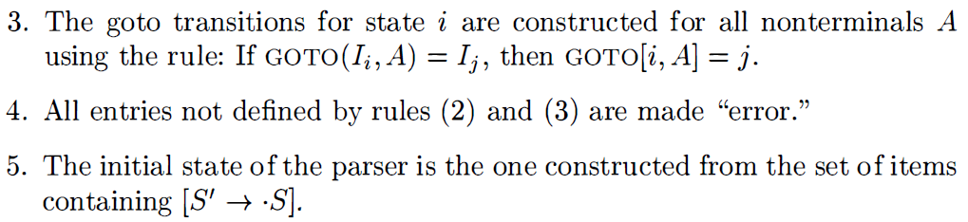
5.3 The LR-Parsing Algorithm
Constructing an SLR-parsing table
The SLR method begins with LR(0) items and LR(0) automata

Slide 25
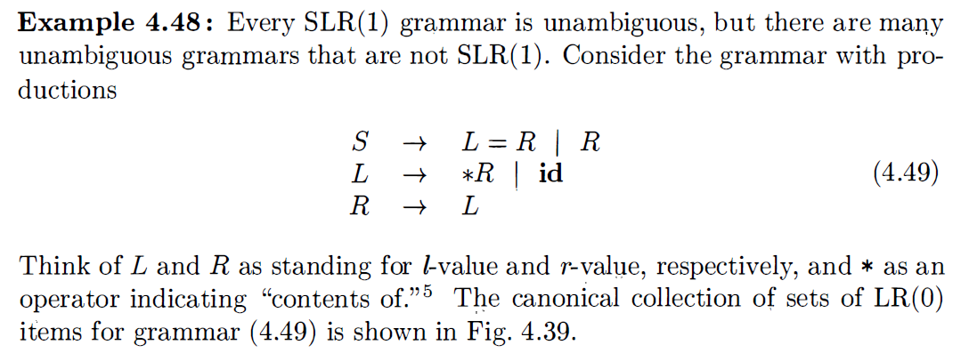
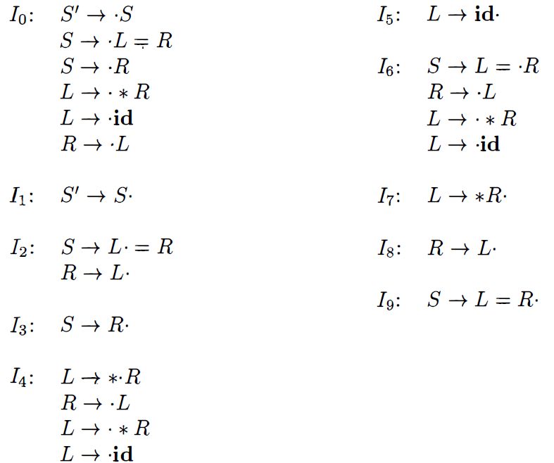
5.3 The LR-Parsing Algorithm

Slide 26
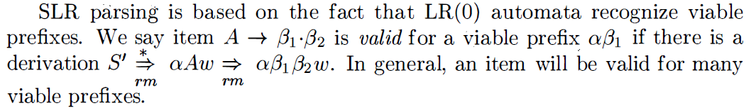
5.3 The LR-Parsing Algorithm
Viable Prefixes
The stack contents must be a prefix of a right-sentential form. If the stack holds and the rest of the input is x, then a sequence of reductions will take to S. In terms of derivations .
Not all prefixes of right-"sentential forms can appear on the stack, however, since the parser must not shift past the handle.
The prefixes of right sentential forms that can appear on the stack of a shift-reduce parser are called viable prefixes.

Slide 27
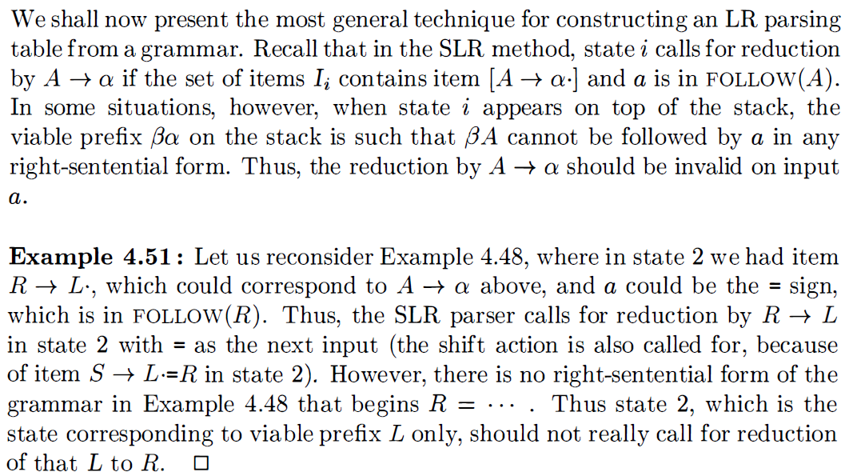

5.4 Canonical LR: LR(1)
Canonical LR(1) Items

Slide 28
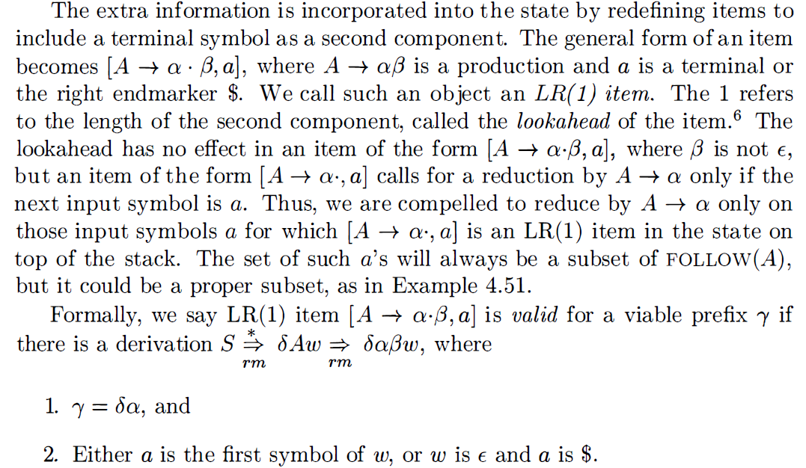
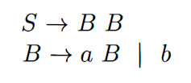
5.4 Canonical LR: LR(1)
Eg.

Slide 29
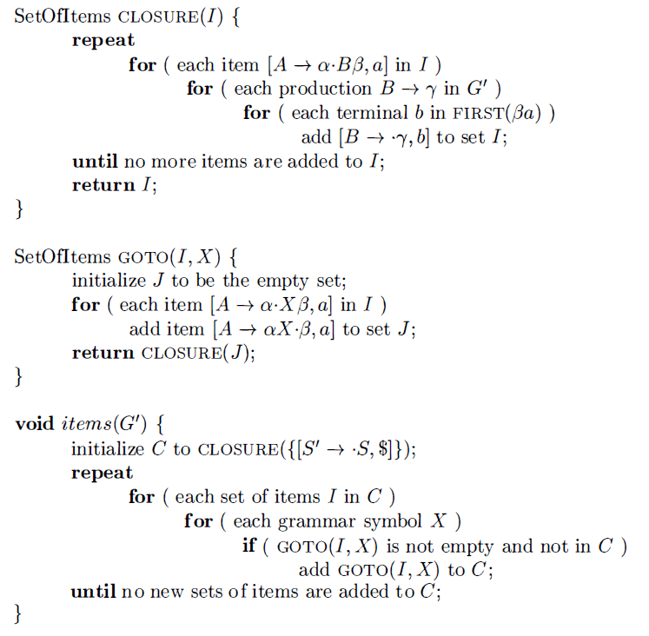
5.4 Canonical LR: LR(1)
Constructing LR(1) Sets of Items
Eg.

Slide 30
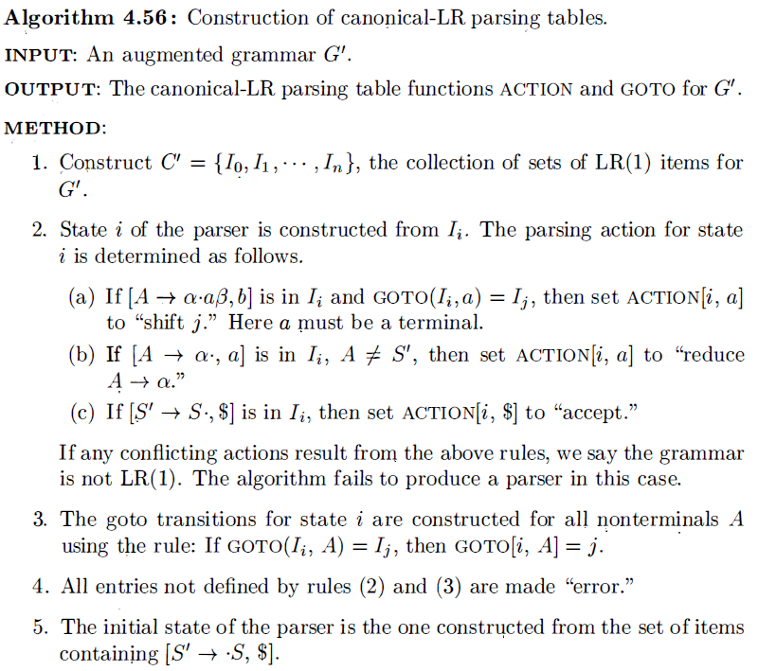
5.4 Canonical LR: LR(1)
Canonical LR( l ) Parsing Tables

Slide 31
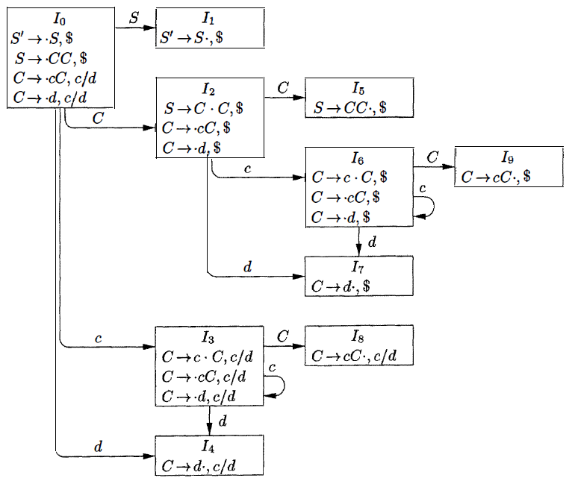
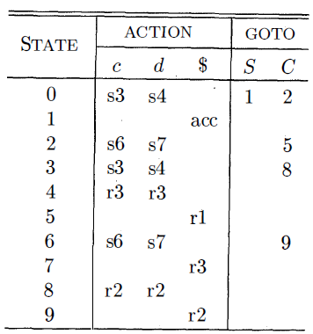
5.4 Canonical LR: LR(1)

Slide 33
Homework 5

