Slide 1
Software Project Management
Jing Zhang Ph.D.

Slide 2
Software Quality
Objectives:
Explain the importance of software quality to software users and developers;
Define the qualities of good software;
Design methods of measuring the required qualities of software;
Monitor the quality of the processes in a software project;
Use external quality standards to ensure the quality of software acquired from an outside supplier.

Slide 3
Quality is generally agreed to be ‘a good thing’.
Some objectives could relate to the qualities of application to be delivered.
Installation standards and procedures are related to quality.
Application to be implemented has special quality requirements.
The entry, exit and process requirements are identified for each activity, which is related to process quality.
Overall quality aspects of the project plan are reviewed.

Slide 4
The importance of software quality
Increasing criticality of software. The final customer or user is naturally anxious about the general quality of software, especially its reliability.
The intangibility of software can make it difficult to know that a project task was completed satisfactorily. Task outcomes can be made tangible by demanding that the developer produce ‘deliverables’ that can be examined for quality.
Accumulating errors during software development In general, the later in a project that an error is found the more expensive it will be to fix. In addition, because the number of errors is unknown, the debugging phase of a project are particularly difficult to control.

Slide 5
Defining software quality
The quality requirements state how well the system is to operate.
Some qualities of a software product reflect the external view of software held by users. These external qualities have to mapped to internal factors of which the developers would be aware.
Measure the quality
A good measure must relate the number of units to the maximum possible.
Measures for a particular quality helps to clarify and communicate what that quality really is.
The measures may be direct
The measures may be indirect. E.g., the number of enquiries by users

Slide 6
Defining software quality
Quality specification
Definition of the quality characteristic
Scale: the unit of measurement
Test: the practical test of the extent to which the attribute quality exists;
Minimal acceptable: the worst value which might be acceptable if other characteristics compensated for it
Target range: the range of values within which it should lie
Now: the value that applies currently
There could be several measures applicable to a quality characteristic, E.g., reliability
Availability: the percentage of a particular time interval that a system is usable;
Mean time between failures: the total service time divided by the number of failures;
Failure on demand: the probability that a system will not be available at the time required or the probability that a transaction will fail.
Support activity: the number of fault reports that are generated and processed.

Slide 7
ISO 9126
The ISO 9126 standard was first introduced in 1991 to tackle the question of the definition of software quality.
Six major external software quality characteristics
Characteristic | Description
Functionality | To satisfy user needs
Reliability | The capability of the software to maintain tis level of performance
usability | The effort needed to use the software
Efficiency | The physical resources used when the software is executed
Maintainability | The effort needed to the make changes to the software
Portability | The ability of the software to be transferred to a different environment.

Slide 8
ISO 9126
ISO 9126 suggests sub-characteristics for each of the primary characteristics. They clarify what is meant by each of the main characteristics.
Characteristic | Sub-characteristics
Functionality | Suitability
 | Accuracy
 | Interoperability
 | Functionality compliance
 | Security
Reliability | Maturity
 | Fault tolerance
 | Recoverability
 | Reliability compliance

Slide 9
ISO 9126
Characteristic | Sub-characteristics | Characteristic | Sub-characteristics
Usability | Understandability | Maintainability | Analyzability
 | Learnability |  | Changeability
 | Operability |  | Stability
 | Attractiveness |  | Testability
 | Usability compliance |  | Maintainability compliance
Efficiency | Time behavior | Portability | Adaptability
 | Resource utilization |  | Installability
 | Efficiency compliance |  | Coexistence
 |  |  | Replaceability
 |  |  | Portability compliance

Slide 10
ISO 9126
Once the requirements for the software product have been established, the following steps are suggested:
Judge the importance of each quality characteristic for the application
Select the external quality measurements within the ISO 9126
Map measurements onto ratings that reflect user satisfaction
Identify the relevant internal measurements and the intermediate products in which they appear.
E.g., response time = sum(all internal instructions)
Overall assessment of product quality.
Response time (sec) | Description
<2 | Exceeds expectation
2-5 | Within the target range
6-10 | Minimally acceptable
>10 | Unacceptable

Slide 11
Product v.s. process quality
It is often easier to measure the product qualities in a completed application rather than during its development. Trying to use the attributes of intermediate products created at earlier stages to predict the quality of the final application is difficult. An alternative approach is to scrutinize the quality of processes used to develop products.
Errors not removed at early stages become more expensive to correct at later stage.
Errors should be eradicated by careful examination of the deliverable of each step before they are passed on.
For each step, there is process requirements
Entry requirements, have to be in place before an activity can start
Implementation requirements, how the process is to be conducted
Exit requirement, which have to be fulfilled before an activity is deemed to have been completed.

Slide 12
Quality management systems
The ISO 9000 series
The ISO 9000 series try to ensure that a monitoring and control system to check quality is in place. They are concerned with the certification of the development process, not of the end-product.
The ISO 9000 series relate to quality systems in general not just those in software development
ISO 9000: describes the fundamental features of a quality management system (QMS)
ISO 9001: describes how a QMS can be applied to the creation of products and the provision of services
ISO 9004: applies to process improvement.

Slide 13
Process capability models
Capability Maturity Model (CMM) , by the Software Engineering Institute (SEI) at Carnegie-Mellon University. (new version CMM Integration)
These models place organizations at one of five levels of process maturity which indicate the sophistication and quality of their production practices.

Slide 14
CMMI
Level 1: Initial The procedures followed tend to be haphazard.
Level 2: Managed have basic project management procedures in place.
Level 3: Defined has defined the way that each task in the software development life cycle should be done.
Level 4: Quantitatively The products and processes involved in software development are subject to measurement and control.
Level 5: Optimizing Improvement in procedures can be designed and implemented using the data gathered from the measurement process.

Slide 15
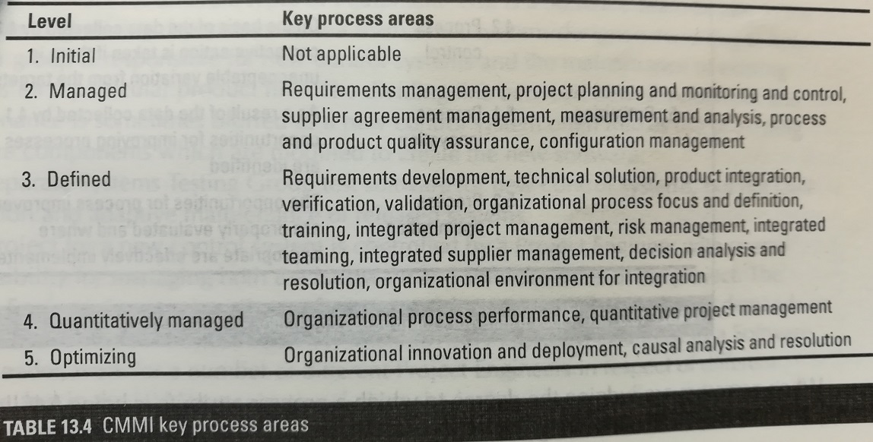
CMMI-Key Process Areas (KPAs)
For each of the levels, apart from the default level 1, key process areas (KPAs) have been identified as distinguishing the current level from the lower ones.

Slide 16
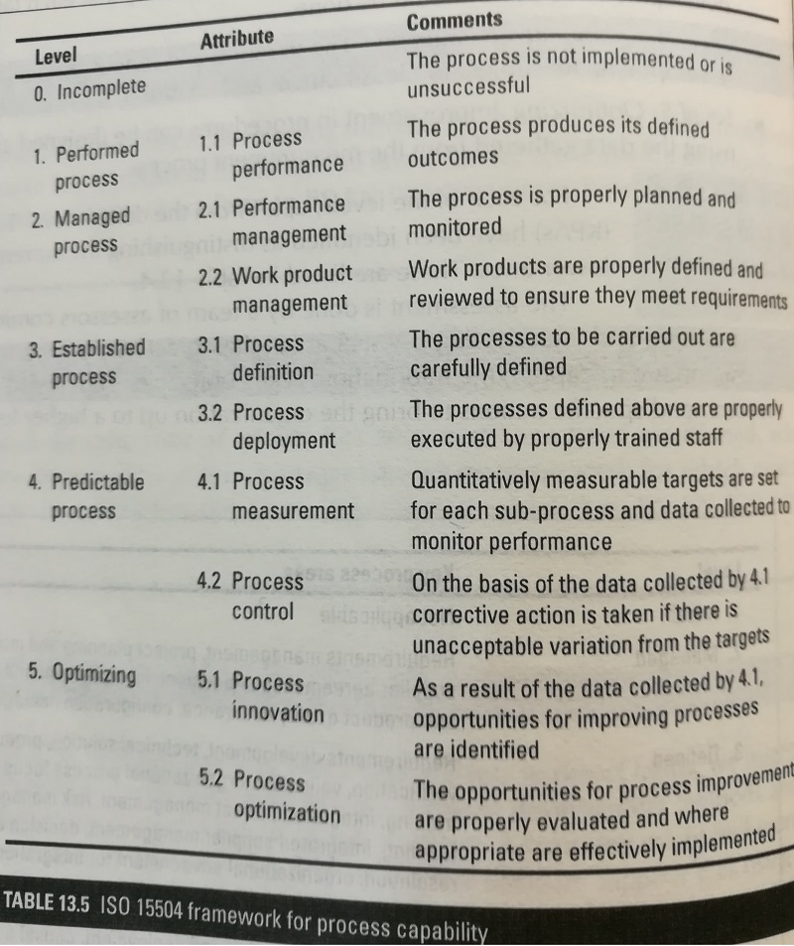
ISO 15504 Process assessment
ISO/IEC 15504 is a standard for process assessment that shares many concepts with CMMI. The two standards should be compatible.

Slide 17
Techniques to help enhance software quality
Increasing visibility looking at each other’s code.
Procedural structure There has been the growth of methodologies where every process in the software development cycle has carefully laid down steps.
Checking intermediate stages The move towards quality practices has emphasized checking the correctness of work at its earlier, conceptual, stages.

Slide 18
Inspections
Inspections can be applied to documents produced at any development stage.
When a piece of work is completed, copies are distributed to co-workers who examine the work, noting defects.
Experience
It is a very effective way of removing superficial errors;
It motivates developers to produce better structured and self-explanatory software
It helps spread good programming practices as the participants discuss specific pieces of code
It can enhance team spirit.

Slide 19
Fagan inspection
IBM made the review process more structured and formal, producing statistics to show its effectiveness. A Fagan inspection is led, not by the author of the work, but by a specially trained ‘moderator’
The general principles behind the Fagan method
Inspections are carried out on all major deliverables
All types of defect are noted-not just logic or function errors
Inspections are carried out by colleagues at all levels except the very top
Inspections are carried out using a predefined set of steps
Inspection meetings do not last for more than two hours
The inspection is led by a moderator who has had specific training in the technique
The other participants have defined roles
Checklists are used to assist the fault-finding process
Material is inspected at an optimal rate of about 100 lines an hour
Statistics are maintained so that the effectiveness of the inspection process can be monitored.

Slide 20
Structured programming and clean-room software development
The way to deal with complex systems is to break them down into components of a size the human mind could comprehend.
The ideas of structured programming have been further developed into the ideas of clean-room software development. There are three separate teams:
A specification team, which obtains the user requirements and also a usage profile estimating the volume of use for each feature in the system;
A development team, which develops the code but which does no machine testing of the program code produced;
A certification team, which carries out testing.

Slide 21
Formal method
formal methods are a particular kind of mathematically based techniques for the specification, development and verification of software systems.
Z notation, describing and modelling computing systems
E.g.
Unused
1 3 4 6 9
used
2 5 7 8 10 11 12
When file is deleted
F1
2
F2
5 7 8
F3
9

Slide 22
Formal method
Used->free
tail

Slide 23
Testing
E.g. V-process for waterfall model
Feasibility Study
Corrections
Review
User requirement
Corrections
User acceptance
System design
Corrections
System testing
Program design
Corrections
Program testing
Code

Slide 24
Quality plans
Purpose- scope of plan
List of reference to other document
Management arrangements, including organization, tasks and responsibilities
Documentation to be produced
Standards, practices and conventions
Reviews and audits
Testing
Problem reporting and corrective action
Tools, techniques and methodologies
Code, media and supplier control
Records collection, maintenance and retention
Training;
Risk management – the method of risk management that are to be used.

Slide 25
Software Quality in Organization
Some concepts
Software Quality Control (SQC) is the set of procedures used by organizations to ensure that a software product will meet its quality goals at the best value to the customer, and to continually improve the organization's ability to produce software products in the future.
Scientific methods for measuring the status of quality
Software Quality Assurance (SQA) is a process that ensures that developed software meets and complies with defined or standardized quality specifications. SQA is an ongoing process within the software development life cycle that routinely checks the developed software to ensure it meets desired quality measures.
A set of quality specifications.
The aim of Software Quality Management (SQM) is to manage the quality of software and of its development process.

Slide 26
Organizational Guarantee for Quality
Has a strong sense of ‘quality first’
Management Level
Project Team
SPEG Group
Test Team
SQA Group
conduct a comprehensive in-depth test
Track, control, improve quality from process
Promote enterprise process definition, maintenance and improvement.

Slide 27
SPEG
A Software Engineering Process Group (SEPG) is an organization's focal point for software process improvement activities. These individuals perform assessments of organizational capability, develop plans to implement needed improvements, coordinate the implementation of those plans, and measure the effectiveness of these efforts.
Obtains and maintains the support of all levels of management.
Facilitates software process assessments.
Works with line managers whose projects are affected by changes in software engineering practice, providing a broad perspective of the improvement effort and helping them set expectations.
Maintains collaborative working relationships with software engineers, especially to obtain, plan for, and install new practices and technologies.
Arranges for any training or continuing education related to process improvements.
Tracks, monitors, and reports on the status of particular improvement efforts.
Facilitates the creation and maintenance of process definitions, in collaboration with managers and engineering staff.
Maintains a process database.
Provides process consultation to development projects and management.

Slide 28
Software Reviews
A software review is "A process or meeting during which a software product is examined by a project personnel, managers, users, customers, user representatives, or other interested parties for comment or approval“
Software peer reviews are conducted by the author of the work product, or by one or more colleagues of the author, to evaluate the technical content and/or quality of the work.
Software management reviews are conducted by management representatives to evaluate the status of work done and to make decisions regarding downstream activities.
Software audit reviews are conducted by personnel external to the software project, to evaluate compliance with specifications, standards, contractual agreements, or other criteria.

Slide 29
Different types of Peer reviews
Code review is systematic examination (often as peer review) of computer source code.
Pair programming is a type of code review where two persons develop code together at the same workstation.
Inspection is a very formal type of peer review where the reviewers are following a well-defined process to find defects.
Walkthrough is a form of peer review where the author leads members of the development team and other interested parties through a software product and the participants ask questions and make comments about defects.
Technical review is a form of peer review in which a team of qualified personnel examines the suitability of the software product for its intended use and identifies discrepancies from specifications and standards.

Slide 30
Roles in review
Role | Responsibilities
author | State the purpose of the review Submit the work product to the reviewer Corresponds to the items on the problem log and error list Report the rework time and the number of defects to the reviewer
Team Leader | Plan, organize and organize review activities Select the reviewers and assign roles Coordinate review meeting Lead the review team to determine the outcome of the work product evaluation
Reader | Present the work products to the review panel, direct the reviewers to comment, ask questions
Recorder | Record and sort the questions raised in the review meeting
Reviewer | Identify product defects, participate in review meetings, ask questions, give suggestions for changes
Approver | Perform a trace to verify that rework is being performed correctly.
Coordinator | Review the owner of the metric database. According to the database to form a report, submitted to the management, process improvement group and the peer review process owner.

Slide 31
Clarify the differences
Role/responsibility | inspection | review | Walkthrough
host | Team Leader | Team Leader or reviewer | author
Presentation | reviewer | Team Leader | author
recorder | Yes | Yes | May be
Having special roles for review | Yes | Yes | No
Checklist | Yes | Yes | No
Tracking and analysis | Yes | May be | No
Evaluation of product | Yes | Yes | No

Slide 32
Procedure of Review
can enter into review?
Plan
Overview Introduction
problem
report
Review
Review analysis
Suggestion for process improvement
Problem solving
Meet the needs?
Tracking

Slide 33
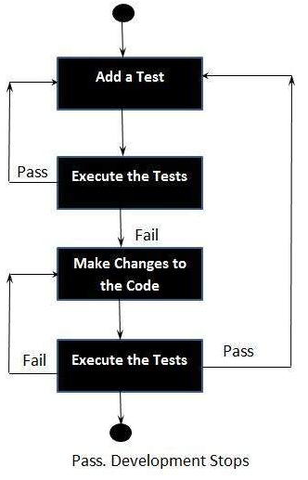
Defect prevention and tracking
Defect prevention
Test-driven Development
Much less debug time
Code proven to meet requirements
Tests become Safety Net
Near zero defects
Shorter development cycles

Slide 34
Defect tracking and analysis
Where Found
product, release, version, hardware, os, drivers, general area
Who Found It
customer, internal, when
Description of the Defect
summary, description, how to reproduce, associated data
links to related defects or features
Triage
severity, likelihood → priority
Audit Trail
all changes to the defect data, by whom, when
State
state, owner

Slide 35
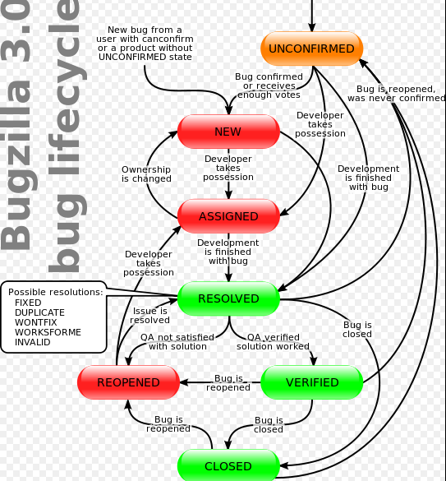
Bug tracking

Slide 36
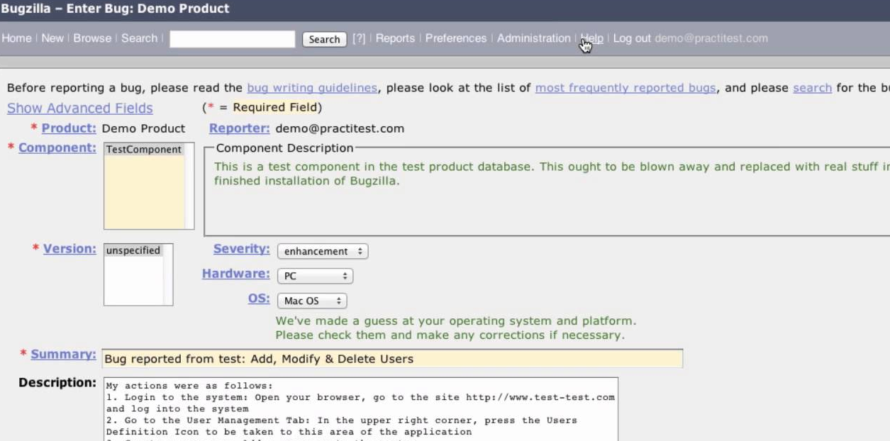
Bug tracking tools
MantisBT, Bugzilla, BugFree

Slide 37
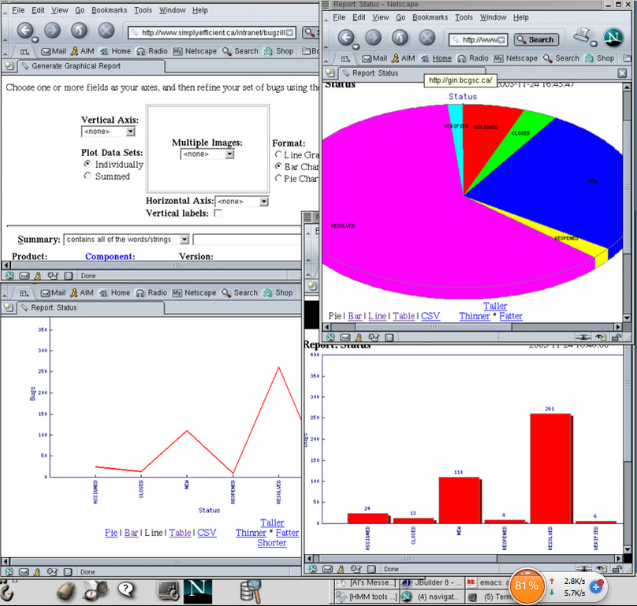
Bug tracking tools-analysis
MantisBT, Bugzilla, BugFree

Slide 38
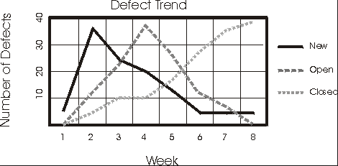
Measures for process quality
Density In Process Faults, DIPF
DIPF = D_{n}/S_{p}
D_{n} number of defects found
S_{p} the size of product to be tested
Defect Removal Efficiency

Slide 39
Conclusion
Quality by itself is a vague concept and practical quality requirements have to be carefully defined.
There have to be practical ways of testing for the relative presence or absence of quality
Most of the qualities that are apparent to the users of software can only be tested for when the system is completed.
Therefore ways are needed of checking during development what the quality of the final system is likely to be.
Some quality-enhancing techniques concentrate on testing the products of the development process, while others try to evaluate the quality of the development processes used.

