Slide 1

Compilers
Principles, Techniques, & Tools
Taught by Jing Zhang
(jzhang@njust.edu.cn)

Slide 2
Lexical Analysis

Slide 3
Outlines
The Construction of a Lexical Analyzer
Regular Expression, Regular Set
Transition Diagram
DFA and NFA
Conversion of an NFA to a DFA
Minimization of DFA
The Conversion of FA, Regular Expression, & Regular Grammar
The Lexical-Analyzer Generator

Slide 4
3.1 The Construction of a Lexical Analyzer
Lexical Analyzer reads input stream and then generator the sequence of tokens that are required by a parser.
token
Lexical Analyzer
Parser
getNextToken
Symbol Table
Sometimes, lexical analyzers are divided into a cascade of two processes:
a) Scanning consists of the simple processes that do not require tokenization of the input, such as deletion of comments and compaction of consecutive whitespace characters into one.
b) Lexical analysis proper is the more complex portion, where the scanner produces the sequence of tokens as output.

Slide 5
3.1 The Construction of a Lexical Analyzer
Lexical Analysis Versus Parsing
1 . Simplicity of design is the most important consideration. The separation of lexical and syntactic analysis often allows us to simplify at least one of these tasks. For example, a parser that had to deal with comments and whitespace as syntactic units would be. considerably more complex than one that can assume comments and whitespace have already been removed by the lexical analyzer. If we are designing a new language, separating lexical and syntactic concerns can lead to a cleaner overall language design.
2. Compiler efficiency is improved. A separate lexical analyzer allows us to apply specialized techniques that serve only the lexical task, not the job of parsing. In addition, specialized buffering techniques for reading input characters can speed up the compiler significantly. (Parsing is more complicated and slower)
3. Compiler portability is enhanced. Input-device-specific peculiarities can be restricted to the lexical analyzer.

Slide 6
3.1 The Construction of a Lexical Analyzer-token
Output of a lexical analyzer：token
Token is a 2-tuple
<name，attribute>
attribute：a point to an entry in Symbol Table
Token name
Keyword：if, while, switch, … (any keyword as a token name)
Identifier：variables, functions, classes… defined by users … (all identifiers have one token name id)
Constant：integer，float, Boolean，literature （Each type has a token name）
Operator：+, -, *, /, %, … （each operator has a token name or each type has a token）
Delimiter：;, {, /**/, … (each delimiter has as token name)

Slide 7
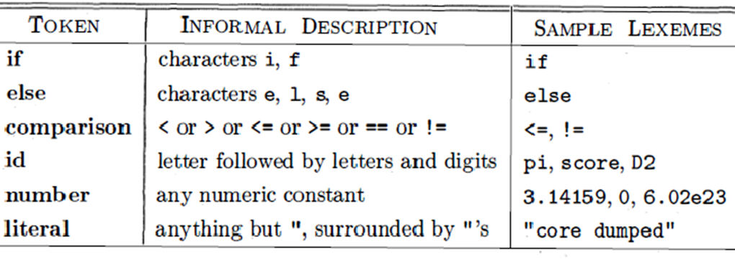
3.1 The Construction of a Lexical Analyzer-token
Token, Pattern and Lexemes
A token is a pair consisting of a token name and an optional attribute value. The token name is an abstract symbol representing a kind of lexical unit.
A pattern is a description of the form that the lexemes of a token may take. In the case of a keyword as a token, the pattern is just the sequence of characters that form the keyword. For identifiers and some other tokens, the pattern is a more complex structure that is matched by many strings.
A lexeme is a sequence of characters in the source program that matches the pattern for a token and is identified by the lexical analyzer as an instance of that token.

Slide 8
3.1 The Construction of a Lexical Analyzer-tokenization
while (i > j) {
k = j * 3.14;
}
<WHILE, ->
<LEFT_PAREN, ->
<ID, pointer to ST entry for i>
<REL_OP, GT>
<ID, pointer to ST entry for j>
<RIGHT_PAREN, ->
<LEFT_BRACE, ->
<ID, pointer to ST entry for k >
<OP_ASSIGN, ->
<ID, pointer to ST entry for j >
<OP_MULT, ->
<REAL, pointer to constant 3.14>
<SEMICOLON, ->
<RIGHT_BRACE,->

Slide 9
3.1 The Construction of a Lexical Analyzer-Lexical Errors
It is hard for a lexical analyzer to tell , without the aid of other components, that there is a source-code error.
The simplest recovery strategy is "panic mode" recovery. We delete successive characters from the remaining input, until the lexical analyzer can find a well-formed token at the beginning of what input is left.
Other possible error-recovery actions are:
(1) Delete one character from the remaining input.
(2) Insert a missing character into the remaining input.
(3) Replace a character by another character.
(4) Transpose two adjacent characters

Slide 10
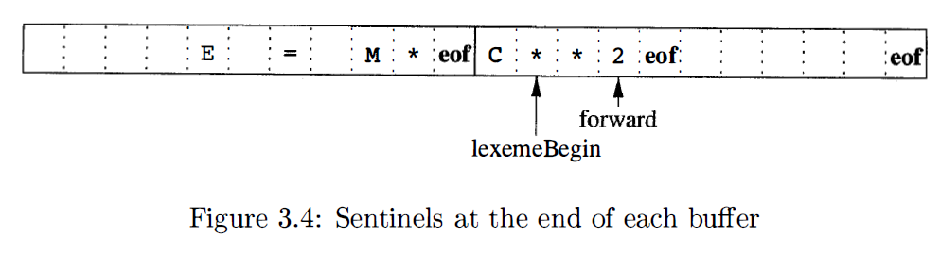
3.1 The Construction of a Lexical Analyzer-Input Buffering
Buffer Pairs
Used to extract lexemes from input streams
Sentinel
Using eof to indicate the end of buffer or input

Slide 11
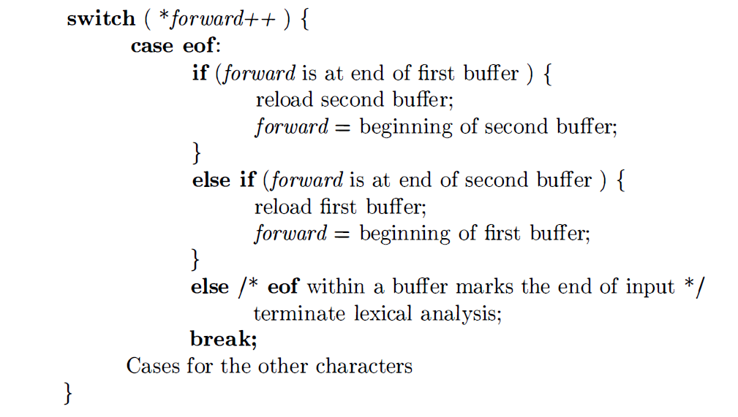
3.1 The Construction of a Lexical Analyzer-Lookahead code with sentinels

Slide 12
3.1 The Construction of a Lexical Analyzer-reading ahead
Keywords recognition
Identifiers
Usually do not need reading ahead
Constant recognition
5.EQ.M and 5.E08
Operators and Delimiters
++,--, /**, >=
1 DO 99 K = 1, 10
2 IF(5.EQ.M) I=10
3 DO 99 K = 1.10
4 IF(5)=55

Slide 13
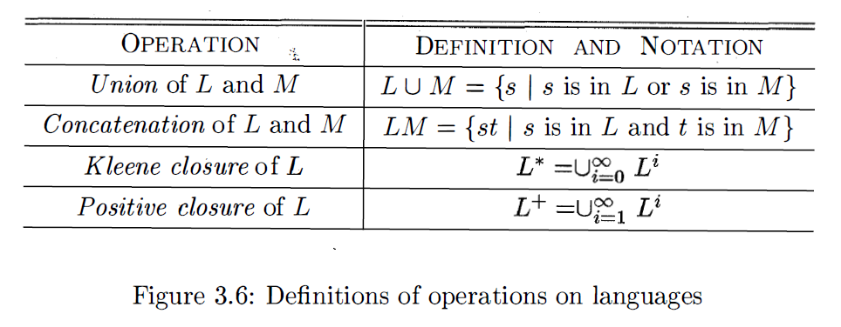
3.2 Regular Expression, Regular Set - Regular Expressions
Review – Operations on Languages
A language is any countable set of strings over some fixed alphabet.

Slide 14
3.2 Regular Expression, Regular Set - Regular Expressions
Regular Expressions over alphabet ∑ are recursively defined as follows：
（1）ε and ϕ are regular expressions， which represent language {ε} and ϕ respectively.
（2）for any a∊ ∑，a is a regular expression，and
（3）U and V are both regular expressions，whose represented languages are L(U) and L(V) respectively. Then，(U|V), (U⋅V) and (U)* are all regular expressions，whose represented languages are L(U)⋃L(V), L(U)L(V) and (L(U))*
Expressions that are defined by finitely applying the above laws are regular expressions. The string set that is only defined by regular expressions is called a regular set.
Precedence of operators：*，⋅，|

Slide 15
3.2 Regular Expression, Regular Set - Regular Expressions – Examples
∑={a, b}
1. ba* strings starting with b followed zero or more a
2. a(a|b)* strings starting with a
3. (a|b)*(aa|bb)(a|b)* strings containing two consecutive a (or b)
4. (aa|bb)*((ab|ba)(aa|bb)*(ab|ba)(aa|bb)*)*
5. (aa|bb|((ab|ba)(aa|bb)*(ab|ba)))*
Languages defined by 4 and 5 are strings that contain even numbers of a and even numbers of b.

