Slide 1

Exercise 2
Design Pattern

Slide 2
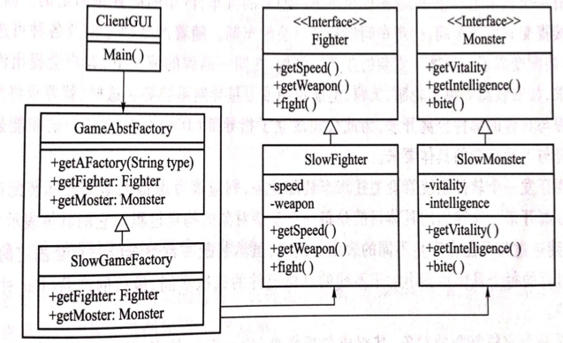
Exercise 2
1. The design class diagram shown in Figure 1 is about the design of game software. In this design, the SlowGameFactory class is responsible for creating the SlowFighter object and the SlowMonster object, and returns the created object as a superclass to the ClientGUI object. The ClientGUI object then manipulates the SlowFighter object and the SlowMonster object so that they fight each other.
Question:
a) What design pattern does the below design use?
b) Add four new classes MedFighter, SuperFighter, MedMonster, and SuperMonster to the below design class diagram to make the MedFighter object can correspond to the MedMonster object and the SuperFighter object can correspond to the SuperMonster object. Draw new design class diagram;

Slide 3
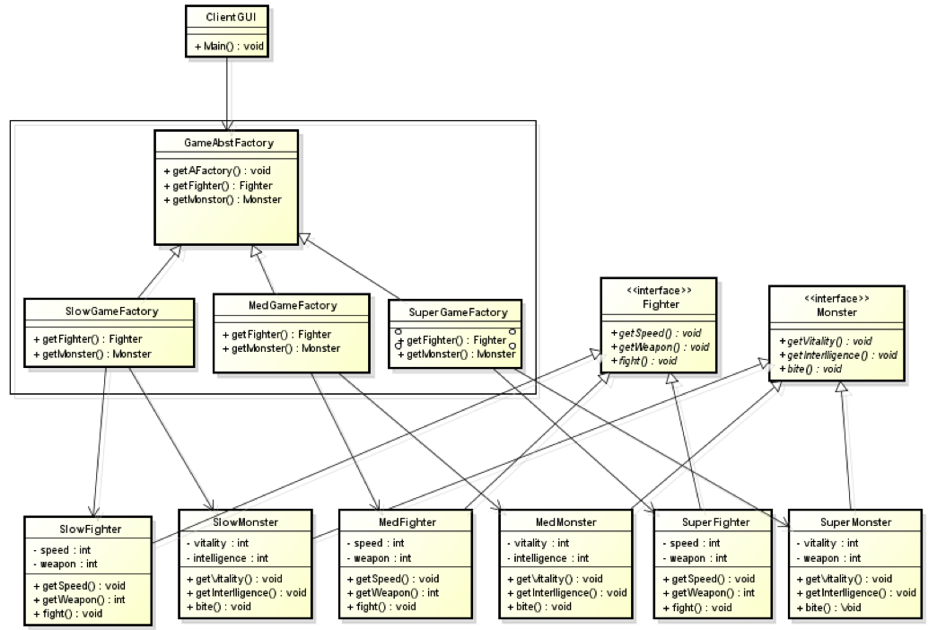
Exercise 2
1.a) Abstract factory pattern
b)

Slide 4
Exercise 2
2. Use singleton mode to design a printer management software. Each computer can have several printers, but only one Printer Spooler can be used to prevent two print jobs from being output to the printer at the same time. The client obtains an instance of Printer Spooler from the class and invokes the printJob(File job) of this instance.
Please draw a class diagram.

Slide 5
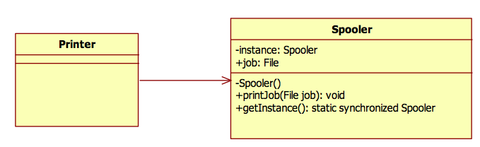
Exercise 2

Slide 6
Exercise 2
3. Use Composite mode to design a framework of Antivirus. This software can not only disinfect a Folder, but also disinfect a specified File. The file types include TextFile, ImageFile and VideoFile. Please draw a class diagram.

Slide 7
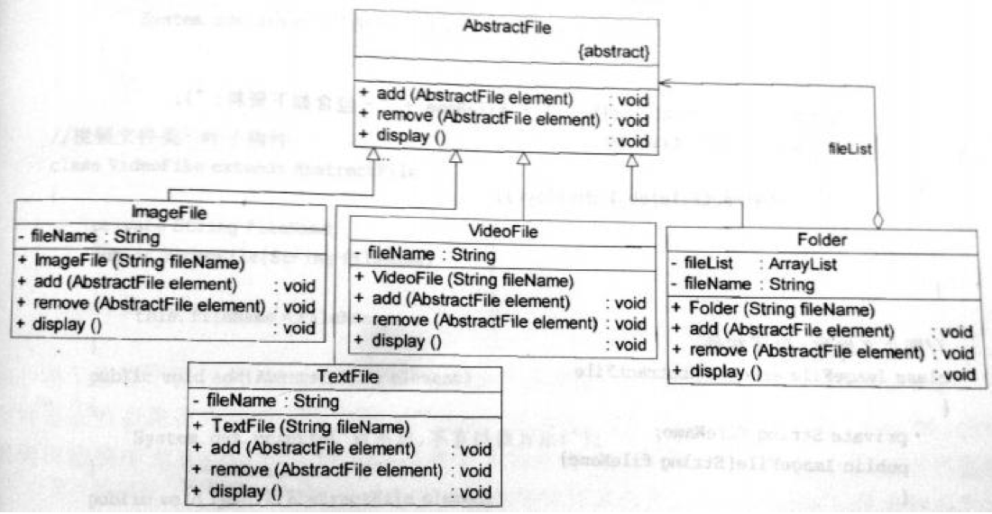
Exercise 2

Slide 8
Exercise 2
4. Develop a cross-platform video player that can play multiple formats of video files(such as MPEG, RMVB, AVI, WMV, and other common video formats) on different operating system platforms (such as Windows, Linux, UNIX, etc.),The Bridge pattern is now used to design the player.

Slide 9
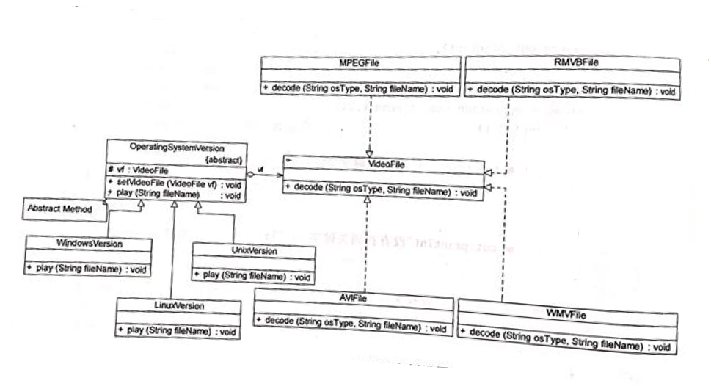
Exercise 2

Slide 10
Exercise 2
5. A movie ticketing system provides different discounts(Discount) for different types of users. Students can enjoy a 20% discount (StudentDiscount) with their student ID cards, children can enjoy a discount of RMB 10 (ChildrenDiscount), VIP users can also earn points in addition to a half price discount(VIPDiscount) . Use the Strategy pattern to design the system and draw the corresponding class diagram.

Slide 11
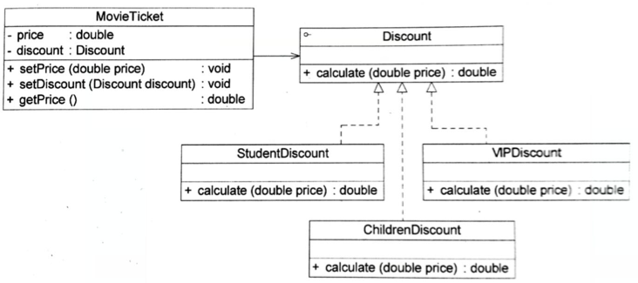
Exercise 2

