Slide 1

Compilers
Principles, Techniques, & Tools
Taught by Jing Zhang
(jzhang@njust.edu.cn)

Slide 2
Syntax Analysis – Top Down Method

Slide 3
Outlines
Context-free Grammar – review
Top-Down Parsing
Write Grammar for Top-Down Parsing
Recursive-Descent Parsing
LL(1) Grammar
Predictive Parsing for LL(1) Grammar
Error Recovery in Predictive Parsing

Slide 4
4.1 Context-free Grammar - review

Slide 5
4.1 Context-free Grammar - review
A grammar is a set of formal regulations that describes the syntax structures of a language.
A context-free grammar has four components
(1) A set of terminal symbols, sometimes referred to as "tokens." The terminals are the elementary symbols of the language defined by the grammar.
(2) A set of nonterminals, sometimes called "syntactic variables." Each nonterminal represents a set of strings of terminals.
(3) A set of productions, where each production consists of a nonterminal, called the head or left side of the production, an arrow, and a sequence of terminals and/or nonterminals , called the body or right side of the production. The intuitive intent of a production is to specify one of the written forms of a construct; if the head nonterminal represents a construct, then the body represents a written form of the construct .
(4) A designation of one of the nonterminals as the start symbol

Slide 6
4.1 Context-free Grammar - review
The context-free grammar G is a 4-tuple
V_{T} is a non-empty finite set, where each element is a terminal.
V_{N} is a non-empty finite set, where each element is a nonterminal,
S is a nonterminal, called start symbol
is as finite set of productions, where each production has the form . . S must appear in the left part of a production at least once.

Slide 7
4.1 Context-free Grammar - review
A parse tree pictorially shows how the start symbol of a grammar derives a string in the language. If nonterminal A has a production , then a parse tree may have an interior node labeled A with three children labeled X, Y, and Z, from left to right:
A
X
Y
Z
The root is labeled by the start symbol
Each leaf is labeled by a terminal or by .
Each interior node is labeled by a nonterminal
If A is the nonterminal labeling some interior node and X_{l} , X₂, • • • , X_{n} are the labels of the children of that node from left to right, then there must be a production . Here, X_{I} , X₂ , . . . , X_{n} each stand for for a symbol that is either a terminal or a nonterminal . As a special case, if is a production, then a node labeled A may have a single child labeled .
From left to right , the leaves of a parse tree form the yield of the tree , which is the string generated or derived from the nonterminal at the root of the parse tree. The process of finding a parse tree for a given string of terminals is called parsing that string.

Slide 8
4.2 Top-Down Parsing
Top-down parsing can be viewed as the problem of constructing a parse tree for the input string, starting from the root and creating the nodes of the parse tree in preorder (depth-first) . Equivalently, top-down parsing can be viewed as finding a leftmost derivation for an input string.
Consider the grammar
S->c A d
A->ab | a
Input string w=cad

Slide 9
4.2 Top-Down Parsing - Problems
1. Left Recursion
2. Backtracking is very time consuming. It will retract a lot tokens, reset the information in symbol table and discard also results in semantic analysis and code generation.
3. Ambiguity
Multiple choices are right. The results of the program is not deterministic.
We must make some changes to the grammar in case it is suitable for Top-Down Parsing

Slide 10
4.3 Write Grammar for Top-Down Parsing
Eliminating Ambiguity
Expressions
If … then … else
Idea: a stmt between a then and an else must be matched

Slide 11

4.3 Write Grammar for Top-Down Parsing
Elimination of Left Recursion
A grammar is left recursive if it has a nonterminal A such that there is a derivation for some string
Immediate left recursion has the form .
Eliminating immediate left recursion
$$α$$

Slide 12
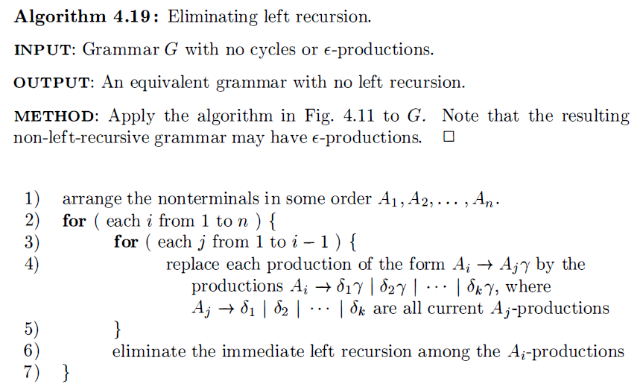
4.3 Write Grammar for Top-Down Parsing
Eliminating left recursion involving derivations of two or more steps.
E.g., we have
If the grammar has no cycles (derivations of the form ) or
the follow algorithm systematically eliminates left recursion.

Slide 13
4.3 Write Grammar for Top-Down Parsing
Left factoring

Slide 14
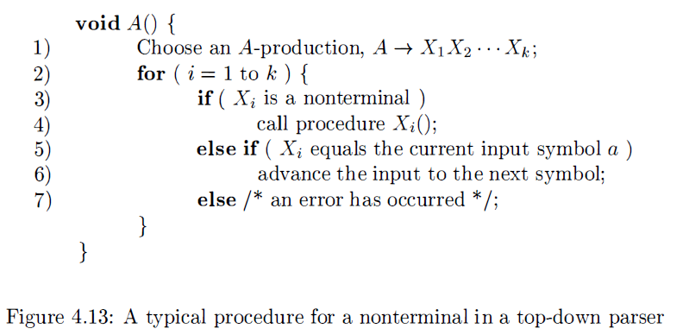
4.4 Recursive-Descent Parsing
If all the following conditions are satisfied, we can construct a recursive-descent parser.
No Ambiguity
No left recursion
Left factoring completed
recursive-descent parsing construct a recursive procedure for each nonterminal.

Slide 15
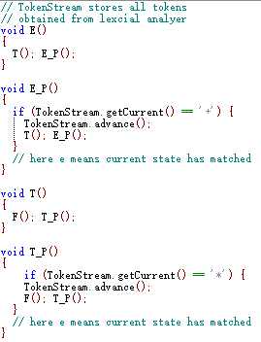
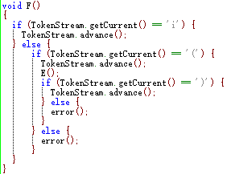
4.4 Recursive-Descent Parsing
E.g.

Slide 16
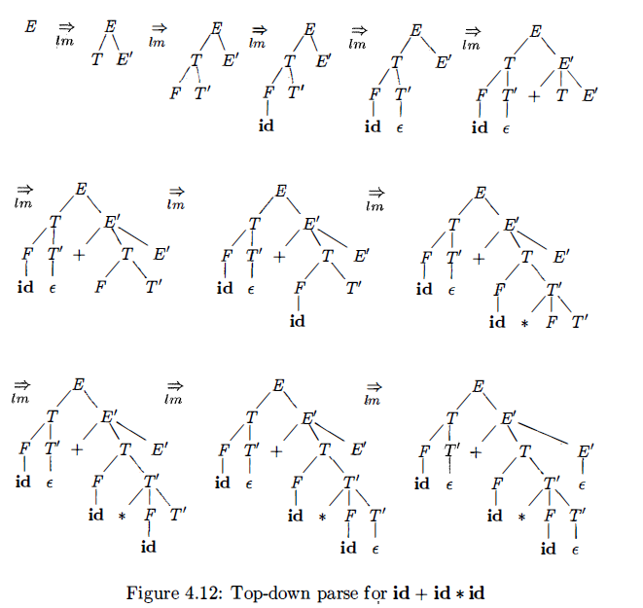
4.4 Recursive-Descent Parsing
E.g.

Slide 17
4.4 Recursive-Descent Parsing
If all the following conditions are satisfied, we can construct a recursive-descent parser.
No Ambiguity
No left recursion
Left factoring completed
My question is whether there exists backtracking during the parsing. We hope not. (Pay attention recursive-descent parsing implicitly includes backtracking because it will try all productions of a nonterminal).
The ideal situation is when we see the input symbol a, we exactly know which production should be chosen, or the occurrence of a is a syntax error.
Which kind of grammar that results in non-backtracking recursive-descent parser?
Do we have more efficient methods that do not involve recursive procedure?

Slide 18
4.5 LL(1) Grammar
Predictive parsers, that is, recursive-descent parsers needing no backtracking, can be constructed for a class of grammars called LL(1) .The first "L" in LL(1) stands for scanning the input from left to right, the second "L" for producing a leftmost derivation, and the "I" for using one input symbol of lookahead at each step to make parsing action decisions.

Slide 19
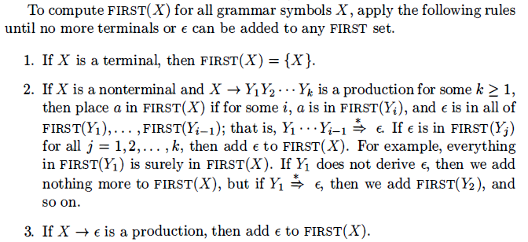
4.5 LL(1) Grammar - FIRST and FOLLOW
Suppose , when facing an input symbol a, if we know exactly which production of A should be designated to match a, we do not need backtracking. That is, the first terminals of should be different.
Formally,
Specially, if , we have
sometimes, start with a nonterminal X, how to compute FIRST(X)?

Slide 20
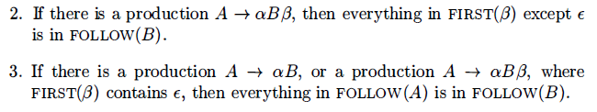
4.5 LL(1) Grammar - FIRST and FOLLOW
Define FOLLOW(A), for nonterminal A, to be the set of terminals a that can appear immediately to the right of A in some sentential form.
Specially, if we have , where is the right endmarker.
To compute FOLLOW(A) for all nonterminals A, apply the following rules
until nothing can be added to any FOLLOW set.

Slide 21
4.5 LL(1) Grammar - definition
A grammar G is LL(1) if the follow conditions are satisfied:
(1) no left recursive production
(2) For each nonterminal A in the grammar, if A has the form
then
(3) For each nonterminal A in the grammar, if
then

Slide 22
4.5 LL(1) Grammar – Top-Down Parsing (Framework)
Suppose that we use a nonterminal A to match input symbol a , if the production of A is
(1) if then we use to match input a
(2) if
if and then let A match
otherwise, the occurrence of a is an error.
According to LL(1) Grammar, each step is deterministic. It will result in a Recursive-Descent Parsing without Backtracking.

Slide 23
4.6 Predictive Parsing for LL(1) Grammar
Weakness of Recursive-Descent Parsing
At least we need a programming language that supports recursion
The efficiency of a recursive programming is not good
Error handling is not easy
A nonrecursive predictive parser can be built by maintaining a stack explicitly, rather than implicitly via recursive calls.

Slide 24
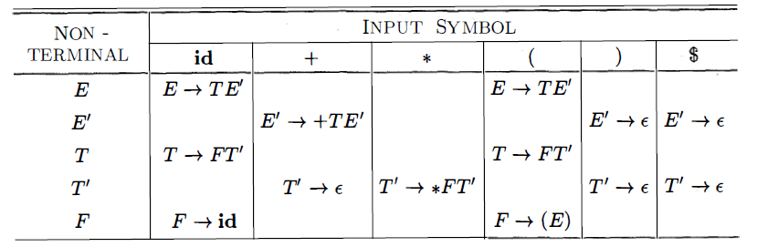
4.6 Predictive Parsing for LL(1) Grammar
Predictive parsing table M [A, a] , a two-dimensional array, where A is a nonterminal, and a is a terminal or the symbol $, the input endmarker. The element of M[A, a] is an A-production, indicating that when A facing a , which production should use. M[A, a] also can store error signs.

Slide 25
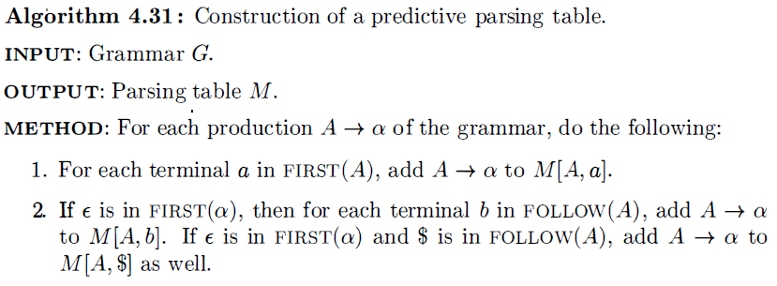
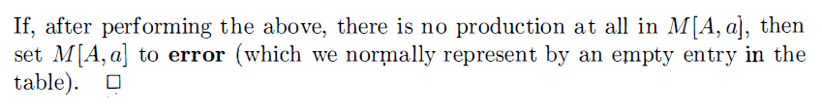
4.6 Predictive Parsing for LL(1) Grammar
Construction of a predictive parsing table M.

Slide 26
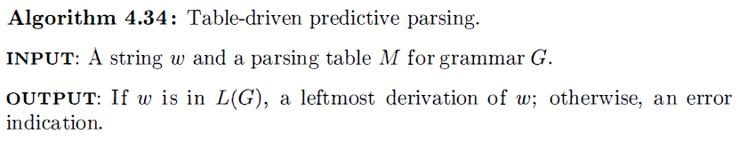
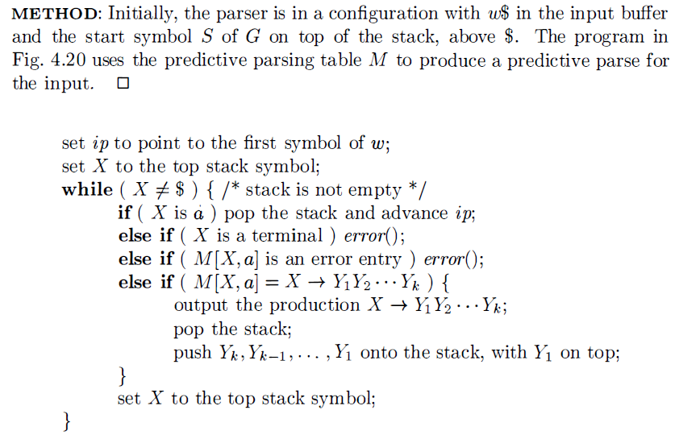
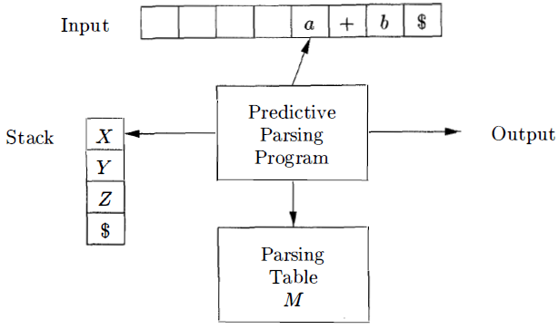
4.6 Predictive Parsing for LL(1) Grammar

Slide 27
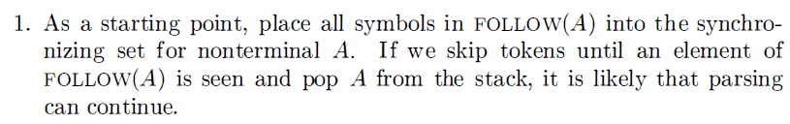
4.7 Error Recovery in Predictive Parsing
In predictive parsing, error occurs when
(1) The terminal on the top of the stack does not match the input symbol.
(2) Nonterminal A is on the top of the stack and faces the input symbol a, but the element M[A, a] in predictive table is empty.
Error Recovery Method
panic mode
Panic-mode error recovery is based on the idea of skipping symbols on the input until a token in a selected set of synchronizing tokens appears. Its effectiveness depends on the choice of synchronizing set. The sets should be chosen so that the parser recovers quickly from errors that are likely to occur in practice. Some heuristics are as follows:

Slide 28

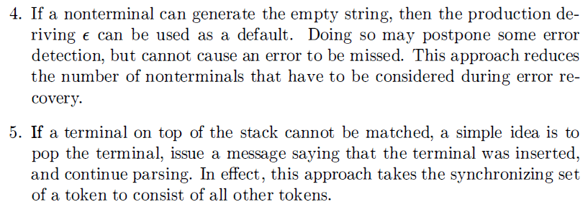
4.7 Error Recovery in Predictive Parsing
int var = 20
double r = 40;
Missing semicolon results in the skip for next keywords

Slide 29
4.7 Error Recovery in Predictive Parsing
synch
synch
synch
synch
synch
synch
synch
synch
synch
If the parser looks up entry M[A, a] and finds that it is blank, then the input symbol a is skipped. If the entry is "synch," then the nonterminal on top of the stack is popped in an attempt to resume parsing. If a token on top of the stack does not match the input symbol, then we pop the token from the stack.

Slide 30
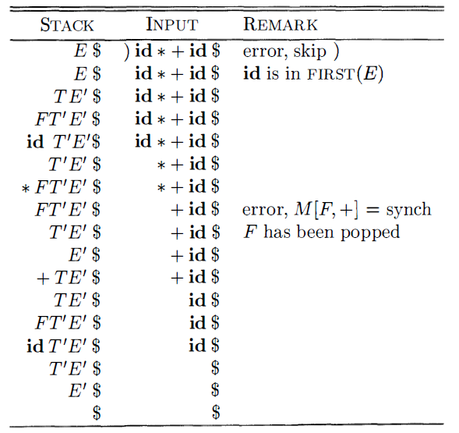
4.7 Error Recovery in Predictive Parsing
Phrase-level Recovery
Phrase-level error recovery is implemented by filling in the blank entries in the predictive parsing table with pointers to error routines. These routines may change, insert, or delete symbols on the input and issue appropriate error messages.

Slide 31
Homework 4
1. Consider Grammar G:
(1)Compute FIRST and FOLLOW for each nonterminal
(2) Proof G is an LL(1) grammar
(3) Construct its predictive Table
(4) Construct its recursive-descent parser.
2. Which of the following grammars are LL(1) grammars.
G1： G2：
G3： G4:

Slide 32
Homework 4
3. Consider Grammar:
(1) Construct LL(1) predictive table for the grammar.
(2) Show the analysis steps for sentence
4. Can we change the following grammar to the LL(1) type? If yes, please write its LL(1) form.

