Slide 1
Software Project Management
Jing Zhang Ph.D.

Slide 2
About Me
Jing ZHANG (张静) Ph. D.
Teach
Software Project Management
Compliers (next semester)
Personal web page
http://jz81.github.com
Email: jzhang@njust.edu.cn
Office: Room 2020, Computer Hall
Office Time: Every Tuesday and Thursday

Slide 3
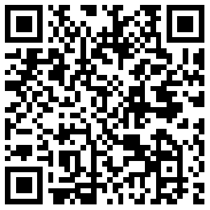
Course Information
http://jz81.github.io/course/spm/spm.html

Slide 4

About the course
32 instruction hours + 16 experimental hours
3 Credits
Audience:
Software Engineering
Computer Science Technology
Information Management
Previous Courses:
Software Engineering
Principle of Management
Text book
By Bob Hughes and Mike Cotterell
5th Edition
https://www.amazon.cn/gp/product/B003U2RZ6M/ref=oh_aui_detailpage_o00_s01?ie=UTF8&psc=1

Slide 5

https://www.amazon.cn/gp/product/B003U2RZ6M/ref=oh_aui_detailpage_o00_s01?ie=UTF8&psc=1

Slide 6
Final score
Final Examination (70%)
Essay Writing (Project, 10%)
Homework (10%)
Presence in Class(10%)

Slide 7
Project (Paper Writing)
Find a topic related to software project management
Every one must write his/her own paper. Plagiarizing (copying) others cannot get score.
The minimum number of words must reach 3000.
A paper should at least includes
Introduction
Methods
Discussion (Your opinions on the methods)
Conclusion
Due date: Dec. 31, 2016.

Slide 8
Main Scopes of SPM
1. Project Evaluation
2. Project Planning
3. Software effort estimation
4. Activity planning
5. Risk Management
6. Resource allocation
7. Managing contracts
8. Managing people
9. Monitoring and control
10. Software quality

Slide 9
Introduction to SPM
Objectives:
Define the scopes of SPM
Understand what project managers worry about
Define the phases of a software project
Explain the factors of management
Be conscious of that a project needs elaborative planning, supervision and control
Identify stakeholders and their objectives
Define the criteria of success

Slide 10
Why is SPM important?
Unfortunately, projects are not always successful.
Standish Group in the U.S. analyzed 13,522 projects and concluded that only a third of them were successful; 82 percent were late and 43 percent exceeded their budget.
The reason for these project shortcomings is often the management of projects.

Slide 11
What is a project?
In dictionary definition, it emphases on
-----Being planned activity
Routine: one knows exactly what to do
Exploratory: full of uncertainties and risks

Slide 12
What is a project?
The characteristics distinguish projects:
non-routine tasks are involved;
planning is required;
specific objectives are to be met or a specified product is to be created;
the project has a predetermined time span;
work is carried out for someone other than yourself;
work involves several specialism;
people are formed into a temporary work group to carry out the task ;
work is carried out in several phases;
the resources that are available for use on the project are constrained;
the project is large or complex.
The more any of these factors apply to a task, the more difficult that task will be.

Slide 13
Project Constraints
Scope:
What work will be done as part of the project
What unique product, service, or result does the customer or sponsor expect from the project
Time
How long should it take to complete the project
Who can approve changes to the schedule
Cost
What is the project’s budget
Who can authorize changes to the budget

Slide 14
Software prj vs. other types of prj
Invisibility: With software, progress is not immediately visible
Complexity: Per dollar, software products contain more complexity than other engineered artefacts
Conformity: Software developers have to conform to the requirements of human clients
Flexibility: Software systems are particularly subject to change
ICT Project – Information and Communication Technology Project

Slide 15
Activities covered by SPM
A software project is not only concerned with the actual writing of software. In fact, where a software application is bought in “of the shelf”, there may be no software writing as such, but this is still fundamentally a software project because so many of the other activities associated with software will still be present.
Three successive processes

Slide 16
Activities covered by SPM
1. The feasibility study: assesses whether a project is worth starting – that it has a valid business case.
2. Planning: If the feasibility study indicates that the prospective project appears viable, then project planning can start.
3. Project execution: The execution of a project often contains design and implementation sub-phases.
Design is making decisions about the form of the products to be created.
Planning details the activities to be carried out to create these products.
E.g., Activities recommended in the international standard ISO 12207

Slide 17
Plans, methods and methodologies
Activity: test a component
Methods: Real activates:
A plan takes the method and convert it to real activities, identifying for each activity
Groups of methods or techniques are often grouped into methodologies such as object-oriented design
Analyze the requirements
Devise and write test cases
Create test scripts and expected results
Compare the actual results and the expected ones
Its start and end dates
Who will carry it out
What tools and materials
a plan

Slide 18
Some ways of categorizing software projects
Compulsory vs. voluntary users
Supermarket transaction system vs. computer game
Information systems vs. embedded systems
Office system vs. machine control system
Objectives vs. products
to meet certain objectives vs. to produce a product (course management system vs. anti-virus system)

Slide 19
Stakeholders
The people who have a stake or interest in the project
Internal to the project team
External to the project team but within the same organization
External to both the project team and the organization
Identify them early for setting up better communication channels

Slide 20
Setting objectives
Objectives focus on the desired outcomes of the project rather than the task within it.
SMART principles
Specific: Effective objectives are concrete and well defined
Measurable: measures of effectiveness which tell us how successful the project has been
Achievable: within the power of the individual or group
Relevant: must be relevant to the true purpose of the project
Time constrained: should be a defined point in time by which the objective should have been achieved

Slide 21
Project success and failure
The project plan should be designed to ensure project success
Project success can usually be summarized and delivering:
the agreed functionality
To the required level of quality
on time
within budget
Project success vs. business success

Slide 22
What is management
Management involves the following activities:
planning – deciding what is to be done;
organizing – making arrangement;
staffing – selecting the right people for the job;
directing – giving instructions;
monitoring – checking on progress;
controlling – taking action to remedy hold-ups;
innovating – coming up with new solutions;
representing- liaising with clients, users, developer, suppliers and other stakeholders.

Slide 23
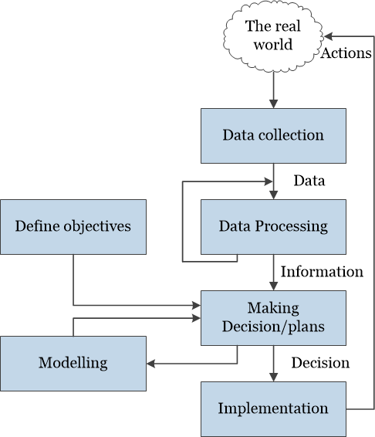
Management control
Management, in general, involves setting objectives for a system and then monitoring the performance of the system.

Slide 24
Advantages
Using project management techniques provides advantages, such as
Better control of financial, physical, and human resources
Improved customer relations
Shorter development times
Lower costs and improved productivity
Higher quality and increased reliability
Higher profit margins
Better internal coordination
Positive impact on meeting strategic goal
Higher worker morale

Slide 25
Conclusion
Projects are by definition non-routine and therefore more uncertain than normal undertakings
Software projects are similar to other projects but have some attributes that present particular difficulties, e.g. the relative invisibility of many of their products.
A key factor in project success is having clear objectives. Different stakeholders in a project, however, are likely to have different objectives. This points to the need for a recognized overall project authority.
For objectives to the effective there must be practical ways of testing that the objectives have been met.
Where projects involve many different people, effective channels of information have to be established. Having objective measures of success helps unambiguous communication between the various parties to a project.

Slide 26
Homework
Section 1.16 Further exercises
Exercises 3
A public library is considering the implementation of a computer-based system to help administer book loans at libraries. Identify the stakeholders in such a project. What might be the objectives of such a project and how might the success of the project be measured in practical terms?

