Slide 1

Software Architect Style
Lecture 3

Slide 2
Independent components

Slide 3
Independent components
Event-based systems
In a system in which the component interfaces provide a collection of procedures and functions, such as an object-oriented system, components typically interact with each other by explicitly invoking those routines.
However, there has been considerable interest in an alternative integration technique, variously referred to as implicit invocation, reactive integration, and selective broadcast. This style has historical roots in systems based on actors, constraint satisfaction, daemons, and packet-switched networks.

Slide 4
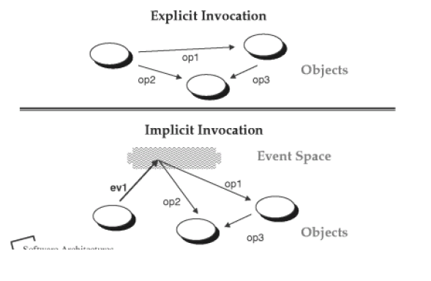
Independent components
Event-based systems

Slide 5
Independent components
Event-based systems
The idea behind implicit invocation is that instead of invoking a procedure directly, a component can announce (or broadcast) one or more events. Other components in the system can register an interest in an event by associating a procedure with it. When the event is announced, the system itself invokes all of the procedures that have been registered for the event. Thus an event announcement “implicitly” causes the invocation of procedures in other modules.
Architecturally speaking, the components in an implicit invocation style are modules whose interfaces provide both a collection of procedures( as with abstract data type) and a set of events. Procedures may be called in the usual way, but a component can also register some of its procedures with events of the system. This will cause these procedures to be invoked when those events are announced at run time.

Slide 6
Independent components
Event-based systems
The main invariant of this style is that announcers of events do not know which components will be affected by those events. Thus components cannot make assumptions about the order of processing, or even about what processing will occur as result of their event. For this reason, most implicit invocation systems also include explicit invocation.

Slide 7
Independent components
Event-based systems
How to make events dispatched to registered components in the system? Need strategies:
System with separate dispatcher module
System without a central dispatcher module
The dispatcher module is responsible for receiving all incoming events and dispatching tem to other modules in the system.

Slide 8
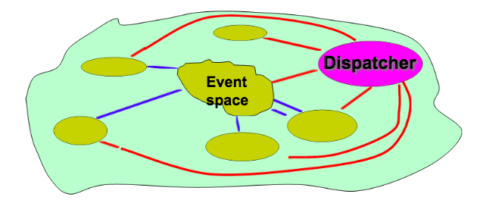
Independent components
Event-based systems
Strategy 1: System with separate dispatcher module

Slide 9
Independent components
Event-based systems
Strategy 1: System with separate dispatcher module
All broadcasting: The dispatcher may broadcast events to all modules the system
Selected broadcasting: The dispatcher sends an events to those modules that registered for that event: Publish/Subscribe strategy

Slide 10
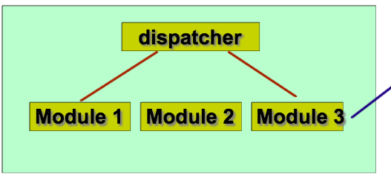
Independent components
Event-based systems
Strategy 1: System with separate dispatcher module
All broadcasting
We all get the event messags

Slide 11
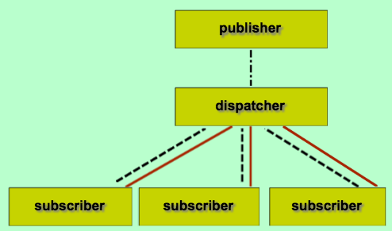
Independent components
Event-based systems
Strategy 1: System with separate dispatcher module
Selected broadcasting
I did not subscribe! I can not get messages of the event

Slide 12
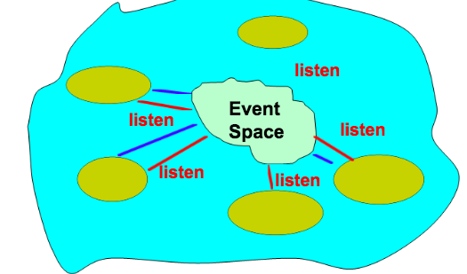
Independent components
Event-based systems
Strategy 2: System without a central dispatcher module

Slide 13
Independent components
Event-based systems—Advantage
Strong support for reuse. Any component can be introduced into a system simply by registering it for the events of that system.
Implicit invocation eases system evolution. Components may be replaced by other components without affecting the interfaces of other components in this system.

Slide 14
Independent components
Event-based systems—Disadvantage
Components relinquish control over the computation performed by the system. When a component announces an event, it cannot assume other components will respond to it. Moreover, even if it dose know what other components are interested in the events it announces, it cannot rely on the order in which they are invoked.
Exchange of data. Sometimes data can be passed with an event, but in other situations event systems must rely on a shared repository for interaction. In this case global performance and resource management can become critical issues.
Reasoning about correctness can be problematic, since the meaning of a procedure that announces events will depend on the context of binding in which it it invoked.

Slide 15
Independent components
Event-based systems
Summary: Independent components asynchronously emit and receive events communicated over event buses
Components: Independent, concurrent event generators and/or consumers
Connectors: Event buses (at least one)
Data Elements: Events-data sent as a first-class entity over the event bus
Topology: Components communicate with the event buses, not directly to each other.
Variants: Component communication with the event bus may either be push or pull based.
Qualities yielded: Highly scalable, easy to evolve, effective for highly distributed applications.
Typical uses: User interface software, wide-area applications involving independent parties (such as financial markets, logistics sensor networks). Cautiolls: No guarantee if or when a particular event will be processed.
Relations to programming languages or environments: Commercial message-oriented middleware technologies support event-based architectures.

Slide 16
Virtual machines

Slide 17
Virtual machines
Interpreters
In an interpreter organization a virtual machine is produced in software.
An interpreter includes the pseudoprogram being interpreter and the interpretation engine itself.
The pseudoprogram includes the program itself and the interpreter’s analog of its execution state(activation record ).
The interpretation engine includes both the definition of the interpreter and the current state of its execution.

Slide 18
Virtual machines
Interpreters
An interpreter generally has four components:
An interpretation engine to do the work
A memory that contains the pseudocode to be interpreted
A representation of the control state of the interpretation engine
A representation of the current state of the program being simulated

Slide 19
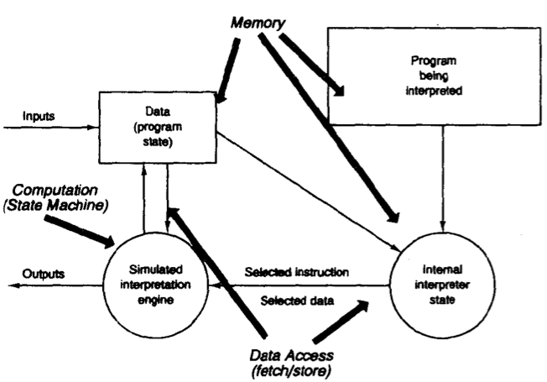
Virtual machines
Interpreters

Slide 20
Virtual machines
Interpreters
Interpreters are commonly used to build virtual machines that close the gap between the computing engine expected by the semantics of the program and the computing engine available in hardware.

Slide 21
Virtual machines
Interpreters
Advantage: It has the advantage of contributing to the portability of applications and the cross-platform capabilities of programming languages, as well as the simulation of unrealized hardware.
Disadvantage: Its disadvantage is that the extra indirection brings system performance degradation.(For example: Java applications are quite slow if JIT (just in time) is not introduced)
Examples of interpreter styles are:
Programming language compiler (such as java compiler, Smalltalk compiler)
Rule-based systems(such as the Prolog language)
Scripting languages(such as Perl, Awk)

Slide 22
Virtual machines
Interpreters
Summary: Interpreter parses and executes input commands, updating the state maintained by the interpreter
Components: Command interpreter, program/interpreter state, user interface.
Connectors: Typically very closely bound with direct procedure calls and shared state.
Data elements: Commands.
Topology: Tightly coupled three-tier; state can be separated from the interpreter.
Quality yielded: Highly dynamic behavior possible, where the set of commands is dynamically modified. System architecture may remain constant while new capabilities are created based upon existing primitives.
Typical uses: Superb for end-user programmability; supports dynamically changing set of capabilities
Cautions: When fast processing is needed {it takes longer to execute interpreted code than executable code}; memory management may be an issue, especially when multiple interpreters are invoked simultaneously.
Relations to programming languages or environments: Lisp and .Scheme are· interpretive languages, and sometimes used when building other interpreters; Word/Excel macros.

Slide 23
Data-centered-systems (repositories)

Slide 24
Data-centered-systems(repositories)
Blackboard
In a repository style there two quite distinct kinds of components:
A central data structure represents the current state
A collection of independent components operate on the central data store
Interactions between the repository and its external components can vary significantly among systems.

Slide 25
Data-centered-systems(repositories)
Blackboard
The choice of a control discipline leads to two major subcategories:
If the types of transactions in an input stream trigger selection of processes to execute, the repository can be a traditional database.
If the current state of the central data structure is the main trigger for selecting processes to execute, the repository can be a blackboard

Slide 26
Data-centered-systems(repositories)
Blackboard
The blackboard model is usually presented with three major parts:
The knowledge source: separate, independent parcels of application-dependent knowledge. Interaction among knowledge source takes place solely through the blackboard.
The blackboard data structure: problem-solving state data, organized into an application-dependent hierarchy. Knowledge sources make changes to the blackboard that lead incrementally to a solution to the problem.
Control: driven entirely by the state of the blackboard. Knowledge sources respond opportunistically when changes in the blackboard make them applicable.

Slide 27
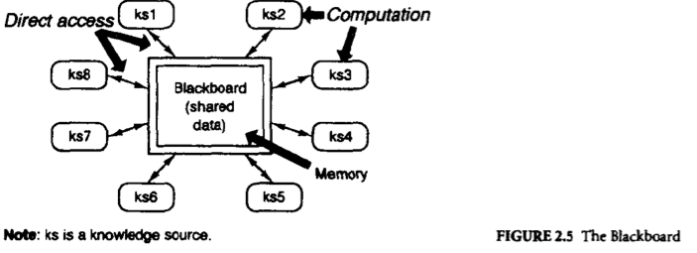
Data-centered-systems(repositories)
Blackboard
a simple view of a blackboard architecture.

Slide 28
Virtual machines
Blackboard
The diagram shows no explicit representation of the control component. Invocation of a knowledge source (ks) is triggered by the state of the blackboard. The actual locus of control, and hen its implementation, can be in the knowledge source, the blackboard, a separate module, or some combination of these.
Blackboard systems have traditionally been used for applications requiring complex interpretations of signal processing, such as speech and pattern recognition. Thay are also appeared in other kinds of systems that involve shared access to data with loosely coupled agents.

Slide 29
Data-centered-systems(repositories)
Blackboard
Advantage:
Easy to share large amounts of data for multiple clients, they do not care when the data is available, who provides it, and how it is provided.
Both facilitate the addition of new applications as knowledge source proxies and facilitate the expansion of shared blackboard data structures.
Disadvantage：
Different knowledge source agents have to agree on shared data structures, and this also makes it harder to modify the blackboard data structure – taking into account the various proxy invocations
Need some synchronization / locking mechanism to ensure the integrity and consistency of the data structure, increase the complexity of system

Slide 30
Data-centered-systems(repositories)
Blackboard
Summary: Independent programs access and communicate exclusively through a global data repository, known as a blackboard.
Components: Independent programs, sometimes referred to as "knowledge sources," blackboard.
Connectors: Access to the blackboard may be by direct memory reference, or can be through a procedure call or a database query.
Data elements: Data stored in the blackboard
Topology: Star topology, with the blackboard at the center.
Variants: In one version of the style, programs poll the blackboard to determine if any values of interest have changed; in another version, a blackboard manager notifies interested components of an update to the blackboard.
Qualities yielded: Complete solution strategies to complex problems do not have to be preplanned. Evolving views of data/problem determine the strategies that are adopted.
Typical uses: Heuristic problem solving in artificial intelligence applications.
Cautions: When. a well-structured solution strategy is available; when interactions between the independent programs require complex regulation; when representation of the data on the blackboard is subject to frequent change (requiring propagating changes to all the participating components).
Relations to programming languages or environments: Versions of the blackboard style that allow concurrency between the constituent programs require concurrency primitives for managing the shared blackboard.

Slide 31
Model-View-Controller

Slide 32
Model-View-Controller
The software system's user interface often changes. For example, the menus need to be reflected when new features are added, different appearance standards exist between different system platforms, the user interface also needs to adapt to the preferences and styles of different users, and even needs to be changed during operation. Moreover, you may need to develop a variety of interfaces for the kernel. Therefore, the user functions obviously can not be closely integrated with the functional kernel.
MVC style provides a very concise solution.

Slide 33
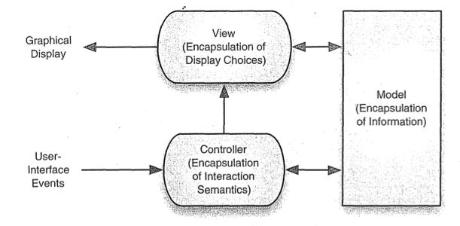
Model-View-Controller

Slide 34
Model-View-Controller
It divides the interactive application into three components：
View: Display model information for the user. View obtains data from model, a model can correspond to multiple views.
Model: The model is the core of the application. It encapsulates the kernel data and state, and any changes to the model will propagate to all views. All objects that need information from the model must be registered as views of the model
Controller: The controller is an interface that provides the user with an operation. Each view is associated with a controller component. The controller accepts user input, usually from mouse movement, keyboard input, etc. The input event is translated into a service request and sent to the model or view. Users interact with the system only through the controller.

Slide 35
Independent components
The notional interactions between these components are as follows (variations exist in the practice)：
When the application changes a value in the model object, notification of that change is sent to the view so that any affected parts of the depiction can be updated and redrawn.
Notification also typically goes to the controller as well, so that the controller can modify the view if its logic so requires.
The view may query the model for additional data needed for the display. When handling input from the user (such as a mouse click on part of the view), the windowing system sends the user event to the controller;
the controller may query the view for information to assist in determining what action to take. The controller then updates the model object in keeping with the desired semantics.
Then, of course, if the model object changes values it must notify the view and controller so that the user interface can be updated, and so the cycle of interactions continues.

Slide 36
Advantages and Disadvantages
Advantages
Decomposition of all aspects simplifies the system design and ensures system scalability.
Changes of the interface do not affect the functional kernel of the application, making the system easy to evolve and develop with good maintainability.
It is easy to change and can even change at runtime, providing a good dynamic mechanism.
Disadvantage
Increased complexity of user interface design and implementation
Inefficiency of data access in view

