Slide 1

Compilers
Principles, Techniques, & Tools
Taught by Jing Zhang
(jzhang@njust.edu.cn)

Slide 2
Grammar Description

Slide 3
2.1 Some Concepts
Let be an alphabet，where each element is called a symbol. A string on is a finite sequence which is composed of symbols in . The string that contains NO symbol is called an ε-string (or ε).
Let be the full set of all strings on , including ε .
Let φ be an empty set {}.
Concatenation of U and V is defined as
Self-concatenation: ,
The closure of V is denoted by
The regular closure:

Slide 4
2.2 Context-free Grammar
A grammar is a set of formal regulations that describes the syntax structures of a language.
A context-free grammar has four components
(1) A set of terminal symbols, sometimes referred to as "tokens." The terminals are the elementary symbols of the language defined by the grammar.
(2) A set of nonterminals, sometimes called "syntactic variables." Each nonterminal represents a set of strings of terminals.
(3) A set of productions, where each production consists of a nonterminal, called the head or left side of the production, an arrow, and a sequence of terminals and/or nonterminals , called the body or right side of the production. The intuitive intent of a production is to specify one of the written forms of a construct; if the head nonterminal represents a construct, then the body represents a written form of the construct .
(4) A designation of one of the nonterminals as the start symbol

Slide 5
2.2 Context-free Grammar – Formal Definition
The context-free grammar G is a 4-tuple
V_{T} is a non-empty finite set, where each element is a terminal.
V_{N} is a non-empty finite set, where each element is a nonterminal,
S is a nonterminal, called start symbol
is as finite set of productions, where each production has the form . . S must appear in the left part of a production at least once.

Slide 6
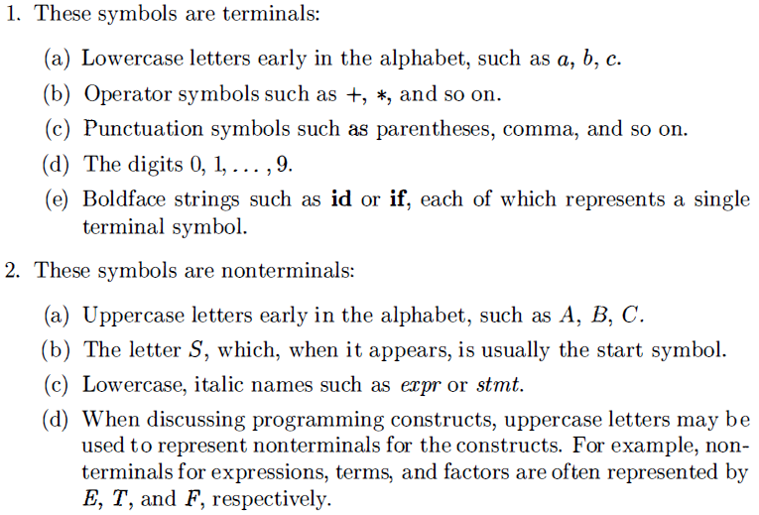
2.2 Context-free Grammar – Notational Conventions

Slide 7
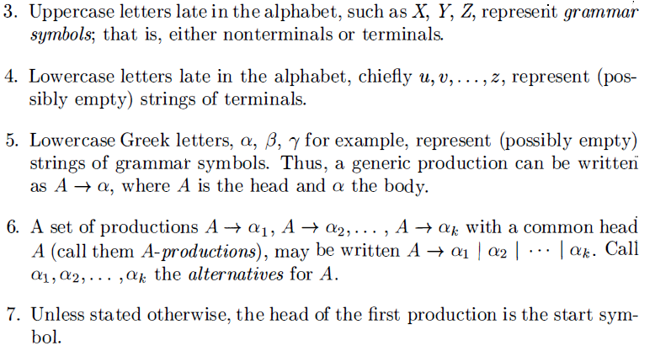
2.2 Context-free Grammar – Notational Conventions

Slide 8
2.2 Context-free Grammar – Derivations
A grammar derives strings by beginning with the start symbol and repeatedly replacing a nonterminal by the body of a production for that nonterminal.
Strictly, we call that derives in one step, i.e.,
if and only if is a production, and .
means “derives in one step”. When a sequence of derivation steps rewrites , we say
. We use symbol” and symbol to represent “derives in zero or more steps” and symbol to represent “derives in one or more steps”.
If , where S is the start symbol of a grammar G, we say that is a sentential form of G.

Slide 9
2.2 Context-free Grammar – Derivations
Note that a sentential form may contain both terminals and nonterminals, and may be empty. A sentence of G is a sentential form with no nonterminals. The language generated by a grammar G is its set of sentences, denoted by L(G) .
Thus, a string of terminals w is in L(G) , if and only if w is a sentence of G (or ). If two grammars generate the same language, the grammars are said to be equivalent.

Slide 10
2.2 Context-free Grammar – Derivations
We consider derivations in which the nonterminal to be replaced at each step is chosen as follows:
1. In leftmost derivations, the leftmost nonterminal in each sentential is always chosen. If is a step in which the leftmost nonterminal in is replaced, we write
2. In rightmost derivations, the rightmost nonterminal is always chosen; we write in this case.
Rightmost derivations are sometimes called canonical derivations.

Slide 11
Parse Tree
A parse tree pictorially shows how the start symbol of a grammar derives a string in the language. If nonterminal A has a production , then a parse tree may have an interior node labeled A with three children labeled X, Y, and Z, from left to right:
A
X
Y
Z
The root is labeled by the start symbol
Each leaf is labeled by a terminal or by .
Each interior node is labeled by a nonterminal
If A is the nonterminal labeling some interior node and X_{l} , X₂, • • • , X_{n} are the labels of the children of that node from left to right, then there must be a production . Here, X_{I} , X₂ , . . . , X_{n} each stand for for a symbol that is either a terminal or a nonterminal . As a special case, if is a production, then a node labeled A may have a single child labeled .
From left to right , the leaves of a parse tree form the yield of the tree , which is the string generated or derived from the nonterminal at the root of the parse tree. The process of finding a parse tree for a given string of terminals is called parsing that string.

Slide 12
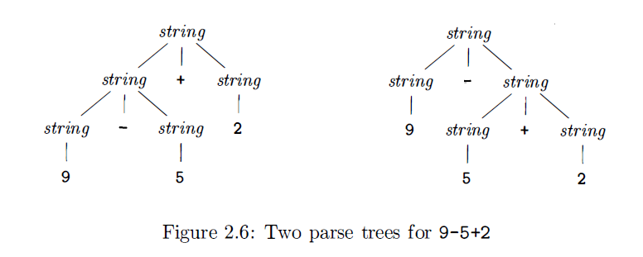
Ambiguity
A grammar can have more than one parse tree generating a given string of terminals. Such a grammar is said to be ambiguous.
Since a string with more than one parse tree usually has more than one meaning, we need to design unambiguous grammars for compiling applications, or to use ambiguous grammars with additional rules to resolve the ambiguities.

Slide 13
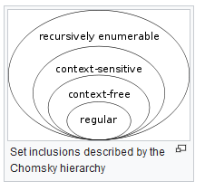
An overview of formal languages
Chomsky Hierarchy
Type-0 grammar (Recursively enumerable) > Type-1 grammar (Context-sensitive) > Type-2 grammar(Context-free) > Type-3 grammar (Regular)
is a type-0 grammar, if each production has the form
, and at least has one nonterminal,
If we applied the following i-th constraint to G we have i-type grammar
Any production satisfies with an exception
Any production has the form
Any production has the form
(right linear grammar)
(left linear grammar)
Context-free grammar can describe the syntax structures of most modern programming languages

Slide 14
Homework
(1) Grammar G is
What is the language L(G) specified by G?
Write the leftmost and rightmost derivations of the sentences 0127, 34 and 568.
(2) Write a grammar, whose specified language is the set of odd numbers and each odd number does not start with 0.
(3) Write the grammars for the following languages

