Slide 1

Exercises 1

Slide 2
Exercises 1
1. What are the design methods used by the main program-subroutine architecture and the object-oriented architecture? What kind of main diagrams do these two programming design produce?

Slide 3
Exercises 1
1.(1) main program-subroutine architecture
Design Method: A top-down functional design approach. The system is designed from the perspective of functions, starting from the top, and gradually down to the detailed design. The design starts with the functional requirements of the system. First, it divides an overall function into several sub-functions. Then it considers subdividing each sub-function into several smaller sub-functions, which in turn will continue until they can no longer be separated.
Main diagram produced: data flow diagram
1.(2) object-oriented architecture
Design Method: Object-oriented programming is a programming approach that organizes models mapped from the concepts in a real world. It uses objects to describe the entities of the problem space. The object is an abstract entity that contains the features of the real world object. It reflects the ability of the system to save information and exchange it. The object is a package of properties and services.
Main diagram produced: class diagram

Slide 4
Exercises 1
2. Try to use the main program-subroutine structure to a design program: Enter a 2-digit decimal month number (01-12) from the keyboard, and then display the corresponding abbreviation. Please draw the program structure diagram.

Slide 5
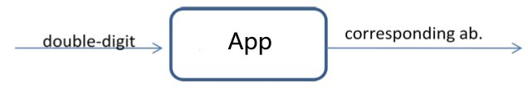
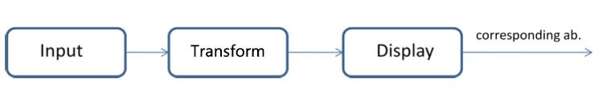
Exercises 1
2.
The Input module receives a 2-digit number from the keyboard
The Locate module associates the number of months entered with its abbreviation
The Display module displays the matching initials on the screen.
Figure 1 The first layer DFD diagram of the converter
Figure 2 The second layer DFD diagram of the converter

Slide 6
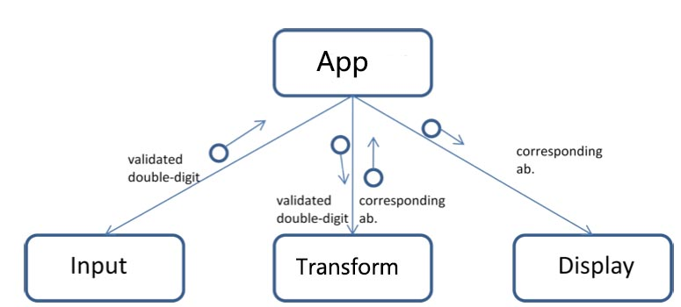
Exercises 1
2.
The Input module receives a 2-digit number from the keyboard
The Locate module associates the number of months entered with its abbreviation
The Display module displays the matching initials on the screen.
Figure 3 Top-down functional design of the converter

Slide 7
Exercises 1
3.Which of the following two situations is appropriate for using the sequential batch architecture?
a. A banking system that requires real-time data processing
b. A census system that requires periodic updates
3. b
the sequential batch architecture is not suitable for real-time systems

Slide 8
Exercises 1
4. Use a pipe-and-filter architecture to design and implement software that processes employee income information. The program should process the input file employee.txt as follows:
Sort the contents of the file according to the employee's salary amount.
Find out all the employees whose annual salary is above 120,000
Calculate the personal income tax of the employees whose annual salary is above 120,000, and the tax rate is 30%.
Print out the tax information of the staff whose annual salary is above 120,000.
a. Draw the design (pipe diagram) logic diagram
b. Draw a design class diagram, including the design and method of all classes
c. Describe the function of each method

Slide 9

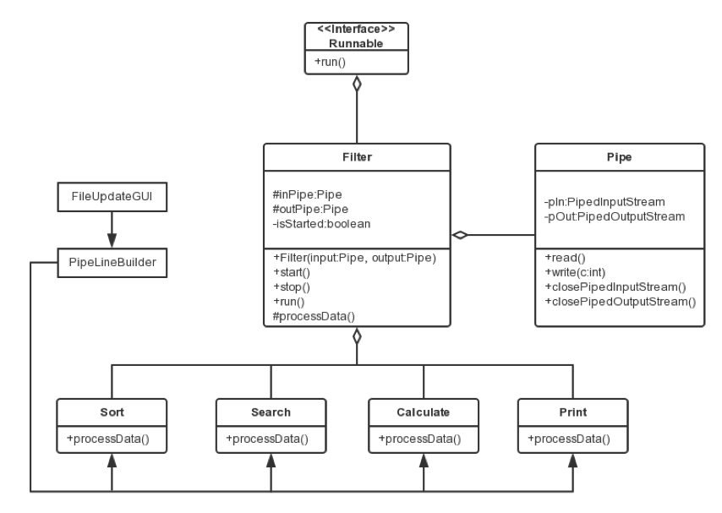
Exercises 1
4.a.Logic diagram
4.b.Class diagram

Slide 10
Exercises 1
4. Instructions
Sort is responsible for reading employee information data from employee.txt, then sorting the data by employees 'salaries, and writing the processed data to the downstream pipeline.
Search reads employee information data from the upstream pipeline and filter out all employees with annual salary of over 120,000. Then write the processed data to the downstream pipeline.
Calculate reads employee information data from the upstream pipeline, then calculates the personal income tax of these employees with annual salary of over 120,000 at the 30% tax rate, and writes the processed data into the downstream pipeline.
Print reads employee information data from the upstream pipeline and displays these processed results to the user graphical interface.
The PipeLineBuilder is responsible for creating pipe and filter objects based on the user's choice and grouping them together.
The FileUpdateGUI object represents the user's graphical interface and is responsible for receiving user input and then calls the PipeLineBuilder.

Slide 11
Exercises 1
5. Design a software system that controls the water quality, temperature, and level of the goldfish tank. Basic requirements: This program automatically controls the water quality, water temperature, and water level in a goldfish tank. The system hardware includes an aquarium tank, a chemical sensor, a water temperature sensor, and a water level sensor. When the reading value of the chemical sensor exceeds a certain range, the fish tank needs to eliminate some of the waste water and supply the fresh water. When the temperature reading value of the water temperature sensor is lower than a certain temperature or exceeds a certain temperature, the heating device or cooling device needs to be turned on to adjust the water temperature. When the water level reading value is higher or lower than a certain height, it needs to turn on the drain, remove some of the water or add fresh water.
It is required to use the observer mode to design the software system. Specific requirements:
Draw a design class diagram.
Explain the style of the designed control program, explain the relationship between the software components in the class diagram, and the functions included in each software component.

Slide 12
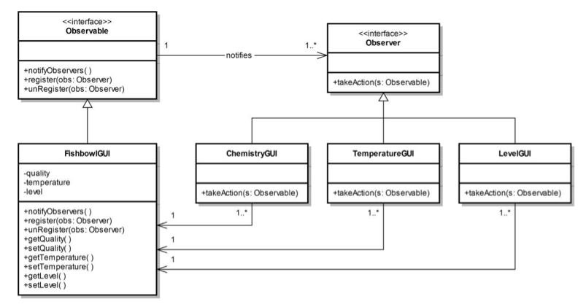
Exercises 1
5.a

Slide 13
Exercises 1
5.b
Among them, Observable and Observer are two interface classes.
The fishbowl class FishbowlGUI is the observed class, which implements the interface class Observable.
The FishbowlGUI has 3 private variables quality, temperature, and level, which represent the tank's water quality, water temperature, and water level height. There are also get and set methods for each private variable to get properties or set properties.
Three observers, ChemistryGUI, TemperatureGUI, and LevelGUI, implement the observer interface Observer.
In the observer interface, there is a method takeAction(s:Observable) that must be implemented. Each class that implements the interface implements its own function in this method: When the quality exceeds a certain range, the chemical sensor ChemistryGUI excludes some of the wastewater from the tank and replenish the new water; when the temperature falls below a certain temperature, or exceeds a certain temperature, the TemperatureGUI turns on. The heating device or cooling device adjusts the water temperature; when the level is higher or lower than a certain level, LevelGUI turns on the drainage device, excluding some water or adding fresh water. This method is passed by parameters to an observer object. Once notified, some methods of the observer's class FishbowlGUI will be called to obtain the changed state.

Slide 14
Exercises 1
6. Point out three typical applications of hierarchical software architecture.
6. Reference answer:
Hierarchical communication protocols, such as OSI models, TCP/IP models.
Database system area.
Operating system area.

Slide 15
Exercises 1
7. Designing a train ticketing system requires a user graphical input interface, including the ticket departure time, price, number of trips, and the current number of remaining ticket displays.
requirements:
Tickets need to display the following information: departure time, price, number of trips, current number of remaining tickets;
Display of the remaining number of tickets must immediately reflect the change in the number of tickets;
The user interface is easy to change and even change at runtime.
This problem is designed using the MVC architecture (using the observer mechanism), where the user input interface and the display view are displayed independently.

Slide 16
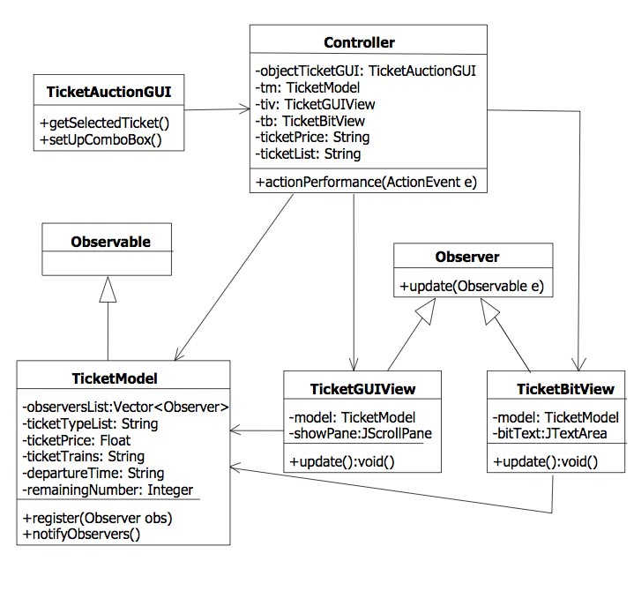
Exercises 1
7.

Slide 17
Exercises 1
8. Describe the difference between a hierarchical architecture and a client-server architecture.
8. The main difference between a three-tier architecture and a three-tier client-server software architecture is that the layers involved in the general hierarchy refer to the logical layer and the layer involves in the three-tier client-server architecture is a physical layer. That is, the client runs on the PC, the service layer is deployed on the application server, and the database layer contains the database and database management system software and is deployed on the database server.

Slide 18
Exercises 1
9. Point out the content contained in each layer of the two-tier client-server architecture and describe it in its own words:
The working principle of the program of the architecture design.
fat client, thin client

Slide 19
Exercises 1
9. In the context of the two-tier client-server architecture, the first tier contains the graphical user interface, application programs, and part of the business logic; the second tier contains part of the business logic, legacy data and other resource management systems, database management systems, and shared resources.
The working principle of the program of the architecture design.
The client sends a SQL statement to perform a data query, or requests to update the database.
The server-side database management system can assist the user in querying and return the query result to the client; or update the database, such as modifying the value of a field in a table, or writing a new business record.
Fat client, thin client
A thin client refers to a computer terminal that is basically application-free in a client-server network architecture. It communicates with the server through some protocols and then accesses the LAN.
Fat clients and thin clients are relative. The difference is that there is a large amount of business logic that needs to be placed on the client. For example, in the C/S structure, the main logic program is placed on the client. Many times the server refers to the database server, so it is a fat client.

Slide 20
Exercises 1
10. What are the obvious advantages of a three-tier client-server architecture compared to a two-tier client-server architecture?

Slide 21
Exercises 1
10.
In terms of system management, the two-tier architecture is complex and requires many business logics to be managed on the client. The three-tier architecture is relatively simple, and applications can be managed centrally using server management tools on the server side.
In terms of security, the two-tier architecture is relatively low-security and belongs to the data-level security. The three-tier architecture has relatively high security and can be adjusted on the server side.
In terms of data encapsulation, the interaction between the client and the server in the two-tier architecture uses SQL statements to expose the data; the three-tier structure is better, and is accomplished by the client invoking services or methods.
In terms of repetitive applications, because it is only a single client, the two-tier architecture is not easy to reuse; and the three-tier architecture performs well in reuse and can reuse services and objects.
In terms of heritage application integration, legacy application integration is difficult for a two-tier client-server architecture because of only limited client communication link management; for a three-tier client-server architecture, you can use the encapsulation services and objects to implement legacy application integration through gateways, network connectors, and routers.
In terms of Internet support, in a two-tier client-server architecture, Internet support is poor because network bandwidth limits the download of thick clients, and the three-tier client-server architecture often results from only web browsers on the client. , so the performance is excellent.
In terms of multiple database support, in a two-tier client-server architecture, the database is locked by the vendor, so it is almost impossible to use multiple databases; in a three-tier structure, a business transaction can use several databases.

Slide 22
Exercises 1
11. Please briefly describe the concept of P2P architecture.
P2P architecture is a decentralized architecture, that is, there is no concept of server or client in the network. In the P2P architecture model, every node in the network is considered as a peer. They have the same status. Any node can request services and provide services. That is, each node is Clients, also Servers

Slide 23
Exercises 1
12 What are the first- to third-generation P2P architectures?
12. The first generation of P2P software architecture is called centralized directory P2P; the second generation of P2P software architecture is called pure P2P; the third generation of P2P software architecture is called unstructured layer pure P2P.

Slide 24
Exercises 1
13. Please briefly describe the advantages and disadvantages of centralized directory P2P
13. The advantages of the centralized directory P2P architecture are: it improves the manageability of the network and makes it easy to find and update shared resources. The disadvantages are: the stability of the network is poor. Once the server fails, the peer nodes under the server may all fail.

