Slide 1

Compilers
Principles, Techniques, & Tools
Taught by Jing Zhang
(jzhang@njust.edu.cn)

Slide 2
Lexical Analysis

Slide 3
Outlines
The Construction of a Lexical Analyzer
Regular Expression, Regular Set
Transition Diagram
Lex
DFA and NFA
Conversion of an NFA to a DFA
Minimization of DFA
The Conversion of FA, Regular Expression, & Regular Grammar
The Lexical-Analyzer Generator

Slide 4
3.1 The Construction of a Lexical Analyzer
Lexical Analyzer reads input stream and then generator the sequence of tokens that are required by a parser.
token
Lexical Analyzer
Parser
getNextToken
Symbol Table
Sometimes, lexical analyzers are divided into a cascade of two processes:
a) Scanning consists of the simple processes that do not require tokenization of the input, such as deletion of comments and compaction of consecutive whitespace characters into one.
b) Lexical analysis proper is the more complex portion, where the scanner produces the sequence of tokens as output.

Slide 5
3.1 The Construction of a Lexical Analyzer
Lexical Analysis Versus Parsing
1 . Simplicity of design is the most important consideration. The separation of lexical and syntactic analysis often allows us to simplify at least one of these tasks. For example, a parser that had to deal with comments and whitespace as syntactic units would be. considerably more complex than one that can assume comments and whitespace have already been removed by the lexical analyzer. If we are designing a new language, separating lexical and syntactic concerns can lead to a cleaner overall language design.
2. Compiler efficiency is improved. A separate lexical analyzer allows us to apply specialized techniques that serve only the lexical task, not the job of parsing. In addition, specialized buffering techniques for reading input characters can speed up the compiler significantly. (Parsing is more complicated and slower)
3. Compiler portability is enhanced. Input-device-specific peculiarities can be restricted to the lexical analyzer.

Slide 6
3.1 The Construction of a Lexical Analyzer-token
Output of a lexical analyzer：token
Token is a 2-tuple
<name，attribute>
attribute：a point to an entry in Symbol Table
Token name
Keyword：if, while, switch, … (any keyword as a token name)
Identifier：variables, functions, classes… defined by users … (all identifiers have one token name id)
Constant：integer，float, Boolean，literature （Each type has a token name）
Operator：+, -, *, /, %, … （each operator has a token name or each type has a token）
Delimiter：;, {, /**/, … (each delimiter has as token name)

Slide 7
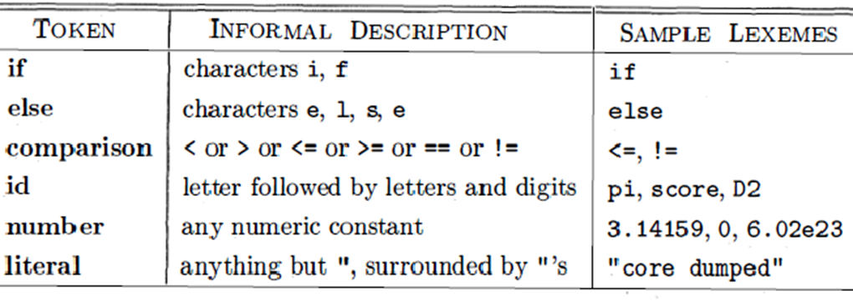
3.1 The Construction of a Lexical Analyzer-token
Token, Pattern and Lexemes
A token is a pair consisting of a token name and an optional attribute value. The token name is an abstract symbol representing a kind of lexical unit.
A pattern is a description of the form that the lexemes of a token may take. In the case of a keyword as a token, the pattern is just the sequence of characters that form the keyword. For identifiers and some other tokens, the pattern is a more complex structure that is matched by many strings.
A lexeme is a sequence of characters in the source program that matches the pattern for a token and is identified by the lexical analyzer as an instance of that token.

Slide 8
3.1 The Construction of a Lexical Analyzer-tokenization
while (i > j) {
k = j * 3.14;
}
<WHILE, ->
<LEFT_PAREN, ->
<ID, pointer to ST entry for i>
<REL_OP, GT>
<ID, pointer to ST entry for j>
<RIGHT_PAREN, ->
<LEFT_BRACE, ->
<ID, pointer to ST entry for k >
<OP_ASSIGN, ->
<ID, pointer to ST entry for j >
<OP_MULT, ->
<REAL, pointer to constant 3.14>
<SEMICOLON, ->
<RIGHT_BRACE,->

Slide 9
3.1 The Construction of a Lexical Analyzer-Lexical Errors
It is hard for a lexical analyzer to tell , without the aid of other components, that there is a source-code error.
The simplest recovery strategy is "panic mode" recovery. We delete successive characters from the remaining input, until the lexical analyzer can find a well-formed token at the beginning of what input is left.
Other possible error-recovery actions are:
(1) Delete one character from the remaining input.
(2) Insert a missing character into the remaining input.
(3) Replace a character by another character.
(4) Transpose two adjacent characters

Slide 10
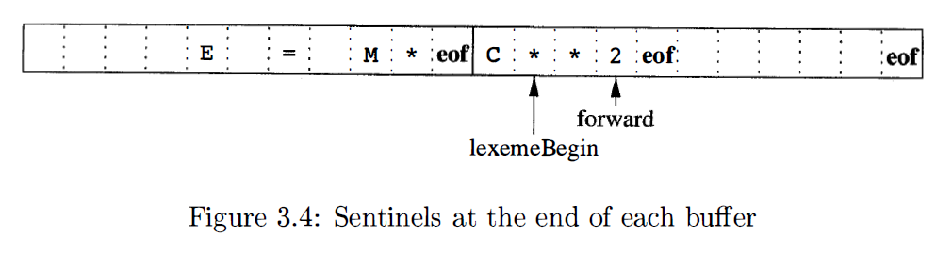
3.1 The Construction of a Lexical Analyzer-Input Buffering
Buffer Pairs
Used to extract lexemes from input streams
Sentinel
Using eof to indicate the end of buffer or input

Slide 11
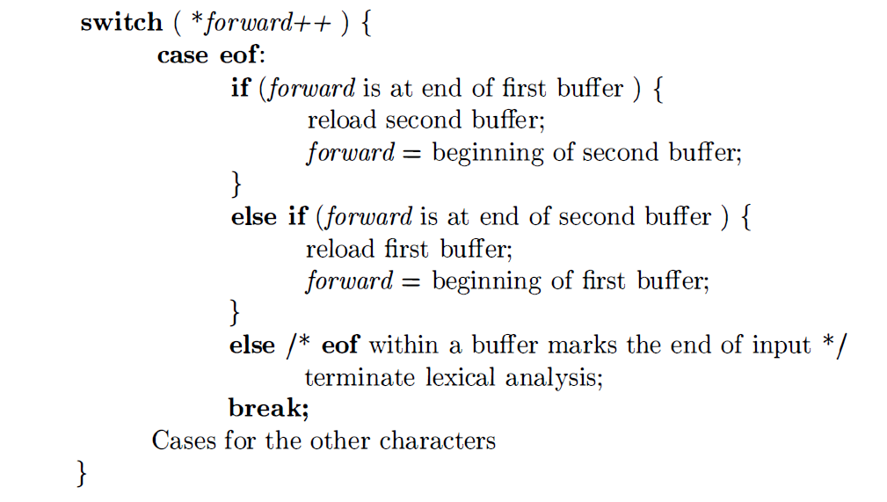
3.1 The Construction of a Lexical Analyzer-Lookahead code with sentinels

Slide 12
3.1 The Construction of a Lexical Analyzer-reading ahead
Keywords recognition
Identifiers
Usually do not need reading ahead
Constant recognition
5.EQ.M and 5.E08
Operators and Delimiters
++,--, /**, >=
1 DO 99 K = 1, 10
2 IF(5.EQ.M) I=10
3 DO 99 K = 1.10
4 IF(5)=55

Slide 13
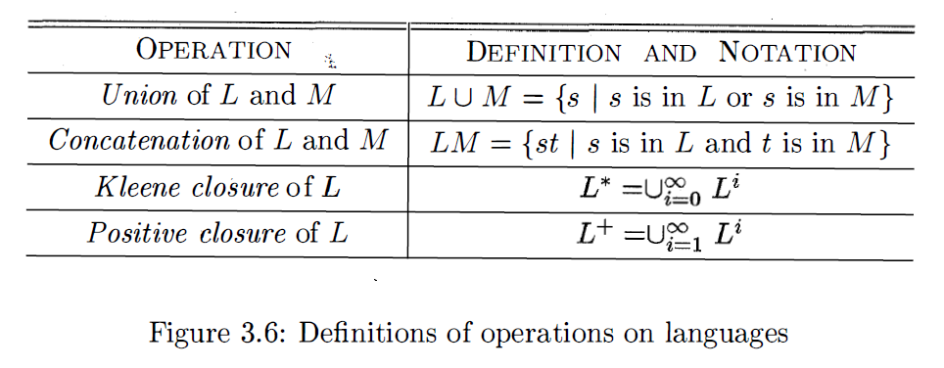
3.2 Regular Expression, Regular Set - Regular Expressions
Review – Operations on Languages
A language is any countable set of strings over some fixed alphabet.

Slide 14
3.2 Regular Expression, Regular Set - Regular Expressions
Regular Expressions over alphabet ∑ are recursively defined as follows：
（1）ε and ϕ are regular expressions， which represent language {ε} and ϕ respectively.
（2）for any a∊ ∑，a is a regular expression，and
（3）U and V are both regular expressions，whose represented languages are L(U) and L(V) respectively. Then，(U|V), (U⋅V) and (U)* are all regular expressions，whose represented languages are L(U)⋃L(V), L(U)L(V) and (L(U))*
Expressions that are defined by finitely applying the above laws are regular expressions. The string set that is only defined by regular expressions is called a regular set.
Precedence of operators：*，⋅，|

Slide 15
3.2 Regular Expression, Regular Set - Regular Expressions – Examples
∑={a, b}
1. ba* strings starting with b followed by zero or more a
2. a(a|b)* strings starting with a
3. (a|b)*(aa|bb)(a|b)* strings containing two consecutive a (or b)
4. (aa|bb)*((ab|ba)(aa|bb)*(ab|ba)(aa|bb)*)*
5. (aa|bb|((ab|ba)(aa|bb)*(ab|ba)))*
Languages defined by 4 and 5 are strings that contain even numbers of a and even numbers of b.

Slide 16
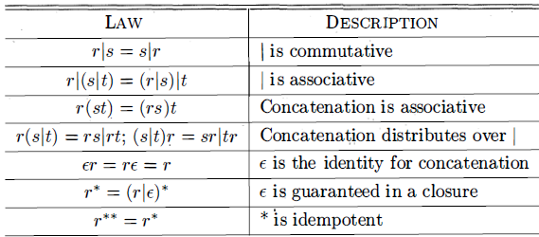
3.2 Regular Expression, Regular Set - Characteristics

Slide 17
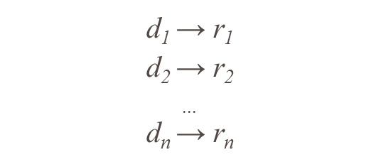
3.2 Regular Expression, Regular Set - Regular Definition
For notational convenience, we may wish to give names to certain regular expressions and use those names in subsequent expressions, as if the names were themselves symbols. If is an alphabet of basic symbols, then a regular definition is a sequence of definitions of the form:
Where (1) each is a new symbol, not in and not the same as any other of the d’s, and
(2) Each is a regular expression over the alphabet

Slide 18
3.2 Regular Expression, Regular Set - Regular Definition Example
Identifies in C programming language
letter_ → A|B|...|Z|a|b|...|z|_
digit → 0|1|...|9
id → letter_(letter_|digit)*
Unsigned number (integer or float) in C programming language
digit → 0|1|...|9
ligits → digit digit*
optionalFraction → .digits | ε
optionalExponent → (E(+|-| ε) digits )| ε
number → digits optionalFraction optionalExponent

Slide 19
3.2 Regular Expression, Regular Set – Extensions for Regular Definition
One or more instance：+
r+ = rr*
r* = r+| ε
Zero or one instances：？
r? = r | ε
Character class
[a₁ a₂ a_{3...} a_{n}] is equivalent to a₁ |a₂|a₃|... |a_{n}
[a-z] is equivalent to a|b|c|...|z

Slide 20
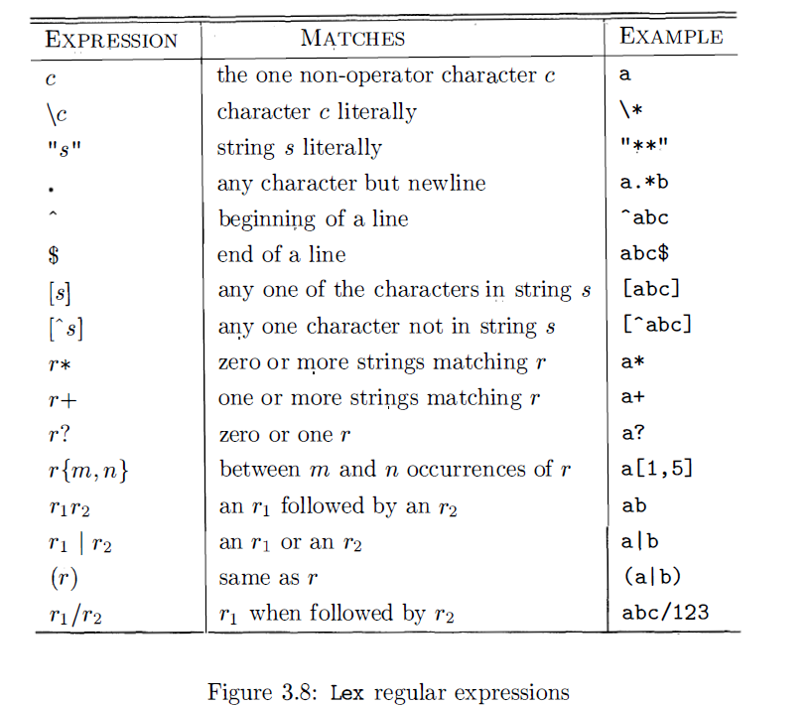
3.2 Regular Expression, Regular Set – Extensions for Regular Definition
Some software defines more complicated extensions for regular expression

Slide 21
3.2 Regular Expression, Regular Set – Regular Grammar
【Review】Chomsky Type-3 Grammar
G=(V_{T}, V_{N}, S, 𝓟), where each production has the form: （1）A → αB| α，where α∊ V_{T}*， B ∊ V_{N}（right linear grammar）
Or，
（2）A → Bα| α，where α∊ V_{T}*， B ∊ V_{N}（left linear grammar）
Regular Language
Regular Set
Regular Expression
Regular Definition
Regular Grammar

Slide 22
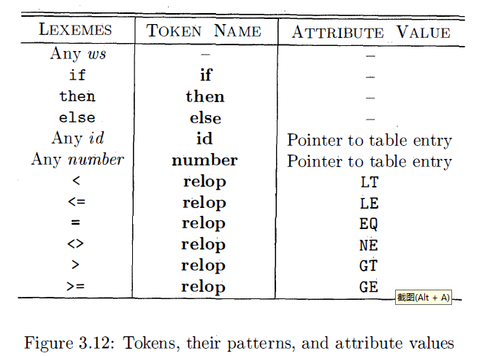
3.3 Transition Diagram – Recognition of Token
A small running example – A grammar for branching statements
stmt -> if expr then stmt | if expr then stmt else stmt | ε
expr -> term relop term | term
term -> id | number
The goal for the lexical analyzer.

Slide 23
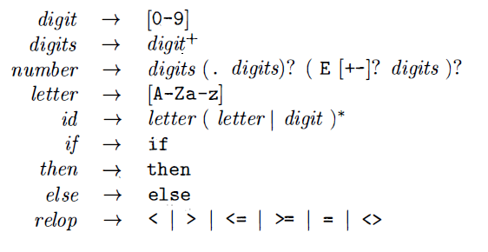

3.3 Transition Diagram – Recognition of Token
Patterns for token of the example

Slide 24
3.3 Transition Diagram – Recognition of Token
Transition Diagrams is a technical method to recognize regular expression
Transition Diagram is a finite directed graph, where nodes (circles) are called states. Each state represents a condition that could occur during the process of scanning the input looking for a lexeme that matches one of several patterns. Edges are directed from one state of the transition diagram to another. Each edge is labeled by a symbol or set of symbols. If we are in some state s , and the next input symbol is a, we look for an edge out of staXte s labeled by a (and perhaps by other symbols, as well). If we find such an edge, we advance the forward pointer and enter the state of the transition diagram to which that edge leads. A transition diagram include finite states, in where one is designated the start (initial) state and at least one is said to be the accepting (final) state (double circle).

Slide 25
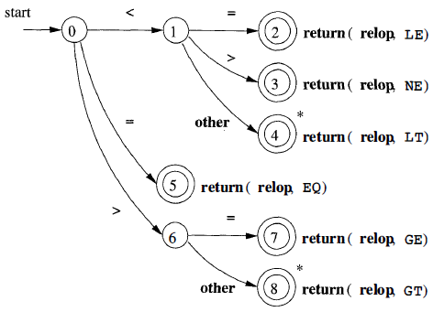
3.3 Transition Diagram – Recognition of relation operator
to indicate that we must retract the input one position

Slide 26
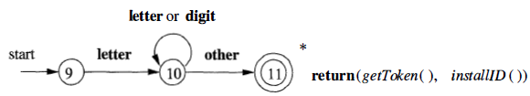
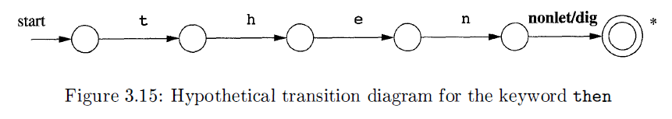
3.3 Transition Diagram – Recognition of reserved words and identifiers

Slide 27
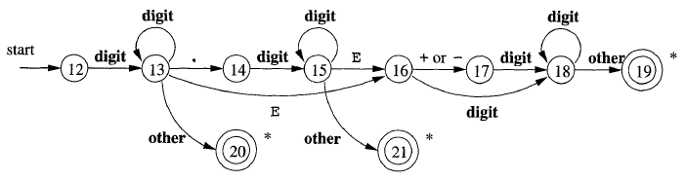
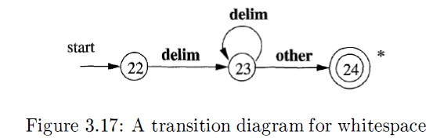
3.3 Transition Diagram – Recognition of unsigned number and others
Unsigned number
other
Err
Whitespace

Slide 28
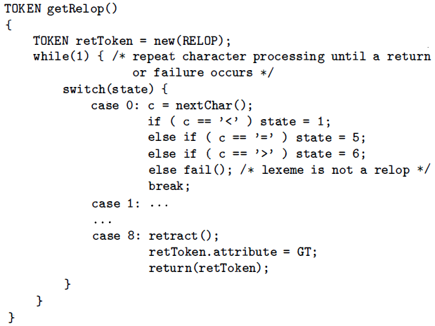
3.3 Transition Diagram – Architecture of a Transition-Diagram-Based Lexical Analyzer

Slide 29
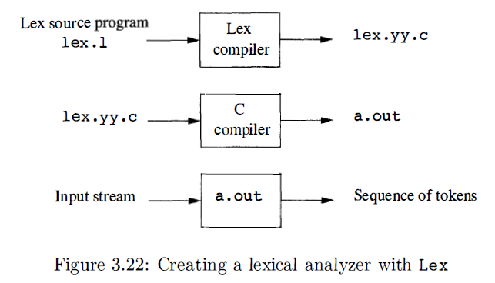
3.5 Lex
Lex is used to generate Lexical analyzers. Users can use Lex language to design their own Lexical analyzers.

Slide 30
3.5 Lex
A Lex program has the following form:
declarations
%%
translation rules
%%
auxiliary functions
The translation rules each have the form
Pattern {Action}

Slide 31
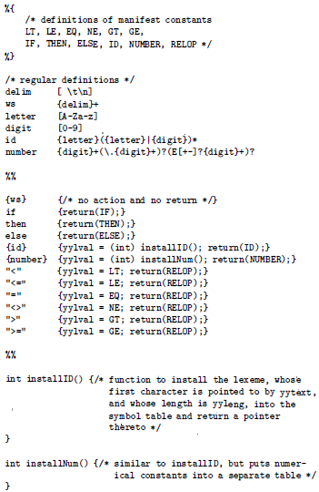
3.5 Lex
Conflict Resolution
Always prefer a longer prefix to a shorter prefix;
If the longest possible prefix matches two or more patterns, prefer the pattern listed first in the Lex program.

Slide 32
3.5 DFA and NFA – introduction
Formal and accurate
Regular Grammar
Regular Expression
Regular Definition
recognize
recognize
Transition Diagram
Formalize
Finite Automata
Formal and accurate
Formal, accurate
（technique）
informal，inaccurate（technique）

Slide 33
3.5 DFA and NFA – description
Finite automata are recognizers; they simply say "yes" or "no" about each possible input string
Finite automata come in two flavors:
(1) Deterministic finite automata (DFA) have, for each state, and for
each symbol of its input alphabet exactly one edge with that symbol
leaving that state
(2) Nondeterministic finite automata (NFA) have no restrictions on the labels of their edges. A symbol can label several edges out of the same state, and ε, the empty string, is a possible label.
Conclusion: Both deterministic and nondeterministic finite automata are capable of recognizing the same languages.

Slide 34
3.5 DFA and NFA – definition
DFA
M={S, ∑, δ, s₀, F}
S: a set of finite state
∑ is finite alphabet, where each element is a input symbol.
δ is a mapping from S ×∑ to one state in S。 δ(s, a)=s’ ：when current state is s，if the input symbol is a , then the transition of the next state is s’
s₀∊S is a unique start state
F⊆S is a set of final states（can be empty ）
NFA
M={S, ∑, δ, S₀, F}
S: a set of finite state
∑ is finite alphabet, where each element is a input letter.
δ is a mapping from S ×∑* to a subset of S，i.e., δ: S ×∑* →2^{S}
S₀ ⊆ S is a non-empty set of start stats
F⊆S is a set of final states (can be empty).

Slide 35
3.5 DFA and NFA – Example
Recognize strings on ∑={a, b} that include two consecutive a or two consecutive b
DFA
a
1
a
start
a
0
b
a
3
b
b
2
b
NFA
a
3
a
a
a
start
5
ε
1
2
ε
6
b
b
4
b
b
Notes:
这里给出一个例子。图中的DFA和NFA都是识别字符集∑={a, b}上含有相继两个a或者相继两个b的串。可以看到，DFA中每个状态都对应两条弧，这两条弧上的标签分别是a和b，而NFA不受此限制。弧上的标记可以是a，也可以是b，或者是ab的串，甚至是空字ε，每个状态的出弧也不要求必须和字母表中的字母数一样。另外，从这个例子，我们可以直观的看到，首先DFA和NFA两者的描述能力是等价的，其次，NFA具备比DFA更好的可读性。这也就是为什么使用NFA来构造识别器比较方便的原因。比如这里，只要将相继的两个a和相继的两个b作为整个NFA中的两个成分，在加上收尾的开始和结束状态，就很容易构造出NFA，但是如果想凭空构造出DFA就比较困难了。但是，DFA的好处就是，它的状态转换是确定的，便于程序处理。

