Slide 1

Compilers
Principles, Techniques, & Tools
Taught by Jing Zhang
(jzhang@njust.edu.cn)

Slide 2
Intermediate- Code Generation

Slide 3
Outlines
Introduction
Variants of Syntax Trees
Three-Address Code
Types and Declarations

Slide 4
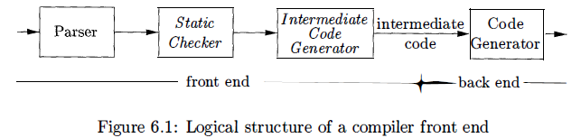

Introduction
we assume that a compiler front end is organized as follows, where parsing, static checking, and intermediate-code generation are done sequentially; sometimes they can be combined and folded into parsing.
In the process of translating a program in a given source language into code for a given target machine, a compiler may construct a sequence of intermediate representations. High-level representations are close to the source language and low-level representations are close to the target machine.

Slide 5
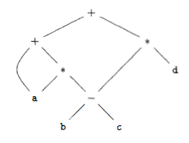
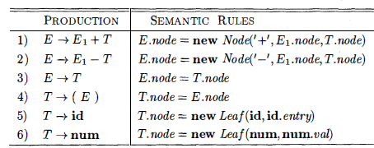
7.1 Variants of Syntax Trees
Directed Acyclic Graphs (DAG)
A node N in a DAG has more than one parent if N represents a common subexpression; in a syntax tree, the tree for the common sub expression would be replicated as many times as the sub expression appears in the original expression. Thus, a DAG not only represents expressions more succinctly, it gives the compiler important clues regarding the generation of efficient code to evaluate the expressions.
E.g. a + a * (b - c) + (b - c) * d

Slide 6
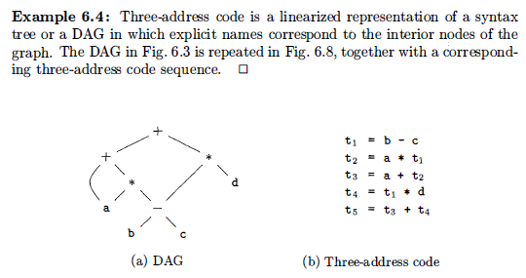
7.2 Three-Address Code
In three-address code, there is at most one operator on the right side of an instruction; that is, no built-up arithmetic expressions are permitted.
E.g. x+y*z
Three-Address Code:

Slide 7

7.2 Three-Address Code – Addresses and Instructions
Addresses
A name.
A constant.
A compiler-generated temporary.
common three-address instruction forms
assignment instructions of the form x = y op z.
assignments of the form x = op y, where op is a unary operation.
copy instructions of the form x = y.
an unconditional jump goto L.
conditional jumps of the form if x goto L and if False x goto L.
conditional jumps such as if x relop y goto L,
procedure calls and returns are implemented using the following instructions:
param x for parameters; call p , n and y = call p , n for procedure and function calls,
respectively; and return y, where y, representing a returned value, is optional.
indexed copy instructions of the form x = y [i] and x [i] = y .
address and pointer assignments of the form x = & y , x = * y , and * x = y.

Slide 8
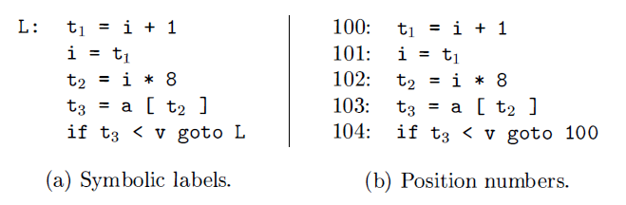
7.2 Three-Address Code – Addresses and Instructions
E.g.
do i = i+ l ; while ( a [i] < v) ;

Slide 9
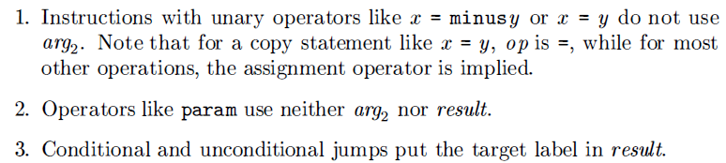
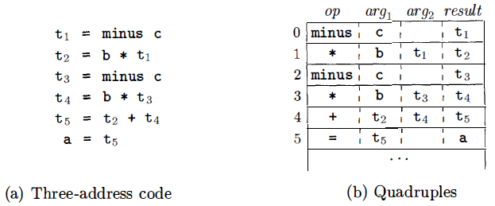
7.2 Three-Address Code – Quadruples
The description of three-address instructions specifies the components of each type of instruction, but it does not specify the representation of these instructions in a data structure. Three such representations are called "quadruples," "triples," and "indirect triples.“
Quadruples
A quadruple (or quad ) has four fields, which we call op, argl arg2 , and result.

Slide 10
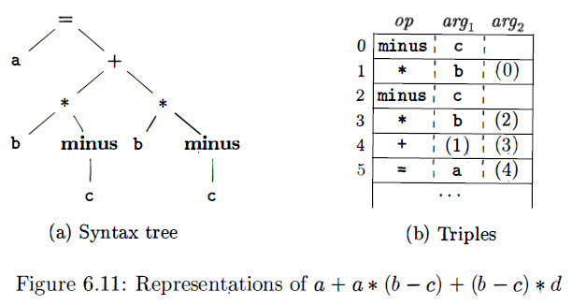
7.2 Three-Address Code – Triples
A triple has only three fields, which we call op, arg1 , and arg2. Using triples, we refer to the result of an operation x op y by its position, rather than by an explicit temporary name.
A ternary operation like x [i]= y requires two entries in the triple structure; for example, we can put x and i in one triple and y in the next. Similarly, x = y [i] can implemented by treating it as if it were the two instructions.

Slide 11
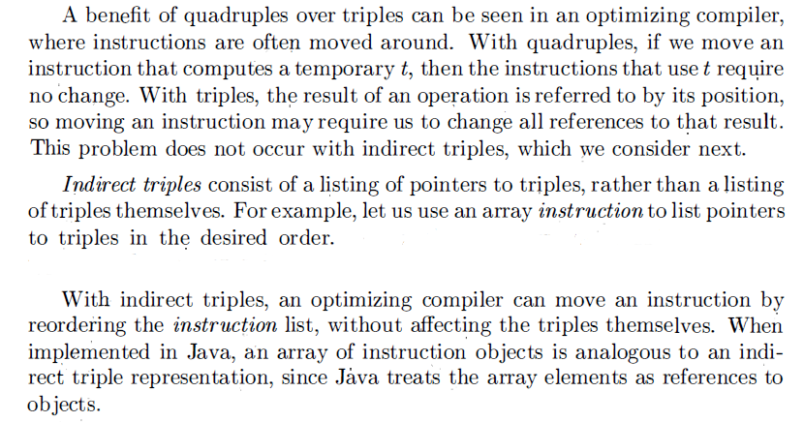
7.2 Three-Address Code – Triples

Slide 12
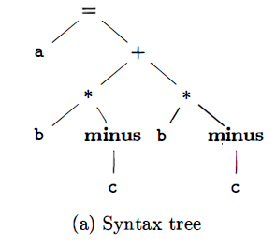
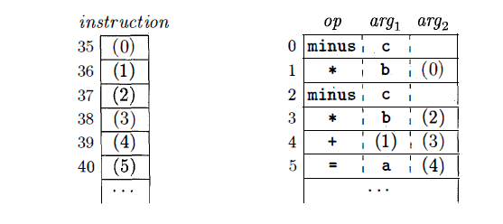
7.2 Three-Address Code – Triples

Slide 13
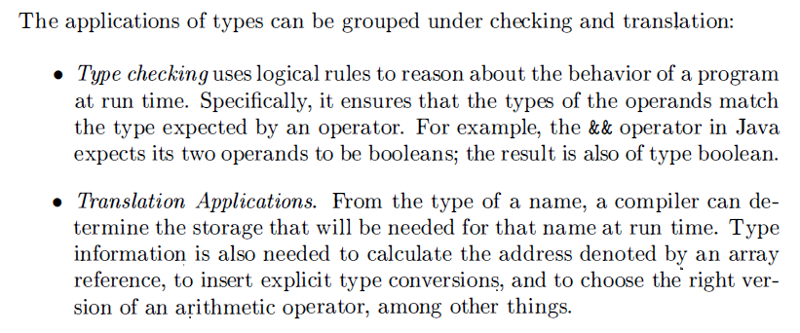
7.3 Types and Declarations

Slide 14
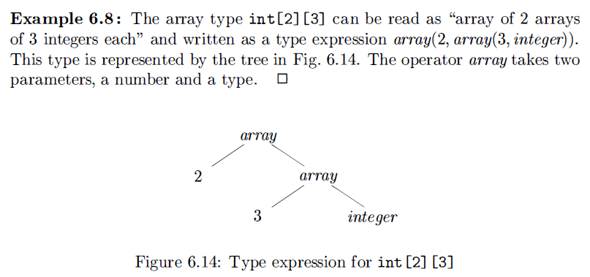
7.3 Types and Declarations-Type Expressions
type expressions: a type expression is either a basic type or is formed by applying an operator called a type constructor to a type expression.

Slide 15
7.3 Types and Declarations-Type Expressions
A basic type is a type expression. Typical basic types for a language include boolean, char, integer, float, and void;
A type name is a type expression;
A type expression can be formed by applying the array type constructor to a number and a type expression;
A type expression can be formed by applying the record type constructor to the field names and their types;
A type expression can be formed by using the type constructor “->”for function types. We write s ->t for "function from type s to type t.“
If s and t are type expressions, then their Cartesian product s x t is a type expression. Products are introduced for completeness; they can be used to represent a list or tuple of types (e.g. , for function parameters ) .
Type expressions may contain variables whose values are type expressions.

Slide 16
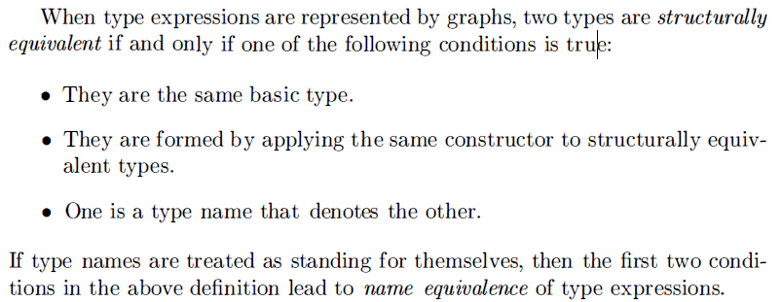
7.3 Types and Declarations-Type Equivalence
Many type-checking rules have the form, "if two type expressions are equal then return a certain type else error.“
The key issue is whether a name in a type expression stands for itself or whether it is an abbreviation for another type expression.

