Slide 1
Software Project Management
Jing Zhang Ph.D.

Slide 2
Course Review

Slide 3
Attributes of Project
The characteristics distinguish projects:
non-routine tasks are involved;
planning is required;
specific objectives are to be met or a specified product is to be created;
the project has a predetermined time span;
work is carried out for someone other than yourself;
work involves several specialism;
people are formed into a temporary work group to carry out the task ;
work is carried out in several phases;
the resources that are available for use on the project are constrained;
the project is large or complex.

Slide 4
Stakeholders
The people who have a stake or interest in the project
Internal to the project team
External to the project team but within the same organization
External to both the project team and the organization
Identify them early for setting up better communication channels

Slide 5
Setting objectives
Objectives focus on the desired outcomes of the project rather than the task within it.
SMART principles
Specific: Effective objectives are concrete and well defined
Measurable: measures of effectiveness which tell us how successful the project has been
Achievable: within the power of the individual or group
Relevant: must be relevant to the true purpose of the project
Time constrained: should be a defined point in time by which the objective should have been achieved

Slide 6
Project Manager
Functionality of a PM
PM is responsible for the execution of the project activities and the achievement of the project objectives.
PM is the highest leader, organizer and responsibility of project execution, which plays a determinative role in project management.
PM is a bridge and link of the project related parties, and is in the core position of the project.
PM is responsible for communication, consultation, resolve all kinds of conflicts and disputes.

Slide 7
Project Manager
Responsibility of a PM
Ensure that the project objectives can be achieved (fundamental)
Develop plans and sub plans
PM breaks down the overall goal, divides it into some main work and work load, determines the milestones of the project stages, outcomes and the progress check points, and establishes the overall control plan.
Organization and implementation
Design the project's organizational structure
For large projects, decide which tasks are done by the project team and which are done by the contractor.
Project Control
Monitor project operation, establish and improve the project team's internal information management system, including meetings and reporting.

Slide 8
Project Manager
Authorities (powers) of a PM
instructions in production
establishment of the project team
appointment, assessment, promotion, punishment, reward, supervision, command and even dismissal.
financial rights
project manager must have financial decision-making authority within the scope of the contract.
technical decision-making rights
review and approve major technical solutions, to convene a technical proposal or to consult an expert if necessary.

Slide 9
Project Manager
Abilities of a PM
Ability to obtain project resources
Project managers, by establishing their own image, with a variety of relationships and senior leadership, through the normal channels to obtain project resources.
Ability to eliminate obstacles and solve problems
Leadership and tradeoffs
Communication skills
Ability to manage time
The project manager must identify the priority of activities, and make a good arrangement.

Slide 10
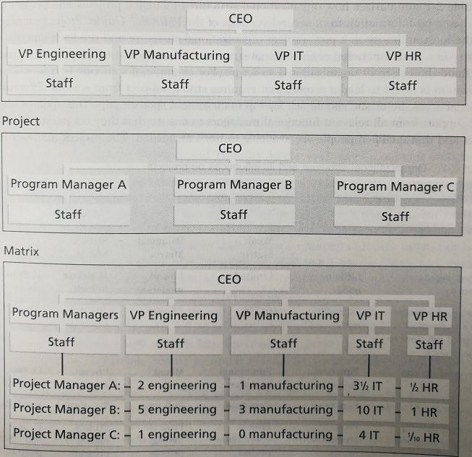
Organizational Structures
Functional organizational structure
Project organizational structure
Matrix organizational structure

Slide 11
Project Life Cycle
Four phases model: Each phase is also called a process groups
A process is a series of actions directed toward a particular result.

Slide 12
A business case
Also known as a feasibility study or a project justification
Objectives: Provide a rationale for the project by showing that the benefits of the project outcomes will EXCEED its costs.

Slide 13
Cost-benefit evaluation techniques
Net profit: the difference between the total cost and the total income over the life of project.
Payback period: is the time taken to break even or pay back the initial investment. (Normally, the project with the shortest payback period will be chosen.)
Year | Project 1 | Project 2 | Project 3 | Project 4
0 | -100,000 | -1,000,000 | -100,000 | -120,000
1 | 10,000 | 200,000 | 30,000 | 30,000
2 | 10,000 | 200,000 | 30,000 | 30,000
3 | 10,000 | 200,000 | 30,000 | 30,000
4 | 20,000 | 200,000 | 30,000 | 30,000
5 | 100,000 | 300,000 | 30,000 | 75,000
Net profit | 50,000 | 100,000 | 50,000 | 75,000

Slide 14
Net present value (NPV) analysis
Basic idea:
vice versa $100 in a year’s time =?? at present
Present value (in year t) takes into account the profitability of a project and the timing of the cache flows.
t is named discount rate
E.g.
If we receive $100 in the next year with a discount rate 10%, it approximately equals $91 if we get them immediately.
$100 (today) ≠$100 (in a year’s time)
$100 (today) =$100 + $100×interest rate

Slide 15
NPV analysis
Successive year’s present value
The Net Present Value （NPV）for a project
where p₀ is the initial investment
Review Your Homework!

Slide 16
Program Management
D. C. Ferns defined a program as ‘a group of projects that are managed in a coordinated way to gain benefits that would not be possible were the projects to be managed independently’
Forms:
Business cycle programs
The collection of projects that an organization undertakes within a particular planning cycle. E.g., many organizations have a fixed budget for ICT development in a financial year
Strategic programs
Several projects together can implement a single strategy
Infrastructure programs
A infrastructure program could refer to the activities of identifying a common ICT infrastructure and its implementation and maintenance.
Research and development programs
A successful portfolio would need to be a mixture of ‘safe projects’ with relatively low returns and some riskier projects that might fail, but if successful would generate handsome profits which will offset the losses on the failures.

Slide 17
Work Breakdown Structure
Used as a basis for a number of processes in particular to produce the subsidiary plans of the Project Management Plan.
The WBS is a deliverable-oriented hierarchy of decomposed project components that organizes and defines the total scope of the project. The WBS is a representation of the detailed project scope statement that specifies the work to be accomplished by the project. (DEFINITION)
The elements comprising the WBS assist the stakeholders in viewing the end product of the project.
The work at the lowest-level WBS component is estimated, scheduled, and tracked.
For a larger project, the structure of WBS is usually divided into 4-6 layers.

Slide 18
Work Breakdown Structure
three types of project work (not all for end customers)
Product
Specifically assigned to a physical product as a unique deliverable
This subset is sometimes referred to as the product breakdown structure
Integration
When products are brought together as a unit
Can be at any level
Support
Level of Effort, Administration, Expenses, Improvement Practices, Contractor Management

Slide 19
The waterfall model
This is the classic model of system development that is also known as the one-shot or once-through model.
A later stage may reveal the need for some extra work at an earlier stage, but this should definitely be the exception rather than the rule.

Slide 20
Software Prototyping
A prototype is a working model of one or more aspects of the projected system. It is constructed and tested quickly and inexpensively in order to test out assumptions
Throw-away prototypes The prototype test out some ideas and is then discarded when true development of the operational system is commenced.
Evolutionary prototypes The prototype is developed and modified until it is finally in a state where it can become the operational system.

Slide 21
Software Prototyping
Some of the reasons why we need prototyping
Learning by doing
Improved communication
Improved user involvement The users can be more actively involved in design decisions.
Clarification of partially known requirements
Demonstration of the consistency and completeness of a specification
Reduced need for documentation
Reduced maintenance costs
Production of expected results

Slide 22
Agile methods
Agile methods are designed to overcome the disadvantages we have noted with heavyweight implementation methodologies. There are various agile approaches
Crystal technologies
Atern
Feature-driven development
Scrum
Extreme Programming (XP)

Slide 23
Agile Manifesto
Some of the leading proponents of these approaches came together in 2001 to issue an Agile Manifesto which stated that their various methods shared four core values:
Individual and interaction over process and tools
Working together over comprehensive documentation
Customer collaboration over contract negotiation
Responding to change over following a plan

Slide 24
eXtreme Programming (XP)
Previously:
Get all the requirements before starting design
Freeze the requirements before starting development
Resist changes: they will lengthen schedule
Build a change control process to ensure that proposed changes are looked at carefully and no change is made without intense scrutiny
Deliver a product that is obsolete on release

Slide 25
XP: Embrace Change
Recognize that:
All requirements will not be known at the beginning
Requirements will change
Use tools to accommodate change as a natural process
Do the simplest thing that could possibly work and refactor mercilessly
Emphasize values and principles rather than process

Slide 26
XP: Values
Communication
Simplicity
Feedback
Courage

Slide 27
XP Values: Communication
Poor communication in software teams is one of the root causes of failure of a project
Stress on good communication between all stakeholders--customers, team members, project managers
Customer representative always on site
Paired programming

Slide 28
XP Values: Simplicity
‘Do the Simplest Thing That Could Possibly Work’
Implement a new capability in the simplest possible way
Refactor the system to be the simplest possible code with the current feature set
‘You Aren’t Going to Need It’
Never implement a feature you don’t need now

Slide 29
XP Values: Feedback
Always a running system that delivers information about itself in a reliable way
The system and the code provides feedback on the state of development
Catalyst for change and an indicator of progress

Slide 30
XP Values: Courage
Projects are people-centric
Ingenuity of people and not any process that causes a project to succeed

Slide 31
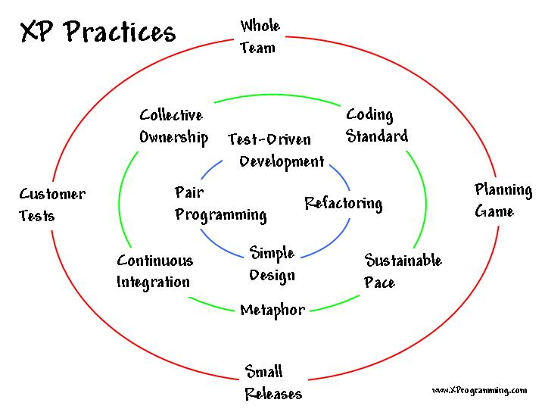
XP Practices

Slide 32
XP Practices: Pair Programming
All production software is built by two programmers, sitting side by side, at the same machine
All production code is therefore reviewed by at least one other programmer
Research into pair programming shows that pairing produces better code in the same time as programmers working singly
Pairing also communicates knowledge throughout the team

Slide 33
XP Practices: Design Improvement
Continuous design improvement process called ‘refactoring’:
Removal of duplication
Increase cohesion
Reduce coupling
Refactoring is supported by comprehensive testing--customer tests and programmer tests

Slide 34
XP Practices: Customer Tests
The Customer defines one or more automated acceptance tests for a feature
Team builds these tests to verify that a feature is implemented correctly
Once the test runs, the team ensures that it keeps running correctly thereafter
System always improves, never backslides

Slide 35




Main ways of estimation
Algorithmic models
Building estimation models (functions with multiple parameters)
Expert judgement
Based on the advice of knowledgeable staff
Analogy
where a similar, completed, project is identified and its actual effort is used as the basis of the estimate
Parkinson
Where the staff effort available to do a project becomes the ‘estimate’
Price to win
where the ‘estimate’ is a figure that seems sufficiently low to win a contract.
Could you tell me
When should we use algorithmic models ?
When should we use expert models ?
Which is more convincing?

Slide 36
Estimating by analogy
This is also called case-based reasoning. The estimator identifies completed projects (source cases) with similar characteristics to the new project (the target cases). The effort recorded for the matching source case is then used as a base estimate for the target. The estimator then identifies differences between the target and the source and adjusts the base estimate to produce an estimate for the new project.
Measures of similarity.
Euclidean distance between cases.
Other similarity measures (Manhattan, Pearson correlation, cosine correlation, …)

Slide 37
Function points Mark II
The Mark II method was originally sponsored by CCTA (Central Computer and Telecommunications Agency, now the Office of Government Commerce or OGC). UK standard, an improvement and replacement of the Albrecht method.
The information processing size is initially measured in unadjusted function points (UFPs). The assumption: IS comprises transactions which have the basic structure as follows.
Datastore
input
output
From user
Process
Return to User
Weights are derived by asking developers the proportions of efforts spent in previous projects

Slide 38
Function point Mark II
The proportions of effort are then normalized into ratios, or weightings, which add up to 2.5. This process for calculating weightings is time consuming and most FP counters use industry average which are currently 0.58 for W_{i}, 1.66 for W_{e} and 0.26 for W_{o}.
E.g. 5.2

Slide 39
Network planning models
These project scheduling techniques model the project’s activities and their relationships as a network. In the network, time flows from left to right. These techniques were originally developed in the 1950s – known as CPM (Critical Path Method) and PERT (Program Evaluation Review Technique)
Two types of networks
Activity-on-node (precedence networks)
Activity-on-arrow
CPM was developed by the Du Pont Chemical Company in 1958, claiming that it had saved them $1 million in its first year of use.
Code
Program test
Install
Data take-on
Code
Program test
Install
Data take-on

Slide 40
Formulating a network model
Constructing well-formed precedence networks
A project network should have only one start node.
A project network should have only one end node.
A node has duration
Links normally have no duration. Links represent the relationships between activities.
Precedents are the immediate preceding activities. We do not speak of ‘Code’ and ‘Data take-on’ as precedents of ‘Install’.
Time moves from left to right.
A network may not contain loops.
A network should not contain dangle.

Slide 41


Examples
Code Program
Test Program
Release Program
Which attribute of the activity does the case violate?
Correct
errors
Diagnose
errors
Code Program
Test Program 1
Diagnose
Errors 1
Correct
Errors 1
Test Program n
Diagnose
Errors n
Correct
Errors n
Release Program
Design Program
Code Program
Test Program
Install Program
Writer User
manual
Design Program
Code Program
Test Program
Install Program
Sign-off
Writer User
manual

Slide 42
Representing lagged activities
Where activities can occur in parallel with a time lag between them, we represent the lag with a duration on the linking arrow.
The above figure indicates that documenting amendments can start one day after the start of prototype testing and will be completed two days after prototype testing is completed.
Build prototype
Test prototype
Revise specification
1
Document amendments
2

Slide 43
Labeling conventions
There are a number of different conventions that have been adopted for entering information on an activity-on-node network.
Earliest start | duration | Earliest completion
Description of the activity
Latest start | float | Latest completion

Slide 44
Time dimension
Example
Activity | Duration (week) | Precedents
A. Hardware selection | 6
B. System configuration | 4
C. Install hardware | 3 | A
D. Data migration | 4 | B
E. Draft office procedures | 3 | B
F. Recruit staff | 10
G. User training | 3 | E, F
H. Install and test system | 2 | C, D

Slide 45
The precedence network for the example project
 | 6 weeks
A. Hardware selection
 | 3 weeks
C. Install hardware
 | 4 weeks
B. Software configuration
 | 4 weeks
D. Data migration
 | 2 weeks
H. Install and test
 | 10 weeks
F. Recruit staff
 | 3 weeks
E. Draft office procedures
 | 3 weeks
G. User training

Slide 46
The forward pass
Calculate the earliest dates on which each activity may be started and completed
0
6
6
9
 | 6 weeks
A. Hardware selection
 | 3 weeks
C. Install hardware
0
4
4
8
9
11
 | 4 weeks
B. Software configuration
 | 4 weeks
D. Data migration
 | 2 weeks
H. Install and test
10
4
7
10
13
 | 10 weeks
F. Recruit staff
0
 | 3 weeks
E. Draft office procedures
 | 3 weeks
G. User training

Slide 47
The backward pass
Calculate the latest dates at which each activity may be started and finished without delaying the end date of the project.
0
6
6
9
 | 6 weeks
A. Hardware selection
 | 3 weeks
C. Install hardware
2
8
8
11
0
4
4
8
9
11
 | 4 weeks
B. Software configuration
 | 4 weeks
D. Data migration
 | 2 weeks
H. Install and test
3
7
7
11
11
13
10
4
7
10
13
 | 10 weeks
F. Recruit staff
0
 | 3 weeks
E. Draft office procedures
 | 3 weeks
G. User training
0
10
7
10
10
13

Slide 48
Identifying the critical path
There will be at least one path through the network that defines the duration of the project. This is known as the critical path.
Critical activity: float = 0 (latest completion – earliest completion)
There will be at least one path through the network joining those critical activities.
0
6
6
9
 | 6 weeks
A. Hardware selection
 | 3 weeks
C. Install hardware
2
2
8
8
2
11
0
4
4
8
9
11
 | 4 weeks
B. Software configuration
 | 4 weeks
D. Data migration
 | 2 weeks
H. Install and test
3
3
7
7
3
11
11
2
13
10
4
7
10
13
 | 10 weeks
F. Recruit staff
0
 | 3 weeks
E. Draft office procedures
 | 3 weeks
G. User training
0
0
10
7
3
10
10
0
13

Slide 49
ISO 9126
The ISO 9126 standard was first introduced in 1991 to tackle the question of the definition of software quality.
Six major external software quality characteristics
Characteristic | Description
Functionality | To satisfy user needs
Reliability | The capability of the software to maintain tis level of performance
usability | The effort needed to use the software
Efficiency | The physical resources used when the software is executed
Maintainability | The effort needed to the make changes to the software
Portability | The ability of the software to be transferred to a different environment.

Slide 50
Process capability models
Capability Maturity Model (CMM) , by the Software Engineering Institute (SEI) at Carnegie-Mellon University. (new version CMM Integration)
These models place organizations at one of five levels of process maturity which indicate the sophistication and quality of their production practices.

Slide 51
CMMI
Level 1: Initial The procedures followed tend to be haphazard.
Level 2: Managed have basic project management procedures in place.
Level 3: Defined has defined the way that each task in the software development life cycle should be done.
Level 4: Quantitatively The products and processes involved in software development are subject to measurement and control.
Level 5: Optimizing Improvement in procedures can be designed and implemented using the data gathered from the measurement process.

Slide 52
Software Quality in Organization
Some concepts
Software Quality Control (SQC) is the set of procedures used by organizations to ensure that a software product will meet its quality goals at the best value to the customer, and to continually improve the organization's ability to produce software products in the future.
Scientific methods for measuring the status of quality
Software Quality Assurance (SQA) is a process that ensures that developed software meets and complies with defined or standardized quality specifications. SQA is an ongoing process within the software development life cycle that routinely checks the developed software to ensure it meets desired quality measures.
A set of quality specifications.
The aim of Software Quality Management (SQM) is to manage the quality of software and of its development process.

Slide 53
Organizational Guarantee for Quality
Has a strong sense of ‘quality first’
Management Level
Project Team
SEPG Group
Test Team
SQA Group
conduct a comprehensive in-depth test
Track, control, improve quality from process
Promote enterprise process definition, maintenance and improvement.

