Slide 1
Software Project Management
Jing Zhang Ph.D.

Slide 2
Software effort estimation
Objectives:
The classification of software effort estimation techniques
Select proper estimation methods in software planning
Albrecht function point analysis
Function points Mark II
COnstructive COst Model II (COCOM II)

Slide 4

The basis for software estimating
The need for historical data
Most estimating methods need information about past project.
Tips: International Software Benchmarking Standard (ISBSG) currently contains data from projects
Measure of work (Direct calculation of costs and time is difficult)
Source lines of code (SLOC)
Thousands of lines of code (KLOC)
Is it reasonable that using the above two metrics as measure of work??

Slide 5




Main ways of estimation
Algorithmic models
Building estimation models (functions with multiple parameters)
Expert judgement
Based on the advice of knowledgeable staff
Analogy
where a similar, completed, project is identified and its actual effort is used as the basis of the estimate
Parkinson
Where the staff effort available to do a project becomes the ‘estimate’
Price to win
where the ‘estimate’ is a figure that seems sufficiently low to win a contract.
Could you tell me
When should we use algorithmic models ?
When should we use expert models ?
Which is more convincing?

Slide 6
Two paradigms to estimate
Bottom-up estimating
Component tasks are identified and sized and these individual estimates are aggregated.
Suitable for a completed novel project or there is no historical data available
A procedural code-oriented approach (Bottom-up approach describe works at the level of activities. (a major activity is writing code)
Envisage the number and type of software modules in the final system
Estimate the SLOC of each identified module
Estimate the work content, taking into account complexity and technical difficulty
Calculate the work-days effort

Slide 7
Bottom-up Example
Exercise 5.4 The IOE annual maintenance contracts subsystem for which Amanda is responsible will have a transaction which sets up details of new annual maintenance contract customers.
The operator will input:
Customer account number
Customer name
Address
Postcode
Customer type
Renewal data
All this information will be set up in a CUSTOMER record on the system’s database. If a CUSTOMER account already exists for the account number that has been input, an error message will be display to the operator.
Draw up an outline program structure diagram for a program to do the processing described above. For each box on your diagram, estimate the number of line of code needed to implement the routine in a programming language that you are familiar with such as Java.

Slide 8
Two paradigms to estimate
Top-down estimating
An overall estimate for the whole project is broken down into the effort required for component tasks.
The top-down approach is normally associated with parametric (or algorithmic) models. (e.g., rebuild a house: costs=bricklayer-hours+carpenter-hours+electrican-hours)
A parametric model have one or more formulae in the form:
Given historical system sizes and efforts on the past prj., we can work out a productivity:
A more sophisticated models use the statistical technique least squares regression to derive an equation in the form:
KLOC
?? Days per KLOC

Slide 9
Top-down Example
Exercise 5.5 Students on a course are required to produce a written report on an ICT-related topic each semester. If you wanted to create a model to estimate how long it should take a student to complete such an assignment, what measure of work content would you use? Some report might be more difficult to produce than others: what factors might affect the degree of difficulty?

Slide 10
Expert judgement
This is asking for an estimate of task effort from someone who is knowledgeable about either the application or the development environment.
Some have suggested that expert judgment is simply a matter of guessing, but some researches have shown that experts tend to use a combination of an informal analogy approach where similar projects from the past are identified, supplemented by bottom-up estimation.

Slide 11
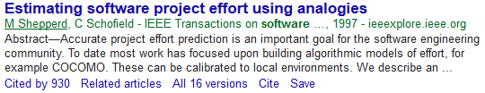
Estimating by analogy
This is also called case-based reasoning. The estimator identifies completed projects (source cases) with similar characteristics to the new project (the target cases). The effort recorded for the matching source case is then used as a base estimate for the target. The estimator then identifies differences between the target and the source and adjusts the base estimate to produce an estimate for the new project.
Measures of similarity.
Euclidean distance between cases.
Other similarity measures (Manhattan, Pearson correlation, cosine correlation, …)

Slide 12
Albrecht function point analysis
A top-down method devised by Allan Albrecht (IBM). The method quantifies the functional size of programs independently of their programming languages.
Information systems comprise five major components (“external user types”), which have different complexity (multipliers).
External input types: input transactions which update internal status.
External output types: transactions where data is output to the user.
External inquiry types: input transactions that do not update internal status
Logical internal file types: a group of data or files used by the system
External interface file types: allow for output and input that may pass to and from other computer applications.
The analyst identifies each instance of each external user type in the application. Each component is then classified as having either high, average or low complexity.

Slide 13
Albrecht function point analysis
Albrecht complexity multipliers
The question of whether the external user type was of high, low or average complexity was intuitive. The International FP User Group (IFPUG) made further refinement.
IFPUG Complexity of external input type
External user type | Multiplier
 | Low | Average | High
External input type | 3 | 4 | 6
External output type | 4 | 5 | 7
External inquiry type | 3 | 4 | 6
Logical internal file type | 7 | 10 | 15
External interface file type | 5 | 7 | 10
 | Number of data type to access
Number of file type to access | <5 | 5~15 | >15
0 or 1 | Low | Low | Medium
2 | Low | Medium | Medium
>2 | Medium | High | High

Slide 14
Function points Mark II
The Mark II method was originally sponsored by CCTA (Central Computer and Telecommunications Agency, now the Office of Government Commerce or OGC). UK standard, an improvement and replacement of the Albrecht method.
The information processing size is initially measured in unadjusted function points (UFPs). The assumption: IS comprises transactions which have the basic structure as follows.
Datastore
input
output
From user
Process
Return to User
Weights are derived by asking developers the proportions of efforts spent in previous projects

Slide 15
Function point Mark II
The proportions of effort are then normalized into ratios, or weightings, which add up to 2.5. This process for calculating weightings is time consuming and most FP counters use industry average which are currently 0.58 for W_{i}, 1.66 for W_{e} and 0.26 for W_{o}.
E.g. 5.2

Slide 16
COCOMO II: a parametric productivity model
Boehm’s COCOMO (Constructive COst MOdel) was originally proposed in the late 1970s on a study of 63 projects. The basic model was built around the equation , where effort was measured in pm of the number of ‘person-months’ consisting of units of 152 working hours, size was measured in kdsi, thousand of delivered source code instructions, and c and k were constants.

Slide 17
COCOMO II: a parametric productivity model
In the above equation, c and k were depended on which the system could be classified into.
Organic mode This would typically be the case when relatively small teams developed software in a highly familiar in-house environment and when the system being developed was small and the interface requirements were flexible.
Embedded mode This meant that the product being developed had to operate within very tight constraints and changes to the system were very costly.
Semi-detached mode This combined elements of the organic and the embedded modes or had characteristic that came between the two.
System type | c | k
Organic | 2.4 | 1.05
Semi-detached | 3.0 | 1.12
Embedded | 3.6 | 1.20

Slide 18
COCOMO II: a parametric productivity model
Estimates are required at different stages in the system life cycle. COCOMO II has three stages, each of which has different model.
Application composition Here the external features of the system that the users will experience are designed. Prototyping will typically be employed to do this.
Early design Here the fundamental software structures are designed.
Post architecture Here the software structures undergo final construction, modification and tuning to create a system that will perform as required.

Slide 19
COCOMO II: a parametric productivity model
Application composition
COCOMO II recommends the Object Point methods, by o[Kauffman and Kumar 1993] and [Banker et al. 1994]
Kauffman, R., and R. Kumar (1993), "Modeling Estimation Expertise in Object Based ICASE Environments," Stern School of Business Report, New York University, January 1993.
Banker, R., R. Kauffman and R. Kumar (1994), "An Empirical Test of Object-Based Output Measurement Metrics in a Computer Aided Software Engineering (CASE) Environment," Journal of Management Information Systems.

Slide 20
COCOMO II: a parametric productivity model
Early design
Function Points are recommended. An FP count may be converted to a LOC equivalent by multiplying the FPs by a factor for the programming language that is to be used.
Constant (2.94 in year 2000)
Effort multipliers
Measured in kdsi (thousand of delivered source code )
Exponent scale factor, derived by
Constant 0.91

Slide 21
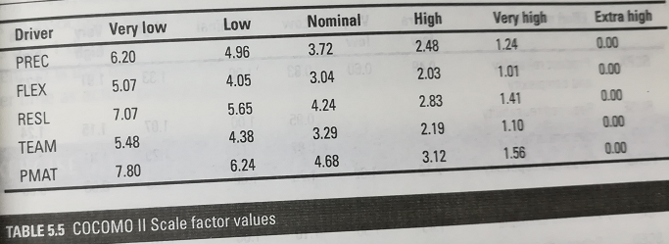
COCOMO II: a parametric productivity model
Exponent driver ratings
Precedentedness (PREC) This quality is the degree to which there are precedents or similar past cases for the current project.
Development flexibility (FLEX) This reflects the number of different ways there are of meeting the requirements.
Architecture/risk resolution (RELS) This reflect the degree of uncertainty about the requirements.
Team cohesion (TEAM) This reflects the degree to which there is a large dispersed team.
Process maturity (PMAT) The more structured and organized the way the software is produced, the lower the uncertainty and the lower the rating will be for this exponent driver.

Slide 22
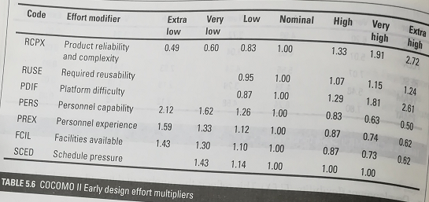
COCOMO II: a parametric productivity model
Effort multipliers (em) adjust the estimate to take account of productivity factors, but do not involve economies or diseconomies of scale.

Slide 23
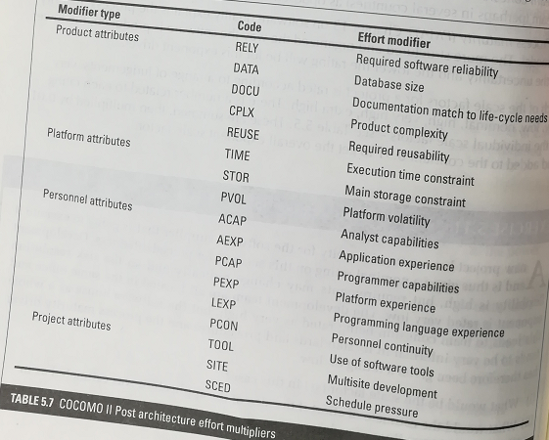
COCOMO II: a parametric productivity model
At a later stage of the project, detailed design of the application will have been completed. There will be a clearer idea of application size in terms of lines of code, and the factors influencing productivity will be better known.

Slide 24
Example for COCOMO II
A new project has ‘average’ novelty for the software supplier that is going to execute it and is thus given a nominal rating on this account for precedentedness. Development flexibility is high, but requirements may change radically and so the risk resolution exponent is rated very low. The development team are all located in the same office and this leads to team cohesion being rated as very high, but the software house as a whole tends to be very informal in its standards and procedures and the process maturity drive has therefore been given a rating of ‘low’.
(1) What would be the scale factor (sf) in this case?
(2) What would the estimate of effort if the size of the application was estimated as in the region of 2000 lines of code.

Slide 25
Conclusion
Estimates are really management target
Collect as much information about previous projects as possible
Use more than one method of estimating
Top-down approaches will be used at the earlier stages of project planning while bottom-up approaches will be more prominent later on.
Seek a range of opinions
Document your method of doing estimates and record all your assumptions.

Slide 26
Homework
5.15 Further exercise
4

Slide 27
Exercises
Exercise 5.4
The system has a transaction which sets up details of new annual maintenance contract customers.
The operator will input: customer account number, customer name, address postcode,
customer type, renewal data.
All this information will be set up in a CUSTOMER record on the system’s database. If a CUSTOMER account already exists for the account number that has been input, an error message will be displayed to the operator.
Draw up an outline program structure diagram for a program to do the processing described above. For each box on your diagram, estimate the number of lines of code needed to implement the routine in a programming language that you are familiar with, such as Java.

Slide 28
Exercise 5.5
Students on a course are required to produce a written report on an ICT-related topic each semester. If you wanted to create a model to estimate how long it should take a student to complete such an assignment, what measure of work content would you use? Some reports might be more difficult to produce than others: what factors might affect the degree of difficulty?

Slide 29
Further Exercise 4
The following details are held about previously developed software modules. A new module has 7 inputs, 1 entity type access and 7 outputs. Which of the modules a to e is the closet analogy in terms of Euclidean distance.
Module | Inputs | Entity Types accessed | Outputs | Days
A | 1 | 2 | 10 | 2.60
B | 10 | 2 | 1 | 3.90
C | 5 | 1 | 1 | 1.83
D | 2 | 3 | 11 | 3.50
E | 1 | 3 | 20 | 4.30
F (New) | 7 | 1 | 7 | ??

