Slide 1

Compilers
Principles, Techniques, & Tools
Taught by Jing Zhang
(jzhang@njust.edu.cn)

Slide 2
Syntax Analysis – Bottom UP Method

Slide 3
Outlines
Bottom-Up Parsing

Slide 4
5.1 Bottom-Up Parsing – the first example
A bottom-up parse corresponds to the construction of a parse tree for an input string beginning at the leaves (the bottom) and working up towards the root (the top) .

Slide 5
5.1 Bottom-Up Parsing – Reduction
We can think of bottom-up parsing as the process of "reducing" a string w to the start symbol of the grammar. At each reduction step, a specific substring matching the body of a production is replaced by the nonterminal at the head of that production. The key decisions during bottom-up parsing are about when to reduce and about what production to apply, as the parse proceeds.
Eg.
By definition, a reduction is the reverse of a step in a derivation
This derivation is in fact a rightmost derivation.

Slide 6
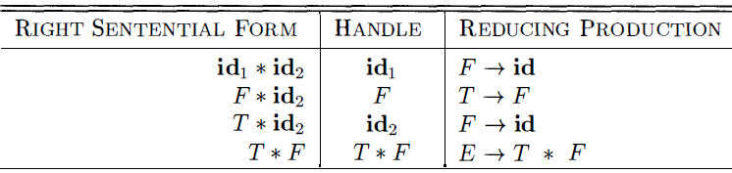
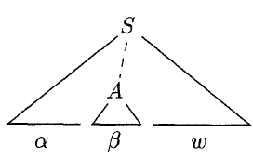
5.1 Bottom-Up Parsing – Handle Pruning
Bottom-up parsing during a left-to-right scan of the input constructs a rightmost derivation in reverse. Informally, a "handle" is a substring that matches the body of a production, and whose reduction represents one step along the reverse of a rightmost derivation.
rm
rm
rm
rm
rm
Formally, if then the production in the position following is a handle of . Notice that the string to the right of the handle must contain only terminal symbols. For convenience, we refer to the body rather than as a handle.
A rightmost derivation in reverse can be obtained by "handle pruning”.

Slide 7
5.1 Bottom-Up Parsing – More Explanations on “Handle”
Right-most derivation is also called “normal derivation”, which guarantees
Proof. if has a handle , i.e, and , then under the rightmost derivation should not be derived out before .
If has the form and , we do not call “handle”, because for right-sentential form then last rightmost derivation is , i.e., is previously derived out to . Thus, the reverse of the last rightmost derivation should take place on .
Thus, a handle is at the leftmost position of a right-sentential form.
Note we say "a handle" rather than "the handle," because the grammar could be ambiguous, with more than one rightmost derivation of . If a grammar is unambiguous, then every right-sentential form of the grammar has exactly one handle.
No handle

Slide 8
5.1 Bottom-Up Parsing – More Explanations on “Handle”
Normal Reduction is a reverse of a Normal derivation (rightmost derivation).
Specifically, is a sentence of grammar G, we call the sequence of sentential forms is a Normal Reduction of , if the sequence satisfies:
(1)
(2) (start symbol of a grammar)
(3) For , can be obtained by replacing the handle of with the left part of its corresponding production.
Thus, Normal Reduction is also called leftmost reduction !

Slide 9
Homework 5

