Slide 1

Compilers
Principles, Techniques, & Tools
Taught by Jing Zhang
(jzhang@njust.edu.cn)

Slide 2
Grammar Description

Slide 3
2.1 Some Concepts
Let be an alphabet，where each element is called a symbol. A string on is a finite sequence which is composed of symbols in . The string that contains NO symbol is called an ε-string (or ε).
Let be the full set of all strings on , including ε .
Let φ be an empty set {}.
Concatenation of U and V is defined as
Self-concatenation: ,
The closure of V is denoted by
The regular closure:

Slide 4
2.2 Context-free Grammar
A grammar is a set of formal regulations that describes the syntax structures of a language.
A context-free grammar has four components
(1) A set of terminal symbols, sometimes referred to as "tokens." The terminals are the elementary symbols of the language defined by the grammar.
(2) A set of nonterminals, sometimes called "syntactic variables." Each nonterminal represents a set of strings of terminals.
(3) A set of productions, where each production consists of a nonterminal, called the head or left side of the production, an arrow, and a sequence of terminals and/or nonterminals , called the body or right side of the production. The intuitive intent of a production is to specify one of the written forms of a construct; if the head nonterminal represents a construct, then the body represents a written form of the construct .
(4) A designation of one of the nonterminals as the start symbol

Slide 5
2.2 Context-free Grammar – Formal Definition
The context-free grammar G is a 4-tuple
V_{T} is a non-empty finite set, where each element is a terminal.
V_{N} is a non-empty finite set, where each element is a nonterminal,
S is a nonterminal, called start symbol
is as finite set of productions, where each production has the form . . S must appear in the left part of a production at least once.

Slide 6
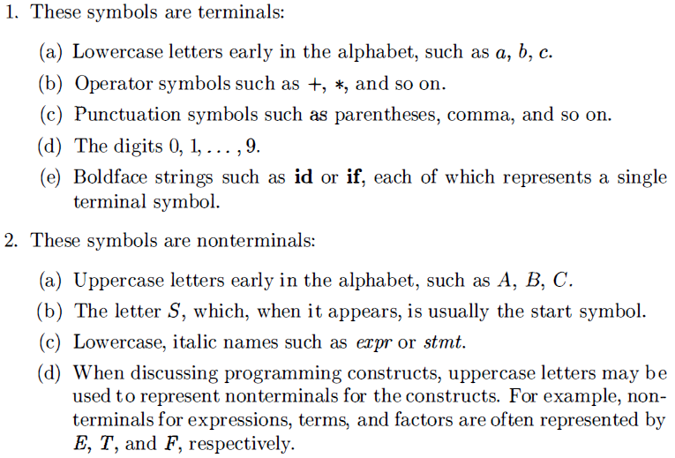
2.2 Context-free Grammar – Notational Conventions

Slide 7
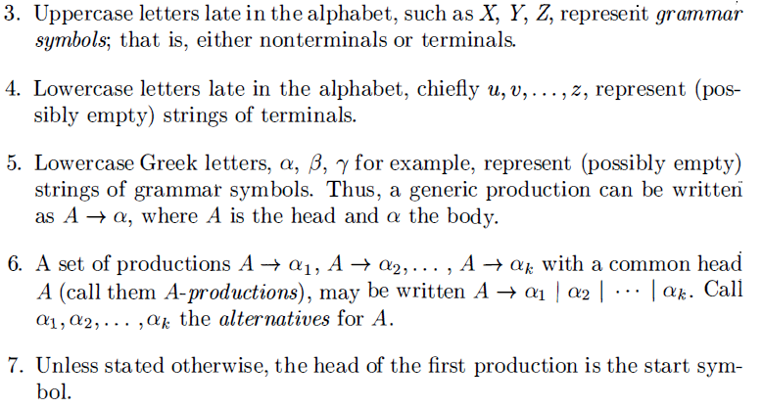
2.2 Context-free Grammar – Notational Conventions

Slide 8
2.2 Context-free Grammar – Derivations
A grammar derives strings by beginning with the start symbol and repeatedly replacing a nonterminal by the body of a production for that nonterminal.
Strictly, we call that derives in one step, i.e.,
if and only if is a production, and .
means “derives in one step”. When a sequence of derivation steps rewrites , we say
. We use symbol” and symbol to represent “derives in zero or more steps” and symbol to represent “derives in one or more steps”.
If , where S is the start symbol of a grammar G, we say that is a sentential form of G.

Slide 9
2.2 Context-free Grammar – Derivations
Note that a sentential form may contain both terminals and nonterminals, and may be empty. A sentence of G is a sentential form with no nonterminals. The language generated by a grammar G is its set of sentences, denoted by L(G) .
Thus, a string of terminals w is in L(G) , if and only if w is a sentence of G (or ). If two grammars generate the same language, the grammars are said to be equivalent.

Slide 10
2.2 Context-free Grammar – Derivations
We consider derivations in which the nonterminal to be replaced at each step is chosen as follows:
1. In leftmost derivations, the leftmost nonterminal in each sentential is always chosen. If is a step in which the leftmost nonterminal in is replaced, we write
2. In rightmost derivations, the rightmost nonterminal is always chosen; we write in this case.
Rightmost derivations are sometimes called canonical derivations.

Slide 11
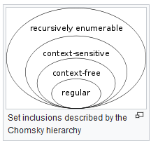
An overview of formal languages
Chomsky Hierarchy
Type-0 grammar (Recursively enumerable) > Type-1 grammar (Context-sensitive) > Type-2 grammar(Context-free) > Type-3 grammar (Regular)
is a type-0 grammar, if each production has the form
, and at least has one nonterminal,
If we applied the following i-th constraint to G we have i-type grammar
Any production satisfies with an exception
Any production has the form
Any production has the form
(right linear grammar)
(left linear grammar)
Context-free grammar can describe the syntax structures of most modern programming languages

