Slide 1
Software Project Management
Jing Zhang Ph.D.

Slide 2
Project Approach Selection
Objectives:
Take account of the characteristics of the system to be developed when planning a project
Select an appropriate process model
Make best use of the “waterfall” process model where appropriate
Reduce risks by the creation of appropriate prototypes
Reduce other risks by implementing the project in increments

Slide 3
Selecting appropriate project approach is based on the analysis of project characteristics.
Projects with different characteristics requires different develop processes.

Slide 4
The first decision: Build or Buy
Buy
Reduce the cost
Can be examined before acquisition, no delay
Most of the bugs are likely to been reported and removed
Not buy
You have the same app as everyone else
Flexibility has limits and you may end up having to change your office procedures in order to fit in with the computer system
You will not own the software code
Once you have, your organization may come to be very reliant upon it.

Slide 5
Choosing methodologies and technologies
The chosen methods and technologies
The training requirements for development staff
The types of staff to be recruited
The development environment
System maintenance arrangement
Identify project as either objective-driven or product-driven
A product-driven project creates products defined before the start of the project.
An objective-driven project will often have come first which will have defined the general software solution that is to be implemented.

Slide 6
Choosing methodologies and technologies
Other project characteristics
Is a data-oriented or process-oriented system?
Data-oriented (information system with DB)
Process-oriented (embedded control system)
Will the software be a general tool or application specific?
Are there specific tools available for implementing the particular type of application?
Does it involve concurrent processing
Will the system to be created be knowledge-based
Will the system to be produced make heavy use of computer graphics
Is the system to be created safety critical?
Is the system designed primarily to carry out predefined services or to be engaging and entertaining?
What is the nature of the hardware/software environment in which the system will operate?

Slide 7
Choosing methodologies and technologies
Identify high-level project risks
Product uncertainty
Data-oriented (information system with DB)
Process-oriented (embedded control system)
Process uncertainty
Resource uncertainty

Slide 8
Software Process
In software engineering, a software process (also known as a software development methodology, system development methodology, software development life cycle, software development process) is a splitting of software development work into distinct phases (or stages) containing activities with the intent of better planning and management.

Slide 9
The waterfall model
This is the classic model of system development that is also known as the one-shot or once-through model.
A later stage may reveal the need for some extra work at an earlier stage, but this should definitely be the exception rather than the rule.

Slide 10
The waterfall model
The waterfall approach may be favored by some managements, because it creates natural milestones at the end of each phase.
Where the requirements are well defined and the development methods are well understood, the waterfall approach allows project completion times to be forecast with some confidence.

Slide 11
Software Prototyping
A prototype is a working model of one or more aspects of the projected system. It is constructed and tested quickly and inexpensively in order to test out assumptions
Throw-away prototypes The prototype test out some ideas and is then discarded when true development of the operational system is commenced.
Evolutionary prototypes The prototype is developed and modified until it is finally in a state where it can become the operational system.

Slide 12
Software Prototyping
What is being prototyped?
The human-computer interface
The functionality of the system
Here the precise way the system should function internally is not known. For example, a computer model of some real-world phenomenon is being developed.

Slide 13
Software Prototyping
Some of the reasons why we need prototyping
Learning by doing
Improved communication
Improved user involvement The users can be more actively involved in design decisions.
Clarification of partially known requirements
Demonstration of the consistency and completeness of a specification
Reduced need for documentation
Reduced maintenance costs
Production of expected results

Slide 14
Software Prototyping
To what extent is the prototyping to be done
Mock-ups As when copies of input screens are shown to the users on a terminal, but the screens cannot actually be used.
Simulated interaction E.g., the user can type in a request to access a record and the system will show the details of a record, but the details shown are always the same and no access is made to a database.
Partial working model
Vertical Some, but not all, features are prototyped fully.
Horizontal All features are prototyped but not in detail.

Slide 15
Software Prototyping
Drawbacks and dangers
Users can misunderstand the role of the prototypes
Lack of project standards possible
Lack of control
Additional expense
Machine efficiency might not be efficient in machine terms
Close proximity of developers

Slide 16
Incremental Delivery
This approach breaks the application down into small components which are then implemented and delivered in sequence.

Slide 17
Incremental Delivery
Advantages
The feedback from early increments improves the later stages
The possible of changes in requirements is reduced because of the shorter time span between the design of a component and its delivery
User get benefits earlier
Early delivery of some useful components improves cash flow
Smaller sub-projects are easier to control and manage
The project can be temporarily abandoned if more urgent work emerges

Slide 18
Incremental Delivery
Disadvantages
Later increments might require modifications to earlier increments.
Software developers may be more productive working on one large system than on a series of smaller ones
A large number of discrete functions with little common infrastructure.

Slide 19
Agile methods
Agile methods are designed to overcome the disadvantages we have noted with heavyweight implementation methodologies. There are various agile approaches
Crystal technologies
Atern
Feature-driven development
Scrum
Extreme Programming (XP)

Slide 20
Agile Manifesto
Some of the leading proponents of these approaches came together in 2001 to issue an Agile Manifesto which stated that their various methods shared four core values:
Individual and interaction over process and tools
Working together over comprehensive documentation
Customer collaboration over contract negotiation
Responding to change over following a plan

Slide 21
eXtreme Programming (XP)
Previously:
Get all the requirements before starting design
Freeze the requirements before starting development
Resist changes: they will lengthen schedule
Build a change control process to ensure that proposed changes are looked at carefully and no change is made without intense scrutiny
Deliver a product that is obsolete on release

Slide 22
XP: Embrace Change
Recognize that:
All requirements will not be known at the beginning
Requirements will change
Use tools to accommodate change as a natural process
Do the simplest thing that could possibly work and refactor mercilessly
Emphasize values and principles rather than process

Slide 23
XP: Values
Communication
Simplicity
Feedback
Courage

Slide 24
XP Values: Communication
Poor communication in software teams is one of the root causes of failure of a project
Stress on good communication between all stakeholders--customers, team members, project managers
Customer representative always on site
Paired programming

Slide 25
XP Values: Simplicity
‘Do the Simplest Thing That Could Possibly Work’
Implement a new capability in the simplest possible way
Refactor the system to be the simplest possible code with the current feature set
‘You Aren’t Going to Need It’
Never implement a feature you don’t need now

Slide 26
XP Values: Feedback
Always a running system that delivers information about itself in a reliable way
The system and the code provides feedback on the state of development
Catalyst for change and an indicator of progress

Slide 27
XP Values: Courage
Projects are people-centric
Ingenuity of people and not any process that causes a project to succeed

Slide 28
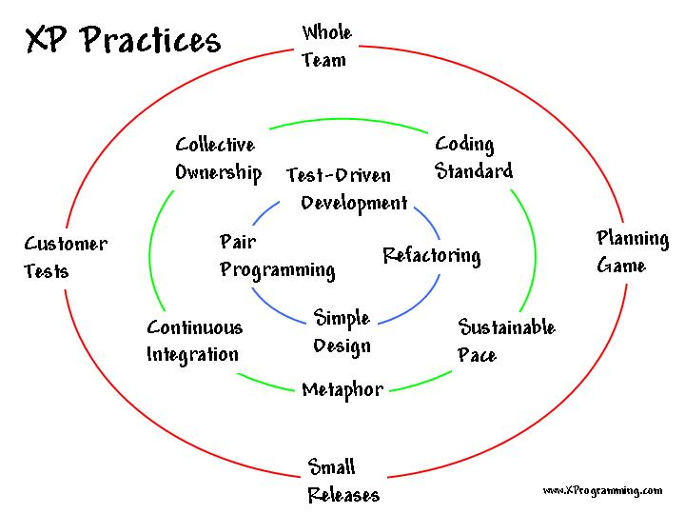
XP Practices

Slide 29
XP Practices: Pair Programming
All production software is built by two programmers, sitting side by side, at the same machine
All production code is therefore reviewed by at least one other programmer
Research into pair programming shows that pairing produces better code in the same time as programmers working singly
Pairing also communicates knowledge throughout the team

Slide 30
XP Practices: Design Improvement
Continuous design improvement process called ‘refactoring’:
Removal of duplication
Increase cohesion
Reduce coupling
Refactoring is supported by comprehensive testing--customer tests and programmer tests

Slide 31
XP Practices: Customer Tests
The Customer defines one or more automated acceptance tests for a feature
Team builds these tests to verify that a feature is implemented correctly
Once the test runs, the team ensures that it keeps running correctly thereafter
System always improves, never backslides

Slide 32
XP Criticism
Unrealistic--programmer centric, not business focused
Detailed specifications are not written
Design after testing
Constant refactoring
Customer availability
12 practices are too interdependent

Slide 33
Conclusion
We need to examine each project carefully to see if it has characteristics which suggest a particular approach or process model.
The classic waterfall process model, which attempts to minimize iteration, should lead to projects that are easy to control. Unfortunately, many projects do not lend themselves to this structure.
Prototyping may be able to reduce project uncertainties by allowing knowledge to be bought through experimentation.
The incremental approach encourages the execution of a series of small, manageable, ‘mini-projects’ but does have some cost.

