Slide 1
Software Project Management
Jing Zhang Ph.D.

Slide 2
Previously on Lecture 1
Overview of Software Project Management
Definition of project
Three Constraints of a project: scope, time, cost
Characteristics of software project
Invisibility, Complexity, Conformity and Flexibility
Identification of stakeholders
The principles of setting project objectives (SMART)
Specific, Measurable, Achievable, Relevant and Time Constrained
Definition of management
Advantages of using the SPM techniques

Slide 3
Project Evaluation
Objectives:
Familiar with your organization and the role of a project manager
Describe the contents of a typical business proposal
Portfolio management
Evaluate and select projects according to the criteria of strategy, technology and finance
Cost-benefit evaluation
Risk evaluation

Slide 4
Project Manager
Functionality of a PM
PM is responsible for the execution of the project activities and the achievement of the project objectives.
PM is the highest leader, organizer and responsibility of project execution, which plays a determinative role in project management.
PM is a bridge and link of the project related parties, and is in the core position of the project.
PM is responsible for communication, consultation, resolve all kinds of conflicts and disputes.

Slide 5
Project Manager
Responsibility of a PM
Ensure that the project objectives can be achieved (fundamental)
Develop plans and sub plans
PM breaks down the overall goal, divides it into some main work and work load, determines the milestones of the project stages, outcomes and the progress check points, and establishes the overall control plan.
Organization and implementation
Design the project's organizational structure
For large projects, decide which tasks are done by the project team and which are done by the contractor.
Project Control
Monitor project operation, establish and improve the project team's internal information management system, including meetings and reporting.

Slide 6
Project Manager
Authorities (powers) of a PM
instructions in production
establishment of the project team
appointment, assessment, promotion, punishment, reward, supervision, command and even dismissal.
financial rights
project manager must have financial decision-making authority within the scope of the contract.
technical decision-making rights
review and approve major technical solutions, to convene a technical proposal or to consult an expert if necessary.

Slide 7
Project Manager
Abilities of a PM
Ability to obtain project resources
Project managers, by establishing their own image, with a variety of relationships and senior leadership, through the normal channels to obtain project resources.
Ability to eliminate obstacles and solve problems
Leadership and tradeoffs
Communication skills
Ability to manage time
The project manager must identify the priority of activities, and make a good arrangement.

Slide 8
Organizational Structures
Functional organizational structure
It is the hierarchy most people think of when picturing an organizational chart. Functional managers or vice presidents in specialties such as engineering, manufacturing, IT, and human resources report to the chief executive officer. Their staffs have specialized skills in their respective disciplines. For example, most colleges and university have very strong functional organizations.

Slide 9
Organizational Structures
Project organizational structure
It also is hierarchical, but instead of functional managers or vice presidents reporting to the CEO, program manager report to the CEO. Their staffs have a variety of skills needed to complete the projects within their programs. For example, many defense, architectural, engineering, and consulting companies use a project organizational structure.

Slide 10
Organizational Structures
Matrix organizational structure
It represents the middle ground between functional and project structures. Personnel often report both to a functional manager and one or more project managers. For example, IT personnel at many companies often split their time between two or more projects, but they report to their manager in the IT department. Project manager in matrix organizations have staff from various functional areas working on their projects. Matrix organizational structures can be strong, weak, or balanced, based on the amount of control exerted by the PM.

Slide 11
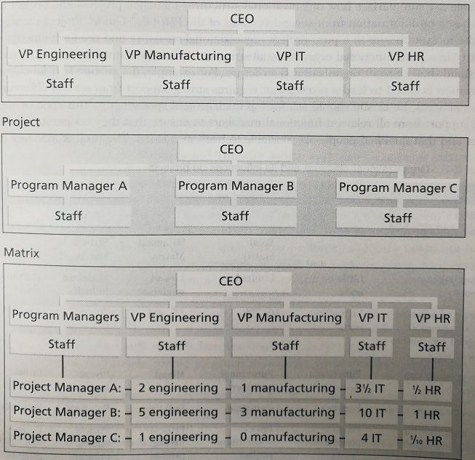
Organizational Chart

Slide 12
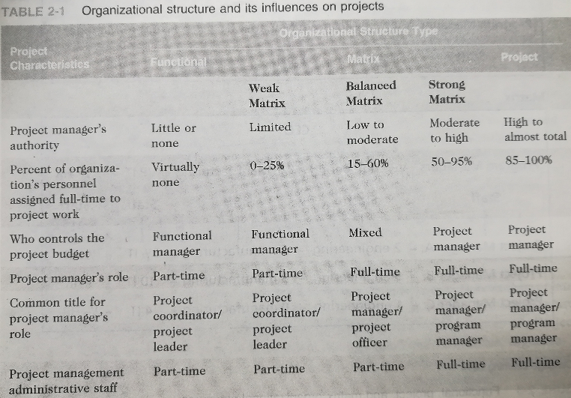
Influence on projects

Slide 13
Homework
Searching the Internet, describe the advantages and disadvantages of the three organizational structures.

Slide 14
Answer
Organizational Structure | Advantage | Disadvantages
Functional | flexibility of personnel usage. Experts can be shared among multiple projects. Professionals from the same department are able to share knowledge and experience. Functional departments can provide the normal promotion path for professionals in this sector. | Customer is not the focus of activity and concern. No one takes full responsibility. The enthusiasm of the staff assigned to the project is often not very high. Professionals tend to focus more on the field than on the overall goal of the project.
Project | The project manager has full power to arrange resources. Focusing on the objectives of project and accelerating decision-making Members in the team only has one leader. Communication within the project team more smoothly and quickly. | Due to the inability to fully utilize the resources, there is a problem of resource sharing among the projects. Project members have difficulties in communicating with departments outside the project. Project members lack a sense of belonging and have no career planning.
Matrix | Project manager is responsible for the project. The technologies, talents and equipment in each department can be more effectively shared. This structure places greater emphasis on customer needs and facilitates learning and communication among program members. | Dual leadership situation The flow of resources between project managers can easily lead to a struggle between them. A number of factors make matrix project teams very difficult to manage.

Slide 15
Project Life Cycle
Four phases model: Each phase is also called a process groups
A process is a series of actions directed toward a particular result.

Slide 16
A business case
Also known as a feasibility study or a project justification
Objectives: Provide a rationale for the project by showing that the benefits of the project outcomes will EXCEED its costs.
Document Structure
1. Introduction and background to the proposal
2. The proposed project
3. The market (needed when creating new product or a new service)
4. Organizational and operational infrastructure
How the structure of the organization will be affected by the implementation of the project
5. The benefits
6. Outline implementation plan
7. Costs
8. The financial case
9. Risk
10. Management plan

Slide 17
Project portfolio management
Portfolio management provides an overview of all the projects that an organization is undertaking or is considering. Concerning:
identifying which project proposals are worth implementation;
assessing the amount of risk of failure that a potential project has;
Deciding how to share limited resources, including staff time and finance, between projects;
being aware of the dependencies between projects, especially where several projects need to be completed for an organization to reap benefits;
ensuring that projects do not duplicate work;
ensuring that necessary developments have not been inadvertently been missed.
Three Key aspects (Skim)
Project portfolio definition
Project portfolio management
Project portfolio optimization

Slide 18
Project Portfolio
Project Portfolio Definition
An organization should record in a single repository details of all current projects.
A decision will be needed about whether projects of all types are to be included.
Project Portfolio management
Once the portfolio has been established, more detailed costings of projects can be recorded . The value that managers hope will be generated by each project can also be recorded. Actual performance of projects on these performance indicators can then be tracked.
Project Portfolio optimization
The performance of the portfolio can be tracked by high-level managers on a regular basis. A better balance of projects may be achieved. Some projects could potentially be very profitable but could also be risky.

Slide 19
Evaluation of individual projects
Technical assessment: whether the required functionality can be achieved with current affordable technologies.
Cost-benefit analysis: whether the estimated benefits will exceed the costs.
Costs:
Development costs;
Setup costs: putting the system into place, file conversion, recruitment and staff training;
Operational cost: relating to operating the system after installation.
Benefits:
Quantified and valued: a direct financial benefit;
Quantified but not valued: e.g., a decrease in the number of customer complaints
Identified but not easily quantified: e.g., public approval of the organization in the locality where it is based.
Cash flow forecasting: indicates when expenditure and income will take place.

Slide 20
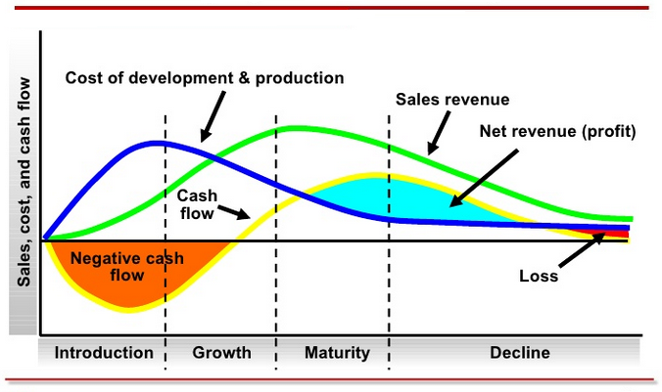
Cash flow forecasting:

Slide 21
Cost-benefit evaluation techniques
Net profit: the difference between the total cost and the total income over the life of project.
Payback period: is the time taken to break even or pay back the initial investment. (Normally, the project with the shortest payback period will be chosen.)
Year | Project 1 | Project 2 | Project 3 | Project 4
0 | -100,000 | -1,000,000 | -100,000 | -120,000
1 | 10,000 | 200,000 | 30,000 | 30,000
2 | 10,000 | 200,000 | 30,000 | 30,000
3 | 10,000 | 200,000 | 30,000 | 30,000
4 | 20,000 | 200,000 | 30,000 | 30,000
5 | 100,000 | 300,000 | 30,000 | 75,000
Net profit | 50,000 | 100,000 | 50,000 | 75,000

Slide 22
Return on investment
The return on investment (ROI), also known as the accounting rate of return (ARR), provides a way of comparing the net profitability to the investment required.
Suffers from two disadvantages
Takes no account of the timing of the cash flows
Bears no relationship to the interest rates offered or changed by banks.
Annualized
Rate of Return

Slide 23
Net present value (NPV) analysis
Basic idea:
vice versa $100 in a year’s time =?? at present
Present value takes into account the profitability of a project and the timing of the cache flows.
t is named discount rate
E.g.
If we receive $100 in the next year with a discount rate 10%, it approximately equals $91 if we get them immediately.
$100 (today) ≠$100 (in a year’s time)
$100 (today) =$100 + $100×interest rate

Slide 24
NPV analysis
Successive year’s present value
The Net Present Value （NPV）for a project
where p₀ is the initial investment
The main difficulty with NPV for deciding between projects is selecting an appropriate discount rate.

Slide 25
Internal rate of return
One disadvantage of NPV as a measure of profitability is that it might not be directly comparable with earnings from other investments or the cost of borrowing capital. Such costs are usually quoted as a percentage interest rate. The internal rate of return (IRR) attempts to provide a profitability measure as a percentage return that is directly comparable with interest rate.

Slide 26
Internal rate of return
IRR)is the interest rate at which the net present value of all the cash flows (both positive and negative) from a project or investment equal zero.
IRR is used to evaluate the attractiveness of a project or investment. If the IRR of a new project exceeds a company’s required rate of return, that project is desirable. If IRR falls below the required rate of return, the project should be rejected.
The formula for IRR
Where are cash flows in period 0, 1, 2, .., n.

Slide 27
Risk evaluation
Project risk: prevent the project being completed successfully (Chapter 7)
Business risk: the delivered products are not profitable
Risk identification and ranking (risk matrix)
Risk | Importance | Likelihood
Client rejects proposed look and feel of site | H | --
Competitors undercut prices | H | M
Warehouse unable to deal with increased demand | M | L
Online payment has security problem | M | M
Maintenance costs higher than estimated | L | L
Response times deter purchasers | M | M

Slide 28
Risk evaluation
Risk and net present value
Where a project is relatively risky it is common practice to use a higher discount rate to calculate net present value.
Cost-benefit analysis
A rather more sophisticated approach to the evaluation of risk is to consider each possible outcome and estimate the probability of its occurring and the corresponding value of the outcome. Rather than a single cash flow forecast for a project, we will then have a set of cash flow forecasts, each of with an associated probability of occurring.

Slide 29
Risk evaluation
Using decision tree
We are not only bystanders but also can reject over-risky projects or choose those with the best risk profile
Market expansion
NPV -100,000 ($)
0.2
Extend the system
75000*0.8-100000*0.2 =40000
0.8
No expansion
D
NPV 75,000 ($)
Market expansion
NPV 250,000 ($)
Replace the system
0.2
250000*0.2-50000*0.8=10000
0.8
No expansion
NPV -50,000 ($)

Slide 30
Program Management
D. C. Ferns defined a program as ‘a group of projects that are managed in a coordinated way to gain benefits that would not be possible were the projects to be managed independently’
Forms:
Business cycle programs
The collection of projects that an organization undertakes within a particular planning cycle. E.g., many organizations have a fixed budget for ICT development in a financial year
Strategic programs
Several projects together can implement a single strategy
Infrastructure programs
A infrastructure program could refer to the activities of identifying a common ICT infrastructure and its implementation and maintenance.
Research and development programs
A successful portfolio would need to be a mixture of ‘safe projects’ with relatively low returns and some riskier projects that might fail, but if successful would generate handsome profits which will offset the losses on the failures.

Slide 31
Program Manager Project Manager
Program manager | Project manager
Many simultaneous projects | One project at a time
Personal relationship with skilled resources | Impersonal relationship with resource type
Need to maximize utilization of resources | Need to minimize demand for resources
Projects tend to be similar | Projects tend to be dissimilar

Slide 32
Create a Program
Program Mandate, program mandate should include a formal document
The new services or capability the program should deliver
How the organization will be improved by use of the new services or capability
How the program fits with corporate goals and any other initiatives
Program brief, outlines the business case for the program
A preliminary vision statement which describe the new capacity that the organization seeks
The benefits that the program should create – including when they are likely to be generated and how they might be measured
Risks and issues
Estimate cost, timescales and effort
The vision statement is taken out from the program brief, and then to be refined and expanded to form a blueprint
The blueprint
Business models outlining the new process required
Organizational structure
Information systems
Data and information requirements
Cost, performance and service level requirements.

Slide 33
Conclusion
Project must be evaluated on strategic, technical and economic grounds.
Not all benefits can be precisely quantified in financial values.
Economic assessment involves the identification of all costs and income over the lifetime of the system, including its development and operation and checking that the total value of benefits exceeds total expenditure.
Money received in the future is worth less than the same amount of money in hand now, which may be invested to earn interest.
Cost-benefit analysis techniques and decision trees provide tools for evaluating expected outcomes and choosing between alternative strategies.

Slide 34
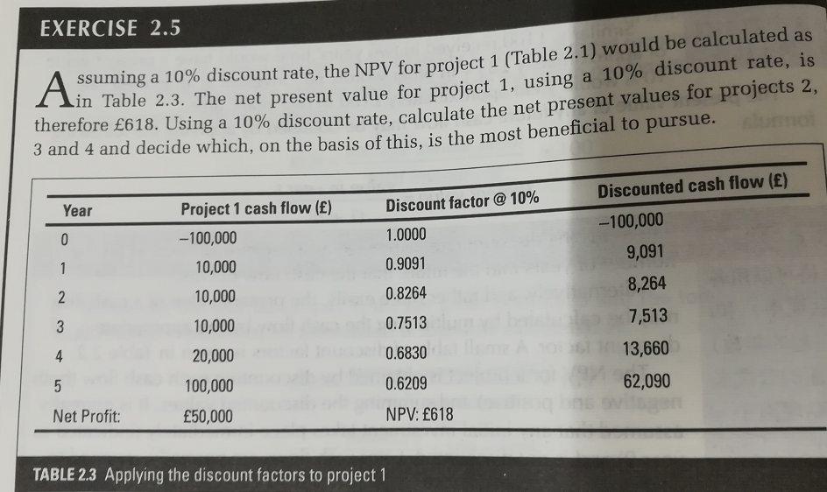
Quiz
Exercise 2.4 (Calculate Annualized ROI )
Exercise 2.5

Slide 35
Homework
Searching the Internet, describe the advantages and disadvantages of the three organizational structures.
Exercises (in text book)
2.6, 2.7
2.15 Further exercise (in text book)
2

