Slide 1

Design pattern
Lecture 7

Slide 2
Structural Patterns
Structural patterns are concerned how classes and objects are composed to form larger structures. Structural class patterns use inheritance to compose interfaces or implementations. As a simple example, consider how multiple inheritance mixes two or more classes into one. The result is a class that combines the properties of its parent classes.
This pattern is particularly useful for making independently developed class libraries.

Slide 3
Adapter

Slide 4
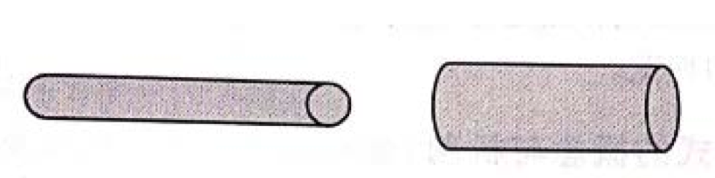
Adapter
Two pipe problems with inconsistent port diameters. Assume that there are two water pipes, one thick and one thin, as shown in Figure 1. How to connect the two water pipes together?
Figure 1 Two different diameter pipes

Slide 5
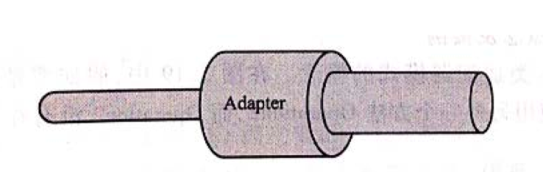
Adapter
The solution is to use a pipe clamp (connector) to connect the two pipes. As shown in Figure 2. In this way, two pipes of different diameters are connected through the pipe clamp. Here the pipe clamp can be called Adapter.
Figure 2

Slide 6
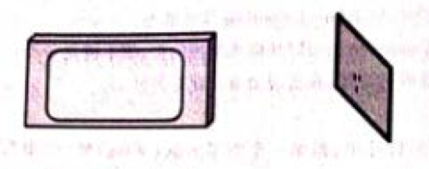
Adapter
Solve the problem of inconsistent voltage. Electric appliances produced in the United States all use 110V AC power, while the AC power provided by China Power Grid is 220V. If there is a TV set produced in the United States, it cannot be used directly in China, as shown in Figure 3. How can we solve this problem?
Figure 3 TV capable of withstanding 110V and 220V supply voltage

Slide 7
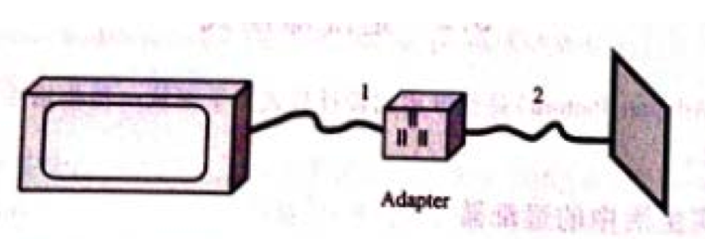
Adapter
The solution is to use a Adapter to convert 220V to 110V. In this way, the voltage received by the TV is 110V, as shown in Figure 4.
Figure 4 Use Adapter to convert 220V to 110V for TV to use

Slide 8
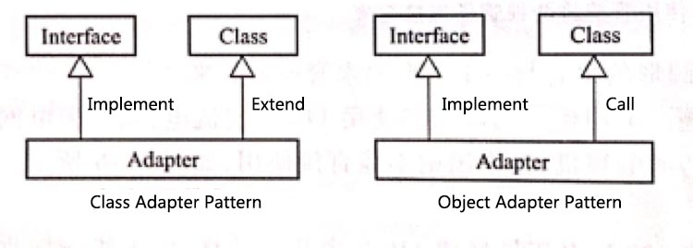
Adapter
In software design, in order to solve the interface inconsistency problem, two software modules often need to be “adapted” through an Adapter class. This pattern is called adapter design pattern.
This pattern can be divided into two types, namely Class Adapter Pattern and Object Adapter Pattern, as shown in Figure 5.
Figure 5 Class Adapter Pattern and Object Adapter Pattern

Slide 9
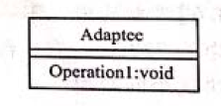
Adapter—Class Adapter Pattern
Class Adapter Pattern: In Figure 6, if you want to use the method Operation1 in the Class Adaptee, and also use another method Operation2, but Operation2 is not in the Class Adaptee, how to solve the problem?
Figure 6 Adaptee class and Operation1 method

Slide 10
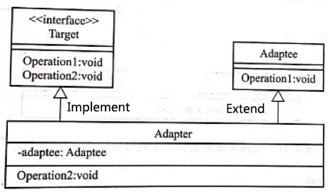
Adapter—Class Adapter Pattern
Use a Target interface to declare all the required methods, and use another Adapter class to implement all the methods in the Target interface. At the same time, the Adapter class extends the Adaptee class, as shown in Figure 7.
Target target = new Target();
target.Operation1();
target.Operation2();
Figure 7

Slide 11
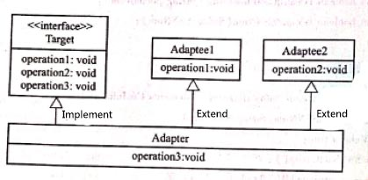
Adapter—Object Adapter Pattern
Object Adapter Mode: Multiple inheritance is not allowed in the Java language. Therefore, if there are two or more classes Adaptee1 and Adaptee2 that need to be adapted at the same time, you cannot continue to use the class adapter pattern for design, as shown in Figure 8. The design diagram is also illegal. In the Adapter class, Operation1 is implemented by means of aggregation. This method is the object adapter mode. Its design is shown in Figure 9.
Figure 8 illegal design

Slide 12
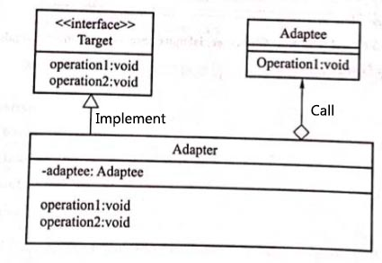
Adapter—Object Adapter Pattern
In the Adapter class, Operation1 is implemented by means of aggregation. This method is the object adapter pattern. Its design is shown in Figure 9.
Adapter adapter = new Adapter();
adapter.operation1();
adapter.operation2();
Figure 9 Object Adapter pattern design diagram

Slide 13
Adapter—Applicability
Use the Adapter pattern when:
You want to use an existing class, and its interface does not match the one you need.
You want to create a reusable class that cooperates with unrelated or unforeseen classes, that is, classes that don’ necessarily have compatible interfaces.
(object adapter only) you need to use several existing subclasses, but it’s impractical to adapt their interface by subclassing every one. An object adapter can adapter the interface of its parent class.

Slide 14
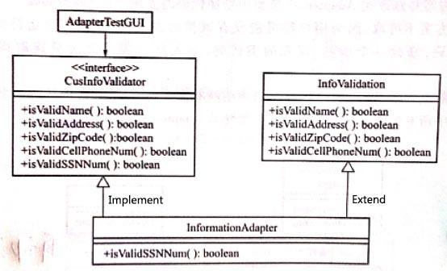
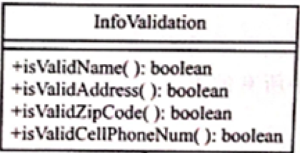
Adapter—Example
A company purchased an off-rack product class InfoValidation for verifying customer information, but the seller did not provide source code. This class can be used to check customer input information, including verification of name, address, telephone area code, and mobile phone number. If you also need to add a function to verify the social security number (SSN), you can use class adapter pattern to achieve.
Figure 10

Slide 15
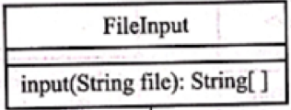
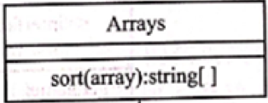
Adapter—Example
Use object adapters to implement string sequence sorting. It is required to read some English character strings from a .txt file and sort the strings. There is already a class FileInput whose main function consists of reading strings from a file. In addition, there is an Arrays in a Java class library that contains a function sort to sort multiple strings.
Figure 11

Slide 16
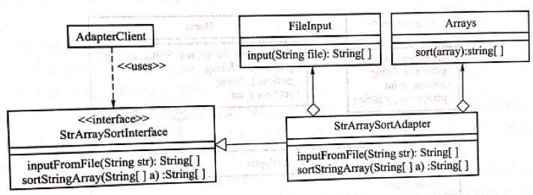
Adapter—Example
Figure 12
StrArraySortAdapter adapter = new StrArraySortAdapter();
String[] input = adapte.inputFromFile("xx.text");
String[] sorted = adapter.sortStringArray(input);

Slide 17
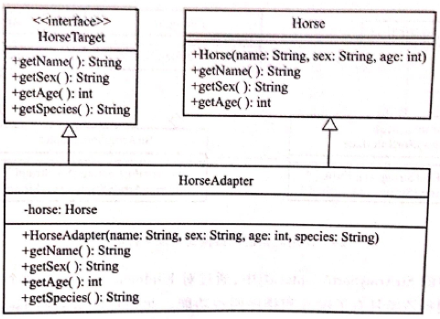
Adapter
The role of Adapter Pattern: The adapter pattern is to transform two interfaces that are different but the function are similar, including the adapter role supplements some methods that the source roles does not have but the target interface needs. However, don't mistakenly think that the adapter pattern is prepared to supplement the methods that the source role does not have. Adapter pattern can be used to add new methods, but its main purpose is to convert interfaces.
Figure 13 Use the object adapter pattern to adjust the interface

Slide 18
Adapter
The difference between Class Adapter Pattern and Object Adapter Pattern:
In the Java language, using the Object Adapter Pattern can adapt multiple different source classes to the same Target interface, and using the Class Adapter Pattern can't do this.
If there is a large number of methods in an adapted source class, it is easier to use the class adapter pattern. It is only necessary for the Adapter class to inherit the adapted source class. At this time, using the object adapter pattern, you must explicitly write each method in the Target role in the Adapter class, and call the corresponding method in the adapted source class one by one in each method.

Slide 19
composite

Slide 20
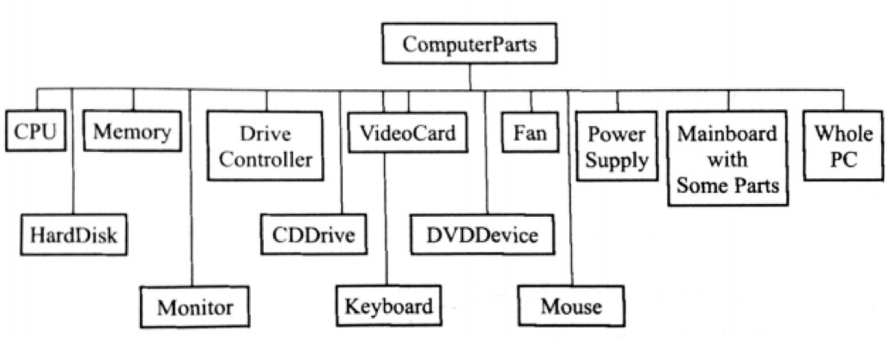
Composite
All the computer accessories are included in Figure 14. Among them are independent accessories such as CPU, Memory, Drive Controller, etc. There are also combined accessories such as Mainboard with some Parts and a complete computer, Whole PC, which includes all the accessories listed in this figure. Therefore, the tree represented by this figure consists of two parts: individual type and composite type. Composite data types are composed of independent types.
Thinking: Suppose you want to design an accessory sales program to implement price query. How should you design?
Figure 14

Slide 21
Composite
In Figure 15, the top interface class ComputerPart has the getPrice() method, and all other subclasses also have this method.
The ArrayList data structure is encapsulated in the composite data class Composite. In addition to the interface getPrice() of the abstract class ComputerPart, this class also has operations such as add(), remove(), and getChild() for the ArrayList data structure.
The Composite class has two subcategories: MainboardPLus and WholePC, which represent the main board and all the devices and complete boxes that are on it, and all the devices contained therein.
In the MainboardPLus class, you can use the ArrayList structure provided by its superclass to add the accessories that should be on the motherboard. Similarly, all of the accessory class objects can be added in the WholePC class.

Slide 22
Composite
Intent
Compose objects into tree structures to represent part-whole hierarchies.
Composite lets clients treat individual objects and compositions of objects uniformly.
Participants
Component: declares the interface for objects in the composition
Leaf: represents leaf objects in the composition. A leaf has no children.
Composite: defines behavior for components having children.
Client: mainpulates objcts in the composition through the Component interface.

Slide 23
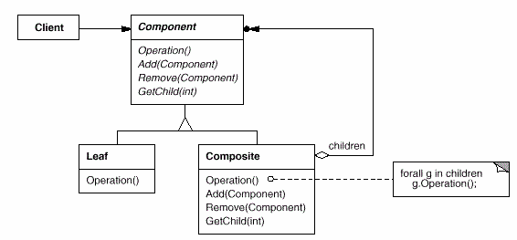
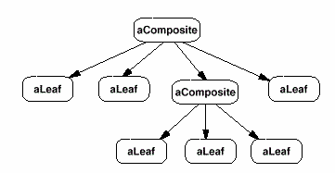
Composite
Structure
A typical Composite object structure might look like this:

Slide 24
Composite—Applicability
Use the Composite pattern when:
You want to represent part-whole hierarchies of objects.
You want clients to be able to ignore the difference between compositions of objects and individual objects. Clients will treat all objects in the composite structure uniformly.

Slide 25
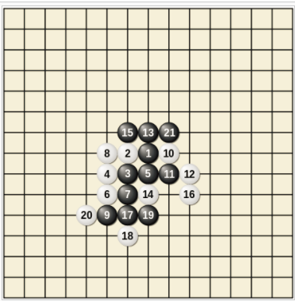
Composite—Example
Use Composite pattern to design Gomoku game. There are only two pieces in the gobang: blacks and whites. Use the abstract class ChessComponent to provide the widget interface for Gomoku . The interface comes with three subclasses: BlackPiece, WhitePiece, and Composite. The first two classes encapsulate two color pieces. The Composite class encapsulates the aggregated data structure of type ArrayList. Each time a player adds a black or white piece to the board, a black or white piece object is generated accordingly, and the object is then stored in the Composite object. The goal is to play back each step after the game is over.

Slide 26
Composite—Example
The design class diagram of the Gomoku game is shown in Figure 15. In this class diagram, there is also a user graphical interface class CLientGUI, which calls another board class Board. The functions of the checkerboard class include generating checkerboard graphics, adding checkers to the board, replaying and implementing playback. In addition, there are two auxiliary classes. One is the chess piece graphics class GChessPiece, whose object represents an actual chess piece image. The image can be added to Board object. Another auxiliary class is the GameOperations class, which provides some matrix methods to determine the outcome of the game.

Slide 27
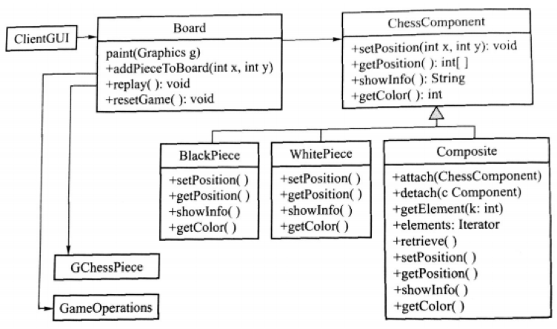
Composite—Example
Figure 15

Slide 28
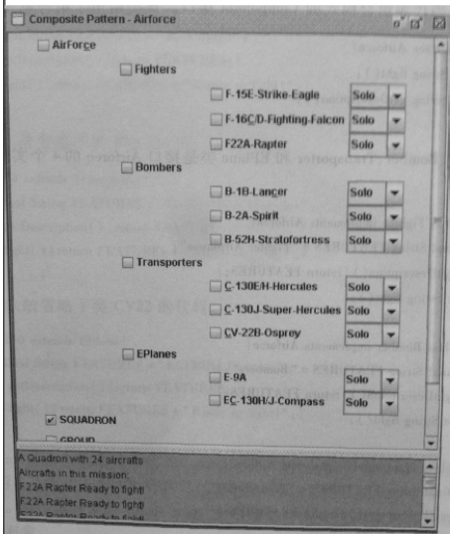
Composite—Example
Use the Composite pattern to design the air command system. Airforce includes Fighter, Bomber, Transporter and EPlane. The combat units are divided into the Squadron and the Group. Each combat unit can be composed of different types of aircraft.

Slide 29
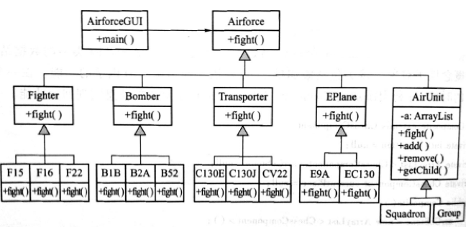
Composite—Example
In order to reflect the composition of combat units, a class was designed called the AirUnit class. This class is a Composite class in composite pattern and is responsible for the formation of Air Force units, Squadron, Group, or ad hoc combat units. At the same time, four abstract classes Fighter, Bomber, Transporter, and EPlane were designed according to the type of aircraft. Each abstract class has the corresponding subclass below. The subclass is the specific model. The Squadron, Group class is designed as a subclass of the Composite class AirUnit. The AirUnit class encapsulates the data type ArrayList, which is a flexible-length List in which various types of objects can be stored.
Squadron squadron = new Squadron();
Squadron.fight(); //Call the fight of all the components of the Air Force Squadron

Slide 30
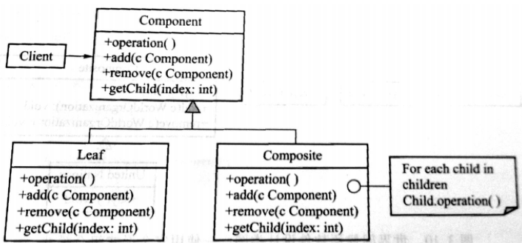
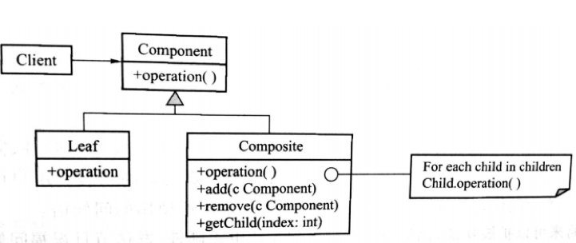
Composite—Discuss
Although the Composite class implements the Add and Remove operations for managing children, an important issue in the Composite pattern is which classes declare these operations in the Composite class hierarchy. Should we declare these operations in the Component and make them meaningful for Leaf classes(Figure 16 ), or should we declare and define them only in Composite and its subclasses(Figure 17)?
Figure 16 Transparency mode of Composite pattern
Figure 17 Safety mode of Composite pattern

Slide 31
Composite—Discuss
The decision involves a trade-off between safety and transparency:
Defining the child management interface at the root of the class give you transparency, because you can treat all components uniformly. It costs you safety, however, because clients may try to do meaningless things like add and remove objects from leaves.
Defining children management in the Composite class gives you safety, because any attempt to add or remove objects from leaves will be caught at compile-time in a statically typed language like C++. But you lose transparency, because leaves and composites have different interfaces.

Slide 32
facade

Slide 33
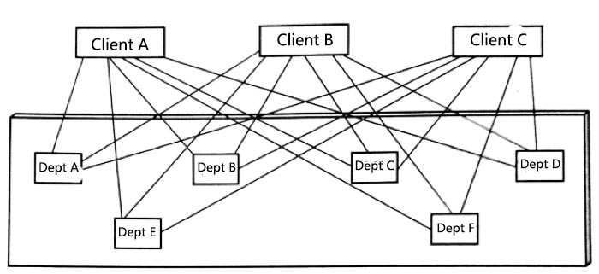
Façade—Introduce
Agency agency receptionist issues. There are many government agencies, and if a company official goes to a government agency to do one thing, he or she often needs to go through all relevant departments to handle the relevant approval documents. It takes a lot of time and effort.
Figure 18

Slide 34
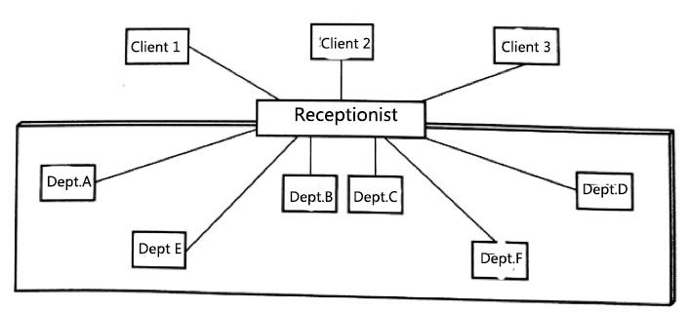
Façade—Introduce
The government agency adopts the receptionist's agency work mode. The service procedures will be simplified. The client only needs to submit the application materials to the receptionist's window. The receptionist will accept and replace the client to each agency to handle the corresponding procedures. In this mode of work, what the customer needs to do is to submit materials to the receptionist's window without having to understand the detailed procedures of the various agencies' services.
Figure 19

Slide 35
Façade
There are multiple classes Class1, Class2...Class12 etc. in the Java class library. The class Client calls the methods in these classes. The programmer of the Client class must understand the description of all functions in the class, including parameter types, return values, complex data structures contained within the class, etc., before deciding to use the appropriate method. This practice is often unrealistic in situations where the class in the class library is more complex and the person's own experience is insufficient. At this point, you can write a Facade class, as shown in Figure 20, to encapsulate the functions needed for the project in this class, so that programmers only need to call the methods provided in this facade class to complete the programming task.

Slide 36
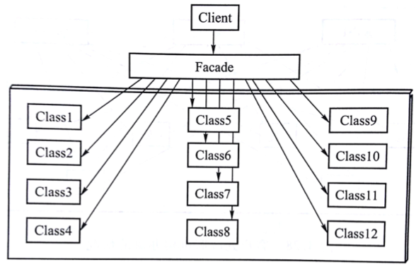
Façade
Figure 20 Class diagram of Façade pattern

Slide 37
Facade
Intent
Provide a unified interface to a set of interfaces in a subsystem. Façade defines a higher-level interface that makes the subsystem easier to use.
Participants
Facade(Compiler)
Knows which subsystem classes are responsible for a request
Delegate cilent requests to appropriate subsystem objects.
Subsystem(Scanner, Parser, ProgramNode, etc)
Implement subsystem functionality
Handle work assigned by Façade object
Have no knowledge of the façade; that is, they keep no references to it

Slide 38
Façade—Applicaility
Use the Facede pattern when
You want to provide a simple interface to a complex subsystem.
There are many dependencies between clients and the implementation classes of an abstraction.
You want to layer you subsystems. Use a façade to define an entry point to each subsystem level.

Slide 39
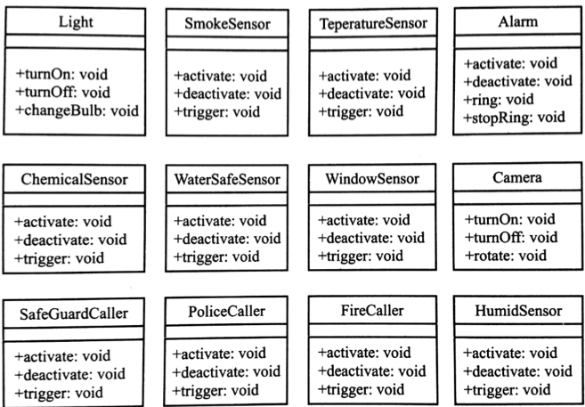
Façade—Example
Use Façade pattern to design the security system. Need to write a security system software to complete automatic alarm, automatic anti-theft and other functions. Assume that the usable classes that can be used to implement the above security system are shown in Figure 21.
Figure 21 Classes that can be used for security systems

Slide 40
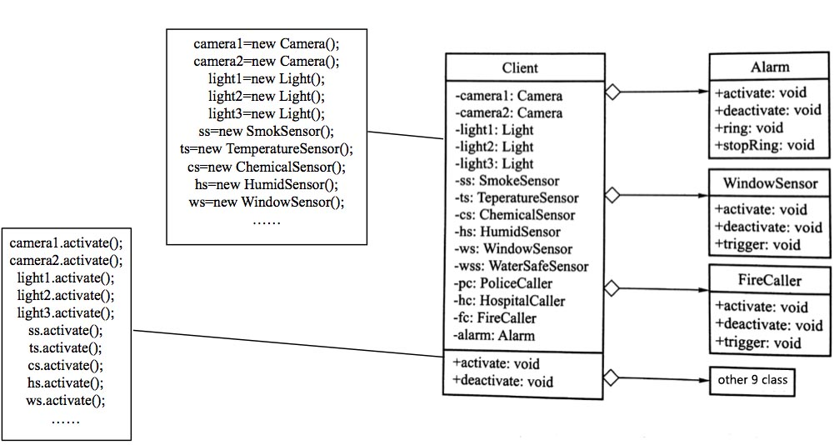
Facade—Example
For such a system, usually create a Client class directly and call the above class library from the Client class directly, the design of class diagram is shown in Figure 22
Figure 22 Preliminary design of the security system.

Slide 41
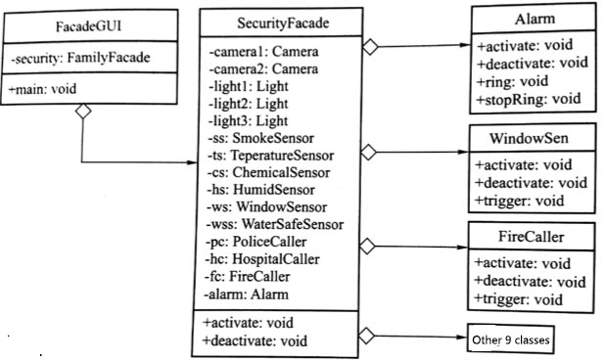
Facade—Example
As you can see from Figure 23, after using the Facede pattern, the client program simply calls the functions activate() and deactivate() in the facade SecurityFacade, without needing to know how these functions are implemented.
//The client only needs to call the Facade class
SecurityFacade sf=new SecurityFacade();
sf.activate();
sf.deactivate();
Figure 23 Facade pattern of the security system.

Slide 42
Façade—Discuss
Both Adapter mode and Façade pattern exist to design new interfaces. The difference between the two pattern is:
The purpose of the Adapter pattern transition interface is to convert an inapplicable interface to an interface that can be used, or to convert interfaces which are different but have the same or similar function, so that they can be used together.
The Façade pattern simplifies the interface to make better use of a class library. The Façade pattern provides an easy-to-use interface as its facade, just to make the existing code Client and the library to be used (which often contains multiple objects with different behaviors and different interfaces) can be used more simply by the newly defined Target interface.

