Slide 1
Software Project Management
Jing Zhang Ph.D.

Slide 2
An overview of project planning
Objectives:
Project Management Knowledge Areas
Approach project planning in an organized step-by step manner
See where the techniques described in other chapter fit into an overall planning approach
Repeat the planning process in more detail for sets of activities within a project as the time comes to execute them

Slide 3
Project Management Knowledge Areas
Project management knowledge areas describe the key competencies that project managers must develop. (10 common KA)
Integration management
Scope management
Time management
Cost management
Quality management
Human resource management
Communication management
Risk management
Procurement management
Stakeholder management

Slide 4
Common Project management tools and techniques by knowledge areas
KA | Tools and Techniques | KA | Tools and Techniques
Integration management | Project selection methods, project management methodologies, stakeholder analysis, work requests, project chart, project management plans, project management software, change requests, change control board, project review meeting, lesson-learned reports | Human Resource management | Motivation techniques, empathic listening, responsibility assignment matrices, project organizational chart, resource histogram, team building exercise
Scope Management | Scope statements, work breakdown structure, statements of work, requirements analysis, scope management plans, scope verification techniques, scope change controls | Communications management | Communication management plans, kick-off meetings, conflict management, communication media selection, status and progress reports, virtual communications, templates, project web sites
Time management | Gantt charts, project network diagrams, critical path analysis, crashing, fast tracking, schedule performance measurement | Risk management | Risk management plans, risk registers, probability/impact matrices, risk rankings
Cost management | Project budgets, net present value, return on investment, payback analysis, earned value management, project portfolio management, cost estimates, cost management plans, cost baselines | Procurement management | Make-or-buy analysis, contracts, requests for proposals or quotes, source selections, supplier evaluation matrices
Quality management | Qualify metrics, checklist, quality control charts, Pareto diagrams, fishbone diagrams, maturity models, statistical methods, test plans | Stakeholder management | Stakeholder management plans, stakeholder identification, stakeholder registrations, stakeholder engagement
Project Integration Management : the processes and activities needed to identify, define, combine, unify, and coordinate the various processes and project management activities within the project management process groups.

Slide 5
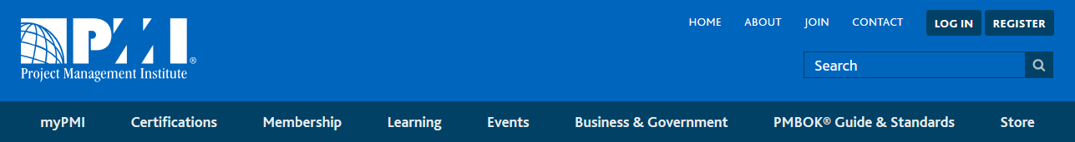
PMBOK (Project Management Body of Knowledge)
The Project Management Body of Knowledge is a set of standard terminology and guidelines (a body of knowledge) for project management. The body of knowledge evolves over time and is presented in A Guide to the Project Management Body of Knowledge, a book whose fifth edition came out in 2013.
The PMBOK as described in the Guide recognizes 47 processes that fall into five basic process groups and ten knowledge areas that are typical of most projects.
First developed by the Project Management Institute in 1996.

Slide 6
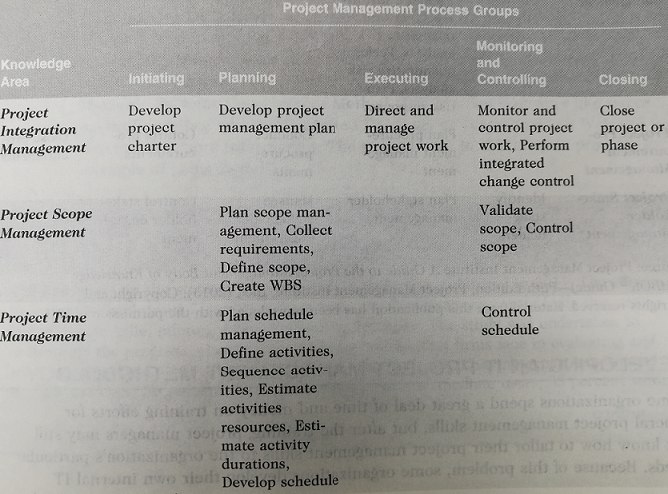
Project management process groups and knowledge area mapping

Slide 7
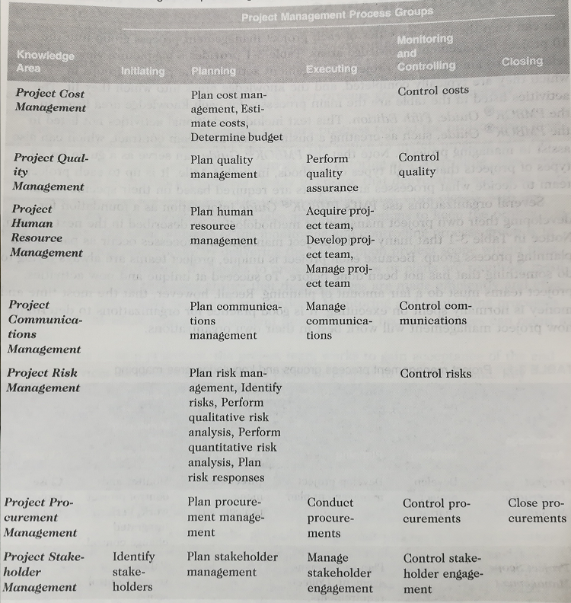
Project management process groups and knowledge area mapping

Slide 8
Other guides or methods
The PMBOK Guide is a standard that describes best practices for what should be done to manage a project. A methodology describes how things should be done, and different organizations often have different ways of doing things.
PRojects IN Controlled Environment (PRINCE2): originally developed for IT projects, PRINCE2 was released in 1996 as a generic project management methodology by the U.K. Office of Government Commerce (OCG). It is the de facto standard in the United Kingdom and is used in over 50 countries. PRINCE2 defines 45 separate subprocesses and organizes them into eight process groups as follows: (www.prince2.com)
Starting up a project
Planning
Initiating a project
Directing a project
Controlling a stage
Managing product delivery
Managing stage boundaries
Closing a project

Slide 9
Other guides or methods
Agile methods (www.agilealliance.org)
Extreme programming
Scrum
Feature-driven development
Lean software development
Agile Unified Process
Crystal
Dynamic Systems Development Method
Rational Unified Process (RUP)
Six Sigma methodologies
Tips: These are good topics for your course essays

Slide 10
Project Planning

Slide 11
Project Planning in PMBOK
Contents and relationship

Slide 12
Step Wise project planning
This figure provides an outline of the main planning activities.
Steps 1 and 2 could be tackled in parallel in some cases. Steps 5 and 6 will need to be repeated for each activity in the project.
Step Wise should be compatible with PRINCE2. Step Wise covers only the planning stages of a project and not monitoring and control.

Slide 13
An outline of Step Wise planning activities
Step | Activities with step | Step | Activities with step
0 | Select project (solved in Chapter 2) | 5 | Estimate effort for each activity 5.1 Carry out bottom-up estimate 5.2 Revise plan to create controllable activities
1 | Identify project scope and objectives 1.1 Identify objectives and measures of effectiveness in meeting them 1.2 Establish a project authority 1.3 Identify stakeholders 1.4 Modify objectives in the light of stakeholder analysis 1.5 Establish method of communication with all parties | 6 | Identify activity risks 6.1 Identify and quantify activity-based risk 6.2 Plan risk reduction and contingency measures where appropriate 6.3 Adjust plans and estimates to take account of risks
2 | Identify project infrastructure 2.1 Establish relationship between project and strategic planning 2.2 Identify installation standards and procedures 2.3 Identify project team organization | 7 | Allocate resources 7.1 Identify and allocate resources 7.2 Revise plans and estimates to take account of resource constraints
3 | Analyze project characteristics 3.1 Distinguish the project as either objective- or product-driven 3.2 Analyze other project characteristic 3.3 Identify high-level project risks 3.4 Take into account user requirements concerning implementation 3.5 Select general life-cycle approach 3.6 Review overall resource estimates | 8 | Review/publicize plan 8.1 Review quality aspects of project plan 8.2 Document plans and obtain agreement
4 | Analyze project products and activities 4.1 Identify and describe project products (including quality criteria) 4.2 Document generic product flows 4.3 Recognize product instances 4.4 Produce ideal activity network 4.5 Modify ideal to take into account need for stages and check points | 9 /10 | Execute plan/lower levels of planning This may require the reiteration of the planning process at a lower level

Slide 14
2.2 identify installation standards and procedures
Any organization that develops software should define their development procedures. As a minimum, the normal stages in the software life cycle to be carried out should be documented along with the products created in each stage.
Change control and configuration management standards should be in place to ensure that changes to requirements are implemented in a safe and orderly way.
In software engineering, software configuration management (SCM ) is the task of tracking and controlling changes in the software.
Version Control
Change Control
Process Support

Slide 15
3.5 Select development methodology and life-cycle approach
Process models
Waterfall model
Incremental model
Prototyping
Spiral model
Agile Process
Extreme Programming
Scrum

Slide 16
4.1 Identify and describe project products (or deliverables)
We ought to ensure that there are no activities that do not produce a tangible product.
The products handed over to the client at the end of project are deliverables.
Others might not be in the final configuration are intermediate products.
The products will form a hierarchy. The main products will have sets of component products which in turn may have sub-component products and so on.
These relationships can be documented in a Product Breakdown Structure (PBS).

Slide 17
4.1 Identify and describe project products (or deliverables)
In PRINCE2 Production Descriptions contain:
the name of the product
the purpose of the product
the derivation of the product
the composition of the product
the form of the product
The relevant standards
the quality criteria

Slide 18
4.2 Document generic product flows
Some products will need one or more other products to exit first before they can be created. These relationships can be portrayed in a Product Flow Diagram (PFD).

Slide 19
Work Breakdown Structure
Used as a basis for a number of processes in particular to produce the subsidiary plans of the Project Management Plan.
The WBS is a deliverable-oriented hierarchy of decomposed project components that organizes and defines the total scope of the project. The WBS is a representation of the detailed project scope statement that specifies the work to be accomplished by the project. (DEFINITION)
The elements comprising the WBS assist the stakeholders in viewing the end product of the project.
The work at the lowest-level WBS component is estimated, scheduled, and tracked.

Slide 21
Some concepts
A WBS dictionary is a companion document to the WBS that describes each WBS element. For each WBS element, the WBS dictionary includes a statement of work, a list of associated activities, and a list of milestones.
Work Package: A group of related tasks that are defined at the same level within a work breakdown structure.
three types of project work
Product
Specifically assigned to a physical product as a unique deliverable
This subset is sometimes referred to as the product breakdown structure
Integration
When products are brought together as a unit
Can be at any level
Support
Level of Effort, Administration, Expenses, Improvement Practices, Contractor Management

Slide 22
Purpose of WBS
WBS help more accurately and specifically define and organize the scope of the total project
WBS help with assigning responsibilities, resource allocation, monitoring the project, and controlling the project
WBS allows you double check all the deliverables’ specifics with the stakeholders and make sure there is nothing missing or overlapping.

Slide 23
Design principles
100% rule: WBS includes 100% of the work defined by the project scope and captures all deliverables – internal, external, interim – in terms of the work to be completed, including project management
Mutually exclusive elements: there is no overlap in scope definition between different elements of a work breakdown structure.
Plan outcomes, not actions
Level of detail: One must decide when to stop dividing work into smaller elements
"80 hour rule" means that no single activity or group of activities at the lowest level of detail of the WBS to produce a single deliverable should be more than 80 hours of effort

Slide 24
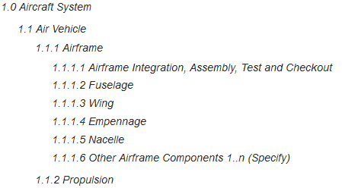
Design principles
Coding scheme: it is common for work breakdown structure elements to be numbered sequentially to reveal the hierarchical structure.
Terminal element: The lowest element in a tree structure, a terminal element is one that is not further subdivided. In a WBS, such elements, also known as work packages, are the items that are estimated in terms of resource requirements, budget and duration; linked by dependencies; and scheduled.
Consistent to norms: The higher WBS structure should be consistent to whatever norms or template mandates exist within the organization or domain.

Slide 25
Create WBS
Decomposition of WBS
According to functionality of the product
According to different phases in software development
According to organizational department or geographical distribution
According to objectives or duties
Steps
Decompose work
Define relationships between activities
Scheduling and resource allocation

Slide 26
Output Documents
General planning
Scope
Progress planning
Cost planning
Quality management planning
Project resource planning
Project risk planning
Procurement planning
Configuration planning
Integration management planning

Slide 27
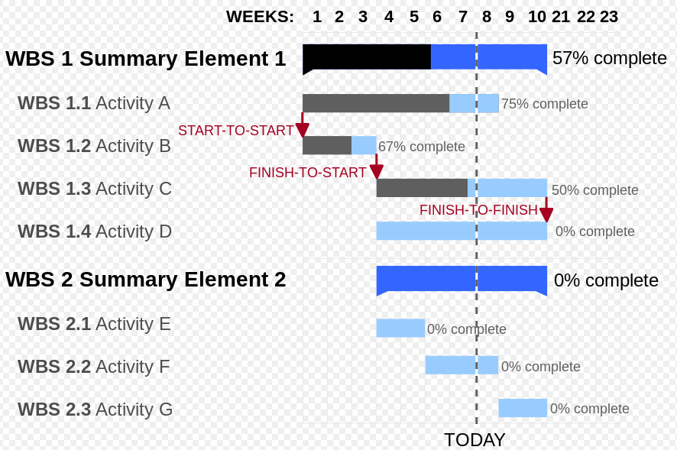
Gantt Chart
A Gantt chart is a type of bar chart, devised by Henry Gantt in the 1910s, that illustrates a project schedule. Gantt charts illustrate the start and finish dates of the terminal elements and summary elements of a project. Terminal elements and summary elements comprise the work breakdown structure of the project.

Slide 28
Tools
Microsoft Project
Oracle Primavera Project Planner
GanttProject
LiquidPlanner
Teamwork
DotProject
Xplanner
……

Slide 29
Conclusion
Any planning approach should have the following elements:
The establishment of project objectives
The analysis of the characteristics of the project
The establishment of an infrastructure consisting of an appropriate organization and set of standards, methods and tools
The identification of the products of the project and the activities needed to generate those products
The allocation of resources to activities
The establishment of quality controls

