Slide 1

Compilers
Principles, Techniques, & Tools
Taught by Jing Zhang
(jzhang@njust.edu.cn)

Slide 2
Intermediate- Code Generation

Slide 3
Outlines
Introduction
Variants of Syntax Trees
Three-Address Code
Types and Declarations
Translation of Expressions

Slide 4
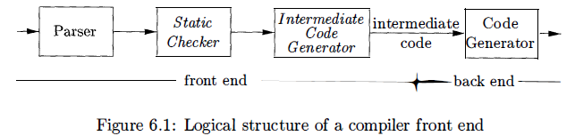

Introduction
we assume that a compiler front end is organized as follows, where parsing, static checking, and intermediate-code generation are done sequentially; sometimes they can be combined and folded into parsing.
In the process of translating a program in a given source language into code for a given target machine, a compiler may construct a sequence of intermediate representations. High-level representations are close to the source language and low-level representations are close to the target machine.

Slide 5
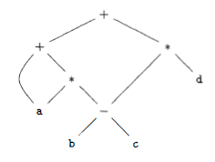
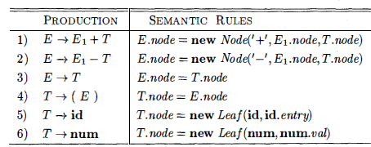
7.1 Variants of Syntax Trees
Directed Acyclic Graphs (DAG)
A node N in a DAG has more than one parent if N represents a common subexpression; in a syntax tree, the tree for the common sub expression would be replicated as many times as the sub expression appears in the original expression. Thus, a DAG not only represents expressions more succinctly, it gives the compiler important clues regarding the generation of efficient code to evaluate the expressions.
E.g. a + a * (b - c) + (b - c) * d

Slide 6
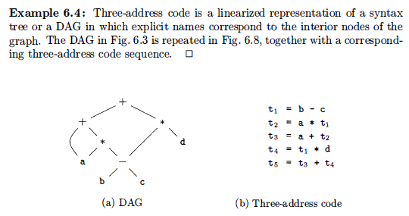
7.2 Three-Address Code
In three-address code, there is at most one operator on the right side of an instruction; that is, no built-up arithmetic expressions are permitted.
E.g. x+y*z
Three-Address Code:

Slide 7

7.2 Three-Address Code – Addresses and Instructions
Addresses
A name.
A constant.
A compiler-generated temporary.
common three-address instruction forms
assignment instructions of the form x = y op z.
assignments of the form x = op y, where op is a unary operation.
copy instructions of the form x = y.
an unconditional jump goto L.
conditional jumps of the form if x goto L and if False x goto L.
conditional jumps such as if x relop y goto L,
procedure calls and returns are implemented using the following instructions:
param x for parameters; call p , n and y = call p , n for procedure and function calls,
respectively; and return y, where y, representing a returned value, is optional.
indexed copy instructions of the form x = y [i] and x [i] = y .
address and pointer assignments of the form x = & y , x = * y , and * x = y.

Slide 8
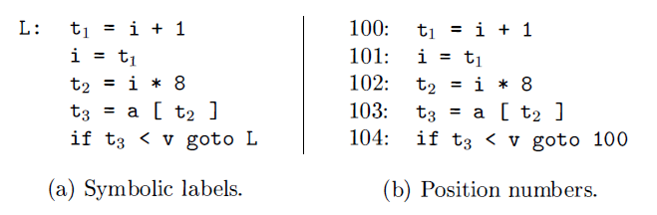
7.2 Three-Address Code – Addresses and Instructions
E.g.
do i = i+ l ; while ( a [i] < v) ;

Slide 9
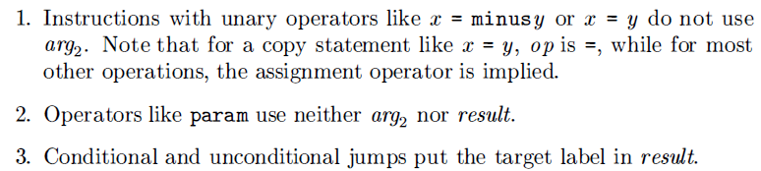
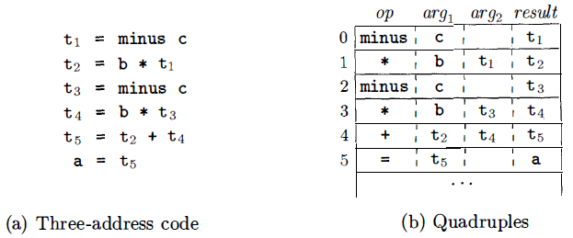
7.2 Three-Address Code – Quadruples
The description of three-address instructions specifies the components of each type of instruction, but it does not specify the representation of these instructions in a data structure. Three such representations are called "quadruples," "triples," and "indirect triples.“
Quadruples
A quadruple (or quad ) has four fields, which we call op, argl arg2 , and result.

Slide 10
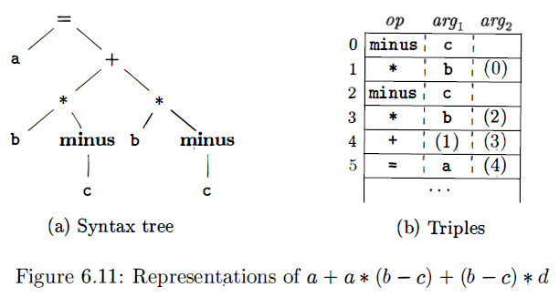
7.2 Three-Address Code – Triples
A triple has only three fields, which we call op, arg1 , and arg2. Using triples, we refer to the result of an operation x op y by its position, rather than by an explicit temporary name.
A ternary operation like x [i]= y requires two entries in the triple structure; for example, we can put x and i in one triple and y in the next. Similarly, x = y [i] can implemented by treating it as if it were the two instructions.

Slide 11
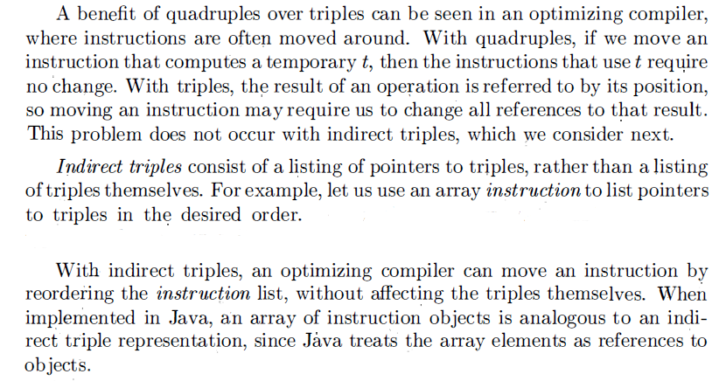
7.2 Three-Address Code – Triples

Slide 12
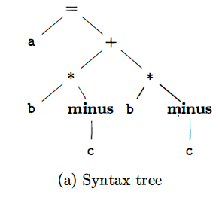
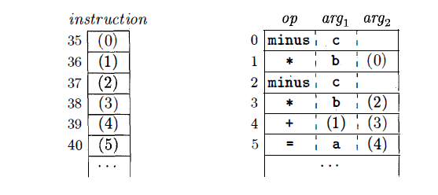
7.2 Three-Address Code – Triples

Slide 13
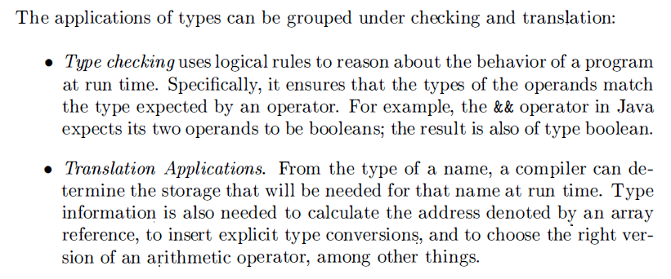
7.3 Types and Declarations

Slide 14
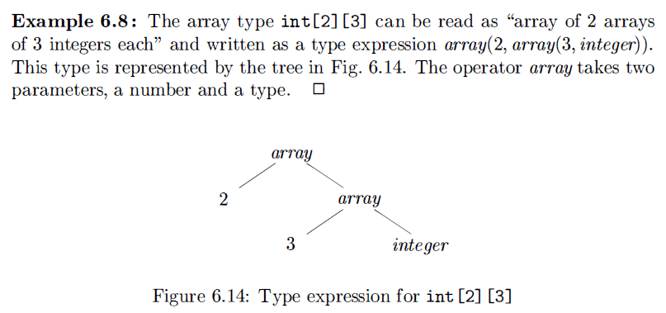
7.3 Types and Declarations-Type Expressions
type expressions: a type expression is either a basic type or is formed by applying an operator called a type constructor to a type expression.

Slide 15
7.3 Types and Declarations-Type Expressions
A basic type is a type expression. Typical basic types for a language include boolean, char, integer, float, and void;
A type name is a type expression;
A type expression can be formed by applying the array type constructor to a number and a type expression;
A type expression can be formed by applying the record type constructor to the field names and their types;
A type expression can be formed by using the type constructor “->”for function types. We write s ->t for "function from type s to type t.“
If s and t are type expressions, then their Cartesian product s x t is a type expression. Products are introduced for completeness; they can be used to represent a list or tuple of types (e.g. , for function parameters ) .
Type expressions may contain variables whose values are type expressions.

Slide 16
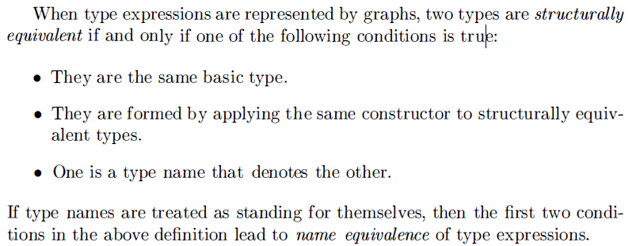
7.3 Types and Declarations-Type Equivalence
Many type-checking rules have the form, "if two type expressions are equal then return a certain type else error.“
The key issue is whether a name in a type expression stands for itself or whether it is an abbreviation for another type expression.

Slide 17
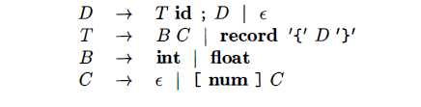
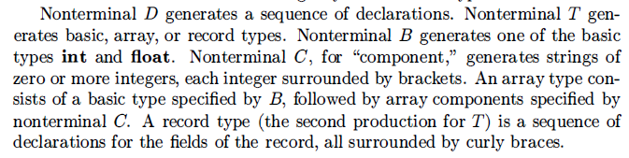
7.3 Types and Declarations-Declaration

Slide 18

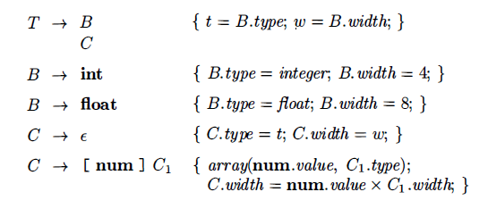
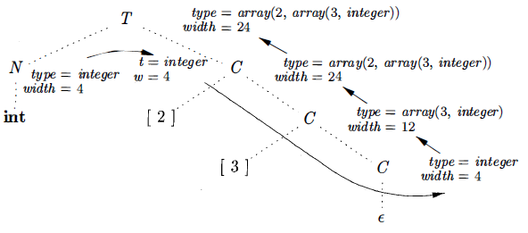
7.3 Types and Declarations-Storage Layout for Local Names
From the type of a name, we can determine the amount of storage that will be needed for the name at run time.

Slide 19
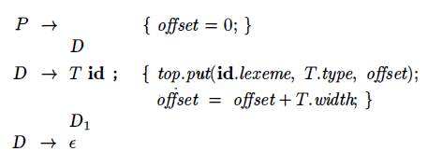
7.3 Types and Declarations-Sequences of Declarations
Languages such as C and Java allow all the declarations in a single procedure to be processed as a group. The declarations may be distributed within a Java procedure, but they can still be processed when the procedure is analyzed. Therefore , we can use a variable, say offset, to keep track of the next available relative address.
creates a symbol table
entry by executing top.put(id. lexeme, T. type, offset) . Here top denotes
the current symbol table.

Slide 20
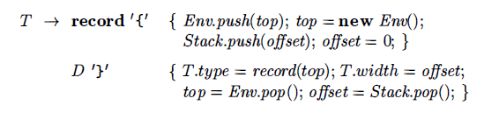
7.3 Types and Declarations-Fields in Records and Classes
This production has two semantic actions. The embedded action before D saves the existing symbol table, denoted by top and sets top to a fresh symbol table. It also saves the current offset, and sets offset to 0. The declarations generated by D will result in types and relative addresses being put in the fresh symbol table. The action after D creates a record type using top, before restoring the saved symbol table and offset.
Let class Env implement symbol tables. The call Env.push( top) pushes the current symbol table denoted by top onto a stack. Variable top is then set to a new symbol table. Similarly, offset is pushed onto a stack called Stack. Variable offset is then set to 0.

Slide 21
7.4 Translation of Expressions-Operations Within Expressions

