Slide 1

Design pattern
Lecture 8

Slide 2
Bridge

Slide 3
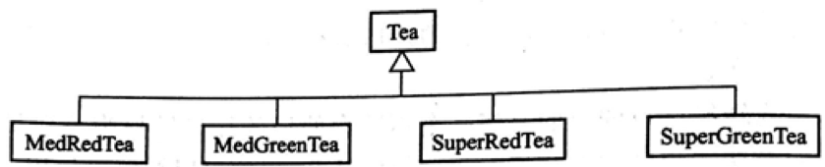
Bridge
Consider an example of an automatic tea selling machine. The tea sold by the machine is divided into medium cups and Super cups on the volume of the cups and red tea and green tea on the tea kind. Sales programs are designed here. For the sake of simplicity, it is assumed that the main function of the program is to calculate the selling price of a cup of tea based on the size of the teacup and the kind of tea. The initial design is shown in Figure 1.
Figure 1
The disadvantages of the above design are repetitive and lack of scalability.

Slide 4
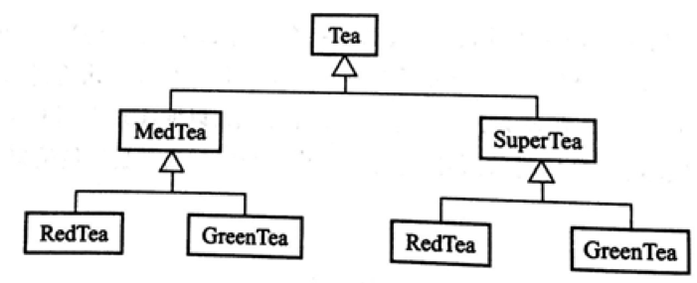
Bridge
According to the size of the teacup, a structure like the one shown in Figure 2 can be designed.
Figure 2 A class diagram designed according to the cup size and tea variety

Slide 5
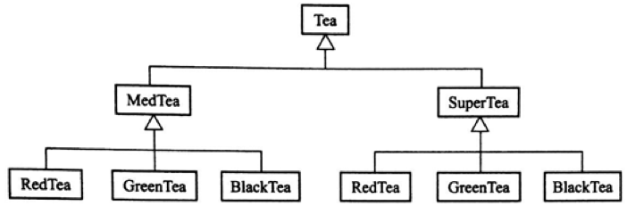
Bridge
Now, if you need to add a new tea kind, such as BlackTea, you need to add the BlackTea class to the subclasses of MedTea and SuperTea, as shown in Figure 3.
Figure 3
The above design does still consistent with the open and close principle, but adding a class needs to operate in two places at the same time, which is still more troublesome.

Slide 6
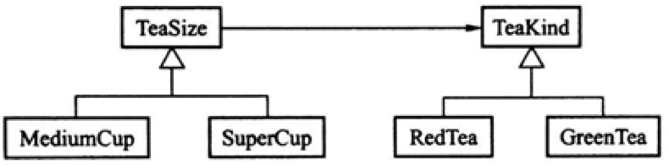
Bridge
Now consider a structure that splits the entire class into two classes and redesigns it, as shown in Figure 4.
Figure 4 Design that separates the abstract part from the implementation part

Slide 7
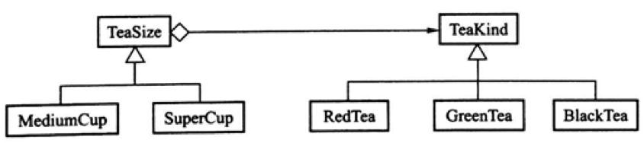
Bridge
Because the new design separates the abstract part from the implementation part, it is relatively easy to add new classes to the tea kind and cup size. For example, if you add a BlackTea class, just add a Teakind subclass, as shown in Figure 5.
Figure 5

Slide 8
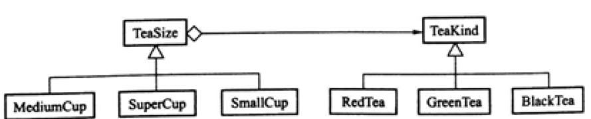
Bridge
If you want to add a new function of selling small cups of tea, you only need to add a TeaSize subclass of SmallCup, as shown in Figure 6.
Figure 6
From this point of view, when there are several dimensions in the designed program, the design that separates the abstract part from the implementation part can make the program independent and add classes without affecting each other. And there is no need to change or even recompile already existing classes.

Slide 9
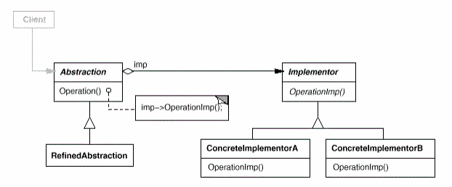
Bridge
Indent
Decouple an abstraction from its implementation so that the two can vary independently.
Structure

Slide 10
Bridge
Structure
Abstraction abstraction;
Implementor implementor;
String imp = getImplementor();
if(imp.compareTo(A)==0) {implementor = new ConcreteImplementorA();}
if(imp.compareTo(B)==0) {implementor = new ConcreteImplementorB();}
abstraction = new RefinedAbstraction(implementor);
abstraction.OperationImp();

Slide 11
Bridge — Applicability
Use the Bridge pattern when:
You want to avoid a permanent binding between an abstraction and its implementation. This might be the case, for example, when the implementation must be selected or switched at run-time.
Both the abstractions and their implementations should be extensible by subclassing. In this case, the Bridge pattern lets you combine the different abstractions and implementations and extend them independently.
Changes in the implementation of an abstraction should have no impact on clients; that is, their code should not have to be recomplied.
(C++) You want to hide the implementation of an abstraction completely from clients. In C++ the representation of a class is visible in class interface.
You want to share an implementation among multiple objects(perhaps using reference counting), and this fact should be hidden from the client.

Slide 12
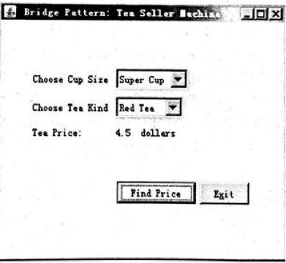
Bridge—Example
Consider an example of an automatic tea selling machine. The tea sold by the machine is divided into medium cups and Super cups on the volume of the cups and red tea and green tea on the tea kind. Sales programs are designed here. For the sake of simplicity, it is assumed that the main function of the program is to calculate the selling price of a cup of tea based on the size of the teacup and the kind of tea. The user obtains the price of a cup of tea by selecting "Super Cup" or "Medium Cup", and "Red Tea" or "Green Tea". Design using bridge mode.

Slide 13
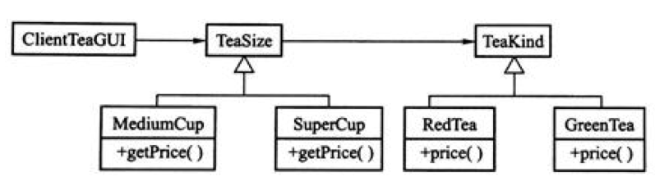
Bridge—Example
Figure 7Tea sales machine programming design using bridge mode
String size = getTeaSize();
String kind = getTeaKind();
if(kind.compareTo(GREENTEA)==0) {tKind = new GreenTea();}
if(kind.compareTo(REDTEA)==0) {tKind = new RedTea();}
if(size.compareTo(SUPERCUP==0) {tSize = new SuperCup(tKind);}
if(size.compareTo(MEDIUMCUP)==0) {tSize = new MediumCup(tKind);}
float price = tSize.getPrice();

Slide 14
Bridge—Example
Volume calculation problems under different metrics. If you want to calculate the volumetric problems of the space geometry under the Meter and Foot, use the bridging mode.

Slide 15
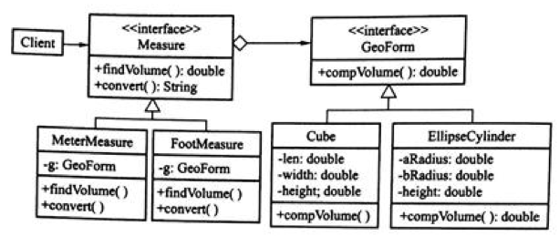
Bridge—Example
GeoForm g;
Measure m;
String form = getGeoForm();
String measure = getMeasure();
if(form.compareTo(Cube)==0) {g = new Cube();}
if(form.compareTo(EllipseCylinder)==0) {g = new EllipseCylinder();}
if(measure.compareTo(MeterMeasure)==0) {m = new MeterMeasure(g);}
if(measure.compareTo(FootMeasure)==0) {m = new FootMeasure(g);}
float volume = m.findVolume();

Slide 16
Behavioral patterns

Slide 17
Behavioral patterns
Motivation
Behavior patterns are concerned with algorithms and assignment of responsibilities between objects. Behavioral patterns describe not just patterns of objects or classes but also the patterns of communication between them.
Content
Iterator pattern abstracts the way you access and traverse objects in an aggregate.
Visitor pattern encapsulates behavior that would otherwise be distributed across classes.
Command pattern encapsulates a request in an object so that it can be passed as a parameter, stored on a history list, or manipulated in other ways.
Mediator pattern avoids explicit references by introducing a mediator object between peers.
The strategy pattern encapsulates an algorithm in an object. Strategy makes it easy to specify and change the algorithm an object uses.
State pattern encapsulates the states of an object so that the object can change its behavior when its state object changes.

Slide 18
iterator

Slide 19
Iterator
Iterator pattern application scenario: Observe an instance that encapsulates the customer's name, store the customer information in a linked list, and assume that each item in the linked list stores the customer name in the form of a string.
public class CustomerAggregate {
LinkedList<String> cusList;
public void add(String name){cusList.add(name);}
public AbsttractCollection<String>getCusList(){return cusList;}
}
Client:
public static void main(String[] args) {
CustomerAggregate customers =new CustomerAggregate();
AbsttractCollection cusList = customers.getCusList();
cusList.add("mike");
......
Iterator itr=cusList.iterator();
while(itr.hasNext()){println(itr.next());}
......
}
The disadvantage of the above design is that CustomerAggregate does not provide a way to iterate through the encapsulated data structures, so the client must know what data structure the CustomerAggregate class encapsulates in order to use the appropriate traversal method.

Slide 20
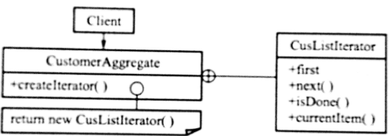
Iterator
A successful solution:
Detach the capabilities of traversing aggregated data structures separately and write them as an internal class. This class provides a set of methods suitable for traversing this aggregate class, usually first() next() and so on.
The advantage of doing this is that the code for the aggregation class itself is made simple and the client does not need to care about the data structures that CustomerAggregate encapsulates.
CustomerAggregate customers =new CustomerAggregate(); customers.add("Mike");
......
CustomerAggregate.CusListIterator itr = customers.createItreator(); for(itr.first();!itr.is_done();itr.next()){ println("itr.currentItem()") }
......

Slide 21
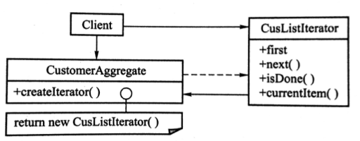
Iterator
Customer information system design. Aggregate classes are very bloated, if you need to modify the iterator code you need to modify the aggregate class code. The inner class can be extracted from the aggregation class and become a separate class CusListIterator.
CustomerAggregate customers =new CustomerAggregate();
customers.add("Mike");
......
CusListIterator itr=customers.createItreator();
for(itr.first();!itr.is_done();itr.next()){ println("itr.currentItem()") }
......

Slide 22
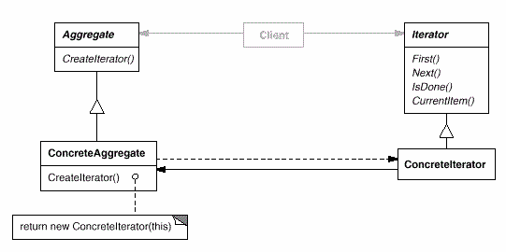
Iterator
The key idea of iterator pattern is to separate the access and traversal of the list from the list object into a separate iteration object.
Intent
Provide a way to access the elements of an aggregate object sequentially without exposing its underlying representation.
Structure

Slide 23
Iterator
Participant
Iterator
Defines an interface for accessing and traversing elements
ConcreteIterator
Implements the Iterator interface
Keeps track of the current position in the traversal of the aggregate
Aggregate
Defines an interface for creating an Iterator object
ConcreteAggregate
Implements the Iterator creation interface to return an instance of the proper ConcreteIerator.

Slide 24
Iterator—Applicability
Use the Iterator pattern
To access an aggregate object’s contents without exposing its internal representation
To support multiple traversals of aggregate objects
To provide a uniform interface for traversing different aggregate structures.

Slide 25
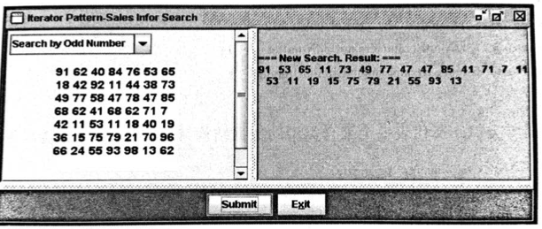
Iterator—Example
Randomly generates an integer matrix (Matrix). The matrix can be seen as aggregated data. Consider two different ways of traversing this matrix (OddNumIterator and CircularIterator). Design class diagram by Iterator pattern.

Slide 26
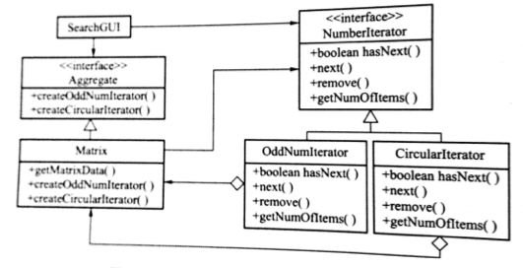
Iterator—Example

Slide 27
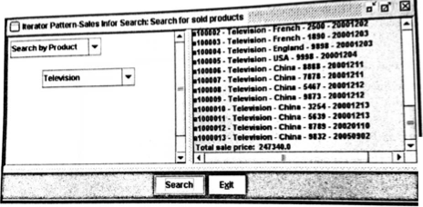
Iterator—Example
Design a product sales information query system, assuming that this system does not involve a database, and all sales information is written in a txt file (TotalSalesInfo) in a fixed format (SalesDataModel). The user queries the document through the user's graphical interface program to obtain the information to be queried. There are two iterators (SalesIterator and DateIterator) in this design, as shown.

Slide 28
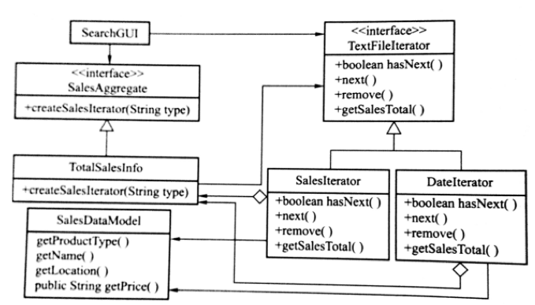
Iterator—Example

Slide 29
Iterator—Advantege
It supports variations in the traversal of an aggregate. Complex aggregates may be traversed in many ways. For example, code generation and semantic checking involve traversing parse trees. Code generation may traverse the parse tree inorder or preorder. Iterators make it easy to change the traversal algorithm: just replace the iterator instance with a different one. You can also define Iterator subclasses to support new traversals.
Iterator simplify the Aggregate interface. Iterator’s traversal interface obviates the need for a similar interface in Aggregate, thereby simplifying the aggregate’s interface.
More than one traversal can be pending on an aggregate. An iterator keeps track of its own traversal state. Therefore you can have more than one traversal in progress at once.

Slide 30
Example
int main(){
deque<int> coll;
deque<int>::iterator pos1;
pos1 = find(coll.begin(), coll.end(), 2);
deque<int>::iterator pos2;
pos2 = find(coll.begin(), coll.end(), 7);
for_each(pos1, pos2, print);
cout << endl;
deque<int>::reverse_iterator rpos1(pos1);
deque<int>::reverse_iterator rpos2(pos2);
for_each(rpos2, rpos1, print);
cout << endl;
return 0;}

Slide 31
mediator

Slide 32
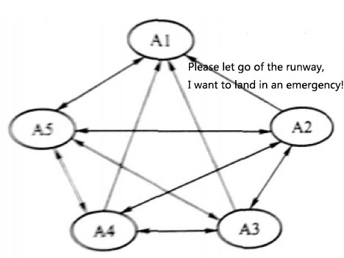
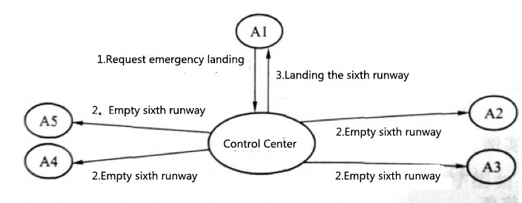
Mediator
In the airport command system, aircraft that take off and land at the same airport do not directly communicate with each other, but each aircraft communicates directly with the command system. The command system then directs all aircraft to take off and land in accordance with the rules. For example, when an aircraft (A1) fails and requires an emergency landing at an airport, the aircraft does not directly talk to all the aircraft at the airport, as shown in Figure 1. Instead, a request was made directly to the airport command center, requesting an emergency landing, and then the airport directed all the appropriate aircraft to give up the runway, as shown in Figure 2.
Through the center as an mediator, the communications of all aircraft are conducted with the center, and the function calls are also concentrated in the command and control center.
Figure 1
Figure 2

Slide 33
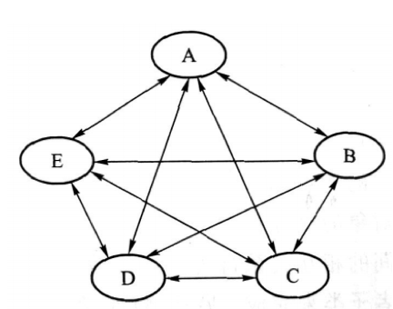
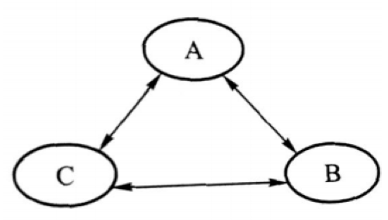
Mediator
In general, a software system contains some objects, each of which can provide some services. If objects are called directly by messages, the message calls between objects are relatively simple when the number of objects is small, as shown in Figure 3.
However, when the number of objects increases from 3 to 5, the number of interactions between objects increases from 6 to 20, as shown in Figure 4. That is, although the number of participants has increased slightly, the number of interactions has increased significantly. In this case, you can use the mediator pattern to reduce direct calls between individual objects.
Figure 3
Figure 4

Slide 34
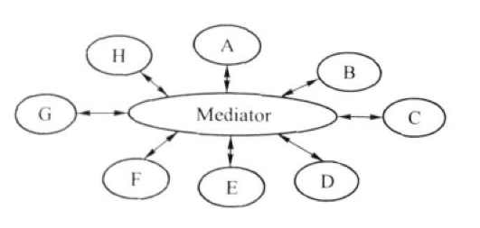
Mediator
The main point of the mediator pattern is to abstract the details of interactions between all objects into a single class, called Mediator, as shown in Figure 5. Each object is still responsible for providing the original design of the service, but there is no direct interaction between the objects. The interaction between the objects is done through the Mediator class.
For example, object B calls a method of Mediator, and in this method will call some of the methods in objects E, F, and G, and it may also call B's method in reverse. Object B may not know at all which object was called.
Figure 5

Slide 35
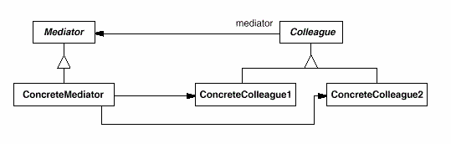
Mediator
Participants
Mediator
Defines an interface for communicating with Colleague objects.
ConcreteMediator
Implements cooperative behavior by coordinating Colleague objects
Knows and maintains its colleagues
Colleague classes
Each Colleague class knows its Mediator object
Each colleague communicates with its mediator whenever it would have otherwise communicated with another colleague.
Structure

Slide 36
Mediator
Structure
Mediator mtr = new ConcreteMediator();
Colleague c1 = new ConcreteColleague1(mtr);
Colleague c2 = new ConcreteColleague2(mtr);
mtr.registerConcreteColleague1(c1);
mtr.registerConcreteColleague2(c2);
mtr.update(“information”);

Slide 37
Mediator—Applicability
Use the Mediator pattern when
A set of objects communicate in well-defines but complex ways. The resulting interdependencies are unstructured and difficult to understand.
Reusing an object is difficult because it refers to and communicates with many other objects.
A behavior that’s distributed between several classes should be customizable without a lot of subclassing.

Slide 38
Mediator—Example
An example of an island mini airfield. There is a miniature military airfield on a small island. The airport has only three types of flights: Bomber, BattlePlane, and Transporter. The airport‘s setup includes a hangar and a runway for the aircraft to take off and land. Aircraft can be parked in the hangar to prevent the aircraft from being damaged on the ground. Only one aircraft can be parked on the runway. When an aircraft is commanded to take off from the hangar, the aircraft is first opened from the hangar to the runway, so if there is already an aircraft on the runway, the aircraft must first enter the hangar to free up the runway to allow the aircraft which is got order before gliding to take off. When an aircraft is commanded to land from the air, if there are still other aircraft on the runway, the aircraft will first enter the hangar to free the runway to allow the landed aircraft to land. It is required to design a software management system for the airport to manage the take-off, landing and entry and exit of the aircraft. Design the system according to the mediator pattern.

Slide 39
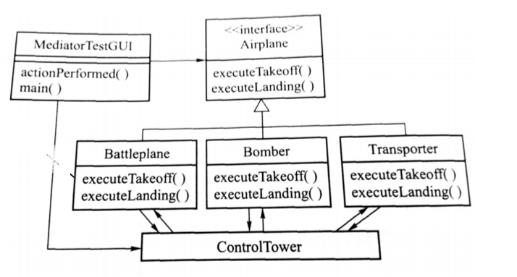
Mediator—Example
ControlTower ct = new ControlTower();
Battleplane bp = new Battleplane(ct);
ct.registerBattleplane(this);

Slide 40
Mediator—Advantage
The interaction of all objects is transferred to an independent mediator object, making it easier for users to modify inter-relationships between objects through mediators. When modifying an interactive behavior, it can be done by modifying or replacing one of the specific mediator subclasses. In addition, the transfer of object interactions into a specialized class also improves object reusability.
Because the objects do not interact directly, the unit test of the object becomes more easier.
Low coupling makes the modification of one class not affect other classes.

