Slide 1

Design pattern
Lecture 9

Slide 2
observer

Slide 3
Observer
There is a lot of wild animals in some grassland in Africa, including herbivores and carnivores. Every year when entering the period from May to October, grassland is green and fragrant, providing herbivores with abundant food. Therefore, a large number of herbivores have entered the grasslands, and various carnivores also enter the grasslands along with herbivores; but when From November to April, the grassland turns yellow. Most of the plants are withered and the water source is dry. All herbivores must leave the grassland or they cannot survive. Various carnivores must also leave the grasslands. In this way, all animals depend on the state of this grassland, and green and yellow can be used to indicate different states. Here, the grasslands are observed and other animals are observers.

Slide 4
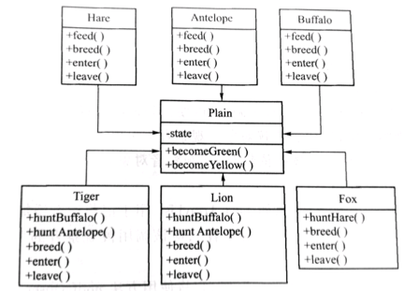
Observer
If you develop a grassland animal observer software, you can design the grassland and each animal as classes. The class diagram is shown in Figure 1.
This class diagram contains a grassland Plain and 6 animal species Hare, Antelope, Buffalo, Tiger, Lion and Fox, which contains 3 herbivores and 3 carnivores. These animals depend on the state of the grassland. If the state state is yellow, all the animals leave the grassland. If the state is green, all the animals enter the grassland.
Figure 1

Slide 5
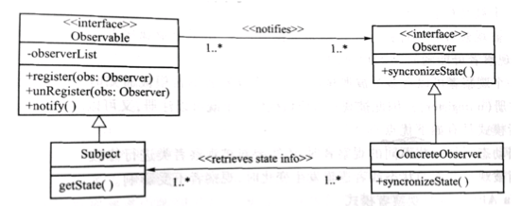
Observer
Intent
Define a one-to-many dependency between objects so that when one object changes state, all its dependents are notified and automatically.
Structure

Slide 6
Observer
Participant
Observable: Observed interface, which declares three methods that should be implemented. In the simple case, the register(obs: Observer) method is responsible for registering the observers in the parameters to the Subject object, keeping a list of concrete observers in the Subject object for recording all the observers.
Subject: The object that the concrete observer depends on. It implements all methods of Observable. The getState() method in the Subject can be called by ConcreteObserver to get the latest status.
Observer: Observer interface, represents the dependent object. There can be more than one observer.
ConcreteObserver: represents a concrete observer object.

Slide 7
Observer
The observer pattern works as follows:
The Subject maintains a data structure, such as a Java ArrayList, for recording dynamically added observers.
The object interested in the state of the Subject(observer) should call the Subject 's Register method to register itself as an observer of it.
Whenever the state of the Subject changes, it will notify the registered observer using the method notifyObservers().
When notified, each observer will check the state of the Subject to keep the state synchronized. According to the new state, the observer will decide to do some synchronous updates or other related operations.
The observer will provide an interface that receives notification from the subject, such as synchronizeState(), which the subject can invoke in the method notify().

Slide 8
Observer—Applicability
Use the Observer pattern when in any of the following situations:
When an abstraction has two aspects, one dependent on the other. Encapsulating these aspects in separate objects lets you vary and reuse them independently.
When a change to one object requires changing others, and you do not know how many objects need to be changed.
When an object should be able to notify other objects without making assumptions about who these objects are. In other words, you don’t want these objects tightly coupled.

Slide 9
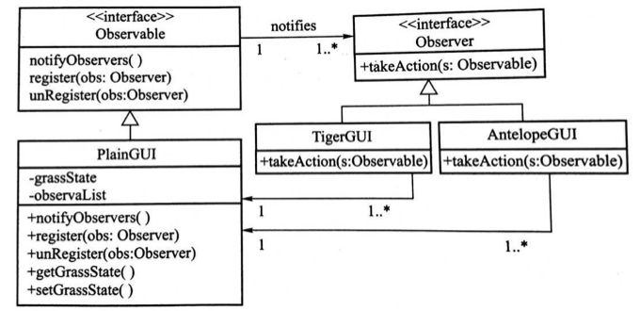
Observer—Example
Assume that there are two groups of animals: tigers and antelopes. Both groups of animals are observing the grassy state of a prairie. When the grass turns green, the antelope group and the tiger group will all come to the grassland; when the grassland turns yellow, both the antelope group and the tiger group will leave. Design a simple program with a graphical interface to simulate the above scenario.
According to the structure of the observer pattern, the design is shown in the figure below.

Slide 10
Observer
Simulate boiler temperature display. The observerd represents the boiler with TemperatureGUI. In order to display the temperature values in different ways, several observers were designed: the Celsius graphic display interface—CelsiusGUI, the FahrenheitGUI object of the Fahrenheit temperature display interface, and the KelvinGUI object of the Kevin temperature display interface to observe the observed TemperatureGUI object.
When the user enters Celsius, Fahrenheit or Kevin temperature in the TemperatureGUI graphical interface, accordingly, according to the temperature conversion, several temperature observer interfaces will display Celsius, Fahrenheit, or Kevin temperature, respectively, and also display the temperature color, That is, different colors indicate different temperatures. The design is shown in Figure2 .

Slide 11
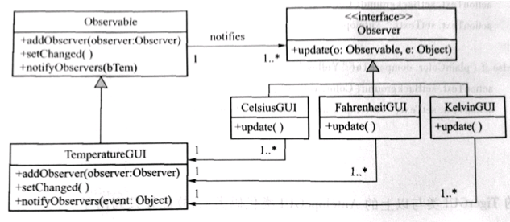
Observer
Figure 2
In this program, the setChanged() and notifyObservers(bTem) methods are used to notify observers of changes in temperature. The parameter bTem represents the temperature value entered by the user. This parameter passes the temperature value to the observer's update method's second parameter. After reading this value in the observer object, the current user input temperature value can be obtained.

Slide 12
Strategy

Slide 13
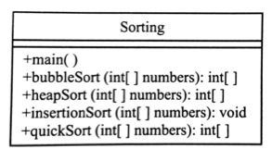
Strategy
One of the basic principles that object-oriented programming follows is separation of duties, and the other is high cohesion and low coupling.
Let‘s first observe an example. This is a sort of Java program. This sorter contains 4 different sort methods. Each method will return an ordered sequence of integers. First design the program as a independent class. The design includes both the main method and some sorting methods.
Advantages: The entire program is designed as a independent class, making it easier to write code;
Disadvantages: There is no separation of duties and there are also problems with scalability and maintainability.

Slide 14
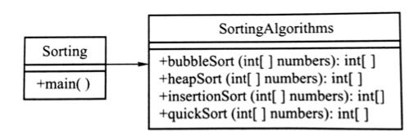
Strategy
In order to overcome the above-mentioned disadvantages, the above design class is split into two classes.
This design strips the customer class Sorting with the main method from the sorting SortingAlgorithms. Therefore, the separation of duties was achieved.
All the sorting algorithms in the design are encapsulated in a class. These methods all accomplish the same task- sorting an integer sequence, so the design has a high cohesive nature.
Advantages: When you need to modify the methods in SortingAlgorithms, you do not have to make any changes to the customer class Sorting.
Problem: When a new algorithm is added to the SortingAlgorithms or when an algorithm is modified, the entire SortingAlgorithms class needs to be recompiled.

Slide 15
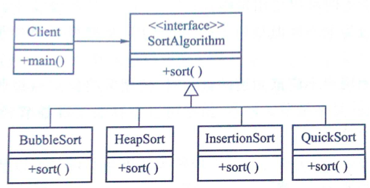
Strategy
Solution:
Split class SortingAlgorithms further, encapsulating each sorting algorithm into a single class, that is, splitting a class into several classes, each encapsulating an algorithm separately.
Advantages: Modifying an algorithm only requires recompiling the class involved in the algorithm without having to recompile other classes. If you want to add a new algorithm, you only need to add a new class that encapsulates the algorithm in the collection of subclasses.
The design is universal, and it can be attributed to this type of pattern— the strategy pattern.

Slide 16
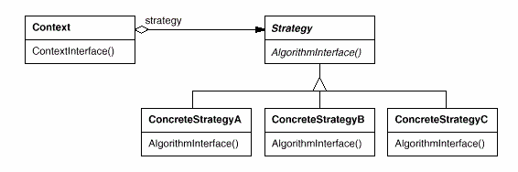
Strategy
Intent
Define a family of algorithm, encapsulate each one, and make them interchangeable. Strategy lets the algorithm vary independently from clients that use it.
Structure

Slide 17
Strategy
Participants
Strategy
Declare an interface common to all supported algorithms. Context uses this interface to call the algorithm defined by a ConcreteStrategy.
ConcreteStrategy
Implements the algorithm using the Strategy interface.
Context
Is configure with a ConcreteStrategy object.
Maintains a reference to a Strategy object
May define an interface that lets Strategy access its data

Slide 18
Strategy —Applicability
Use the Strategy pattern when
Many related classes differ only in their behavior. Strategies provide a way to configure a class with one of many behaviors.
You need different variants of an algorithm. For example, you might define algorithms reflecting different space/time trade-offs. Strategies can be used when these variants are implemented as a class hierarchy of algorithms.
An algorithm uses data that clients shouldn’t know about. Use the Strategy pattern to avoid exposing complex, algorithm-specific data structures.
A class defines many behaviors, and these appear as multiple conditional statements in its operations. Instead of many conditionals, move related conditional branches into their own Strategy class.

Slide 19
Strategy
Advantage
Obtain a series of reusable algorithms, these algorithms inherit a common abstract class, so the common functions can be put into the super class;
Encapsulate different algorithms in different strategy subclasses to make the logic clearer and each algorithm can change independently;
It is easier to change or extend functions. Modifying an algorithm does not require recompiling “Client” and “Context”.
Disadvantage
Clients must be aware of different Strategies. The pattern has a potential drawback in that a client must understand how Strategies differ before it can select the appropriate one. Clients might be exposed to implementation issues. Therefore you should use the Strategy pattern only when the variation in behavior is relevant to clients.

Slide 20
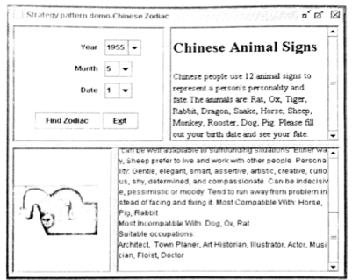
Strategy—Example
Chinese Zodiac query system. Use the strategy pattern to design this example.
Encapsulate each of the twelve Zodiac as a class and design a common interface (ChineseZodiac) for these classes. Users enter their date of birth using the user's graphical interface, and when creating a Context object, the date is passed as a parameter to the Context class. The Context class performs calculations based on user input, derives the initial Zodiac class, and is responsible for creating the Zodiac object. The Context class uses this object to call the subclass's say() function to introduce the features of the Zodiac.

Slide 21
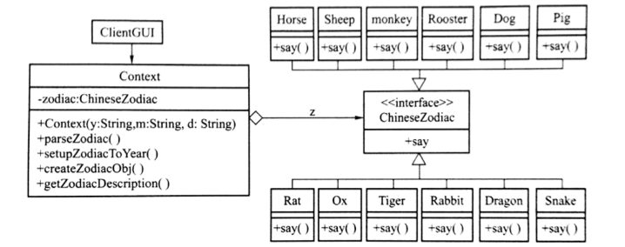
Strategy
Chinese Zodiac query system designed by strategy pattern

