Slide 1

Software architecture
Lecture 1

Slide 2
Software Crisis
The causes of the software crisis
The scale of the software is getting bigger and bigger
Increasing complexity
Delivery time is relatively short

Slide 3
Software Crisis
The IBM 360 operating system developed by IBM of the United States from 1963 to 1966，which took 5000 people a year to work, with at most 1000 people working on development, and nearly a million lines of programming…According to statistics, each new release of the operating system is the result of finding 1000 bug fixes in the previous version…
The director of the project, F. D. Brooks, later summed up his painful lessons in the development process:’... Just as a fugitive beast falls into the mire and becomes a moribund struggle, the more it struggles, the deeper it sinks, the last it cannot escape. Programming is just like this. A lot of programmers are forced to struggle in the mud... No one expected that the problem would fall into such a predicament...’. The history of the IBM360 operating system has become a classic example of software development projects.

Slide 4
Software Crisis
The crisis manifested itself in several ways
Increasing software costs
Development progress is difficult to control
Software was very inefficient
Software was of low quality
Projects were unmanageable and code difficult to maintain

Slide 5
The main manifestation of the software crisis
Increasing software costs
In the 1950s software costs accounted for 10% -20% of the total computer system cost. By the mid-1960s, the share of software costs in computer systems had risen to about 50%.
Moreover, the figure is constantly increasing. The following is a set of data from the Air Force computer system: In 1955, software costs accounted for about 18% of the total cost, reaching 60% in 1970, reaching 72% in 1975 and reached in 1980 80% in 1985 reached about 85%.

Slide 6
The main manifestation of the software crisis
Development progress is difficult to control
In the software development process, user’s demand changes and other unexpected situations emerge in an endless stream, making the software development process is difficult to ensure that the plan is achieved on schedule.
Blindly increasing the software developer is not proportional to improve the ability of software development. On the contrary, with the increase of the number of personnel, the problems of personnel organization, coordination, communication, training and management will be even more serious.

Slide 7
The main manifestation of the software crisis
Software was very inefficient and of low quality
Due to the lack of guidance of engineering thought, programmers almost always use their own ideas to replace the user’s demand for software. The software designs with randomness, many functions are just a programmer‘s wishful thinking, which is the important factor of the software is unsatisfactory

Slide 8
The main manifestation of the software crisis
Projects were unmanageable and code difficult to maintain
Because in the process of software design and development, the developers didn‘t strictly follow the software development standard, and there is no complete record of the true state of the system documentation, resulting in great difficulties in software maintenance.
Especially in the process of using the software, the original developer may have left the original development organization for various reasons, making the software almost unmaintainable .
Data show that the industry is responsible for the maintenance of software to pay for the total hardware and software costs of 40-75%.

Slide 9
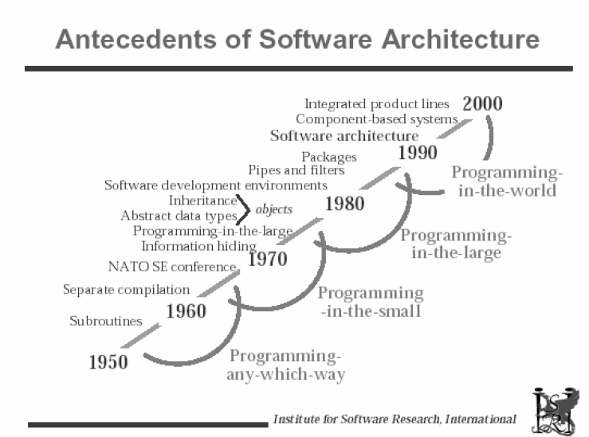
How to overcome the software crisis？

Slide 10
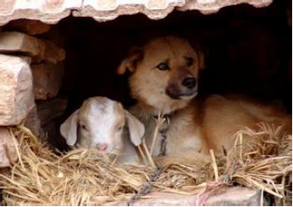
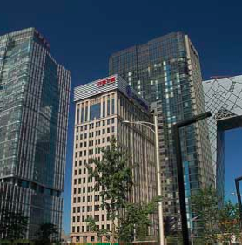
Introduction
The story about kennel, architecture and modeling…
We are building a software skyscraper in a Kennel’s way

Slide 11

Kennel’s architecture design
One person can build
Need:
Design plan (idea) in the builder's mind
Simple process: building while thinking
Simple tools

Slide 12
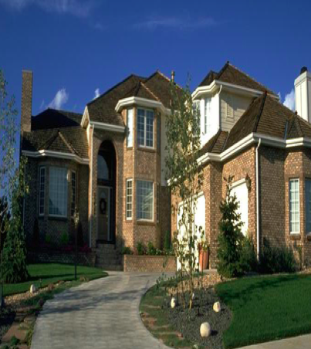
Villa’s architecture design
Built by a team and must be built effectively and efficiently.
Need:
Design, modeling
Well defined process
Powerful tools

Slide 13
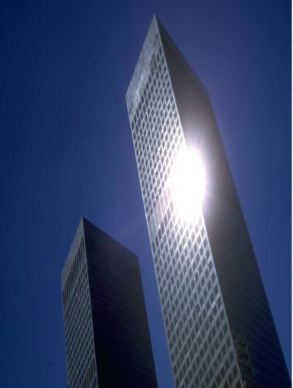
Buildings’architecture design
HOW TO BUILD?

Slide 14
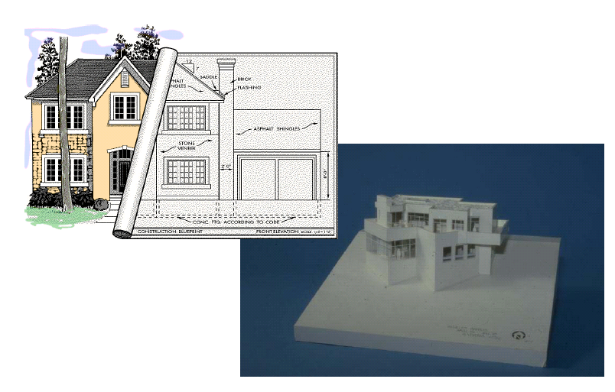
Story moral: pay attention to the design of architecture
Point 1:the part and the whole
Point 2:Modeling and Implementation

Slide 15
Architecture
The definition of Computer Architecture was introduced by C.M Amdahl in introducing the IBM 360 system in 1965: Computer architecture is the computer's property, conceptual structure and functional characteristics, seen by programmers.
The concept of Software Architecture was mentioned in An Introduction to Software Architecture by David Garlan and Mary Shaw in 1993.

Slide 16
Reference material
Bass L, Clements P, Kazman R, Software Architecture in Practice, 2nd Edition, Addison Wesley, 2003.
Shaw M, Garlan D, Software Architecture – Perspectives on an emerging discipline, Prentice Hall, 1996.
Stephen T.Albin, The Art of Software Architecture Design Methods and Techniques,2003.

Slide 17
What is software architecture？
Definition of IEEE610.12—1990
Architecture is the basic organization of a system based on the relationship between components and components, the relationship between components and the environment, and the principle that guides the design and evolution of the above content.
Software Architecture = {Components, Connectors, Environment, Principle}

Slide 18
What is software architecture？
Definition of Booch&Rumbaugh&Jacobson
Software Architecture encompasses the significant decisions about
the organization of a software system,
the selection of the structural elements and their interfaces by which the system is composed together with - their behavior as specified in the collaboration among those elements,
the composition of these elements into progressively larger subsystems,
the architectural style that guides this organization, these elements and their interfaces, their collaborations, and their composition.
Software Architecture = {Components, Elements , Subsystems, Style}

Slide 19
What is software architecture？
Definition of Bass
The software architecture of a program or computing system is one or more structures of the system, including the software components, the external visual properties of the components, and the relationships between the components.
Definition of Garlan&Perry
The structure of the components of a program/system, their interrelationships, and principles and guidelines governing their design and evolution over time.

Slide 20
What is software architecture？
Definition of Shaw
Shaw made the following classification of the various views of the software architecture definition：
Structure Model
This is the most Direct and prevalent module establishment method. Using component /connector and other conception to describe architecture , and inflect critical content including system configuration/restriction/consumption/style and characters with architecture.
Core to Structure Model is architecture description language.

Slide 21
What is software architecture？
Definition of Shaw
Framework Model
Similar with Structure Model,not concentrate particularly to detail, but to unitary framework.
Framework model is aiming to solution to special problem.
Dynamic Model
Supplement to structure and framework model, it mainly focus on extensive behavior characters. For example, description to system reconfiguration or evolvement.

Slide 22
What is software architecture？
Definition of Shaw
Process Model
Research on steps and process of system
Configuration model is following to Process Model

Slide 23
What is software architecture？
Definition of Garlan&Shaw ‘s model
Software Architecture = {Components, Connectors, Constrains}
Component
Component can be a set of code, such as program modules, it can be a separate program, such as a database server. Component is a collection of related objects, running to achieve some calculation logic. They are either structurally related or logically related. The component is relatively independent, only through interface and external interaction, and the customization and normalization of component embedded in different application systems can be significant for the reuse of component.

Slide 24
What is software architecture？
Definition of Garlan&Shaw ‘s model
Software Architecture = {Components, Connectors, Constrains}
Connector
Connector can be process calls, pipelines, remote procedure calls, etc., which used to represent the interaction between components, they connect different components to form part of the architecture. The connector is also a group of objects. It generally appears as a framed or transposed object.

Slide 25
What is software architecture？
Definition of Garlan&Shaw ‘s model
Software Architecture = {Components, Connectors, Constrains}
Constrain
The constraint is generally the rule of the object connection, or indicates the attitude or condition of the connection of the component, for example, the upper component can require the service of the lower component, and vice versa. Two objects must not send messages recursively. The consistency constraints on code copy migration and under what conditions is the connection invalid?

Slide 26
What is software architecture？
Definition of Perry&Worf ‘s model
software architecture is a set of architecture elements that have a particular form. This set of elements is divided into 3 categories:
The Processing Elements responsible for completing the data processing
the Data Elements being processed
The Connecting Elements used to connect the different combinations of the architectures together
Software Architecture = {Elements, Form, Rational}

Slide 27
What is software architecture？
Definition of Boehm ‘s model
Software architecture includes system components, connectors, constraints, the set reflects the needs of different groups of people, as well as rational.
Software Architecture = {Components, Connectors, Constrains, Stakeholders’needs ,Rationale}

Slide 28
What is the significance of software architecture?
“Good architecture design has always been a major factor determining the success of a software system”
Architecture is the means by which stakeholders can communicate
Software architecture represents the system's high level of public abstraction. In this way, most, if not all, of the people involved in the system can use it as a basis for building a mutual understanding and form a common understanding and exchange of ideas.
Architecture provides a common language to express various concerns and consultations, which makes rational management of large and complex systems. This has a great impact on the final quality and use of the project.

Slide 29
What is the significance of software architecture?
Architecture is the embodiment of early design decisions
Software architecture defines the constraints of the system.
Software architecture determines the organizational structure for developing and maintaining the organization.
Software architecture restricts the quality attributes of the system.
By studying the software architecture may predict the quality of the software.
Software architecture makes inference and control changes easier.
Software architecture is helpful for progressive prototyping.
Software architecture can be used as a basis for training.

Slide 30
What is the significance of software architecture?
Software architecture is a transitive and reusable model Software
Software architecture reuse means that architecture decisions can affect multiple systems with similar needs, which is more advantageous than code-level reuse.

Slide 31
The History of Software Architecture
Characterized by small-scale application development in assembly language
‘Non-architecture’ design phase
The theme of program structure design emerged, characterized by control flow graph and the data flow graph as a software structure
Germination phase
The structure model of the system is described from different aspects, and UML is the typical representative.
initial phase
To describe the high-level abstraction of the system structure as the center, do not care about the modeling of specific details, divides the architecture model and the limits of traditional software structure, the phase marked by Kruchten suggests ‘4 + 1’ model
Advanced phase

Slide 32
Research Status of Software Architecture
Software architecture description research
Software Architecture Description Language (ADL)
ADL is such a language that system designers can use the features it provides to model software system conceptual architectures. ADL provides a conceptual framework for specific syntax and characterization architectures.
Use the '4 + 1' model to describe the software architecture
The ‘4 + 1’ model consists of a logical view, a development view, a process view and a physical view, and organically combines the four views through the scene.
Use the UML to describe the software architecture

Slide 33
Research Status of Software Architecture
Software architecture design research
Architecture style research
Architecture design principles
Architecture Design Patterns
Architecture design method

Slide 34
Research Status of Software Architecture
Architecture-based software development methodology
In essence, software architecture is an abstract solution to software requirements. After introducing the software development of the architecture, the construction process of the application system becomes： problem definition—software requirements—software architecture—software implementation
Software Architecture Assessment
Common software evaluation methods include Software Architecture Analysis Method(SAAM) and Architecture Tradeoff Analysis Method(ATAM). They are both scenario based software architecture evaluation methods.
Domain Specific Software Architecture (DSSA)
DSSA applies software architecture theory to specific areas. Because applications in specific areas have similar characteristics, they can learn from the mature software systems in the field. Through the field of software architecture, solutions can be achieved in a field of reuse。
Software Architecture Support Tools

Slide 35
Developing Directions of Software architecture
Information exchange among various software architecture languages
Design tools and the environment
Architecture re-engineering issues

Slide 36
Quality Attributes
What is Quality Attribute？
A quality attribute (QA) is a measurable or testable property of a system that is used to indicate how well the system satisfies the needs of its stakeholders.
How to express the Quality Attribute
Availability
Interoperability
Modifiability
Performance
Security
Testability
Usability
Other Quality attrbutes

Slide 37
Quality Attributes
Availability
Availability refers to the ability of a system to mask or repair faults such that the cumulative service outage period does not exceed a required value over a specified time interval.
The availability of a system can be calculated as the probability that it will provide the specified services within required bounds over a specified time inter- val. When referring to hardware, there is a well-known expression used to derive steady-state availability:
where MTBF refers to the mean time between failures and MTTR refers to the mean time to repair. In the software world, this formula should be interpreted to mean that when thinking about availability, you should think about what will make your system fail, how likely that is to occur, and that there will be some time required to repair it.

Slide 38
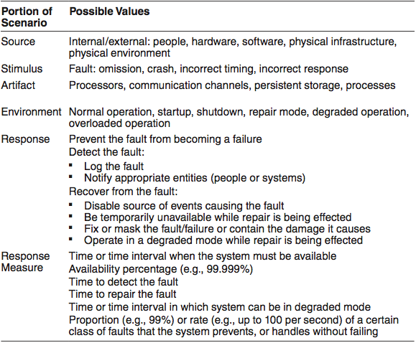
Quality Attributes
Availability General Scenario

Slide 39
Quality Attributes
Tactics for Availability
Detect Faults
Ping/echo Ping/echo refers to an asynchronous request/response message pair ex- changed between nodes, used to determine reachability and the round-trip delay through the associated network path.
Heartbeat Heartbeat is a fault detection mechanism that employs a periodic message exchange between a system monitor and a process being monitored.
Exception detection Exception detection refers to the detection of a system condition that alters the normal flow of execution.
…

Slide 40
Quality Attributes
Tactics for Availability
recover from faults
preparation-and-repair .Preparation-and-repair tactics are based on a variety of combinations of re- trying a computation or introducing redundancy.
reintroduction Reintroduction is where a failed component is reintroduced after it has been corrected.
Prevent faults
Removal from service
Transactions.
Predictive model
Exception prevention
Increase competence set.

Slide 41
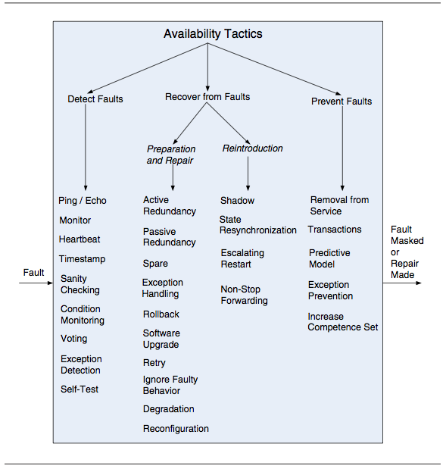
Quality Attributes
Tactics for Availability

Slide 42
Quality Attributes
Interoperability
Interoperability is about the degree to which two or more systems can usefully exchange meaningful information via interfaces in a particular context. The definition includes not only having the ability to exchange data (syntactic interoperability) but also having the ability to correctly interpret the data being exchanged(semantic interoperability).

Slide 43
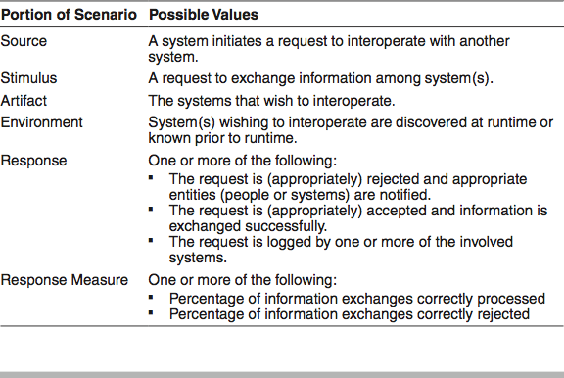
Quality Attributes
Interoperability General Scenario

Slide 44
Quality Attributes
Tactics for Interoperability
Locate
Discover service. Locate a service through searching a known directory service. There may be multiple levels of indirection in this location process—that is, a known location points to another location that in turn can be searched for the service. The service can be located by type of service, by name, by location, or by some other attribute.
Manage Interfaces
Orchestrate. Orchestrate is a tactic that uses a control mechanism to coordinate and manage and sequence the invocation of particular services (which could be ignorant of each other).
Tailor interface. Tailor interface is a tactic that adds or removes capabilities to an interface.

Slide 45
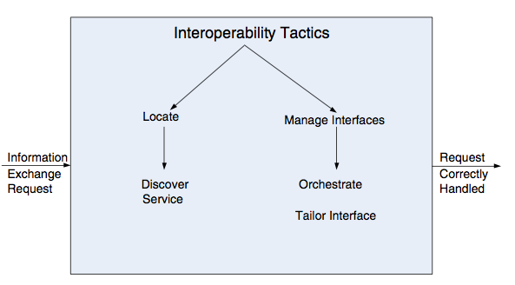
Quality Attributes
Tactics for Interoperability

Slide 46
Quality Attributes
Modifiability
Modifiability is the ability to quickly make changes to a system at a higher performance-to-price ratio. Often based on some specific changes, the modifiability is measured by examining the costs of these changes.
What can change?
What is the likelihood of the change?
When is the change made and who makes it?
What is the cost of the change?

Slide 47
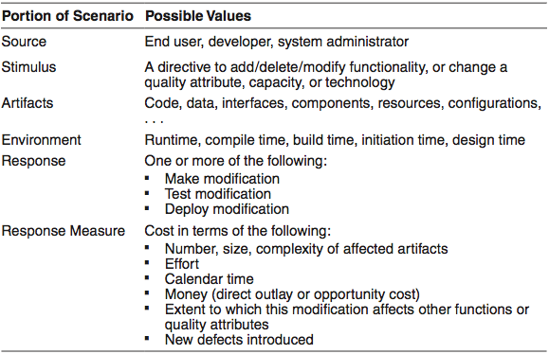
Quality Attributes
Modifiability General Scenario

Slide 48
Quality Attributes
Tactics for Modifiability
Reduce the Size of a Module
Split module. If the module being modified includes a great deal of capability, the modification costs will likely be high. Refining the module into several smaller modules should reduce the average cost of future changes.
Increase Cohesion
Increase semantic coherence. If the responsibilities A and B in a module do not serve the same purpose, they should be placed in different modules. This may involve creating a new module or it may involve moving a responsibility to an existing module. One method for identifying responsibilities to be moved is to hypothesize likely changes that affect a module. If some responsibilities are not affected by these changes, then those responsibilities should probably be removed.

Slide 49
Quality Attributes
Tactics for Modifiability
Reduce Coupling
Encapsulate. Encapsulation introduces an explicit interface to a module.
Use an intermediary breaks a dependency.
Restrict dependencies is a tactic that restricts the modules that a given module interacts with or depends on.
Refactor is a tactic undertaken when two modules are affected by the same change because they are (at least partial) duplicates of each other. Code re- factoring is a mainstay practice of Agile development projects, a
Abstract common services.
Defer Binding
bind values at compile time or build time
bind values at deployment time
bind values at runtime

Slide 50
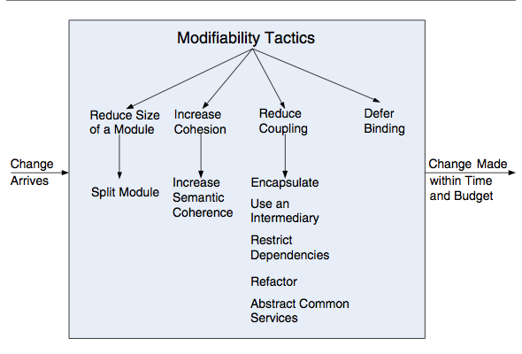
Quality Attributes
Tactics for Modifiability

Slide 51
Quality Attributes
Performance
It’s about time and the software system’s ability to meet timing requirements. When events occur—interrupts, messages, requests from users or other systems, or clock events marking the passage of time—the system,or some element of the system, must respond to them in time.Characterizing the events that can occur (and when they can occur) and the system or element’s time-based response to those events is the essence is discussing performance.

Slide 52
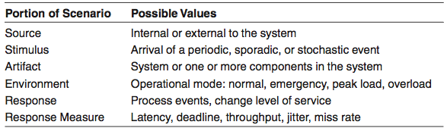
Quality Attributes
Performance General Scenario

Slide 53
Quality Attributes
Tactics for Performance
Control Resource Demand
Manage sampling rate.
Limit event response.
Prioritize events.
Reduce overhead.
Bound execution times.
Increase resource efficiency
Manage Resources
Increase resources.
Introduce concurrency.
Maintain multiple copies of computations.
Maintain multiple copies of data.
Bound queue sizes.
Schedule resources.

Slide 54
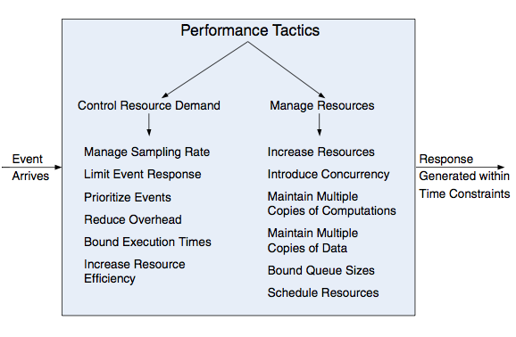
Quality Attributes
Tactics for Performance

Slide 55
Quality Attributes
Security
Security is a measure of the system’s ability to protect data and information from unauthorized access while still providing access to people and systems that are authorized.
The simplest approach to characterizing security has three characteristics: Confidentiality, Integrity, and Availability (CIA). Other characteristics that are used to support CIA are these: Authentication , Nonrepudiation , Authorization

Slide 56
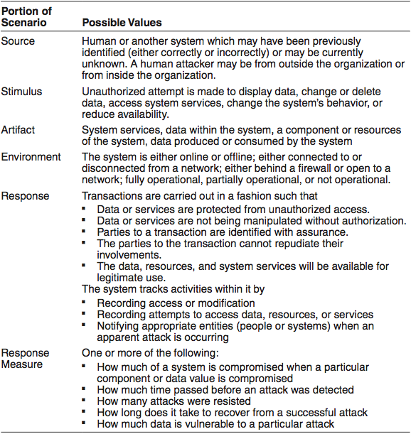
Quality Attributes
Security General Scenario

Slide 57
Quality Attributes
Tactics for Security
Detect Attacks
Detect intrusion
Detect service denial
Verify message integrity
Detect message delay
Resist Attacks
Identify actors.
Authenticate actors.
Authorize actors.
Limit access.
Limit exposure.
Encrypt data.
Separate entities.
Change default settings.

Slide 58
Quality Attributes
Tactics for Security
React to Attacks
Revoke access.
Lock computer.
Inform actors.
Recover from Attacks
maintain an audit trail
Restore

Slide 59
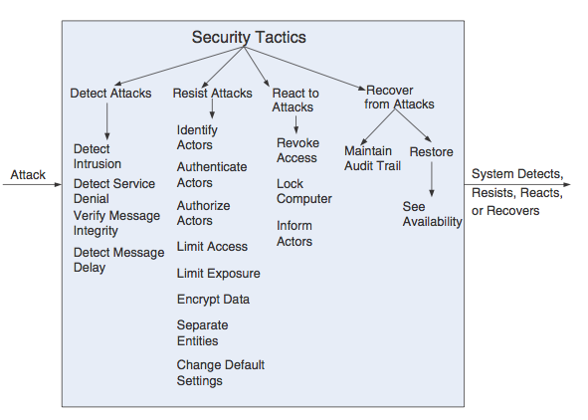
Quality Attributes
Tactics for Security

Slide 60
Quality Attributes
Testability
Software testability refers to the ease with which software can be made to demonstrate its faults through (typically execution-based) testing. Specifically, testability refers to the probability, assuming that the software has at least one fault, that it will fail on its next test execution. Intuitively, a system is testable if it“gives up” its faults easily.

Slide 61
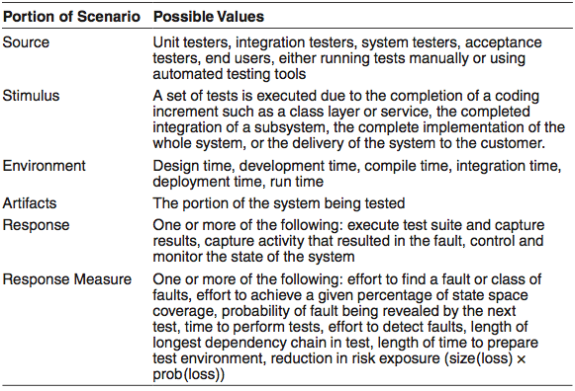
Quality Attributes
Testability General Scenario

Slide 62
Quality Attributes
Tactics for Testability
Control and Observe System State
Specialized interfaces.
Record/playback.
Localize state storage.
Abstract data sources.
Sandbox.
Executable assertions.
Limit Complexity
Limit structural complexity
Limit nondeterminism.

Slide 63
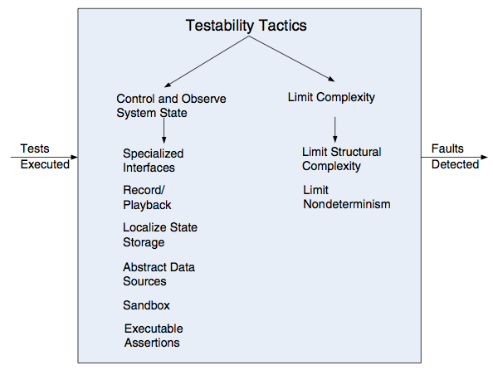
Quality Attributes
Tactics for Testability

Slide 64
Quality Attributes
Usability
Usability is concerned with how easy it is for the user to accomplish a desired task and the kind of user support the system provides.
Usability comprises the following areas:
Learning system features.
Using a system efficiently.
Minimizing the impact of errors.
Adapting the system to user needs.
Increasing confidence andatisfaction.

Slide 65
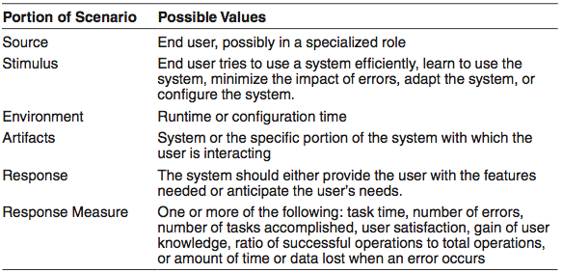
Quality Attributes
Usability General Scenario

Slide 66
Quality Attributes
Tactics for Usability
Support user Initiative
Cancel.
Undo.
Pause/resume.
Aggregate.
Support System Initiative
Maintain task model.
Maintain user model.
Maintain system model.

Slide 67
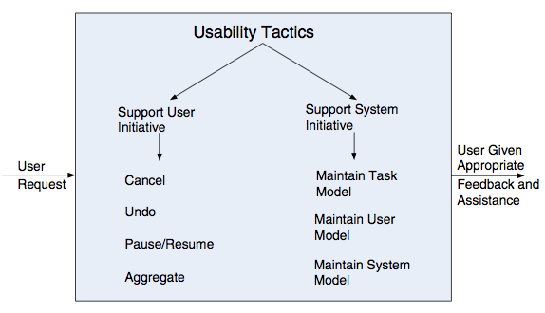
Quality Attributes
Tactics for Usability

Slide 68
Quality Attributes
Other Important Quality attributes
Variability
Portability
development distributability
Scalability
deployability
Mobility
Monitorability
Safety

