Slide 1
Big Mountain Resort
Data analysis and modeling for future revenue increase

Slide 2
Problem Identification
Big Mountain Resort has added a new chairlift, but the additional costs of its operation are 1,540,000 for this season.
How can we keep profit margin at least at 9.2 percent given these operating costs?

Slide 3
Recommendations
According to our modeling, we have reason to believe the resort is already undercharging for their tickets in the first place. A first step would be to increase ticket price by at least $2.83
Other possible scenarios include adding a chairlift to increase their prices by $8.46, or closing 3-5 of the least used runs.

Slide 4
Analysis
To create a model, competitors were first chosen based off of a comparison of pricing scaled by those features in conjunction with statewide population and acreage data, and it was determined that all resorts in the data frame had reasonable points of comparison.
For example, New York had more resorts with lower price range possibly due to population density of the state, but its resorts did not have many of the features that Big Mountain has.
With the missing values in the data, we imputed them in with the median and then scaled all feature values to zero mean and unit variance.
Using 8 features was the sweet spot and the results were then cross validated to see how it would perform. Using random forest regression proved to have the highest predictability.

Slide 5
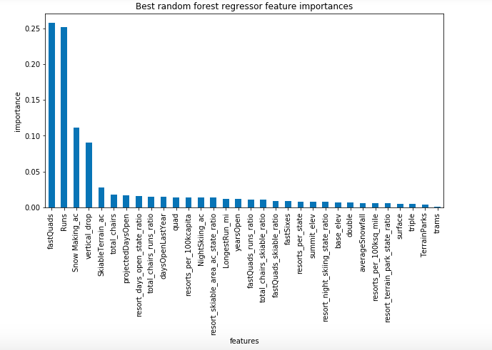
Analysis
After running the model on price, 4 features stood out in terms of their level of importance associated with ticket price. Those happen to be the vertical drop, amount of fast-quads, runs, and snow-making.
In each of the four most important price-predictive features, Big Mountain fared exceedingly well.

Slide 6
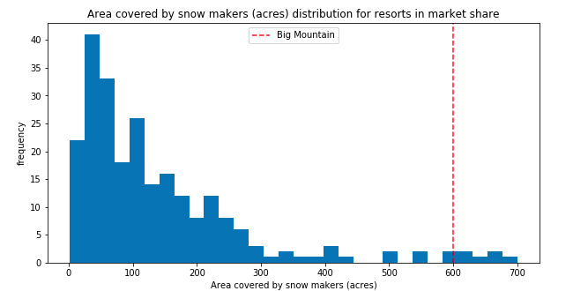
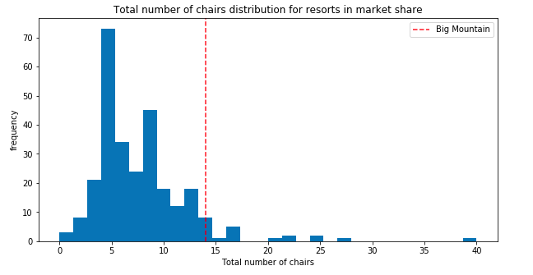
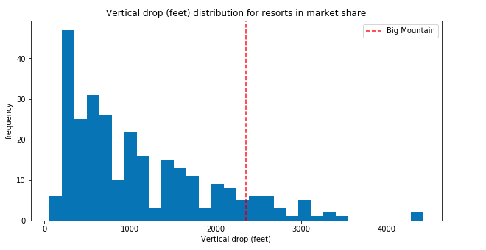
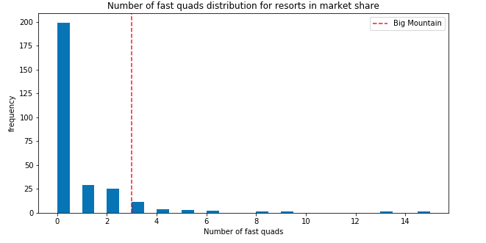
Big Mountain (red line) compared to other resorts in top four pricing features
As you can see, Big Mountain is in the top range for three of the most important features, and is in the upper half for vertical drop.

Slide 7
The initial results from the model predicted a price for Big Mountain of $94.22, which is obviously much higher than the actual current ticket prices. Especially considering where Big Mountain stands in terms of the four most important features associated with price, this higher price makes sense.
Subtracting the mean absolute error from that predicted price leads to a rough estimate of a minimum increase, which could be as small as $2.83.
If the resort is projected to have 350,000 visitors a year, and each of those visitors buys the average of 5 days of skiing, that would lead to increased revenue of 4,952,500. Subtracting the operating costs of 1,540,000 for the new chairlift still leads to 3,412,500. While we were told we needed to keep the profit margin at 9.2 percent, we were also not given the total operating costs of the resort in full, so it is unknown what the final profit margin could be for such a small price increase.

Slide 8
Summary
No matter how you look at it, Big Mountain has room to increase their ticket prices, even if it’s a small amount. This amount is primarily dependent on how many chairs the resort can offer, how many of those chairs are fast quads, and the amount of snow-making acreage. At minimum, the tickets can increase in price by $2.83, but there is room for those tickets to increase up to $94.22

