Slide 1
ENGI 301
Talking Button Proposal
October 2019
Bonnie Wang

Slide 2
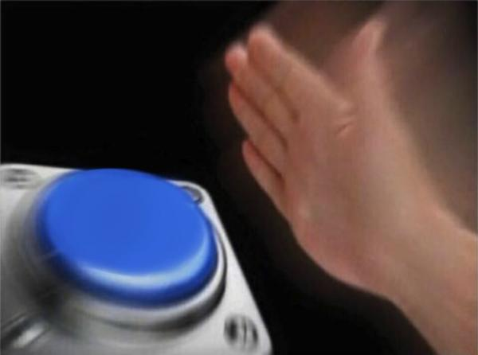
Background Information
Proposal:
  Device that will record audio input for ten seconds, and then immediately play it back
  Currently no pocket beagle powered
machine that is similar
please give me an A

Slide 3
System Block Diagram
LED / button
P2.2
Micro USB
Pocket Beagle
USB 0
Audio input/output
GND

Slide 4
Power Block Diagram
5V
LED / button
P2.2
Micro USB
5V
Pocket Beagle
USB 0
Audio input/output
GND

Slide 5
Components / Budget
Component | Need to Buy | Cost
Arcade Button | 1 | $2
Plugable Audio Input / Output | 1 | $9.95
Breadboard | 0
Pocket Beagle
Resistors
 | TOTAL: | $11.95

