Slide 1
自我介紹
nizima Live

Slide 2

1.目標
我是一位非常熱愛畫畫的女孩，我的夢想是畫出一幅完美的風景畫，並參加學校的繪畫比賽。
Notes:
Xiao Mei 在日落時分站在室外，拿著畫簿，準備為學校的繪畫比賽描繪完美的落日。她有著肩長的黑髮和困倦的黑眼睛，穿著藍色背心搭配白襯衫，灰色百褶裙配黑鞋。這真是一幅美麗的景象。

Slide 3
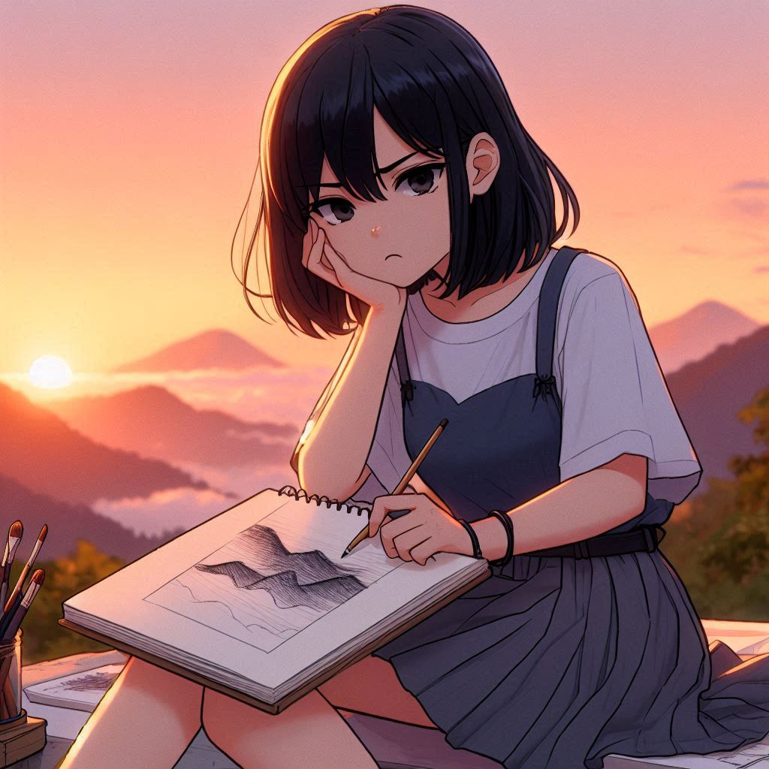
2.阻礙
但在創作的過程中，我發現無法把山間的光影表現得自然生動，為此而苦惱。
Notes:
Xiao Mei, a girl with shoulder-length black hair and black eyes, looking frustrated as she stares at her incomplete sketch. She is sitting outdoors on a hill at sunset, surrounded by art supplies. She wears a blue tank top over a white shirt, a gray pleated skirt, and black shoes. The sketchbook shows her struggling to capture the light and shadows of the sunset on the mountains in the distance.

Slide 4
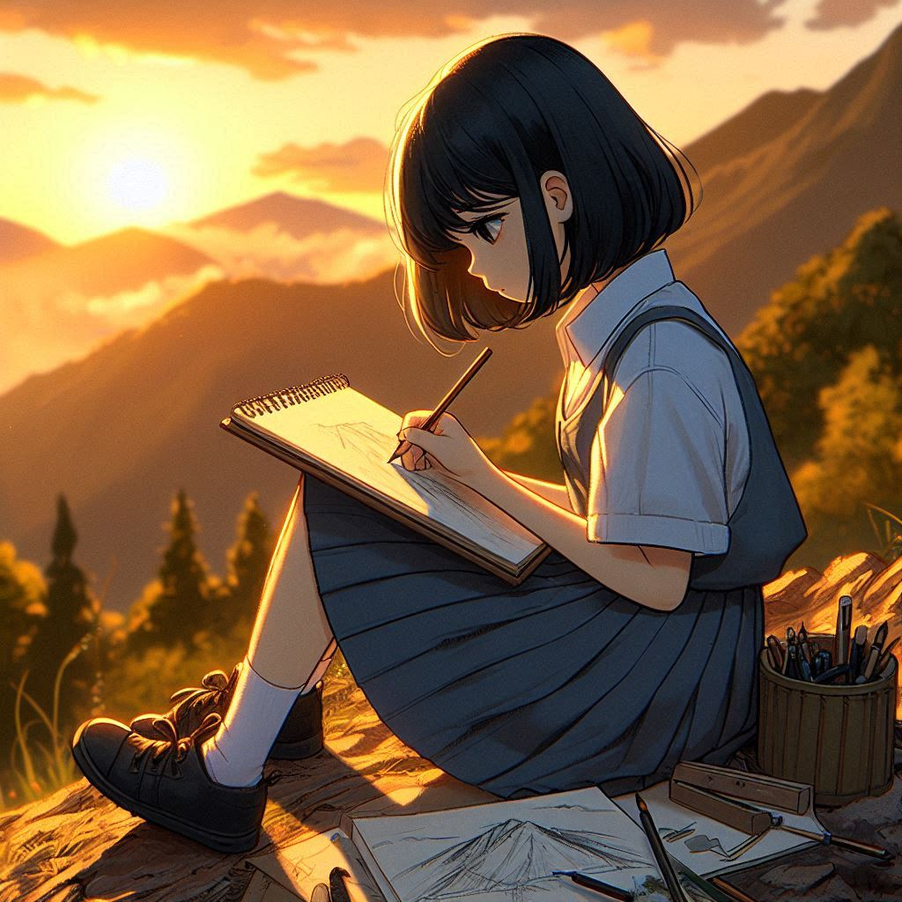
3.努力
我決定不放棄，她每天放學後都跑到山上觀察夕陽，試圖捕捉光線的變化。
Notes:
Xiao Mei, a girl with shoulder-length black hair and sleepy black eyes, sitting on a hill at sunset, diligently practicing her landscape drawing. She wears a blue tank top over a white shirt, a gray pleated skirt, and black shoes. Her sketchbook on her lap shows rough sketches of mountains and the sunset. The golden light illuminates the scene, and Xiao Mei is surrounded by art supplies as she studies the landscape, trying to capture the perfect balance of light and shadow in her drawing.

Slide 5
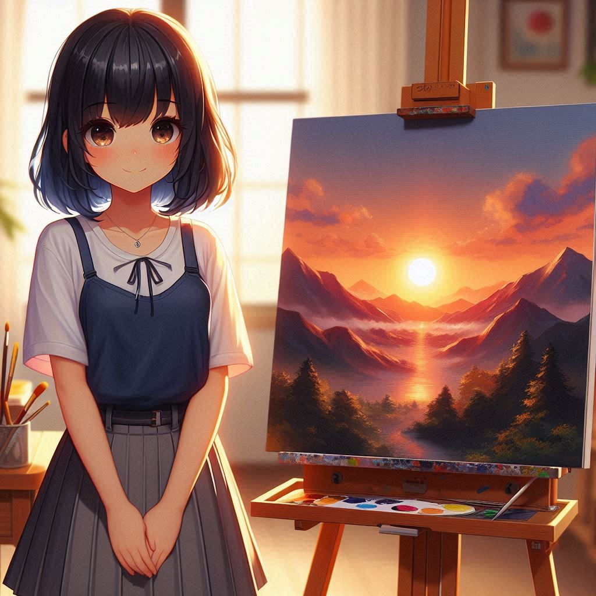
4.結果
經過無數次的修改和練習，我終於完成了一幅她滿意的風景畫。我興奮地將畫作交給老師，參加了學校的比賽。
Notes:
In a Japanese anime style and 3:2 vertical ratio, Xiao Mei, a girl with shoulder-length black hair and sleepy black eyes, proudly standing next to her finished landscape painting of a sunset over mountains. She wears a blue tank top over a white shirt, a gray pleated skirt, and black shoes. The completed painting is displayed on an easel beside her, featuring vibrant warm colors and detailed shadows. Xiao Mei smiles confidently, surrounded by her art supplies. The scene is bathed in soft evening light, with expressive anime-style features, bright colors, and a glowing, peaceful background.

Slide 6
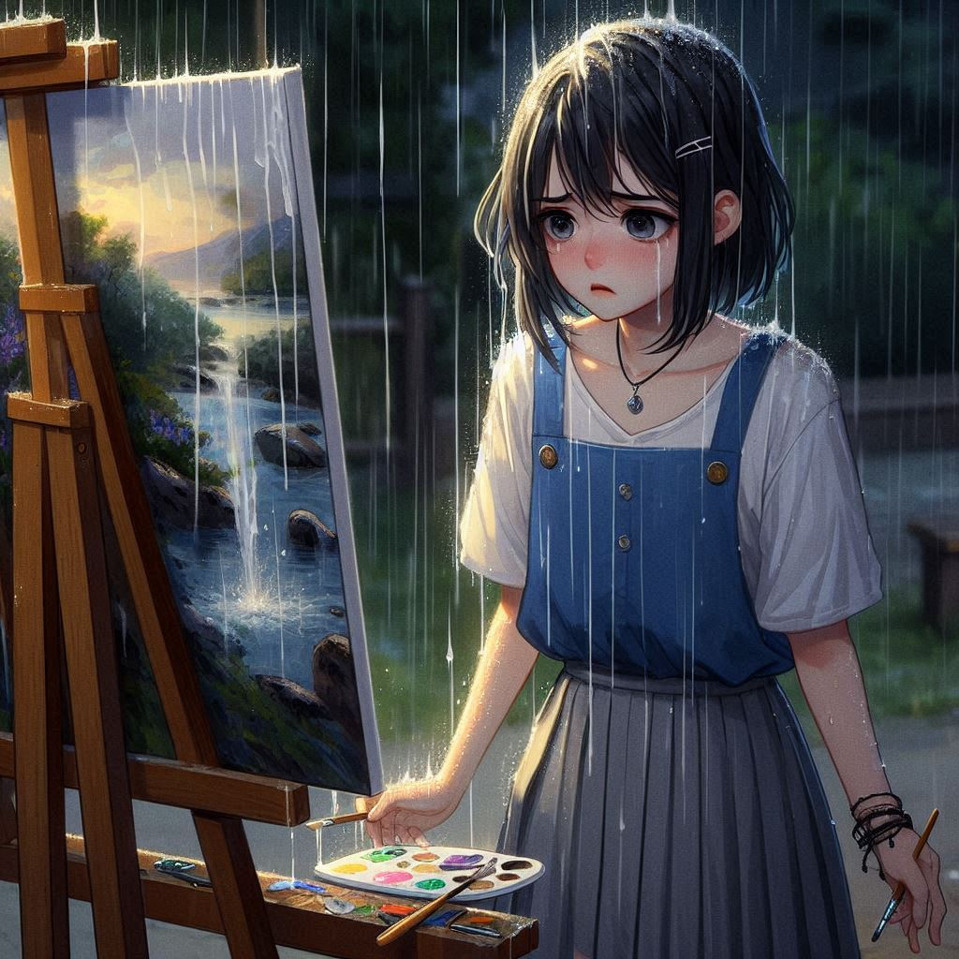
5.意外
然而，評審當天，一場突如其來的暴風雨把我的畫作弄濕了，顏料被沖開，畫面變得模糊不清。
Notes:
Xiao Mei, a girl with shoulder-length black hair and sleepy black eyes, standing in shock as rain pours down on her finished landscape painting. She wears a blue tank top over a white shirt, a gray pleated skirt, and black shoes. The painting on the easel, once detailed and vibrant, now has streaks of color running down due to the rain. Xiao Mei looks distressed, her sketchbook and art supplies scattered around, some wet. The scene takes place outdoors at dusk, with the dramatic rainfall and soft fading light creating a tense and emotional atmosphere.

Slide 7

6.轉彎
評審們注意到這幅畫在雨水沖刷後，形成了一種意外的美感。
Notes:
Xiao Mei，黑色短髮，參加比賽，她向評審展示夕陽的畫作。

Slide 8

7.結局
最終，我獲得了比賽的特別獎。 也明白了，創作不僅是技巧，還包含了對意外的包容與欣賞。
Notes:
Xiao Mei一個女生，有著黑色及肩短髮和黑色的眼睛，穿著校服，包括長袖白襯衫、藍色背心和百褶裙。得獎了非常開心，環境光很溫暖，有綵帶飄落。

