Slide 1
冒險故事
Vtube Studio

Slide 2

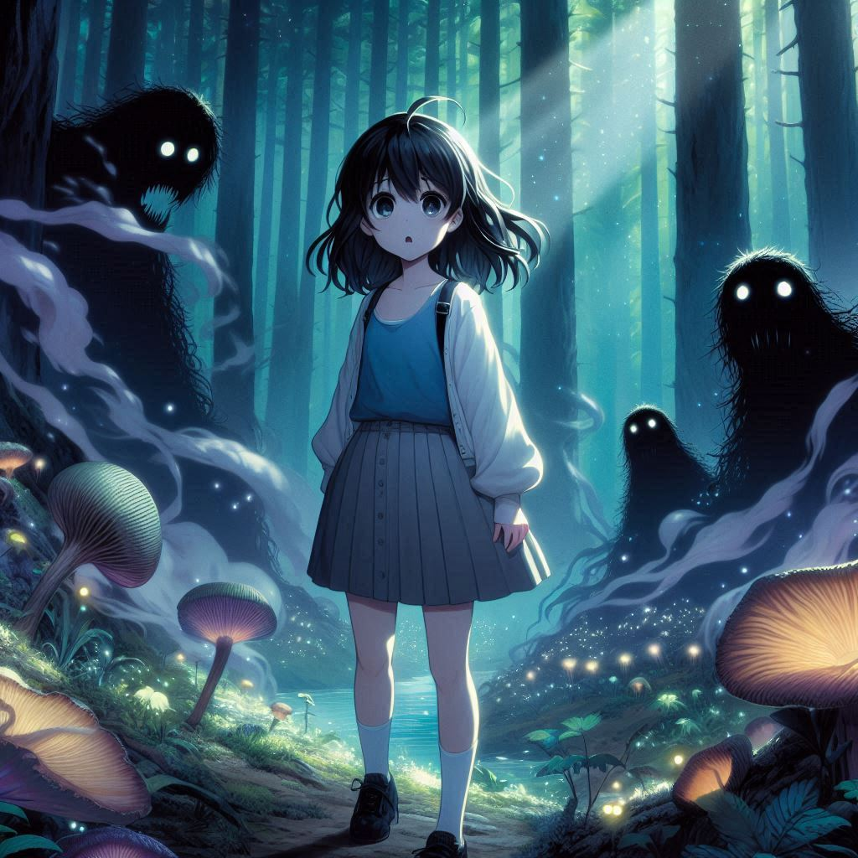
1.目標
有天，我發現一支神秘的畫筆，我畫出了一片奇幻森林，卻被吸入其中。這個世界充滿了會說話的樹木和發光的河流。
Notes:
In a Japanese anime style, Aimi, a girl with shoulder-length black hair and sleepy black eyes, holding a magical glowing paintbrush in her hand. She is wearing a blue tank top over a white shirt, a gray pleated skirt, and black shoes. She stands in awe as her drawing of a fantasy landscape begins to shimmer and come to life. The scene around her is bathed in soft, glowing light, with bright colors and expressive anime-style features, hinting at the start of an exciting magical adventure.

Slide 3
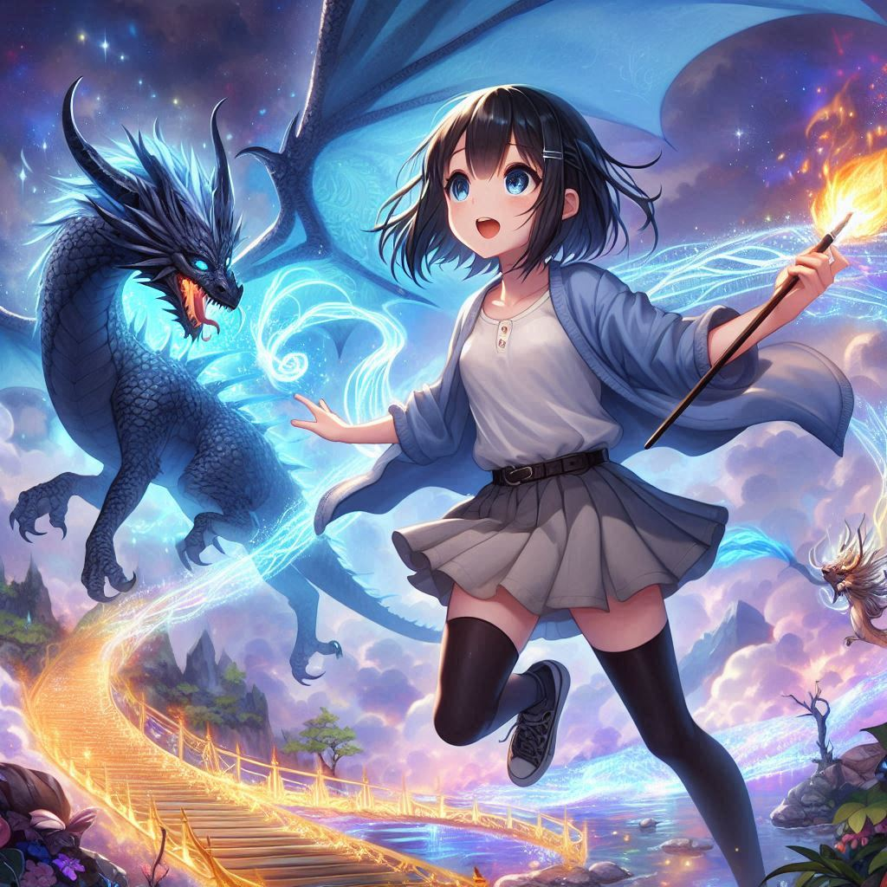
2.阻礙
當我畫出一片奇幻森林並被吸入其中後，發現這個世界正被一個黑暗生物創造的怪物侵襲。
Notes:
In a Japanese anime style, Aimi, a girl with shoulder-length black hair and sleepy black eyes, standing in a mystical forest filled with towering trees and glowing plants. She wears a blue tank top over a white shirt, a gray pleated skirt, and black shoes. Aimi looks worried as she faces a group of shadowy monsters that have emerged from the dark, threatening the peaceful forest. The atmosphere is tense, with swirling dark clouds and eerie lighting, while the creatures take on a menacing, anime-style appearance.

Slide 4
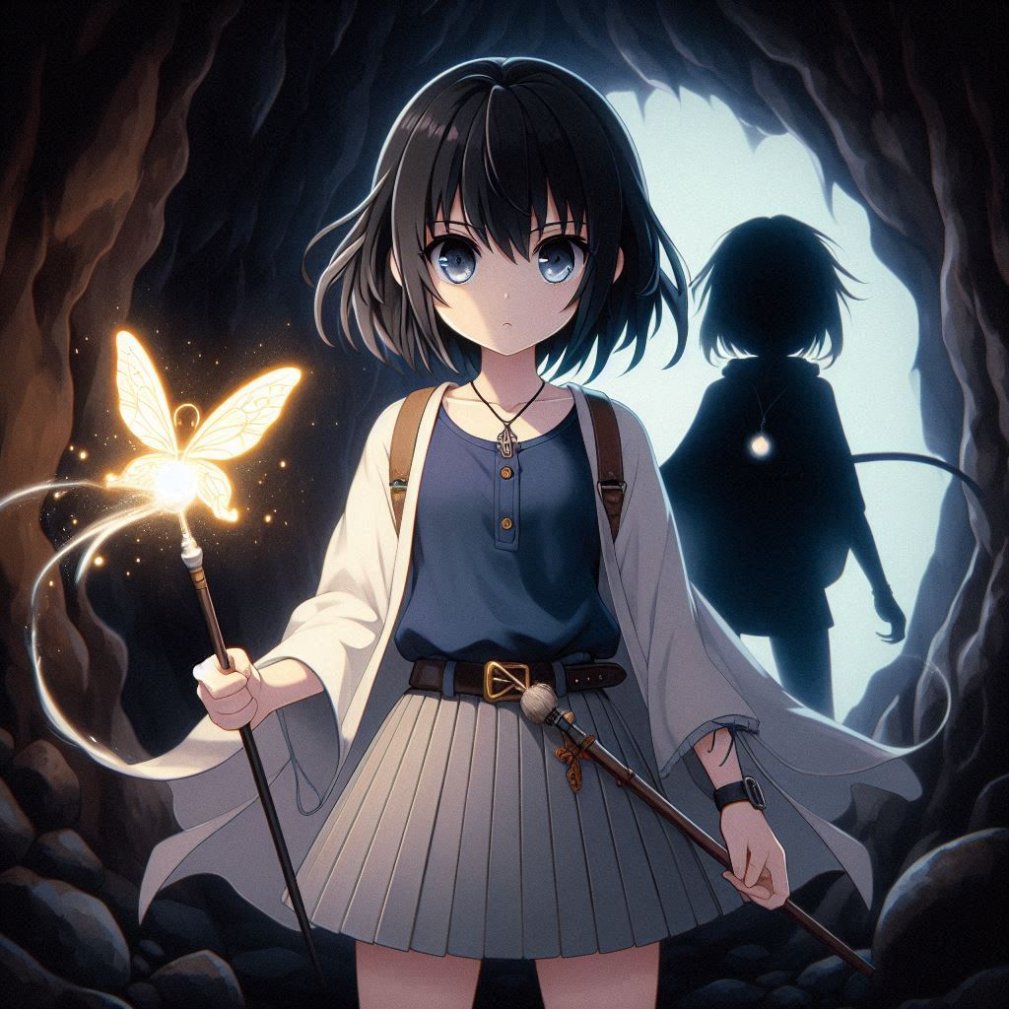
3.努力
我決心用畫筆來幫助這個世界，開始創造魔法生物和工具來對抗怪物，並尋找黑暗生物的巢穴。
Notes:
In a Japanese anime style, Aimi, a girl with shoulder-length black hair and sleepy black eyes, using her magical glowing paintbrush to summon a majestic dragon and a shining bridge of light. She is wearing a blue tank top over a white shirt, a gray pleated skirt, and black shoes. Aimi stands confidently as the dragon soars into the sky, ready to help her, while the glowing bridge leads the way deeper into the enchanted forest. The scene is full of vibrant colors and dynamic lighting, with anime-style magical effects illuminating the forest around her.

Slide 5
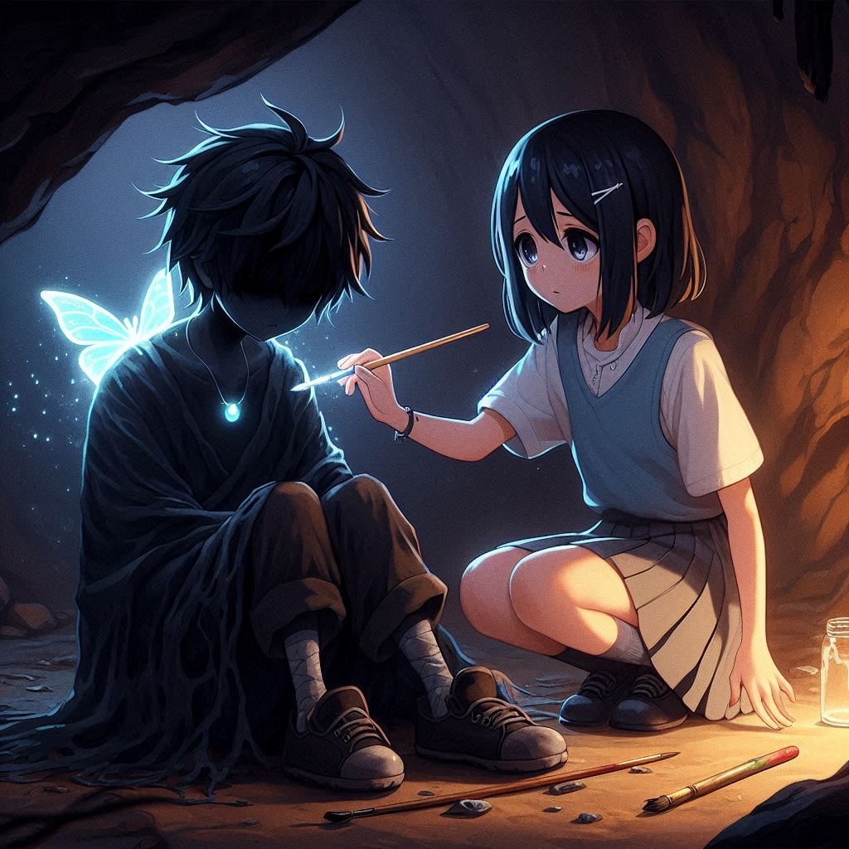
4.結果
經過漫長的爭鬥，我終於來到黑暗巢穴的深處，準備迎來最終的對決。
Notes:
In a Japanese anime style, Aimi, a girl with shoulder-length black hair and sleepy black eyes, stands with a serious and determined expression in front of a dark cave, ready to confront the shadowy figure inside. She is holding her magical glowing paintbrush tightly, wearing a blue tank top over a white shirt, a gray pleated skirt, and black shoes. The glowing dragon she summoned hovers protectively above her, while the light bridge fades behind. The atmosphere is intense, with swirling mist and dark shadows around the cave entrance, emphasizing the dramatic tension of the moment.

Slide 6
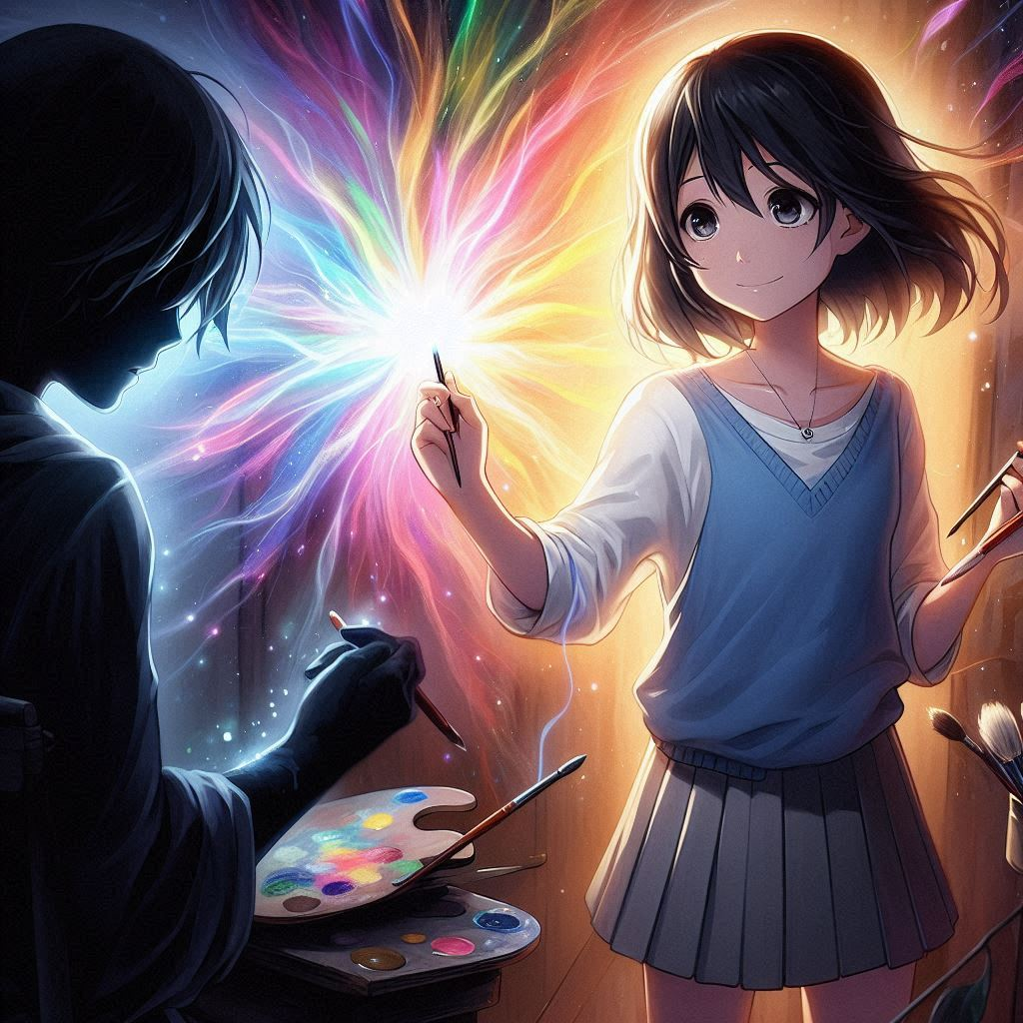
5.意外
然而，她發現這個黑暗生物曾經也是一位畫家，只是因為失去了希望，畫筆才被黑暗力量控制。
Notes:
In a Japanese anime style, Aimi, a girl with shoulder-length black hair and sleepy black eyes, is gently comforting the dark, shadowy figure in the cave, who is now revealed as a former artist. She is kneeling beside him, showing a soft and compassionate expression, while holding her glowing paintbrush. The shadowy figure looks sad and defeated, his broken magical paintbrush lying beside him. Aimi is wearing a blue tank top over a white shirt, a gray pleated skirt, and black shoes. The cave is still dark, but a soft light emanates from Aimi, creating a warm and emotional atmosphere as she tries to offer comfort.

Slide 7

6.轉彎
小美意識到，她不能僅靠戰鬥取勝，而是要讓這位畫家重新相信畫畫的美好。
Notes:
In a Japanese anime style, Aimi, a girl with shoulder-length black hair and sleepy black eyes, holding her magical glowing paintbrush, is drawing a radiant and colorful painting in the air. The dark, shadowy figure, now revealed as a former artist, watches in awe as the vibrant colors and light bring hope back to him. Aimi's expression is warm and encouraging, and the dark cave is slowly filling with light, with shadows fading away. She is wearing a blue tank top over a white shirt, a gray pleated skirt, and black shoes. The atmosphere is hopeful and full of transformation, as Aimi helps the figure rediscover the beauty of art.

Slide 8
7.結局
小美用畫筆畫出了黑暗生物內心的夢想，幫助他找回光明，讓奇幻世界恢復了和平。
Notes:
In a Japanese anime style, Aimi, a girl with shoulder-length black hair and sleepy black eyes, is lying on a grassy meadow alongside the former shadowy figure, now a peaceful artist. Both are smiling and looking up at the sky, feeling relaxed and content. They are surrounded by soft grass, colorful flowers, and trees in the distance, with sunlight gently shining down on them. The atmosphere is peaceful and joyful, capturing a moment of calm and happiness in the serene forest setting.

