Slide 1

The Future of the Brooklyn
Time Series Analysis on Best Investment Opportunities in Brooklyn, New York
Bonnie Ma
Feb, 2020

Slide 2
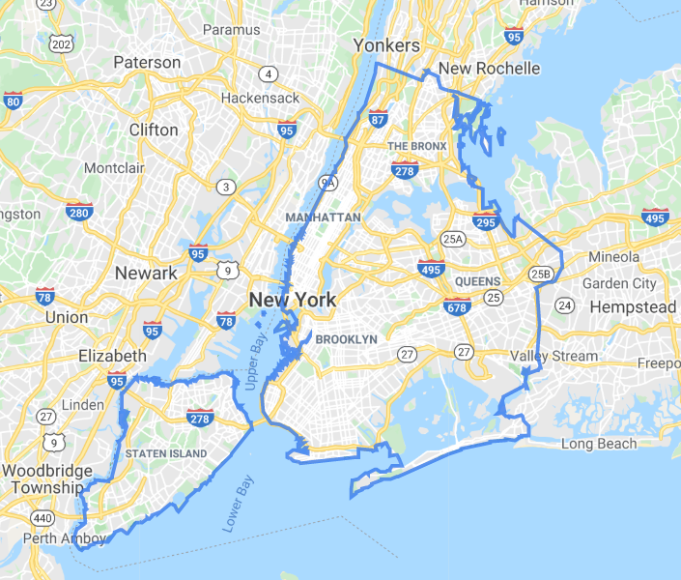
Background
Brooklyn, is increasingly favored by investors and home buyers because of the relatively lower price (than Manhattan) and the convenience to the city life
In this analysis, our goal is to provide you 5 zip codes/neighborhoods that could maximize your Return on Investment
Dataset: past 8 years monthly house price from zillow.com
Methodology: Time Series Model with ARIMA
ROI = Selling price – Buying price/Buying price
Notes:
New York City regularly ranks among the most expensive real estate markets in the world with high demand and limited supply

Slide 3
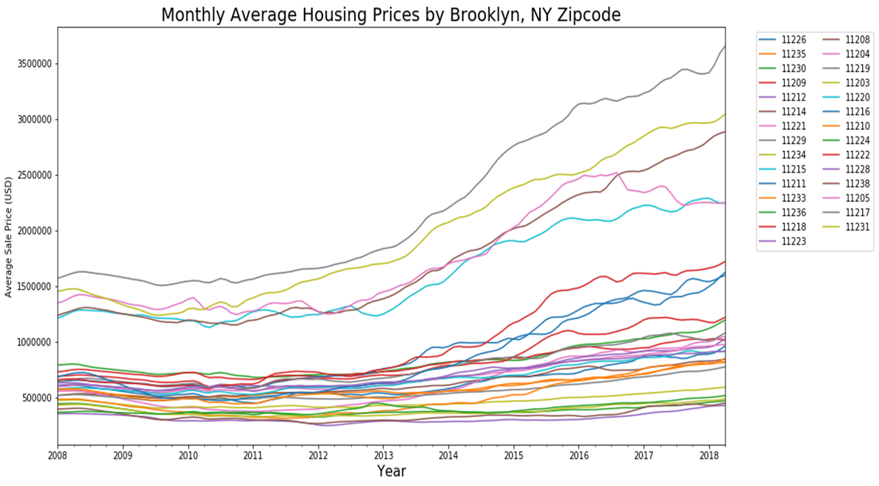
Overall housing price on the rise after financial crisis
Modeling Period

Slide 4
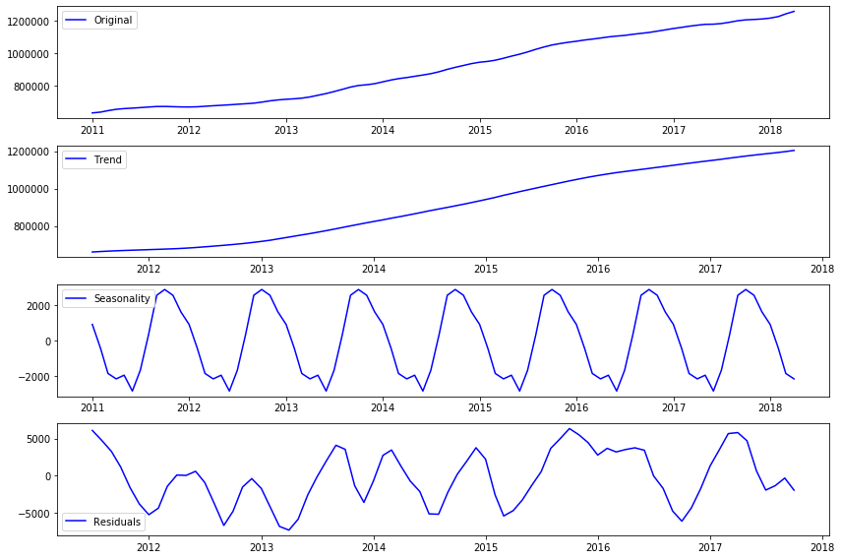
Seasonal decomposition of total average house price
Overall trend is increasing
There is a yearly seasonality
Residuals are not stationary (fluctuation exist)
Notes:
SARIMA model takes account into autocorrelation, moving averages, seasonal components.

Slide 5
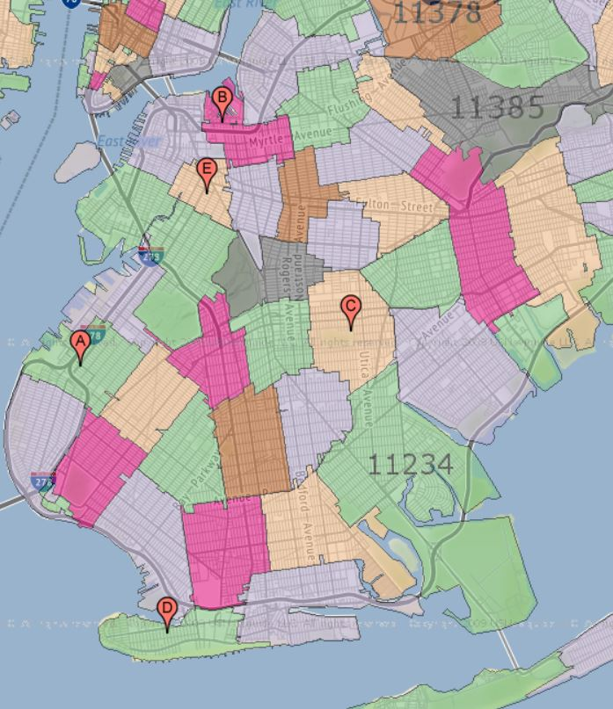
Based on the Time Series Seasonal ARIMA model, we found the top 5 zip codes/neighborhoods to invest in for long term (> 3yrs) return
11205
Clinton Hill
11217
Boerum Hill
South Sunset Park (11220)
Clinton Hill (11205)
East Flatbush (11203)
Coney Island (11224)
Boerum Hill (11217)
11203
East Flatbush
11220
South Sunset Park
11224
Coney Island

Slide 6
3 Yrs and 5 Yrs ROI
You can get a median of 30% 3Yrs return and 50% 5Yrs return in below 5 zip codes.
South Sunset Park (11220), Clinton Hill (11205) and Boreum Hill (11217) have a lower volatility which means lower risk for investors. While East Flatbush (11203) and Coney Island (11224) have a higher volatility.
Zipcode | Current Value | 3 Years Value | 5 Years Value | 3Yr-ROI | 5Yr-ROI | 3Yr-ROI-Lower | 3Yr-ROI-Upper | 5Yr-ROI-Lower | 5Yr-ROI-Upper
11220 | $1,026,600 | $1,562,324 | $1,906,698 | 52% | 86% | 17% | 87% | 17% | 155%
11205 | $1,195,400 | $1,765,556 | $2,139,029 | 48% | 79% | 17% | 79% | 17% | 141%
11203 | $963,200 | $1,379,875 | $1,642,406 | 43% | 71% | 8% | 78% | 4% | 137%
11224 | $489,900 | $674,646 | $792,561 | 38% | 62% | -1% | 76% | -14% | 137%
11217 | $852,300 | $1,138,072 | $1,324,995 | 34% | 55% | 6% | 61% | 4% | 107%

Slide 7
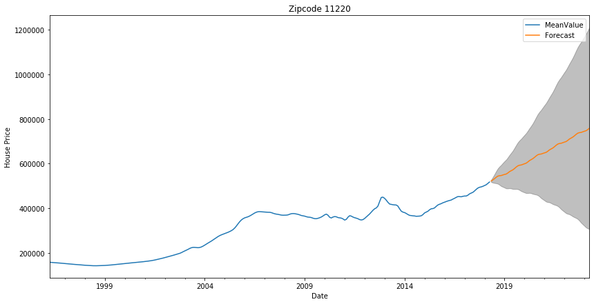
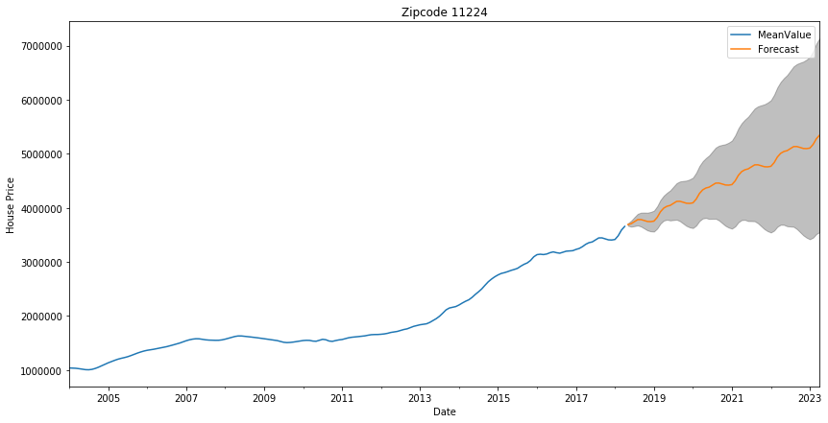
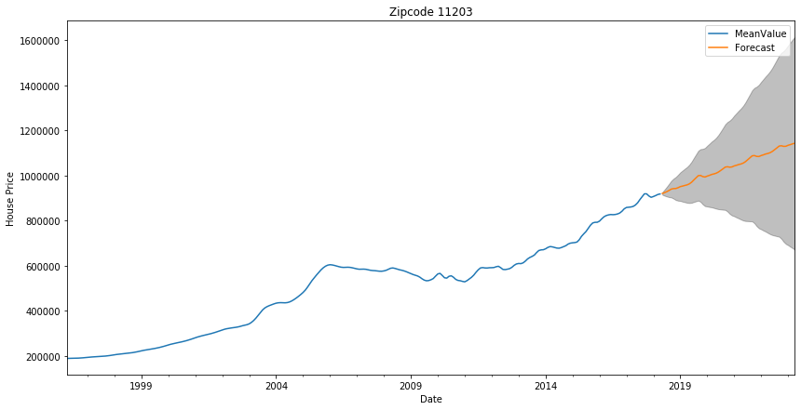
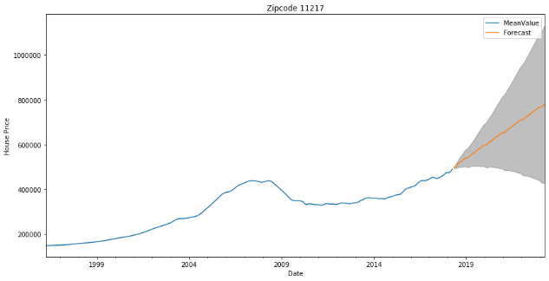
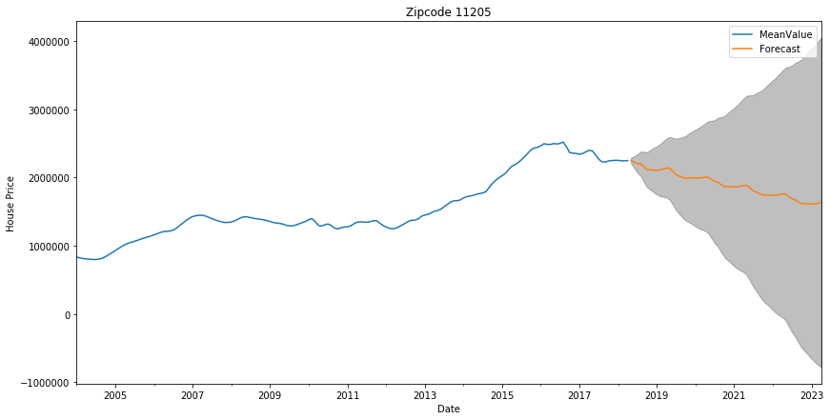

Slide 8

Future Considerations
Different criteria for rental vs sale
Investor’s input (safety, convenience, school district, budget limit)
Build linear model with more additional features such as federal interest rate, house market safety score, etc.

Slide 9
Project Workflow
Step 1: Data Processing
Step 2: Data Exploration and Visualization
Step 3: Decide on Model Approach and KPI
Transform raw data to time series with time being the index
Seasonal Decomposition, Autocorrelation with ACF and PCAF, etc.
Seasonal ARIMA
Use AIC to select best set of parameters for SARIMA model
Step 4: Model Development and Validation
Step 5: Make Future Predictions
Make dynamic forecast on part of the data and compare with real values
Make future 3 and 5 years forecast and calculate the ROI

