Slide 1
Extruded Aluminum (AL 6060 T6) Modeling Summary
LS-Dyna
*MAT_024 vs. *MAT_036

Slide 2
Outline
Material Models
Uniaxial Tensile Tests
Simulation – DIC snapshot comparison
Regularization Study
3-Point Bend Tests

Slide 3
LS-Dyna Materials Models
*MAT_024
*MAT_036
Isotropic
Input
One hardening load curve (0 degree direction)
Anisotropic
Inputs
Three hardening load curves (0 degree, 45 degree, 90 degree directions)
R-values:
Constant values in three directions
Load curve (R vs. Plastic strain) in each direction

Slide 4
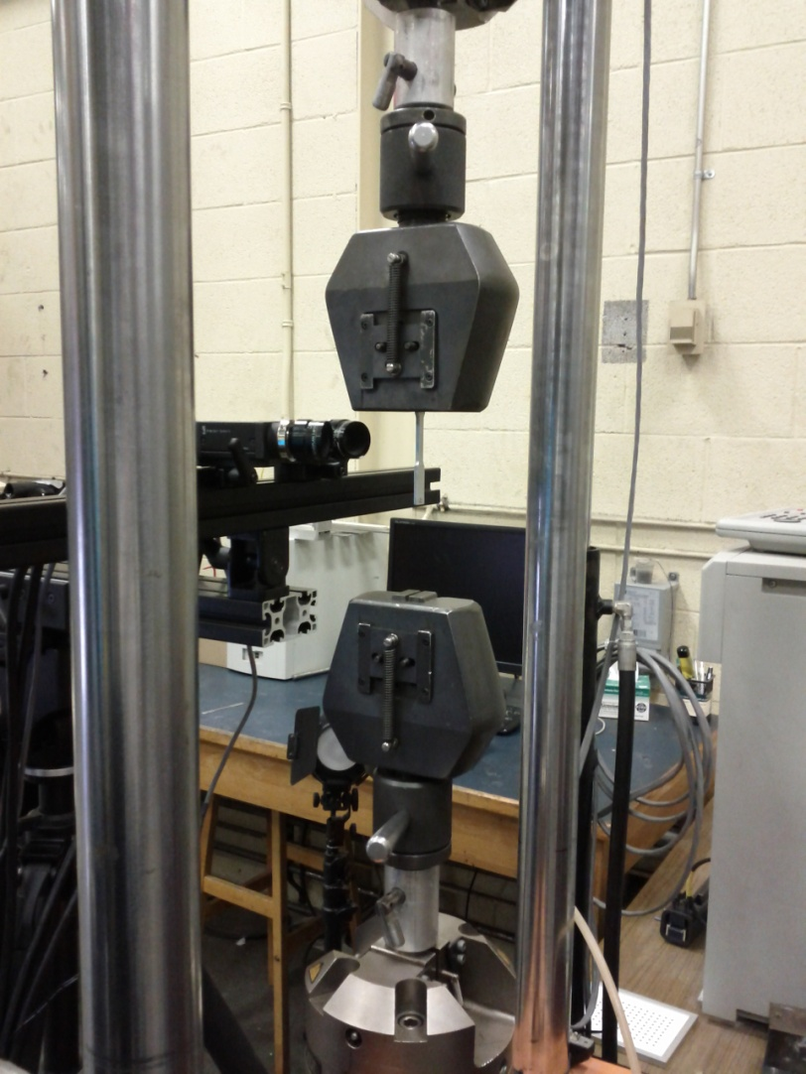
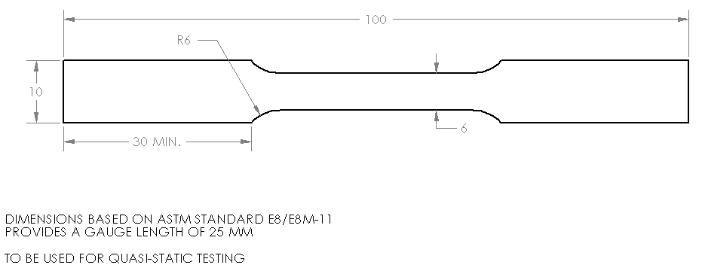
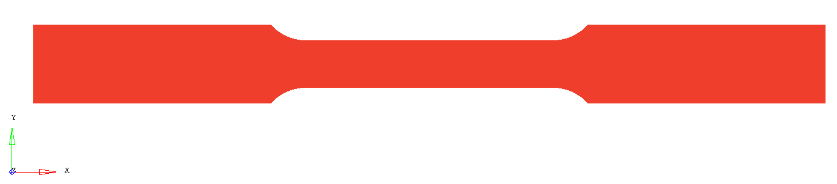
Uniaxial Tensile Tests

Slide 5
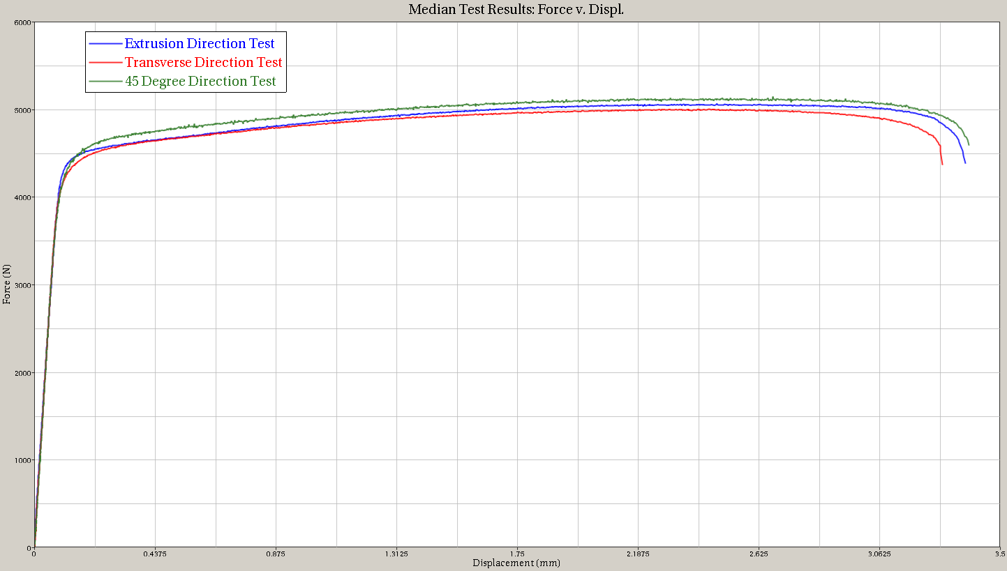
Uniaxial Tensile Tests
Median Results: Force vs. Displacement

Slide 6
Failure: R-Values
Introduction to R-Values
R=1 → Isotropic
Steels : 0.9-to-1.1 (isotropic)
AL: 0.2-to-2.0
Definition: Ratio of width to thickness strains for tension
Width and longitudinal strains measured with DIC
Thickness strain calculated assuming material incompressibility
Definition : Ratio of transverse to extrusion strain for compression
Through thickness and transverse strains measured with DIC
Extrusion strain calculated assuming material incompressibility

Slide 7
Failure: R-Values
 | Honda | Reyes [6060-T1]
G₀ | 1.00 | 1.00
G₄₅ | 0.99 | 1.02
G₉₀ | 0.99 | 1.01
r₀ | 0.47 | 0.48
r₄₅ | 0.79 | 0.29
r₉₀ | 0.75 | 1.76
r_{b} | 0.53 | -
Very low values as compared to steel. This influences the fracture. Also note the difference from Published(literature) values. This can be attributed to heat-treatment
Flow stress ratios and r-values
taken as average of all tests with
outliers removed
Constant R-Values are not adequate to effectively predict the failure modes for anisotropic extruded aluminum.

Slide 8
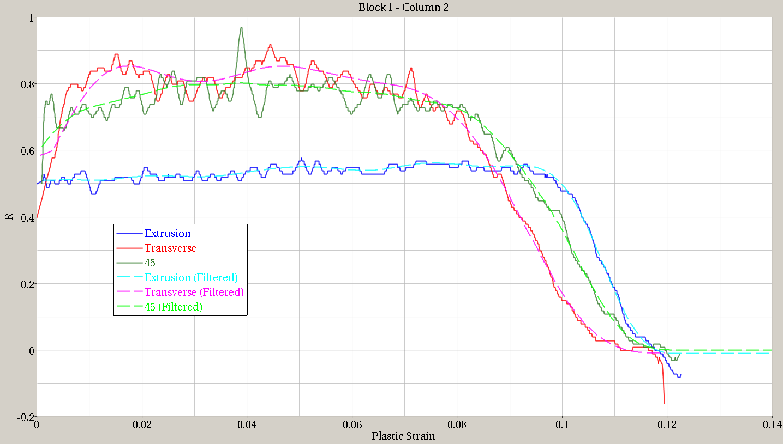
Variable R-Curves
Filtering R vs. 𝜀_{p} Results

Slide 9
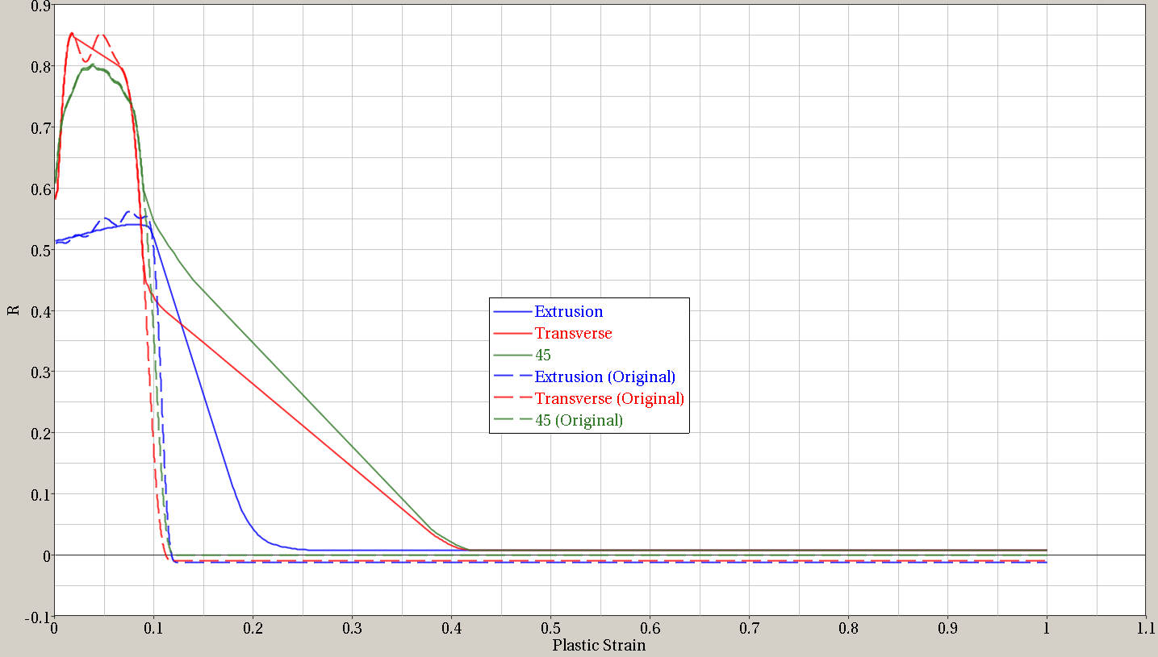
Variable R-Curves
Smoothing and Extrapolation of Results

Slide 10
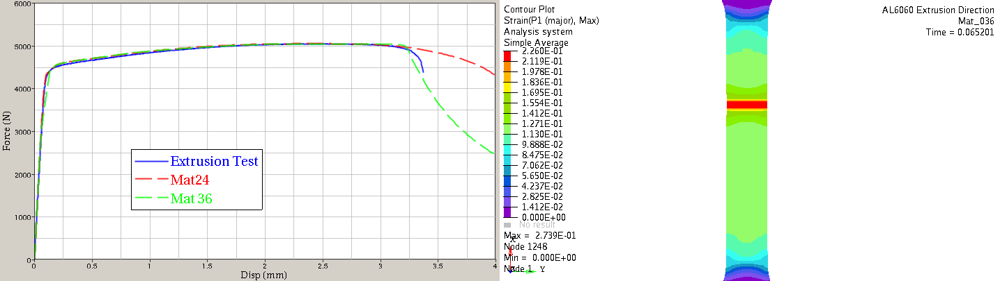
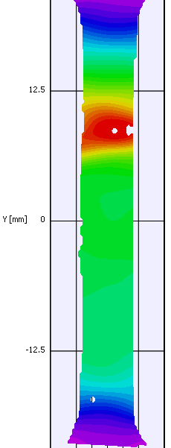
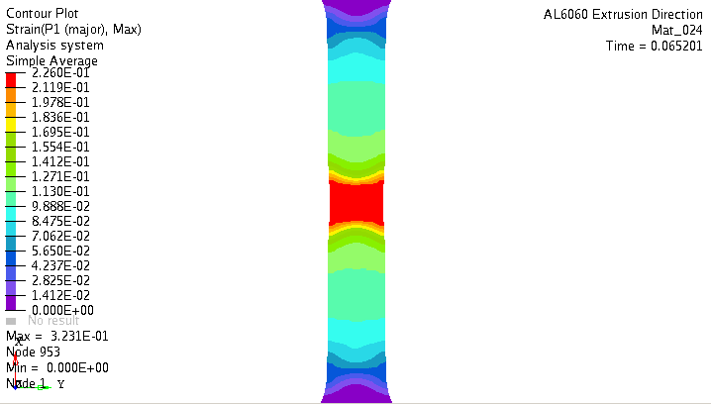
Extrusion Direction
CAE MAT_036
(green curve)
DIC Test Data
(blue curve)
Good Match for Failure Mode
CAE MAT_024
(red curve)

Slide 11
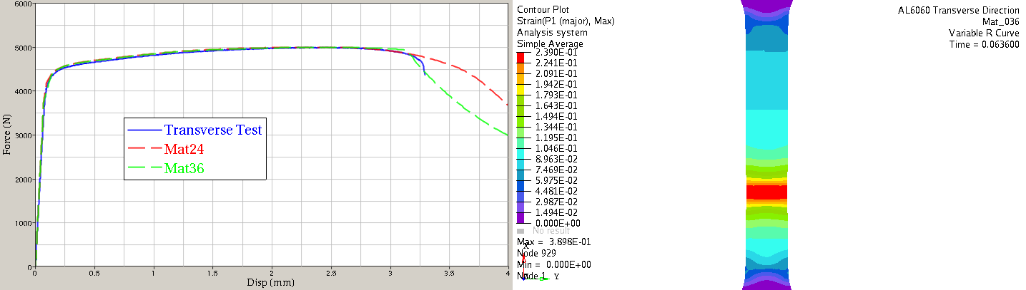
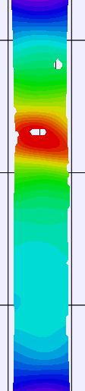
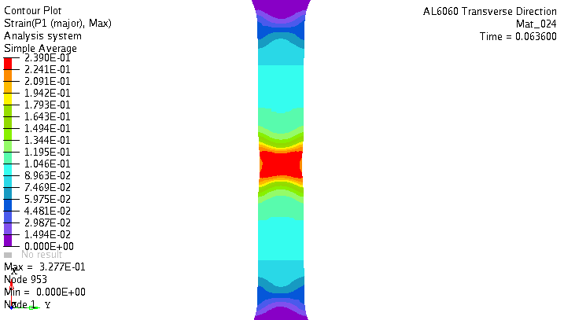
Transverse Direction
CAE MAT_036
(green curve)
DIC Test Data
(blue curve)
Good Match for Failure Mode
CAE MAT_024
(red curve)

Slide 12
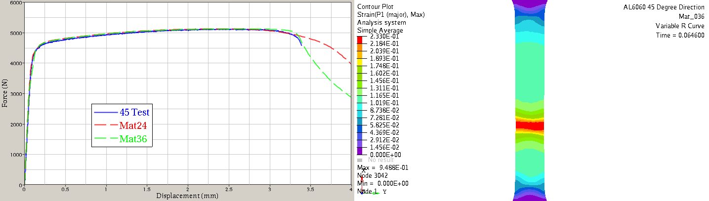

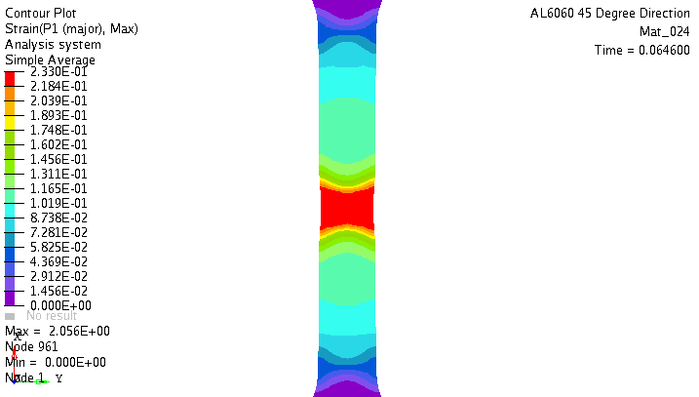
45 Degree Direction
CAE MAT_036
(green curve)
DIC Test Data
(blue curve)
Good Match for Failure Mode
CAE MAT_024
(red curve)

Slide 13
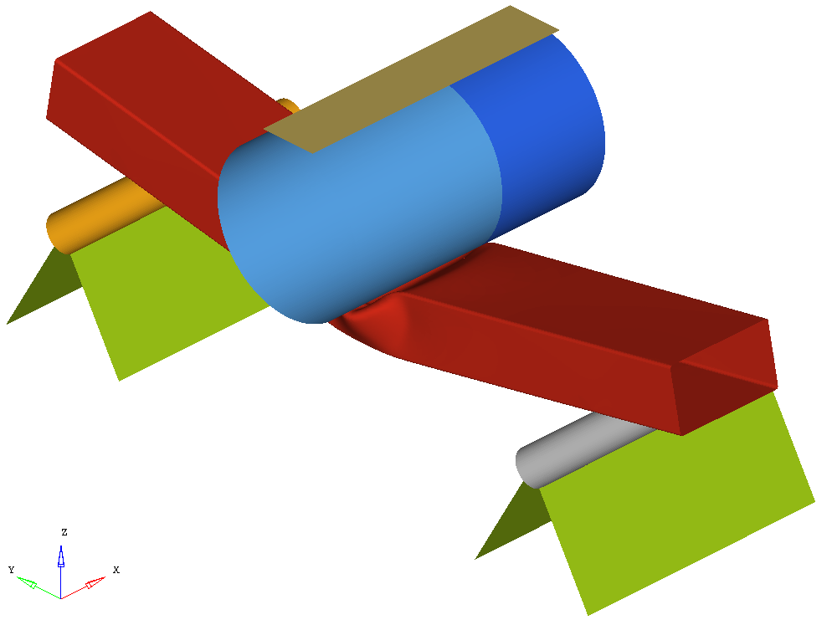
3-Point Bend Tests

Slide 14
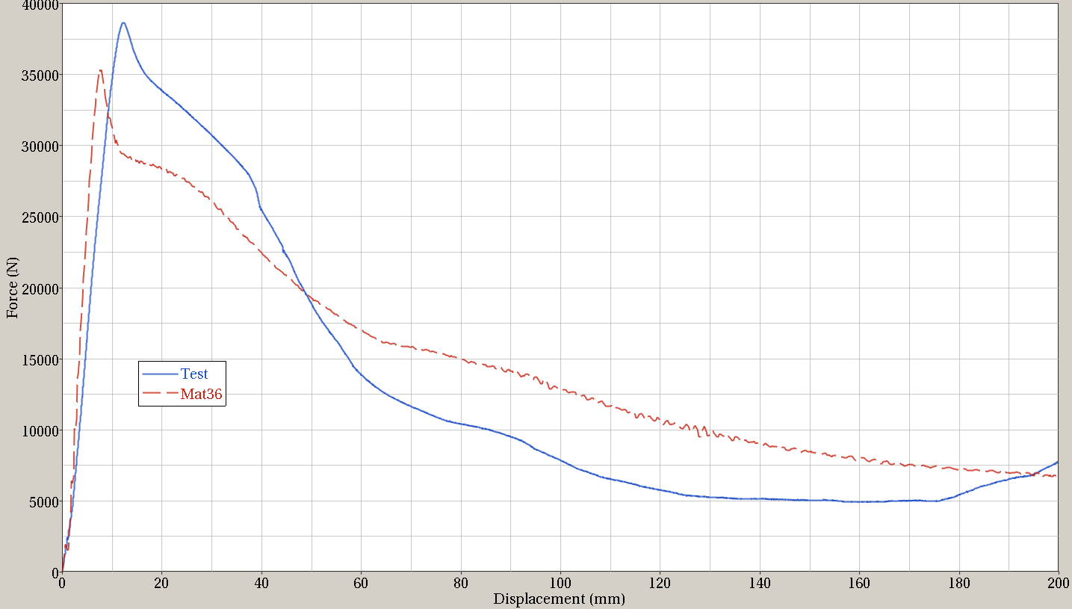
3-Point Bend Tests
 | Test | *MAT_036
Peak Force (N) | 38705.9 | 35299.3
Displacement at Peak Force (mm) | 12.2829 | 7.3999
Peak Force % Difference | N/A | 8.80 %
Suggested that the difference between the simulation and the test results is coming from friction effects, and a high sensitivity to the modeling of the geometry and the radii in particular.

Slide 15
Results Summary
*MAT_036 (3-Parameter Barlat Model) offers more robust modeling of anisotropic materials than *MAT_024
*MAT_036 better captures the strain states and the tensile test failure mode for AL6063 T-6 than *MAT_024
The Force-Displacement Curve and the state of stress and strain in the simulation are highly dependent on the R vs. 𝜀_{p} curve and its extrapolation.
Simulation of a 3-Point Bend test gives a peak force result within 9% of that seen in the test. There is also a discrepancy in the slope of the F-D curve approaching this peak.

Slide 16
Contents for next few slides.
Compression simulation . CAE vs TEST.
1-Element model.
Tensile Specimen: (Variable R-value)
Tri-axiality vs eps and “b vs eps” comparison
Issues.
Tensile Specimen: (Constant R-value)
Tri-axiality vs eps and “b vs eps” comparison
Tensile Specimen (Regularization)
Issues

Slide 17
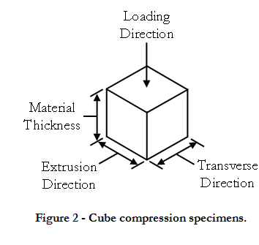
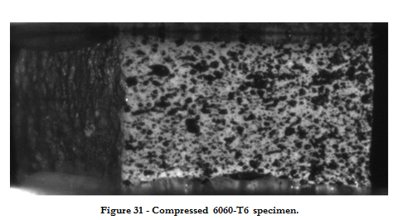
Compression Tests - Background
Figure 29 - Comparison of True stress vs. strain for all test directions.

Slide 18
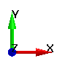
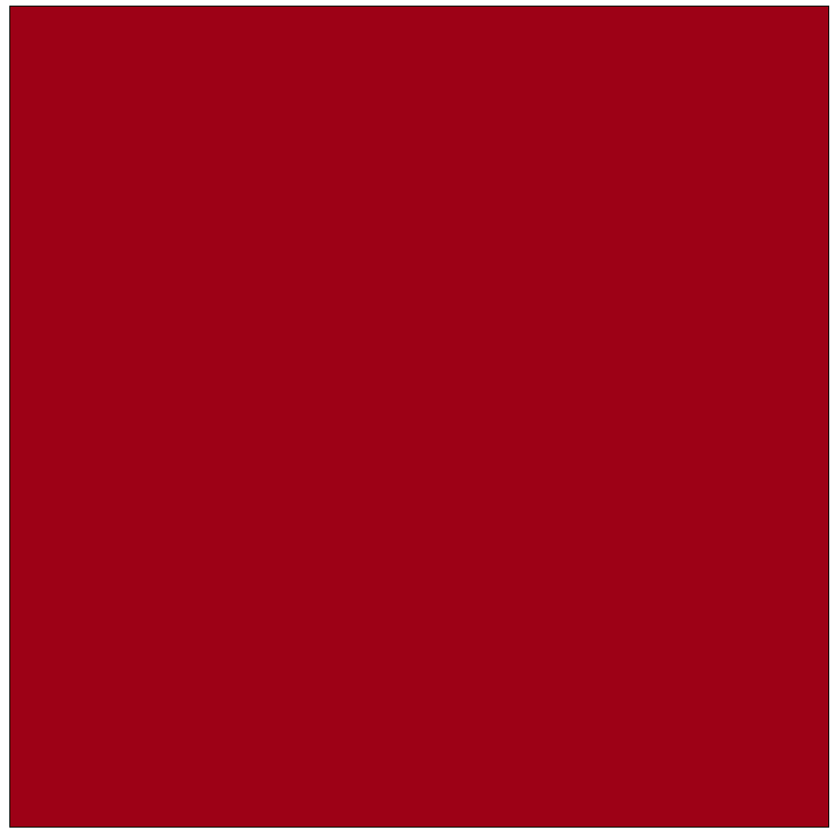
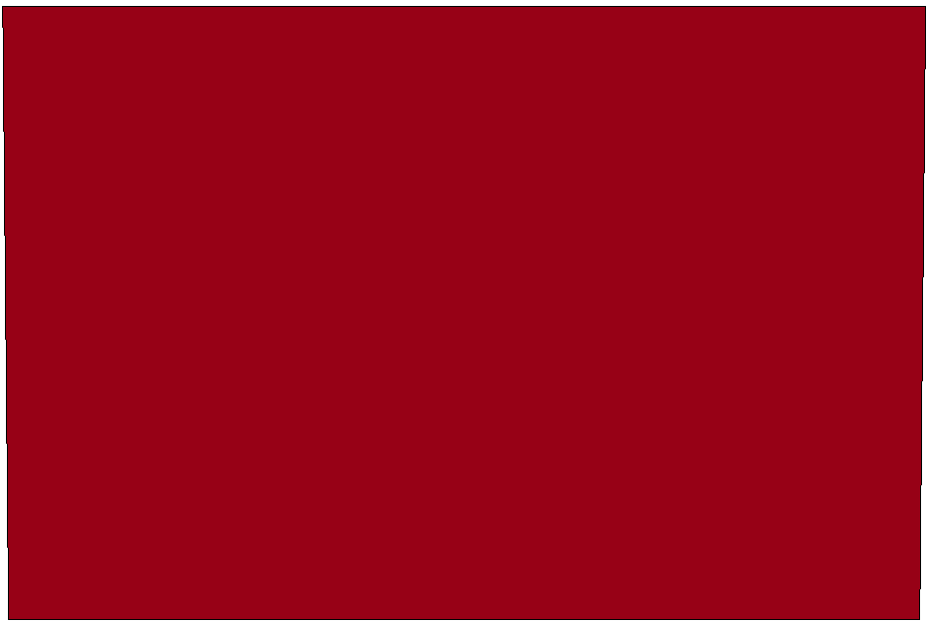
Compression Tests - Simulation
Undeformed Element
Deformed Element

Slide 19
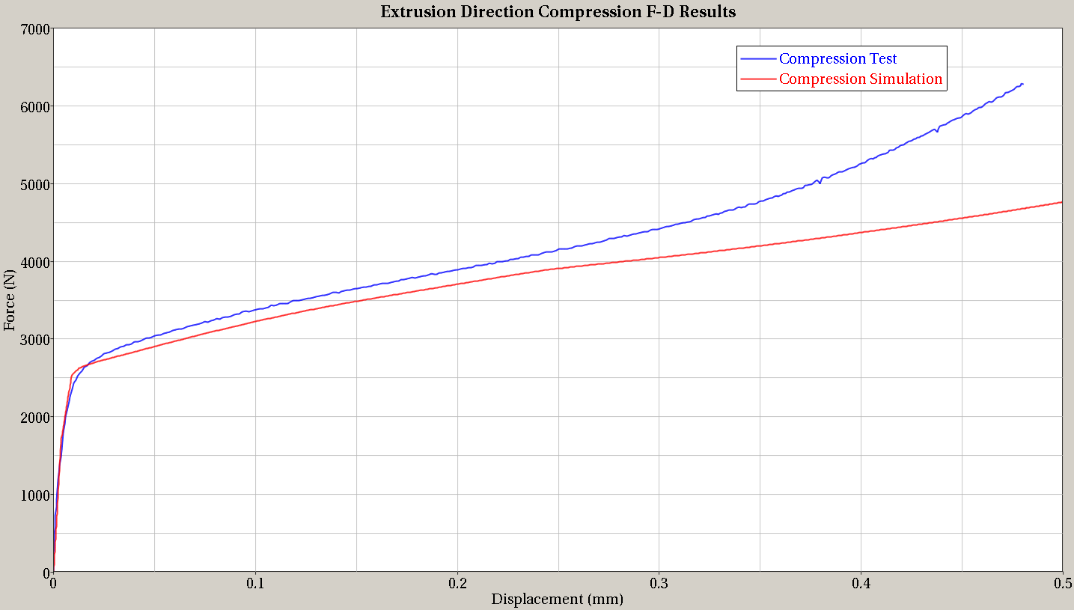
Compression Tests - Results
Decent match up to 0.3mm displacement.
Diverges later – Most likely due to friction effects

Slide 20
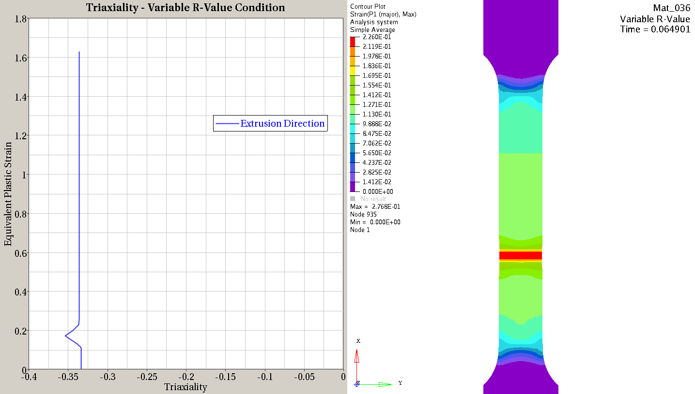
Triaxiality (k) – Variable R-Value
See a small blip in tri-axilaity and then remains constant @ -0.33
See next slide
Good Match for Failure Mode

Slide 21
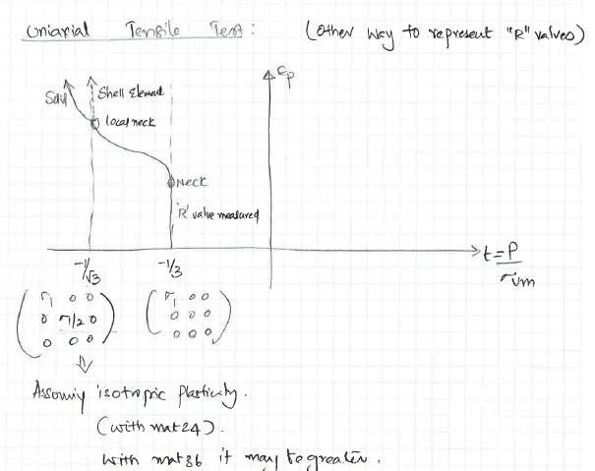
Triaxiality (k)
When R = 1, this picture shows the expected triaxiality behavior.
When R = 0, triaxiality would be expected to remain constant.
Additionally, lower R values should result in less initial decrease of triaxiality at necking.

Slide 22
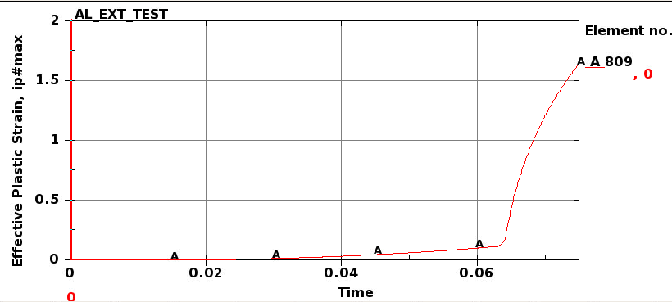
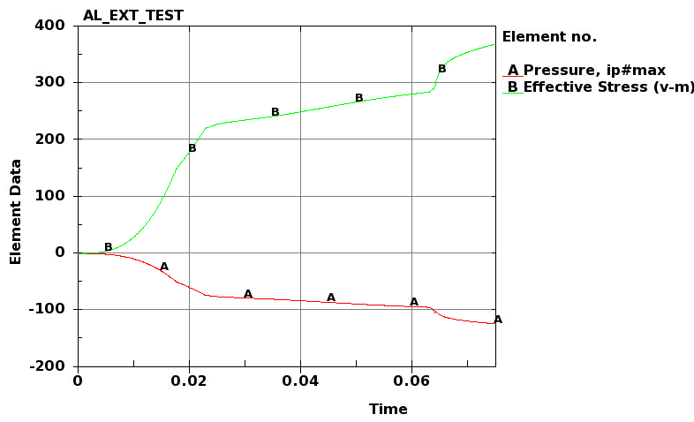
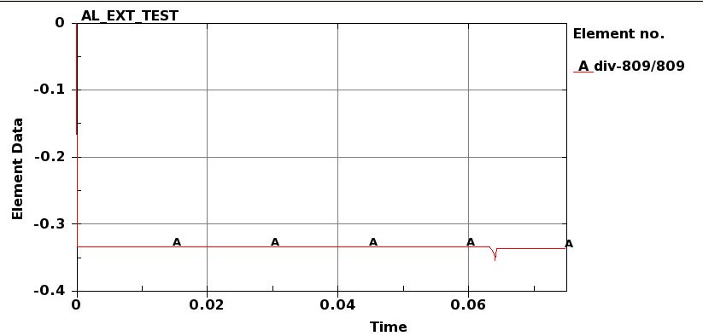
Additional data from simulation
See a small blip here and then tri-axiality (k) remains constant (0.33).
But eps rapidly increases because of localization
Time vs tri-axiality

Slide 23
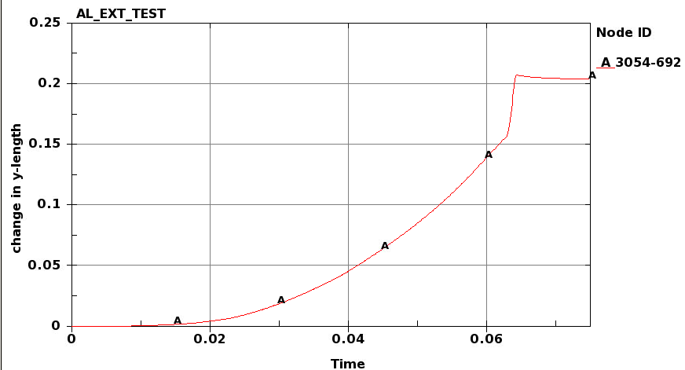
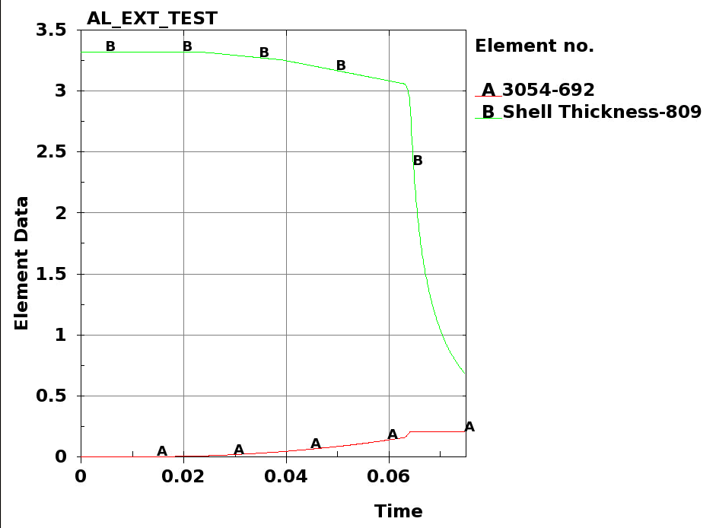
Additional data from simulation
Time vs change in Width
Time vs change in Width
This behavior seems to match what’s seen in DIC and all CAE data seems consistent
The behavior was unexpected, but does not seem to be incorrect.

Slide 24
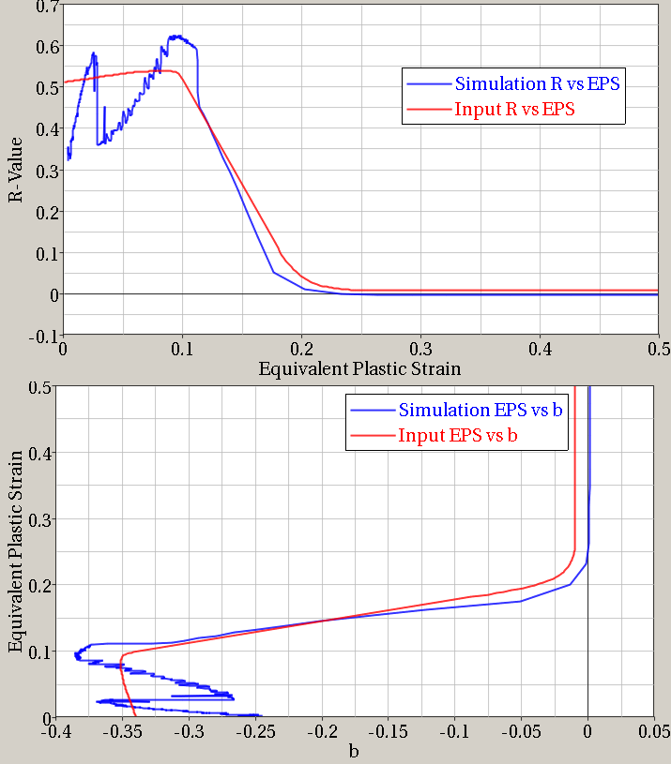
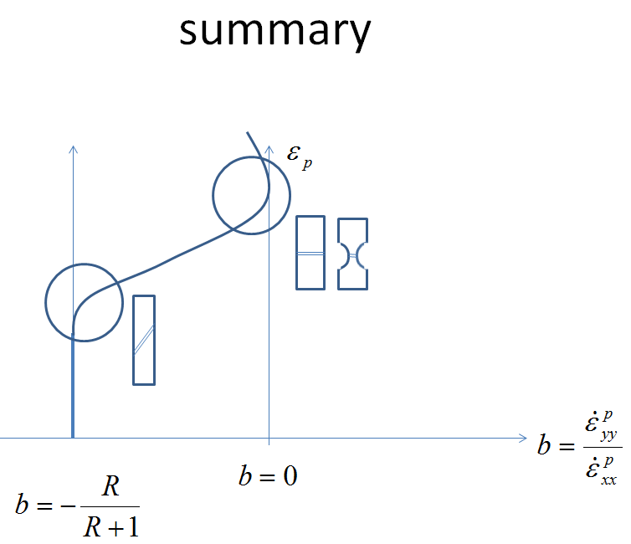
b vs. 𝜀_{p} - Variable R-Value
This is calculated from simulation output
Expected Behavior
Eps=0.27 for failure based on simulation.

Slide 25
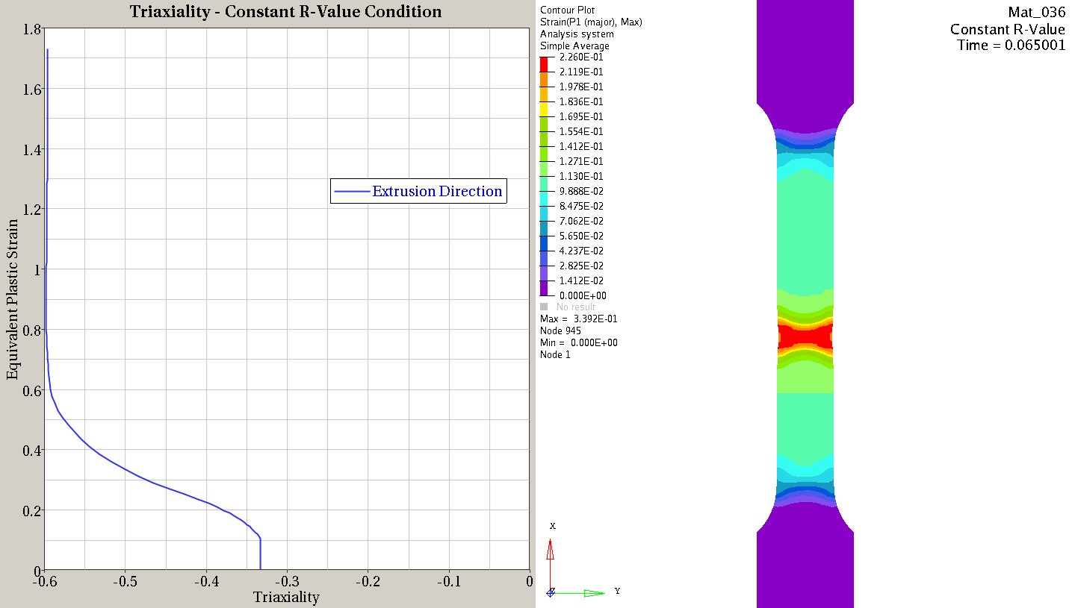
Triaxiality – Constant R-Value
Expected Triaxiality Behavior
Incorrect Failure Mode

Slide 26
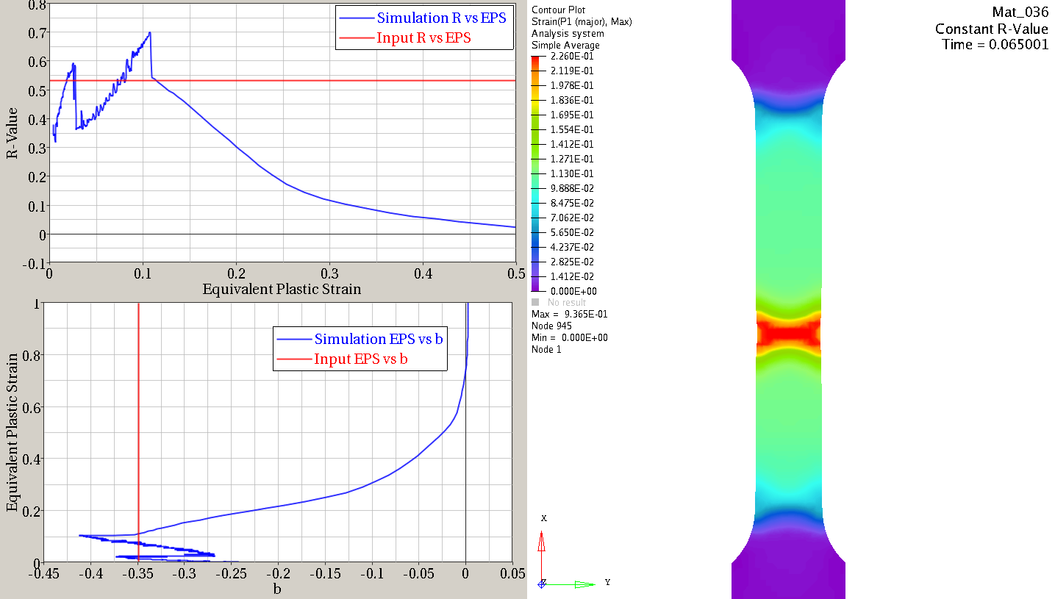
b vs. 𝜀_{p} – Constant R-Value
This is calculated from simulation output
Behavior of R-value (or b) vs. EPS is a result of the material and the geometry, not simply the inputted R-curve.
Incorrect Failure Mode

Slide 27
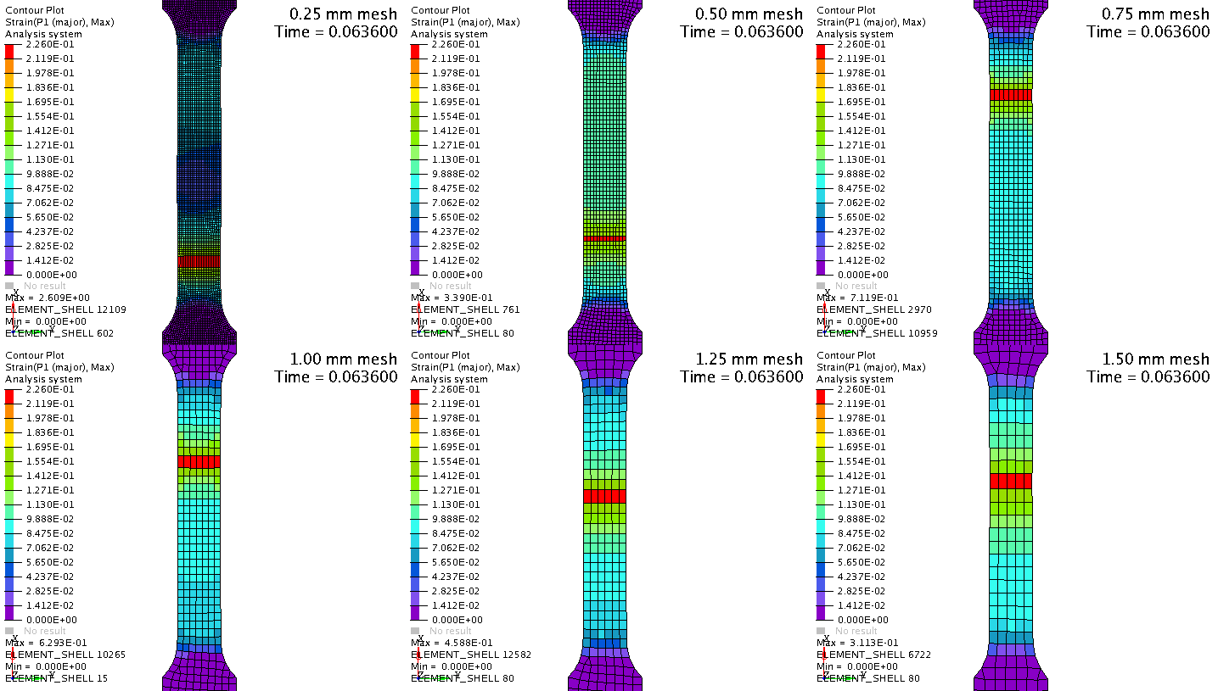
Regularization Study
Mesh Size Comparison
Base mesh size

Slide 28
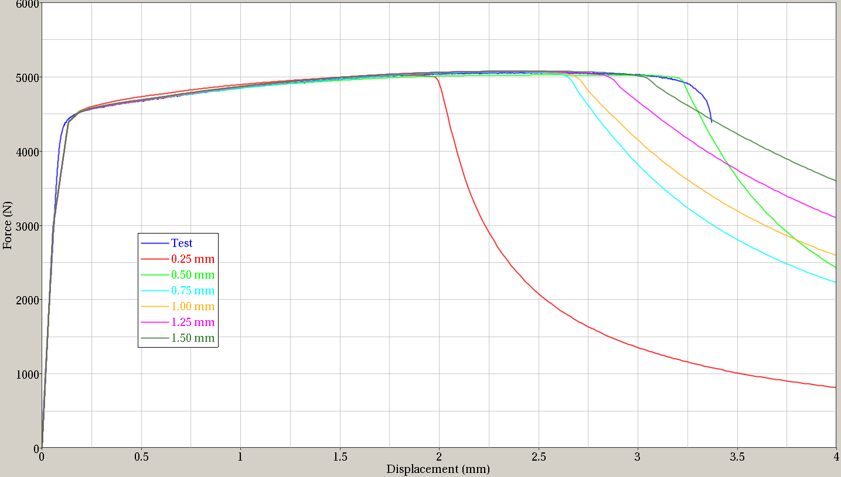
Regularization Study
Wide variation in failure strains points?
Mesh Size Comparison
TEST
0.5mm
0.25mm
base mesh size is 0.5mm.
The trend in these curves does not match what is expected with typical Mat24. Bigger mesh-size load taking capacity (say 1.5mm) drops after 0.5mm mesh.

Slide 29
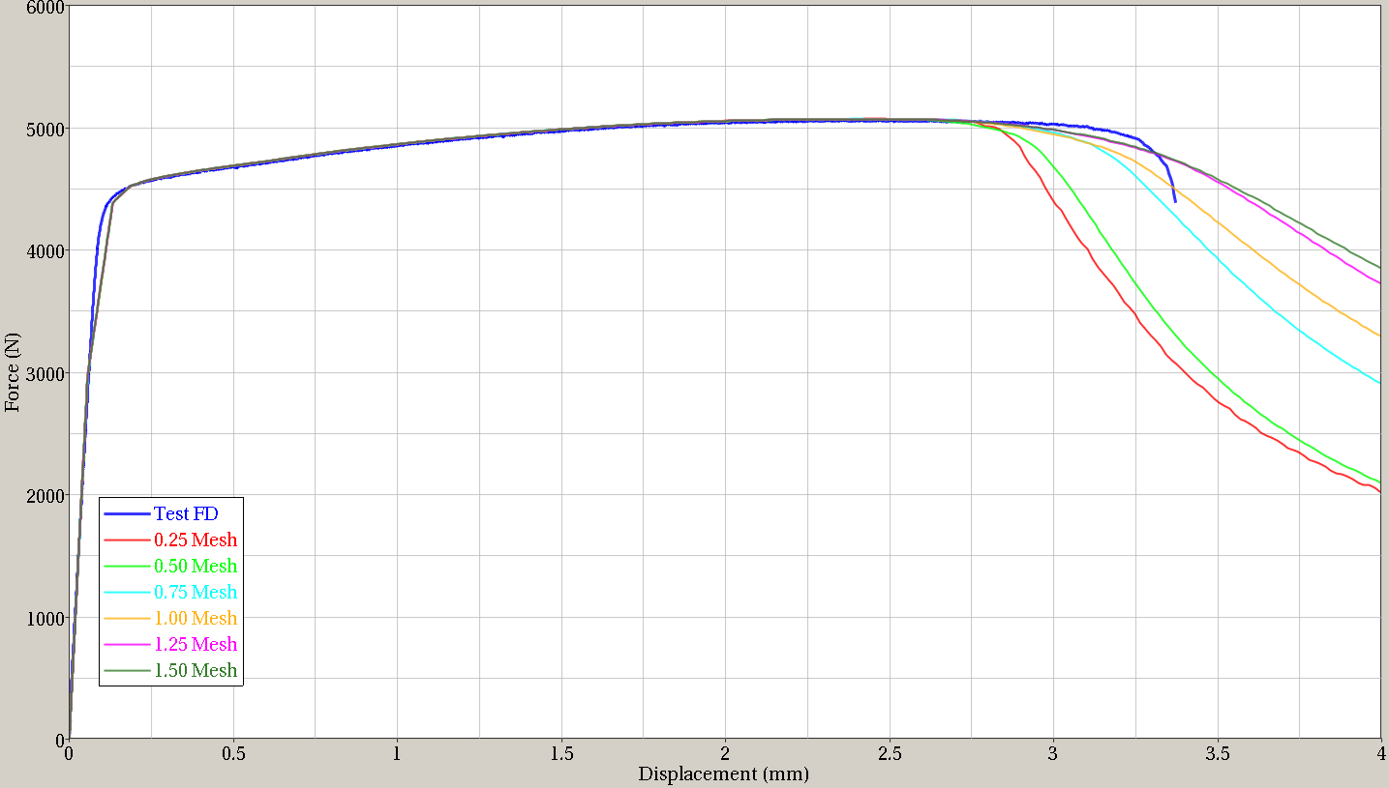
Regularization – *Control_Timestep
Mesh Size Comparison
TEST
Adding a standard time step to the keyword file rather than letting LS-Dyna calculate one has a drastic effect on the regularization results: The expected trend (seen in typical Mat24) is present; load-taking capacity is increasing with mesh size. The base mesh is no longer coordinated with the initial test results, but this can be accounted for in the hardening curve and R-curve. The regularization is now behaving as expected.
0.25mm
0.5mm
Base mesh size is 0.5mm.
*CONTROL_TIMESTEP: DT2MS = -5.00E-7

