Slide 1

Real-Time Fire and Gas Leak Detection in Industrial Zones An Innovative IoT-Based Approach for Enhanced Safety
Student Name: Anish Bansal
Student ID: 221435713
Task: 9.1P Research Presentation
Notes:
"Hello, everyone. My name is Anish Bansal, and today I'll be presenting my project on real-time fire and gas leak detection in industrial zones. The goal of this project is to enhance safety in these environments by creating a scalable and cost-effective solution for detecting both fire and gas leaks."

Slide 2

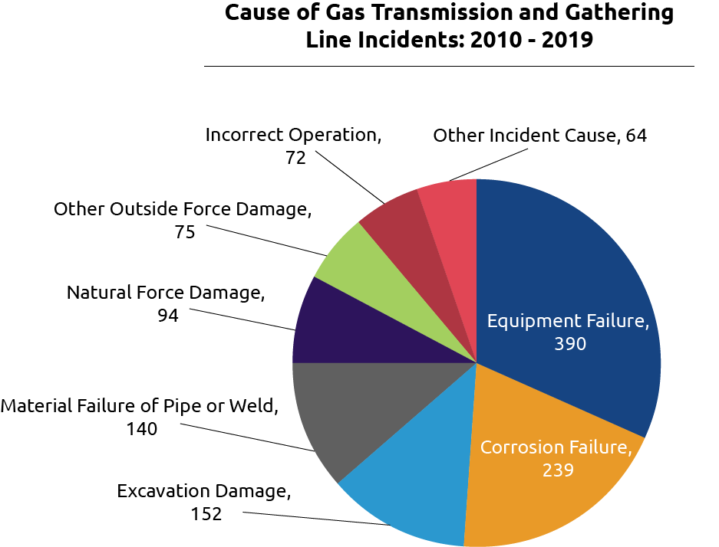
Problem Statement
Industrial zones face significant risks from fire and gas leaks, threatening both human safety and infrastructure. Current detection systems either lack real-time response or are prohibitively expensive for smaller industries. The need for affordable, scalable, and efficient monitoring solutions is critical to mitigate catastrophic damage and loss.

Slide 3
Research Objective
The primary goal is to develop a cost-effective and scalable IoT-based system for detecting fires and gas leaks in real-time. This system aims to provide early detection, efficient alert mechanisms, and actionable data analytics to enhance safety measures in industrial settings.

Slide 4
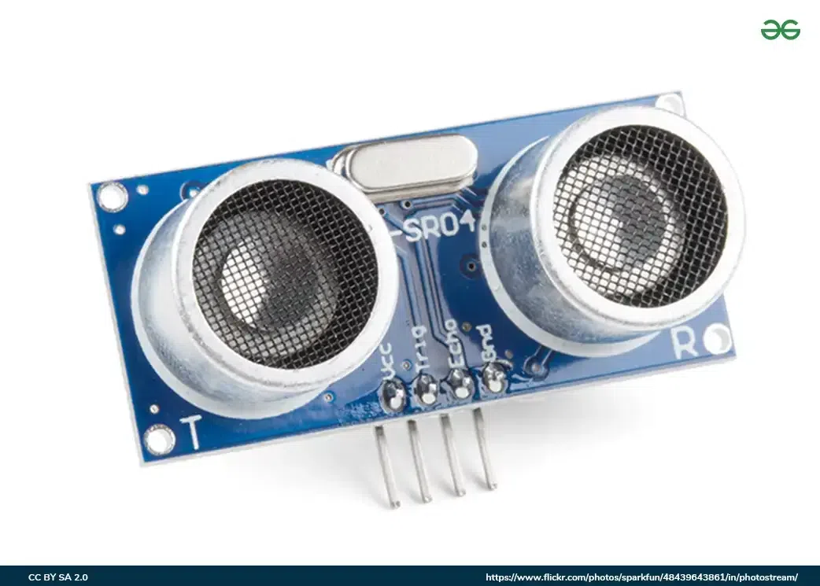
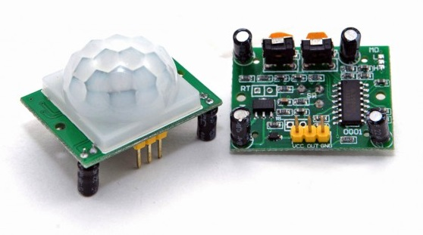
Review of Current Detection Systems
Key Gaps Identified:
High Costs & Scalability Issues: Expensive and complex technologies are not suitable for widespread use in smaller industries.
Limited Detection Capabilities: Most systems detect either fire or gas but not both.
Environmental Sensitivity: Prone to noise and other interferences affecting accuracy.
Technology/Method | Advantages | Shortcomings
MWIR Imaging (Sun et al., 2024) | Precise gas leak detection | High computational resources required
Ultrasonic Sensors (Kim et al., 2024) | Improved detection probabilities | Susceptible to environmental noise
AI & IoT Framework (Samal et al., 2023) | Efficient for LPG leak detection | Limited to specific gases; High cost of AI implementation

Slide 5

Integrated IoT-Based Detection System
A holistic, IoT-based detection solution employing sensors (DHT22, MQ135, Flame Sensor) to capture data on temperature, humidity, smoke, and gas levels. The data will be transmitted to the Arduino IoT Cloud for real-time analytics and visualisation, enabling timely alerts and comprehensive safety monitoring.

Slide 6

Solution Components and Design
Data Sources:DHT22 Sensor: Measures temperature and humidity.
MQ135 Sensor: Monitors various gases, such as CO2, ammonia, and smoke.
Flame Sensor: Detects visible flames.
Data Capture: Uses MQTT for data transfer.Data Storage: Dual storage - locally on a microSD card and in the Arduino IoT Cloud.
Visualisation & Alerts: Plotly Dash for real-time monitoring and visual alerts when safety thresholds are breached.

Slide 7

Visualisation and Notification Mechanism
Data Sources: Sensors for temperature, humidity, gas concentration, and flame.
Data Capture & Protocol: Using MQTT for seamless data transfer.
Data Storage: Local microSD logging and Arduino IoT Cloud for backup and analytics.
Data Analytics & Alerts: Real-time monitoring with threshold-based alerts.

Slide 8
Project Timeline and Budget Overview
Gantt Chart Overview: Detailed breakdown of activities from sensor setup, Arduino programming, cloud integration, Python back-end, to testing and documentation.Budget Summary:Hardware Costs: $108 (Sensors, microcontroller, etc.)
Software & Cloud: Free or open-source.
Operational Costs: $65 (Internet and calibration materials).
Human Resources: $7,550 (280 hours of development).
Total Budget: $7,723 USD
Category | Total Cost (USD)
Hardware | 108
Software | 0
Operational | 65
Human Resources | 7,550
GRAND TOTAL | $7,723

Slide 9
Ethics, Privacy & Future Improvements
Ethical Considerations:Data Security: Encrypt all data using TLS/SSL.
Data Anonymization: Mask sensitive data for privacy compliance.
Access Control: Role-based access and two-factor authentication.
Multi-Sensor Verification: Cross-check data from different sensors to avoid false positives.
Future Improvements:
Enhance machine learning for anomaly detection.
Scale the solution to other industrial applications.
Task | Week 1 | Week 2 | Week 3 | Week 4 | Week 5 | Week 6 | Week 7 | Week 8 | Man Hours
Sensor Selection & Hardware Setup | ✔ | ✔ |  |  |  |  |  |  | 20
Arduino Programming (Microcontroller) |  | ✔ | ✔ | ✔ |  |  |  |  | 40
Back-End Data Processing (Python) |  |  | ✔ | ✔ | ✔ |  |  |  | 50
Arduino IoT Cloud Integration |  |  | ✔ | ✔ |  |  |  |  | 30
Data Storage & Logging (Cloud & Local) |  |  |  | ✔ | ✔ |  |  |  | 20
Machine Learning Model Development |  |  |  |  | ✔ | ✔ |  |  | 60
Testing & Validation (End-to-End) |  |  |  |  | ✔ | ✔ | ✔ |  | 30
Documentation & User Guide |  |  |  |  |  | ✔ | ✔ | ✔ | 20
Final Presentation & Submission |  |  |  |  |  |  | ✔ | ✔ | 10

Slide 10

Conclusion & Q&A
The proposed IoT-based detection system is designed to be cost-effective, scalable, and secure, with real-time monitoring and predictive analytics capabilities. It aims to improve safety standards in industrial zones effectively.
Thank You!
Questions? Feel free to ask.

