Slide 1
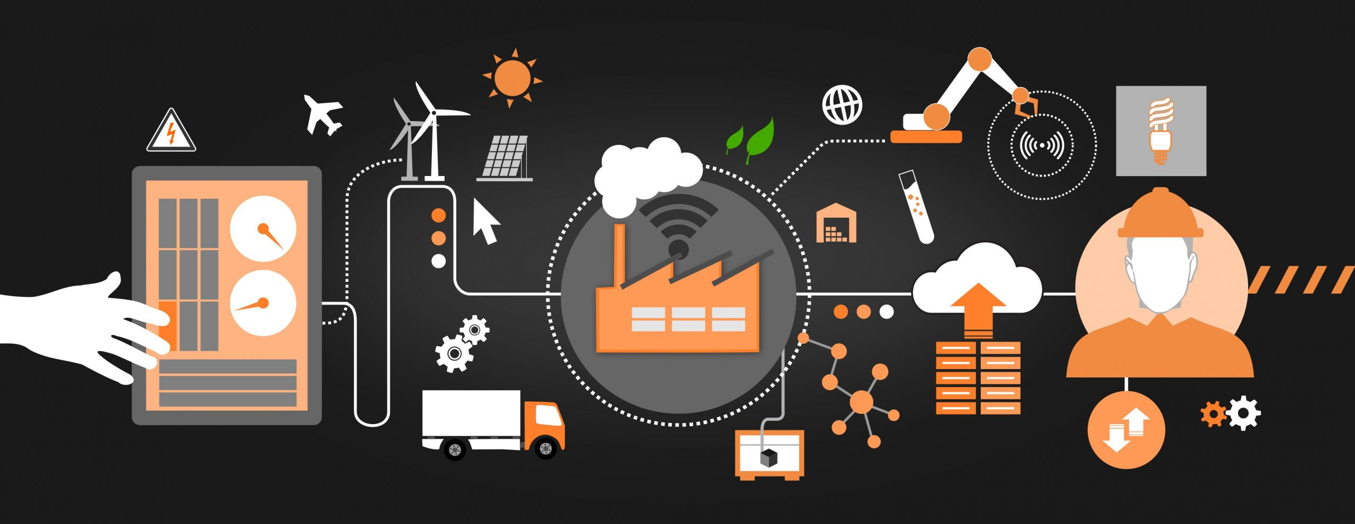
Real-Time Fire and Gas Leak Detection in Industrial Zones An Innovative IoT-Based Approach for Enhanced Safety
Student Name: Anish Bansal
Student ID: 221435713
Task: 9.1P Research Presentation
Notes:
"Hello, everyone. My name is Anish Bansal, and today I'll be presenting my project on real-time fire and gas leak detection in industrial zones. The goal of this project is to enhance safety in these environments by creating a scalable and cost-effective solution for detecting both fire and gas leaks."

Slide 2
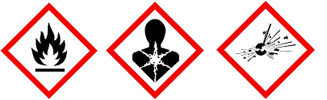
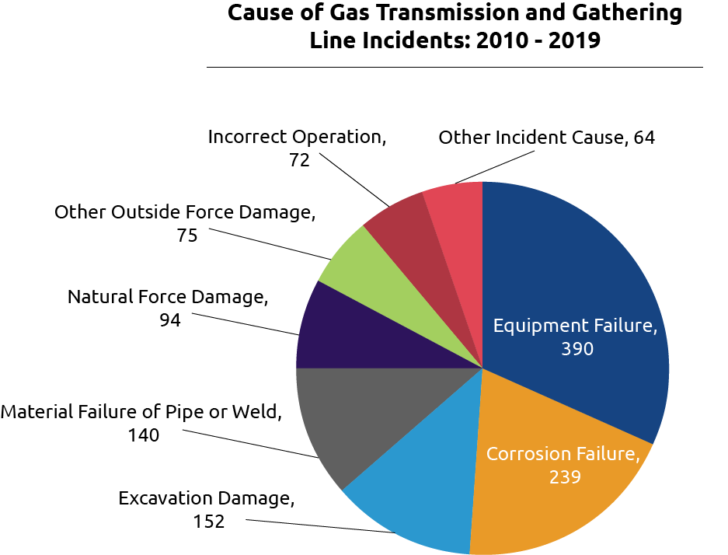
Problem Statement
Problem Identification:Industrial zones handling flammable materials face safety threats from fires and gas leaks.
Current systems either lack real-time alerting capabilities or are too expensive for small industries.
Numerous incidents highlight the need for better safety mechanisms.
Objective:To develop an affordable and scalable IoT-based system that provides early detection and alerts for fire and gas leaks using sensors and cloud-based analytics.

Slide 3
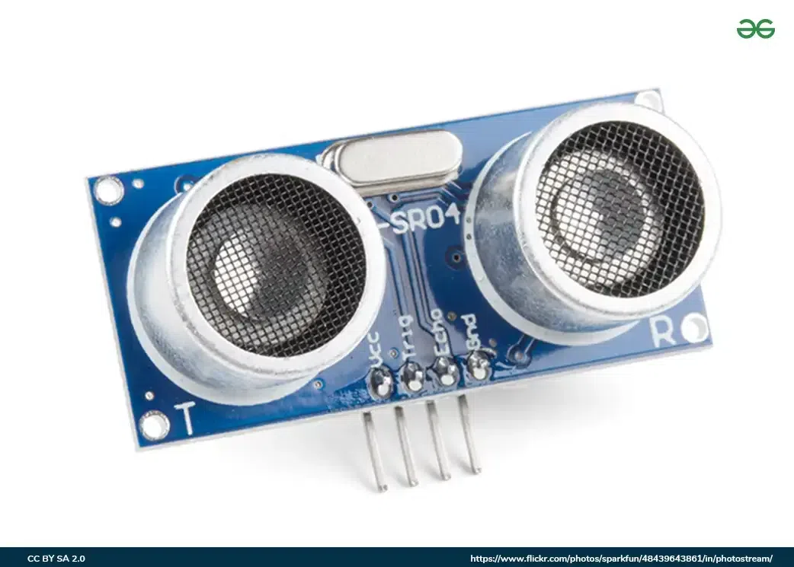
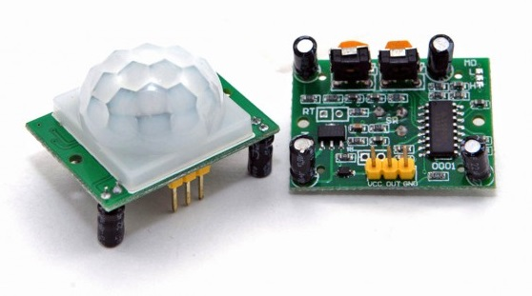
Literature Review on Detection Systems
MWIR Imaging (Sun et al. 2024): Accurate but computationally intensive.Ultrasonic Sensors (Kim et al. 2024): Improved detection but sensitive to noise.AI & IoT Framework (Samal et al. 2023): Efficient for LPG but costly and limited in scope.Gaps in Existing Solutions:Limited range for simultaneous fire and gas detection.
High cost & scalability issues.
Environmental sensitivity affecting accuracy.

Slide 4

Proposed Solution Overview
System Overview: "IoT-based system with integrated sensors for fire and gas leak detection."Core Components: DHT22 for temperature/humidity, MQ135 for gases, Flame Sensor for fire detection.Real-Time Alerts: Data sent to Arduino IoT Cloud; alerts generated when abnormalities are detected

Slide 5

Solution Components and Design
Data Sources:DHT22 Sensor: Measures temperature and humidity.
MQ135 Sensor: Monitors various gases, such as CO2, ammonia, and smoke.
Flame Sensor: Detects visible flames.
Data Capture: Uses MQTT for data transfer.Data Storage: Dual storage - locally on a microSD card and in the Arduino IoT Cloud.
Visualisation & Alerts: Plotly Dash for real-time monitoring and visual alerts when safety thresholds are breached.

Slide 6

Visualisation and Notification Mechanism
Dashboard with Plotly Dash: Real-time visualization with line graphs for temperature, gas levels, and flame status.Threshold-Based Alerts: Alerts triggered for any data exceeding predefined safe limits.Notifications to Users: Alerts sent via SMS, email, or push notifications.

Slide 7
Use Case & System Workflow
Target Users: Safety officers, plant managers, SMEs.Workflow Steps:Sensor Detection: Data collected from temperature, gas, and flame sensors.
Data Transmission & Logging: Data sent via MQTT to Arduino IoT Cloud; logged locally and on the cloud.
Alert & Response: Dashboard alerts users to anomalies; notifications sent out to prevent incidents.

Slide 8

Project Timeline & Gantt Chart
Development Phases:Week 1-2: Sensor setup & hardware testing (5-7 hours).
Week 3-4: Arduino programming for data collection (5-7 hours).
Week 5: Back-end Python processing & visualization (7-15 hours).
Week 6: Data storage & logging (7-10 hours).
Week 7: Machine learning model development (7-15 hours).
Week 8: Testing, validation & documentation (15 hours total).
Effort Summary: ~58 hours over 8 weeks.

Slide 9

Project Budget Overview
Budget Breakdown:Hardware Costs: $108 (Arduino Nano 33 IoT, DHT22, MQ135, Flame sensor, etc.).
Software & Cloud: Free/Open-source (Arduino IDE, Python libraries).
Operational Costs: $65 (Internet subscription, calibration materials).
Total Budget: $173 USD

Slide 10

Ethics, Privacy, and Future Improvements
Data Security & Privacy:Encryption: TLS/SSL for secure data transmission.
Anonymization: Mask sensitive data.
Access Control & Compliance: Role-based access and legal framework compliance (e.g., GDPR).Future Work:Enhance machine learning for better anomaly detection.
Modular sensor design for expanded applications.

Slide 11

Conclusion & Q&A
The proposed IoT-based detection system is designed to be cost-effective, scalable, and secure, with real-time monitoring and predictive analytics capabilities. It aims to improve safety standards in industrial zones effectively.
Thank You!
Questions? Feel free to ask.

