Slide 1
Rectlinear Block Packing Using the O-tree Representation
Yingxin Pang Koen Lampaert
Mindspeed Technologies
Chung-Kuan Cheng
University of California, San Diego
Weize Xie
Hewlett-Packard Research Laboratories

Slide 2
Motivation
Recent advance of sub-micron technology makes it possible to realize a big system on a single chip.
Designing such a huge VLSI layout is hard and design reuse has been attracting much interest
The integrated circuit components are not limited to rectangular blocks
Traditional algorithms designed primarily for placing rectangle blocks are no longer effective

Slide 3
Basic Strategy
Partition each rectilinear block into sub-rectangle blocks
Treat each sub-rectangle blocks as a unit block
The relationship of the sub-blocks of a rectilinear module are represented in a encoding or in additional constraints

Slide 4
Properties of Our Solution
Compactness:
  for each feasible compact placement, there is a feasible O-tree corresponding to it
Efficiency:
  the transformation form a feasible O-tree to a feasible placement takes a linear time

Slide 5

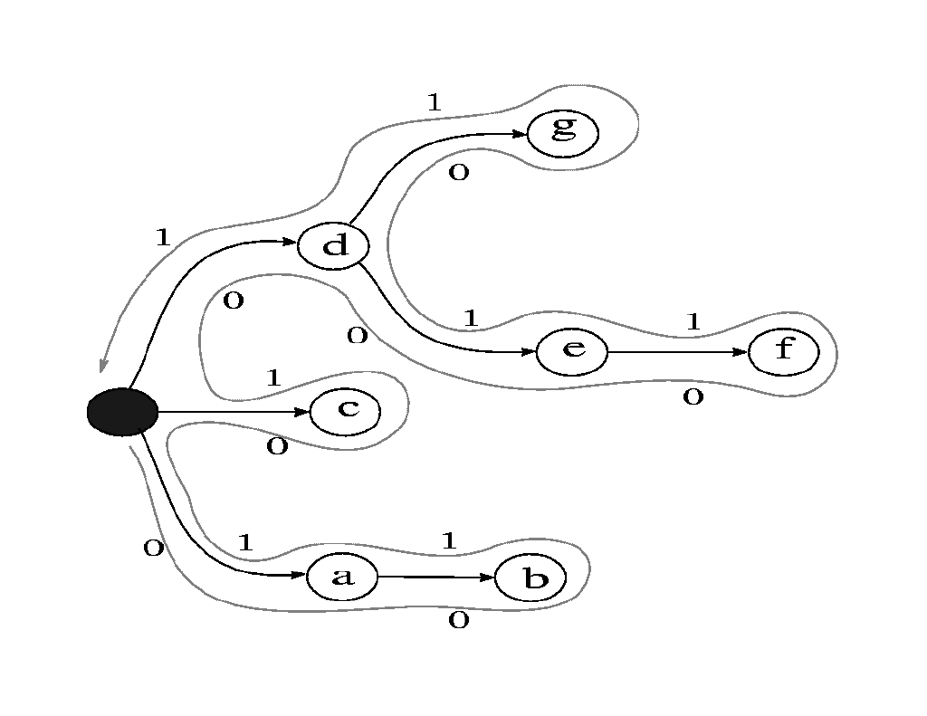


O-tree Representation
An O-tree is an ordered tree, which can be encoded by
is a 2n-bit string which identifies the structure of the tree
is a permutation of n nodes
An Example:
00110100011011, abcdefg

Slide 6
O-tree to Placement
g
d
e
f
c
a
b

Slide 7






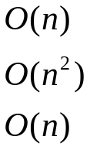
O-tree’s Advantages
Configurations
  Binary tree
  Sequence pair
  O-tree
Storage needed for individual configuration
  Binary tree
  Sequence pair
  O-tree
Transformation to a placement
  Binary tree
  Sequence pair
  O-tree

Slide 8
L-shaped blocks
Type I L-shaped blocks
Type II L-shaped blocks

Slide 9
L-admissible O-tree
If L(B_{i},B_{j}) is type I L-shaped block, B_{i} and B_{j} are adjacent siblings
Type I L-shaped blocks:L(B₁, B₂), L(B₃,B₄), L(B₇, B₈)
B₄
B₆
B₁₁
B₁₀
B₃
B₅
B₉
B₂
B₈
B₁
B₇

Slide 10


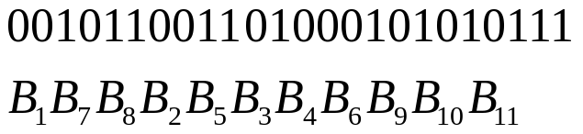
L-admissible O-tree
If L(B_{i},B_{j}) is a type II L-shaped block
  If
    B_{i} has no child
    No block between them in has horizontal spanning interval overlapping with
B₄
B₆
B₁₁
B₃
B₁₀
B₅
B₉
B₂
B₈
Type II L-shaped blocks: L(B₅, B₆)
B₁
B₇

Slide 11




L-admissible O-tree
  If
    B_{j} has no child
    No block between them in has horizontal spanning interval overlapping with
  If
    No block between them in has horizontal spanning interval overlapping with

Slide 12
L-admissible O-tree
Theorem
If an O-tree is L-admissible, a minimum area placement satisfying both horizontal positioning constraints and L-shaped constraints can be built in O(n) time

Slide 13
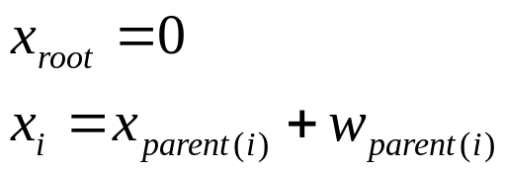
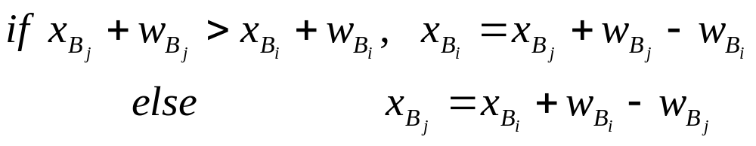
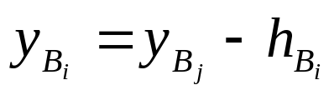
L-admissible O-tree to Placement
X-coordinate
For every type II L-shaped block L(B_{i},B_{j})
Place the blocks by the depth first search order, place blocks as down as possible with x-coordinates fixed
For every L-shaped block L(B_{i},B_{j})

Slide 14
L-admissible O-tree to Placement
B₄
B₆
B₁₁
B₁₀
B₃
B₅
B₉
B₂
B₈
B₁
B₇
B₄
B₆
B₁₁
B₃
B₁₀
B₅
B₉
B₂
B₈
B₁
B₇

Slide 15
Sufficiency of the L-admissible O-tree
Theorem
Any compact placement containing L-shaped blocks can be encoded with an L-admissible O-tree.

Slide 16

Placement to L-admissible O-tree
Partition all L-shaped blocks
Construct a horizontal constraint graph
B₄
B₆
B₁₁
B₃
B₁₀
B₅
B₉
B₂
B₈
B₁
B₇

Slide 17
Placement to L-admissible O-tree
Generate the shortest path tree
B₄
B₆
B₁₁
B₃
B₁₀
B₅
B₉
B₂
B₈
B₁
B₇

Slide 18
Placement to L-admissible O-tree
For each type I L-shaped block L(B_{i},B_{j})
  Delete the tree edge to B_{i}
  Add an edge to B_{i} from parent of B_{j}
B₄
B₆
B₁₁
B₃
B₁₀
B₅
B₉
B₂
B₈
B₁
B₇

Slide 19
Placement to L-admissible O-tree
For each type II L-shaped block L(B_{i},B_{j})
  if B_{i} is compact to the left
  move B_{j}’s children to be B_{i}’s children
  else move B_{i}’s children to be B_{j}’s children
B₄
B₆
B₁₁
B₃
B₁₀
B₅
B₉
B₂
B₈
B₁
B₇

Slide 20
Properties of the L-admissible O-tree
The width of the placement has not be changed after the alignment operation
The height of the placement has not be changed after the abutment operation
The non L-admissible O-tree is redundant
No extra post process is needed

Slide 21
Rectilinear Block Packing
L-partition the rectilinear blocks
  A rectilinear block can be represented by a set of adjacent sub-L-shaped blocks
Admissible O-tree
  O-tree is admissible if it is L-admissible for all sub-L-shaped blocks
Extend our approach to handle rectilinear blocks

Slide 22

L-partition
Two adjacent sub-rectangle form L-shaped
-rectangle insertion
B₁
B₂
B₃
B₁
B₁₂
B₁
B₂
B₂
B₃
B₃

Slide 23
Expandable Rectilinear Block

Slide 24
Rectilinear Block Packing
Transitivity property for alignment
  If a O-tree is L-admissible to two adjacent sub-L-shaped blocks {B_{i-1}, B_{i}} and {B_{i}, B_{i+1}}, the alignment property for {B_{i-1}, B_{i}, B_{i+1}} can be restored by applying the moving and expanding operation
Transitivity property for abutment
  If a O-tree is L-admissible to two adjacent sub-L-shaped blocks {B_{i-1}, B_{i}} and {B_{i}, B_{i+1}}, the abutment property for {B_{i-1}, B_{i}, B_{i+1}} can be restored by applying the lifting and expanding operation

Slide 25
The Heuristic Optimization Algorithm
Delete a block from the O-tree
  if it is a sub-block of an L-shaped block, delete the other sub-block
Operate the tree rotation and insert the deleted blocks at the best insertion position in each O-tree
Choose the best one according to the cost function

Slide 26
O-tree Rotation
c
f
c
f
e
e
g
b
g
b
a
d
a
d
c
f
f
c
e
g
e
g
b
b
a
d
a
d

Slide 27
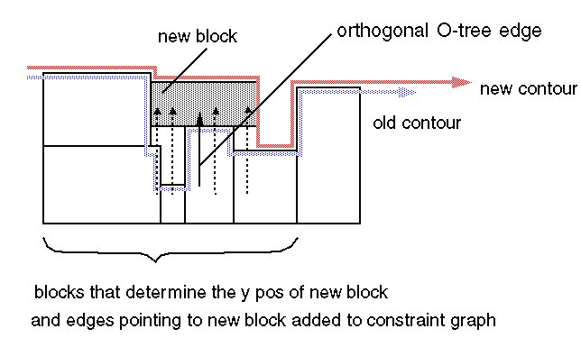
An O-tree to Its Orthogonal O-tree

Slide 28
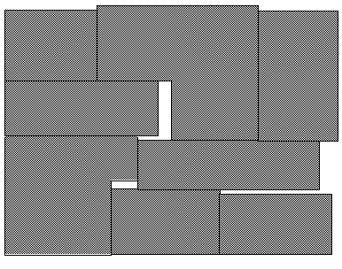
L-shaped Block Packing

Slide 29
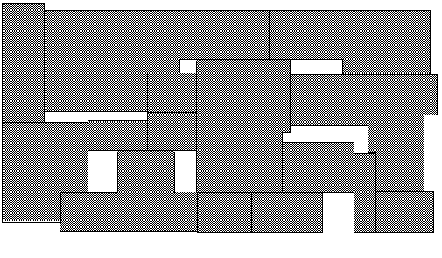
Rectilinear Block Packing

Slide 30
Conclusions
Develop a simple technique to handle rectilinear block packing problem
Transforming an admissible O-tree to a placement can be realized in linear time
No post-process needed to recover the original rectilinear shape

