Slide 1
ECBL: An Extended Corner Block List with Solution Space including Optimum Placement
Shuo Zhou,Sheqin Dong, Xianlong Hong,Yici Cai
Dept. of Computer Science and Technology,
Tsinghua University, Beijing
100084 P.R. China
Chung-kuan Cheng
Dept. of Computer Science and Engineering, University of California,San Diego
La Jolla,CA 92093-0114,USA
Jun Gu
Department of Computer Science,
Science & Technology University
of HongKong
April, 2001

Slide 2
Outline
Introduction
Extended Corner Block List
Approach
Experimental Results
Conclusions

Slide 3
Introduction
Definition of Mosaic Floorplan
N-room Constraint of Mosaic Floorplan
Mosaic Floorplan with Dummy Blocks
Bounded Sliceline Grid (BSG)
Relations of BSG and TBT, CBL

Slide 4
Definition of Mosaic Floorplan
No Empty Space: n rectangles ⇔ n blocks
Topological Equivalence on Segment Sliding
Non-Degenerate Topology
A
B
A
B
ε
C
D
C
D

Slide 5
Mosaic Floorplan
N-Room Constraint of
B
A
A
B
C
C
D
D

Slide 6

Mosaic Floorplan with Dummy Blocks
x
x
x

Slide 7
Bounded-Sliceline Grid (BSG)
Bounded-Sliceline Grid (BSG): n x n grids
BSG covers general floorplan
Thus, mosaic floorplan with n² dummy blocks covers general floorplan
x₁
x₂
c
a
x₃
x₄
d
x₅
b

Slide 8
Relations of BSG and TBT, CBL
BSG: CBL, TBT
c
c
x₂
x₄
x₂
x₄
x₁
x₁
x3
b
x₃
0
b
0
a
x₅
x₁
x₂
c
x
a
0
x₅
x
x
1
1
x
0
d
0
1
d
1
0
1
a
x₃
x₄
0
0
1
0
1
d
x₅
b
θ₁=01100110, θ₂=10011001
order(τ₁)=order(τ₂)=x₁ax₂cx₃dx₅x₄b
ECBL(S,L,T): S= dx₅ax₁x₃bx₄x₂c
L= 10011001
T= 010010100100

Slide 9
Extended Corner Block List (ECBL)
Given n blocks,
ECBL_{λ} = corner block list (S,L,T) with
⎣λn⎦ rooms, where λ ≥ 1.
The list (S,L,T) contains (⎣λn⎦-n) dummy blocks.

Slide 10
ECBL
#ECBL_{λ} =
Complexity of transformation: O(λn)
ECBL_{n} covers BSG_{n×n}

Slide 11
Approach
Perturbation for simulated annealing process
  Exchange two labels in sequence S.
  Change bits in sequence L and T.
Selection Of λ
  Try λ∈[1.5, …, 3]

Slide 12
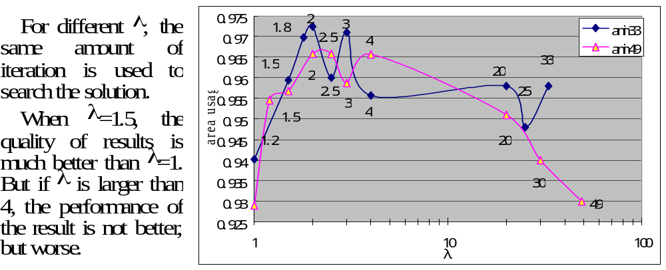
Selection of λ

Slide 13
Experimental Results
The algorithm is implemented in C programming language.
All experiments are performed on a SUN spark20 workstation.
Our experiments do not include soft blocks.
λ of ECBL is set between 1.8 and 2.5.

Slide 14
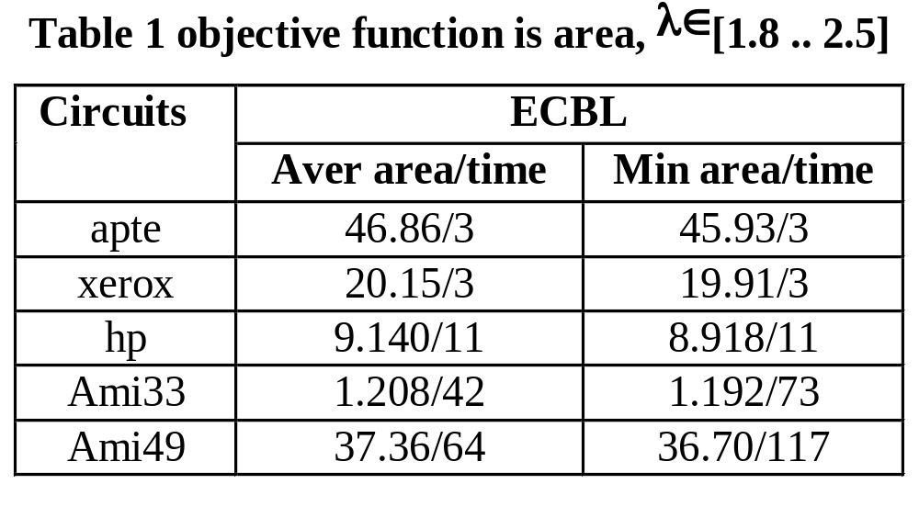
Experimental Results

Slide 15
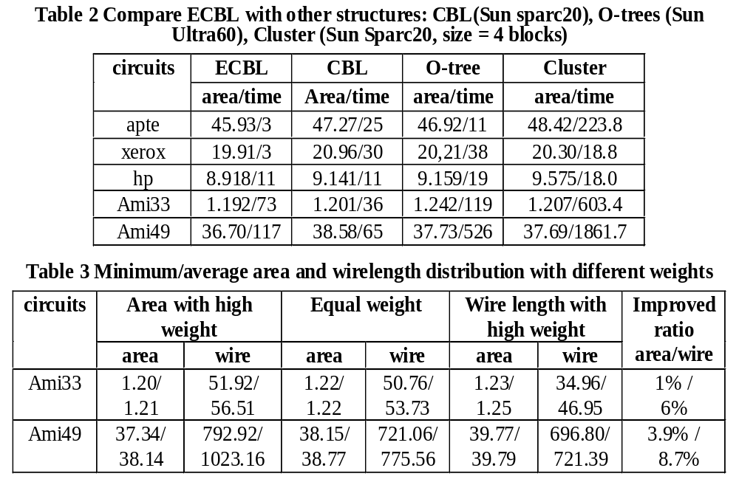

Slide 16
Conclusion
Mosaic floorplan is extended to general floorplan.
ECBL_{λ} covers general floorplan, if λ=n.
ECBL_{λ} based-algorithm has the complexity of O(n) when λ is a constant.
Experiments on benchmark show promising results.

