Slide 1

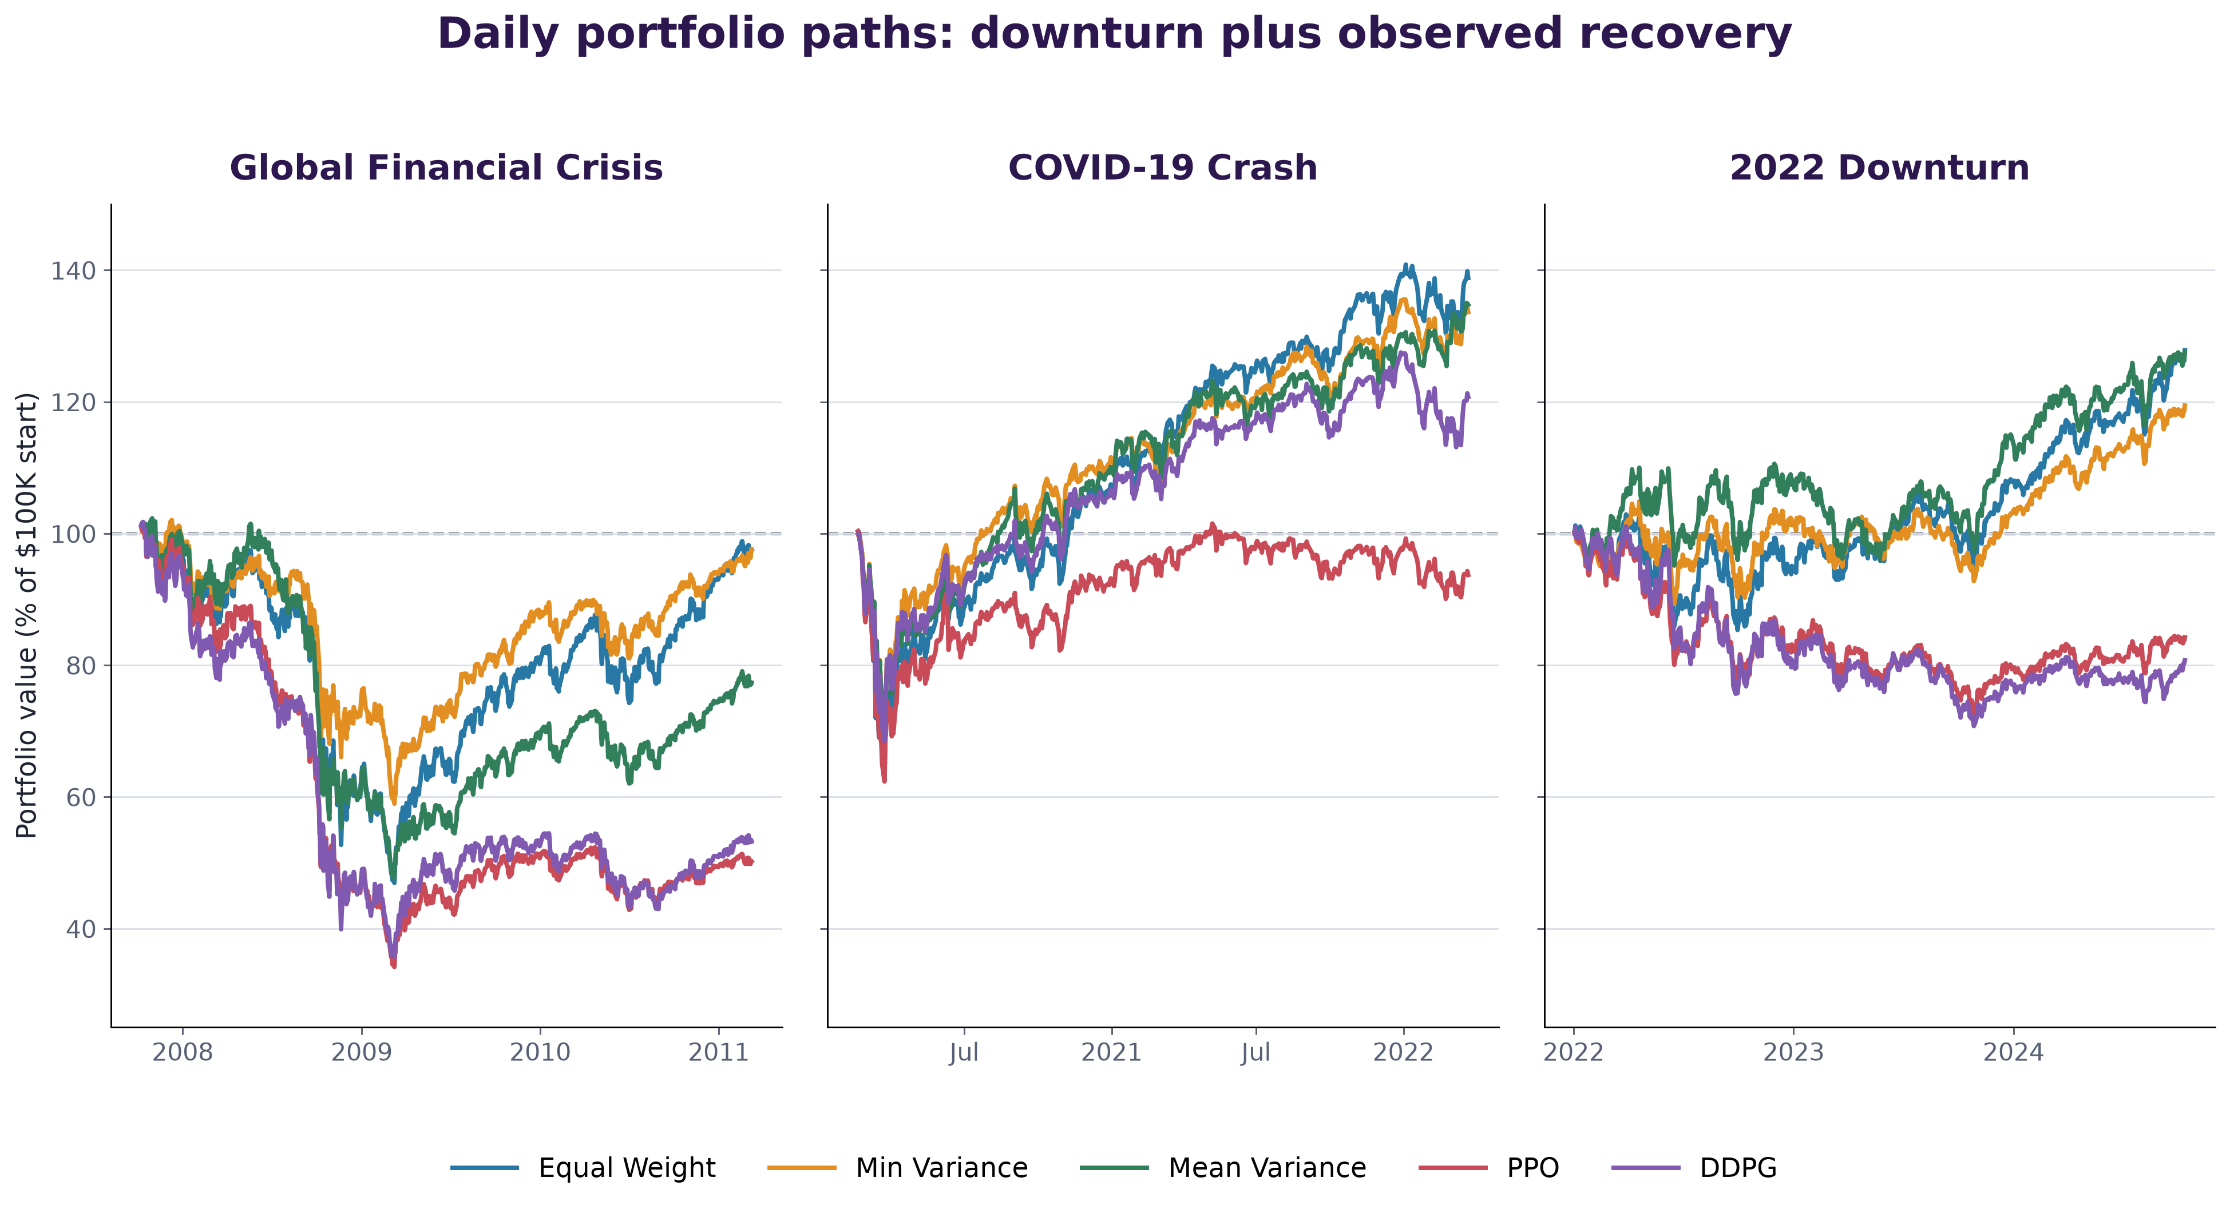
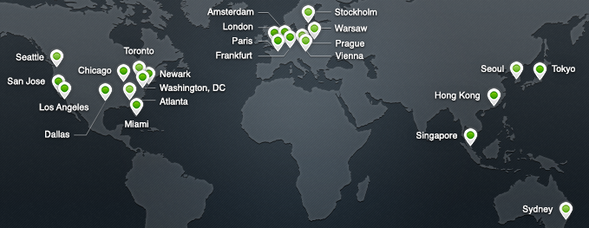
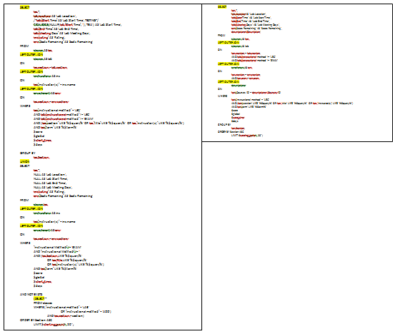
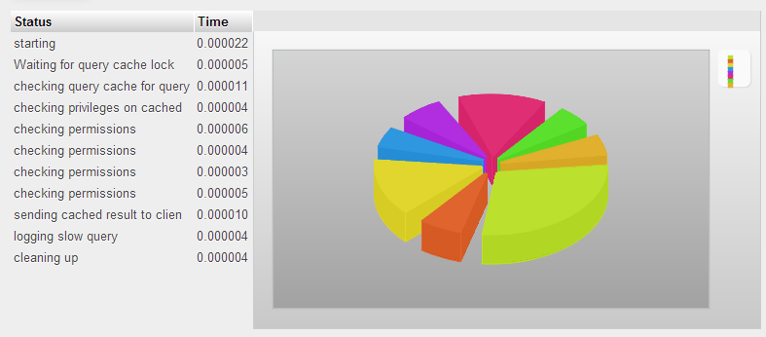
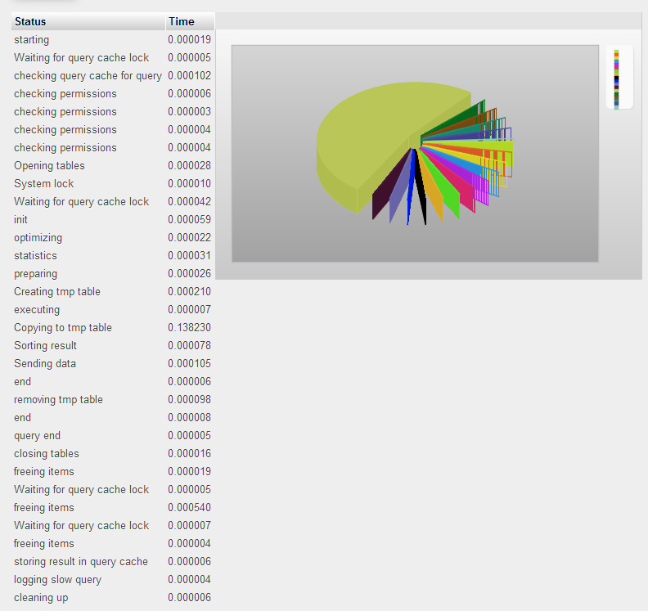
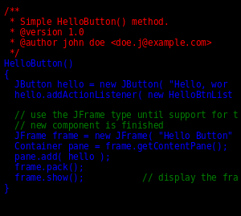
Reinforcement Learning vs. Traditional
Portfolio Strategies During Market Downturns
A cost-aware comparison across the Global Financial Crisis, COVID-19, and 2022
Kelvin Bonsu | Department of Computer Science, Furman University
5 strategies • 3 historical events • 9 U.S. sector ETFs • $100,000 initial capital
RESEARCH QUESTION
PORTFOLIO PATHS THROUGH DOWNTURN & RECOVERY
WHAT STANDS OUT?
• How do PPO and DDPG compare with traditional portfolio strategies during market downturns and recovery?
• Measure net return, risk, transaction costs, and recovery using the same assets and cost-aware backtest.
• Compare Equal Weight, Minimum Variance, Mean Variance, PPO, and DDPG; no strategy is assumed to win.
• Traditional portfolios led the best downturn return in all three events: MinVar in GFC/COVID; MVO in 2022.
• RL strategies traded more dynamically and incurred much higher fees in GFC and 2022.
• Downturn fees — GFC: PPO $17.8K; DDPG $20.1K. 2022 fees: PPO $12.1K; DDPG $13.2K.
• Frequent reallocation is not automatically protective when turnover costs compound.
DATA & EVENT DESIGN
• Nine U.S. sector ETFs (XLB, XLE, XLF, XLI, XLK, XLP, XLU, XLV, XLY); adjusted-close returns from Yahoo Finance. Cboe VIX is a market-state feature, not an asset.
• Daily coverage: 2003–2024; 252-session warm-up for rolling strategies.
Event
Train
Validate
Downturn test
Recovery observed
GFC
04/2004–10/2006
10/2006–10/2007
10/2007–03/2009
03/2009–03/2011
RECOVERY TO $100K
COVID
02/2016–02/2019
02/2019–02/2020
02/2020–03/2020
03/2020–03/2022
Daily portfolio value as a percentage of the $100K starting capital; transaction costs included. Dashed line = starting capital. Curves extend through each observed recovery window.
Strategies first crossing initial capital after the downturn trough:
2022
01/2018–01/2021
2021
01/2022–10/2022
10/2022–10/2024
GFC
0 / 5
None recovered within 24 months
Calendar ranges shown; calculations use inclusive, aligned trading-day endpoints (last data: 2024-10-11).
COVID
5 / 5
All crossed; PPO later ended below $100K
DOWNTURN PERFORMANCE
2022
3 / 5
PPO and DDPG did not recover
Net total return / maximum drawdown during the downturn (costs included)
Recovery = first crossing of $100K after trough; a temporary crossing counts.
Strategy
GFC
Return / MDD
COVID
Return / MDD
2022
Return / MDD
SHARED DECISION & EVALUATION PIPELINE
Equal Weight
-53.1% / -53.5%
-36.5% / -36.7%
-14.1% / -17.0%
LIMITATIONS
INPUTS
20 days of 9 ETF returns + lagged VIX, VIX change, and current weights
Min Variance
-41.0% / -42.2%
-29.7% / -29.7%
-9.7% / -14.8%
• One random seed (42) and one validation episode per checkpoint; no confidence intervals or multi-seed robustness.
• Only nine U.S. sector ETFs and three selected historical windows; results may not generalize.
• Constant 10 bp trading cost and zero daily risk-free rate are simplifying assumptions.
• Recovery is observed only through the available window (data end: 2024-10-11).
191-D STATE
Lagged information only; no same-day closing-return lookahead
Mean Variance
-52.4% / -53.4%
-31.4% / -31.4%
-2.6% / -13.5%
PPO
-65.8% / -66.1%
-37.7% / -37.9%
-22.0% / -23.3%
POLICY
Equal Weight • MinVar • MVO • PPO • DDPG → target allocation
DDPG
-64.2% / -64.9%
-31.5% / -31.5%
-22.8% / -25.2%
TRADE & SCORE
Long-only capped weights → fees → net return, risk, and recovery
Best-return cells highlighted. All 15 strategy/event downturn returns were negative; lower loss is better.
BACKTEST & TRAINING CHOICES
SOURCES & REPRODUCIBILITY
• Start at $100K; fully invested, long-only, 30% maximum per ETF. Equal Weight rebalances monthly; optimizers and RL act daily.
• Decisions use information available after the prior close; the allocation earns the current day’s return.
• Turnover = sum of absolute weight changes. Fee = 0.10% × pre-trade value × turnover; charged once before return.
• PPO/DDPG: 100,000 requested steps per model; seed 42; best checkpoint selected on validation. Observation normalization fitted on training data only.
• 252 trading days/year; zero daily risk-free rate for Sharpe (explicit simplifying assumption).
TAKEAWAY
• Markowitz, H. (1952). Portfolio Selection. Journal of Finance, 7(1), 77–91.
• Schulman et al. (2017). Proximal Policy Optimization Algorithms. arXiv:1707.06347.
• Lillicrap et al. (2015). Continuous control with deep reinforcement learning. arXiv:1509.02971.
• Data: Yahoo Finance (yfinance) adjusted closes; Cboe VIX history.
• Run settings: configs/experiment.yaml • seed 42 • Stable-Baselines3 2.9.2.
• Daily results: results/tables/summary_metrics.csv; full pipeline: src/experiments/run_experiment.py.
No universal winner—and no RL strategy led a tested downturn.
• Minimum Variance had the strongest downturn return and Sharpe in the 2007–09 and 2020 tests.
• Mean Variance led in 2022, with a −2.6% net downturn return versus −22.0% PPO and −22.8% DDPG.
• These are historical, single-seed results—not evidence of general or statistically significant superiority.

