Slide 1
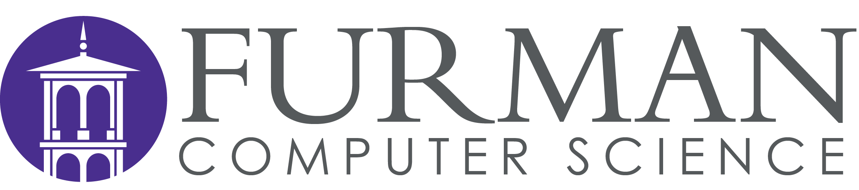
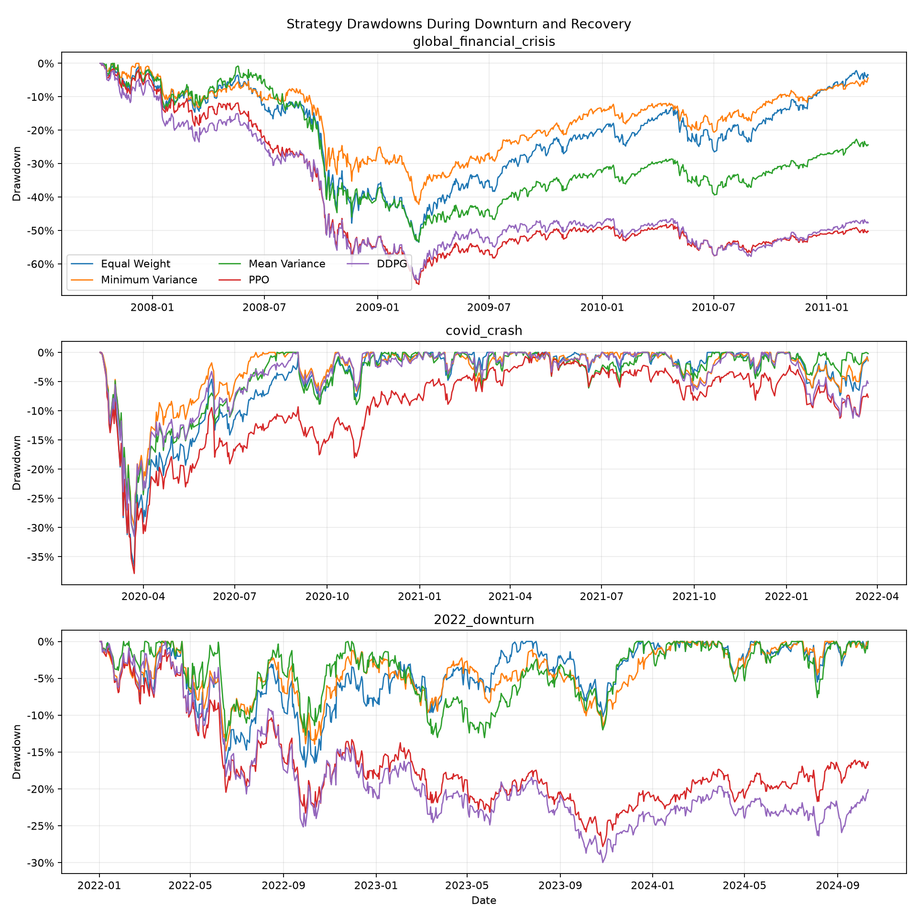
Reinforcement Learning vs. Traditional Portfolio Strategies During Market Downturns
Kelvin Bonsu
INTRODUCTION
METHODS
The results showed that no single strategy performed best across all three market downturns. All five strategies experienced losses during their respective test periods, but their relative performance differed across market conditions.
Minimum Variance achieved the strongest return and Sharpe ratio among the tested strategies during the Global Financial Crisis and the COVID-19 crash. During the 2022 market downturn, Mean-Variance Optimization performed best among the five strategies. PPO and DDPG did not achieve the strongest downturn return in any of the three events.
Recovery performance also varied. None of the strategies returned to the initial portfolio value within the two-year recovery period following the Global Financial Crisis. All five crossed the initial value at some point during the COVID-19 recovery period, although PPO finished that period below the starting value. Following the 2022 downturn, the three traditional strategies crossed the initial value, while PPO and DDPG did not.
Overall, the findings suggest that reinforcement learning did not consistently outperform traditional portfolio strategies during the downturns tested.
Portfolio management involves choosing how to distribute money across different assets while balancing return and risk. Traditional methods use mathematical models to determine portfolio weights while reinforcement learning uses past market information and rewards to learn allocation decisions. However, market downturns can make portfolio decisions more difficult because asset returns change and losses can happen quickly.
This project compares traditional portfolio strategies with reinforcement learning during three major market downturns: the 2007–2009 Global Financial Crisis, the 2020 COVID-19 crash and the 2022 market downturn.
Research Question: How do reinforcement learning portfolio strategies compare with traditional portfolio optimization strategies during major market downturns?
Supporting Question: How do PPO and DDPG differ in their risk and return performance across different market downturns?
Data: Daily historical prices for nine U.S. sector ETFs were collected using Yahoo Finance data through Python. The ETFs represent Materials, Energy, Financials, Industrials, Technology, Consumer Staples, Utilities, Health Care and Consumer Discretionary. The CBOE Volatility Index (VIX) was included as a market volatility feature for the reinforcement learning agents.
Strategies: Five portfolio strategies were compared: Equal Weight, Mean-Variance Optimization, Minimum Variance, PPO and DDPG. All strategies used a starting portfolio value of $100,000. Portfolios were long-only with no leverage and a maximum allocation of 30% to any single ETF. A transaction cost of 0.10% was included in the backtesting setup.
Experimental Design: The strategies were tested during three historical downturns: the Global Financial Crisis (2007–2009), the COVID-19 crash (2020) and the 2022 market downturn. Separate training, validation, test and recovery periods were used for each event. The reinforcement learning models were trained on earlier data and evaluated on later periods to reduce look-ahead bias.
Evaluation Metrics: Performance was evaluated using total return, annualized return, annualized volatility, Sharpe ratio, maximum drawdown and transaction costs. Recovery performance was also examined by measuring whether the portfolio returned to its starting value and how long recovery took.
BACKGROUND
RESULTS
CONCLUSION
Traditional portfolio strategies use mathematical methods to distribute investments across assets. Equal Weight gives each asset the same allocation while Mean-Variance Optimization uses expected returns and risk to choose portfolio weights. Minimum Variance focuses on finding an allocation with the lowest estimated portfolio variance.
Reinforcement learning approaches portfolio management as a sequence of decisions. The agent observes market information, selects portfolio weights and receives a reward based on the portfolio outcome. Proximal Policy Optimization (PPO) and Deep Deterministic Policy Gradient (DDPG) are two reinforcement learning algorithms that can learn allocation policies from market data.
Previous research has explored reinforcement learning for adaptive portfolio allocation and has examined how performance changes across market conditions. This project focuses specifically on comparing these methods during major downturns rather than assuming that one approach will always perform best.
This project compared traditional portfolio optimization methods with PPO and DDPG during three major market downturns. The results did not show that reinforcement learning consistently outperformed traditional strategies. Minimum Variance performed best during the Global Financial Crisis and COVID-19 crash, while Mean-Variance Optimization performed best during the 2022 downturn.
These findings suggest that portfolio performance depends on market conditions and the strategy being used. Reinforcement learning may still be useful for adapting portfolio allocations, but it should be evaluated carefully against traditional methods, especially during periods of high volatility.
easily modifiable
ACKNOWLEDGMENTS
Market data: Yahoo Finance
Volatility data: CBOE Volatility Index (VIX),

