Slide 1
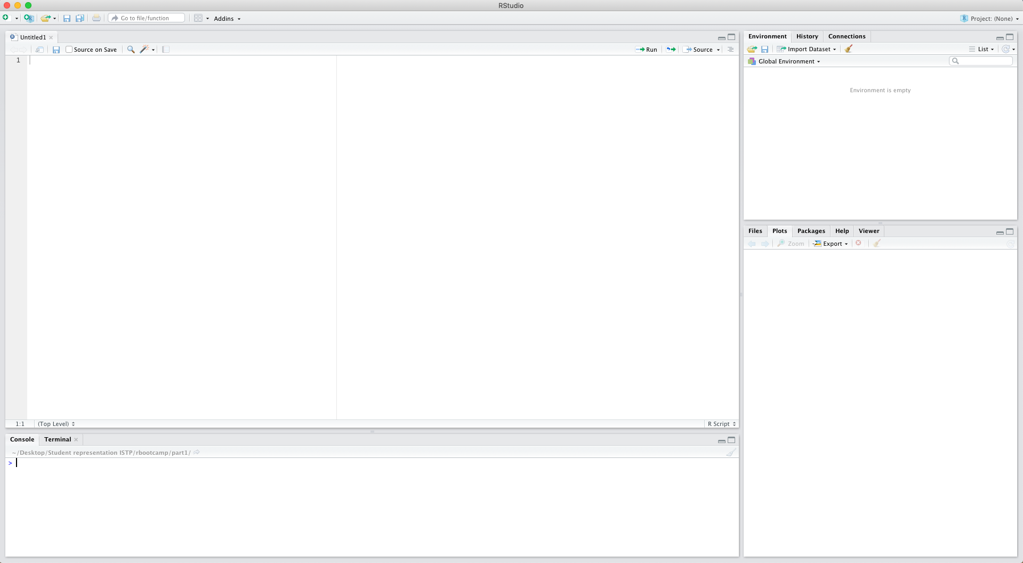
Run your code
Open a new:
script
Rmarkdown
Rpresentation
…
Previous assignments/
commands
Workspace
Assigned variables,
loaded data-sets,
…
This is where you write your script
Working directory,
and all files contained in that
Installed packages
This is where you can perform quick calculations, call variables, see output

