Slide 1
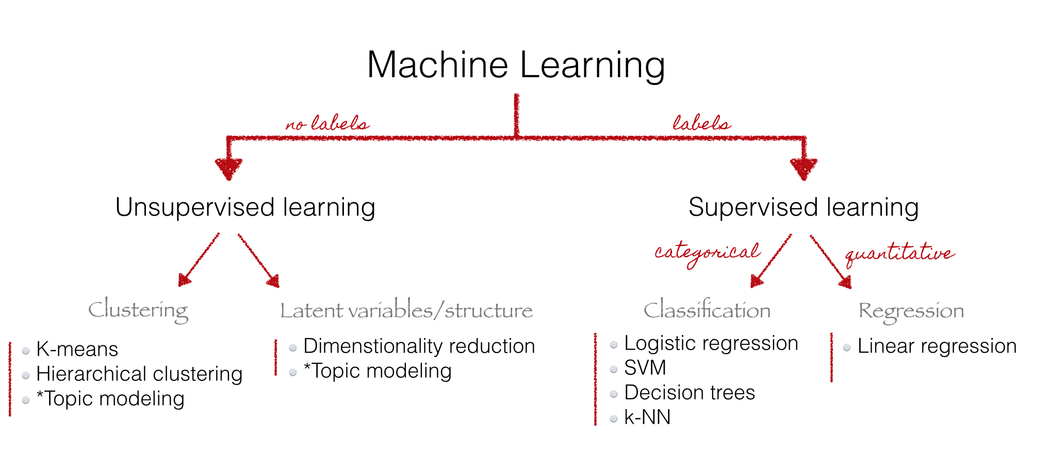

Slide 2
Definitions
A topic model is a type of statistical model for the abstract that occur in a collection of [1]
Topic models are a suite of algorithms that uncover the in document collections. These algorithms help us develop new ways to and summarize large archives of texts [2]
Topic models provide a simple way to analyze large volumes of text. A "topic" consists of a of words that occur together[3]
http://en.wikipedia.org/wiki/Topic_model http://www.cs.princeton.edu/~blei/topicmodeling.html http://mallet.cs.umass.edu/topics.php

Slide 3
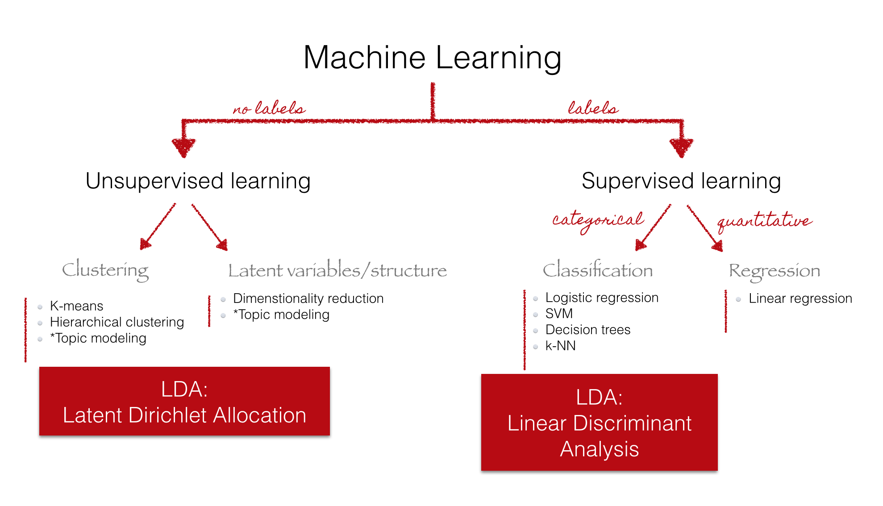

Slide 4
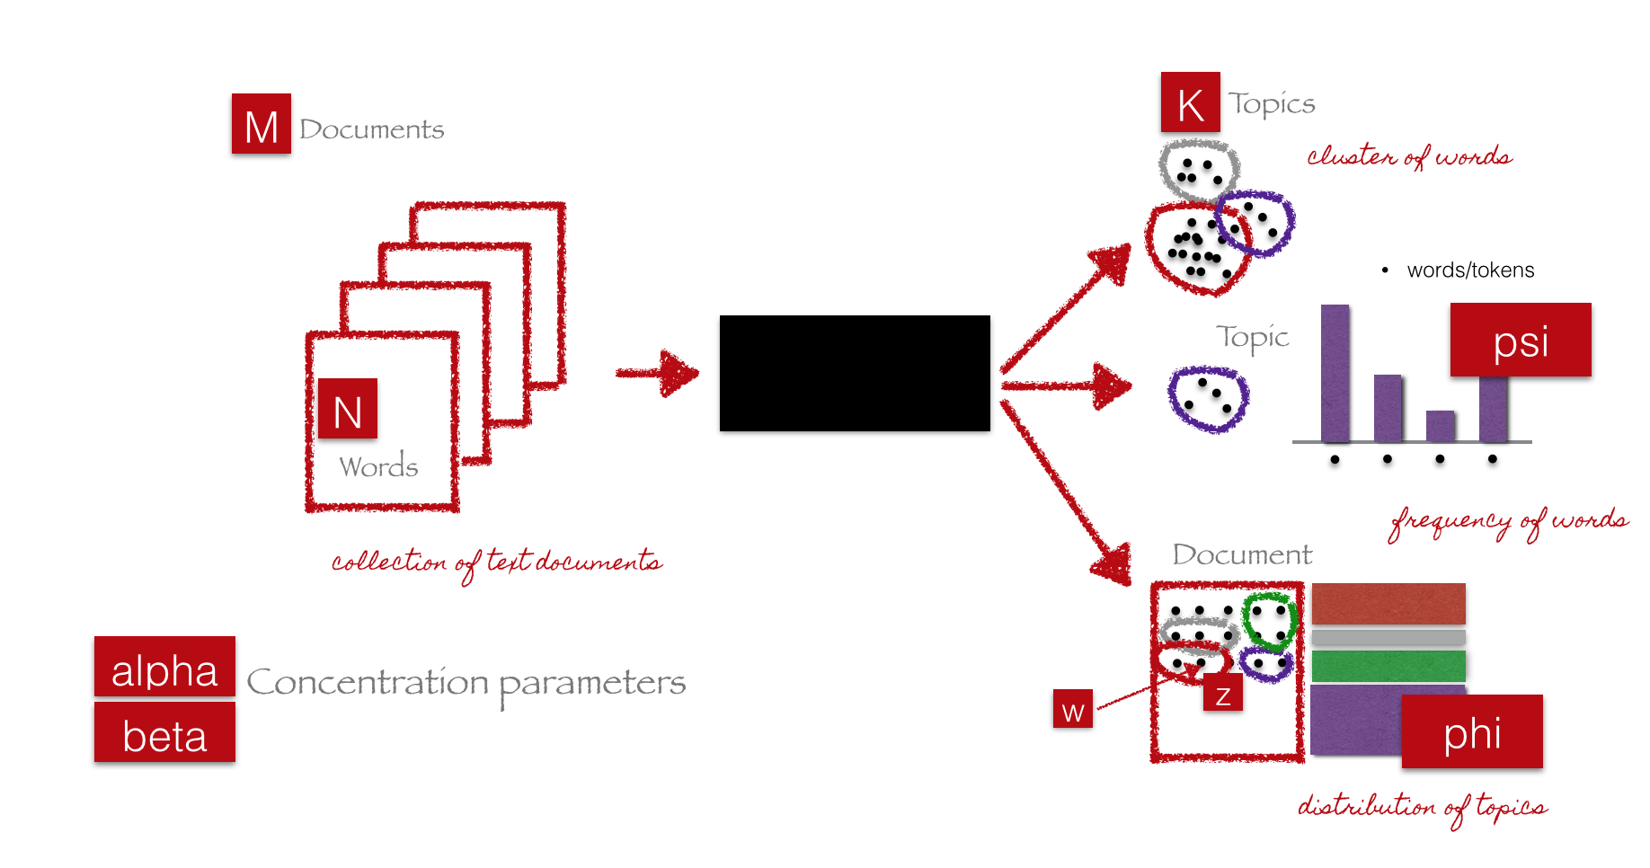
Parameters and Variables

Slide 5
LDA algorithm
Iterative algorithm
Initialize parameters
Initialize topic assignments randomly
Iterate
For each word in each document:Resample topic for word, given all other words and their current topic assignments
Get results
Evaluate model

Slide 6
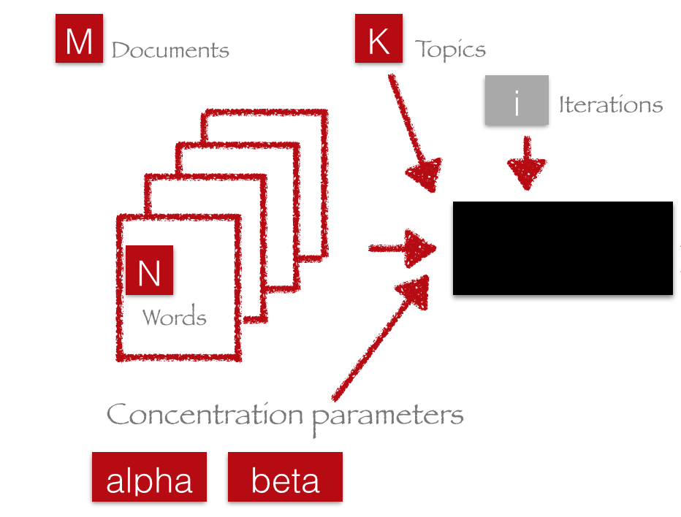
Initialize Parameter

Slide 7
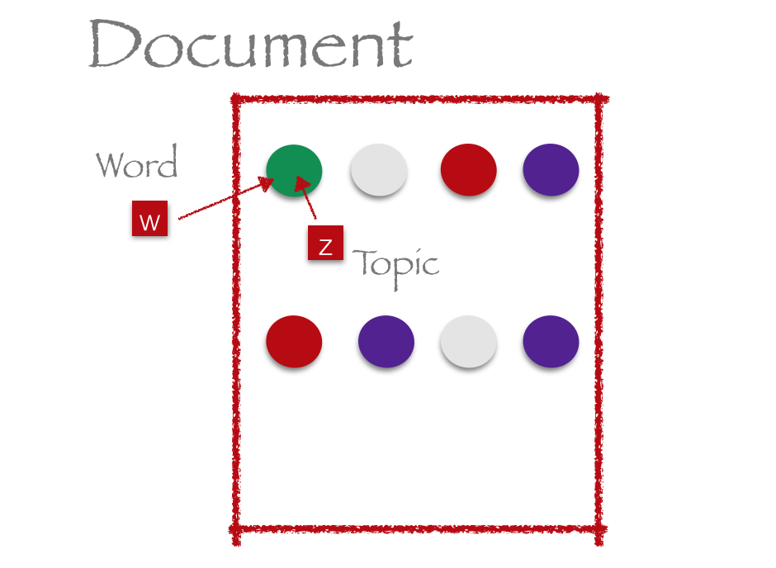
Initialize topic assignments randomly

Slide 8
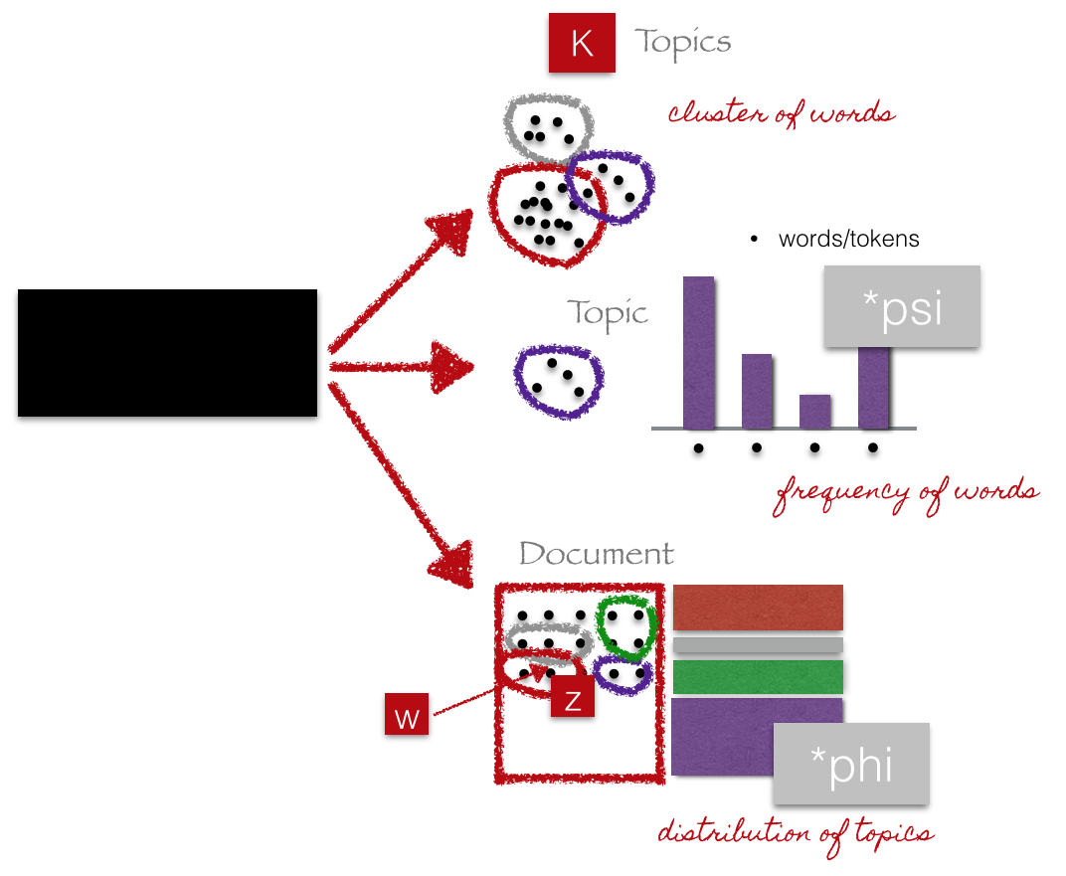
Iterate

Slide 9
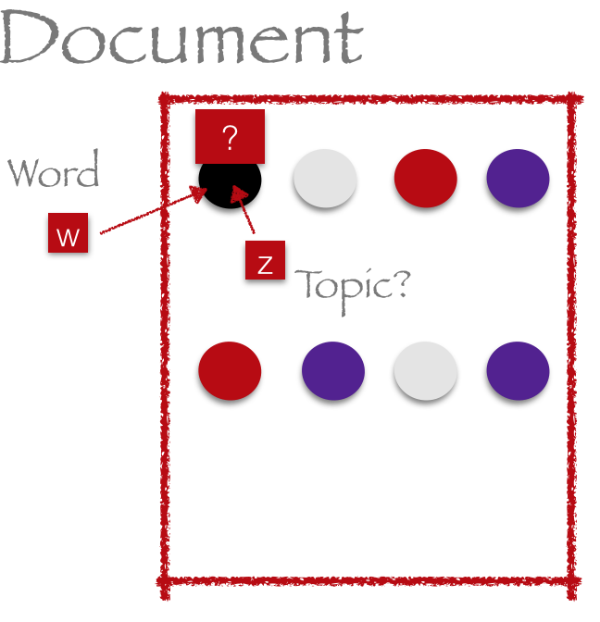
Iterate

Slide 10
Resample topic for word, given all other words and their current topic assignments
Which topics occur in this document?
Which topics like the word X?

Slide 11
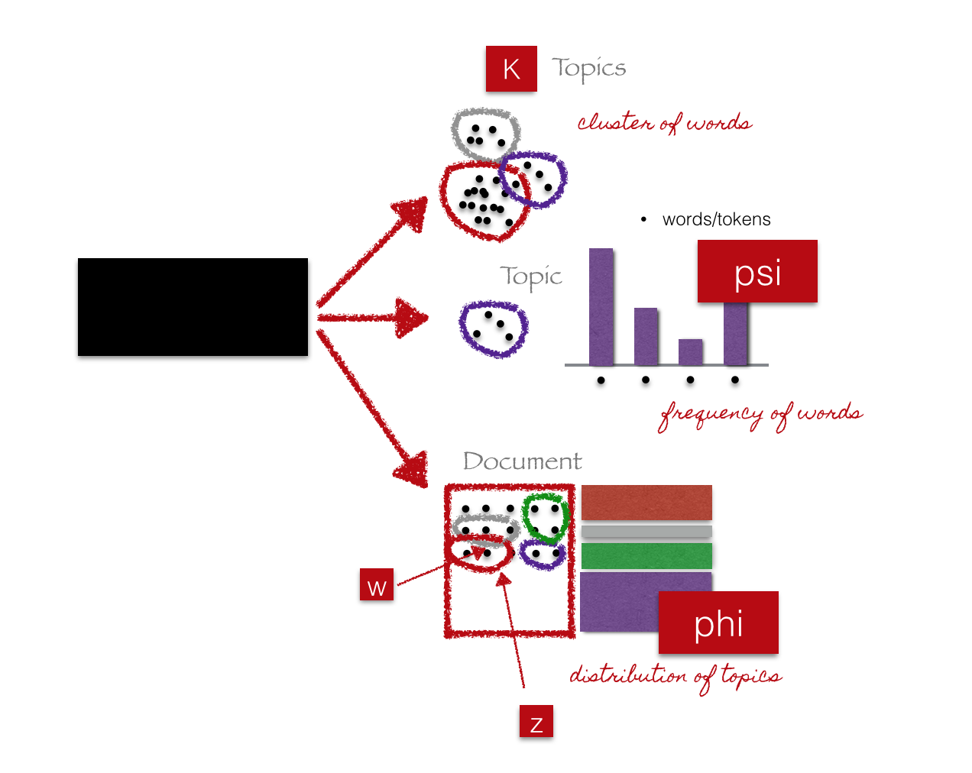
Get Results

Slide 12
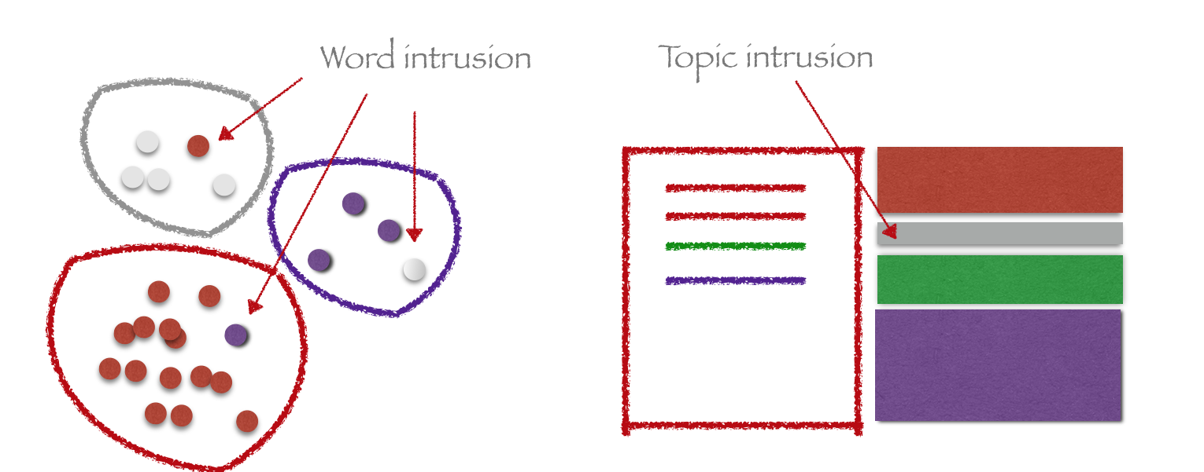
Evaluate Model
Cosine similarity: split each document into two parts, and check that topics of the first half are similar to topics of the second halves of different documents are mostly dissimilar

Slide 13
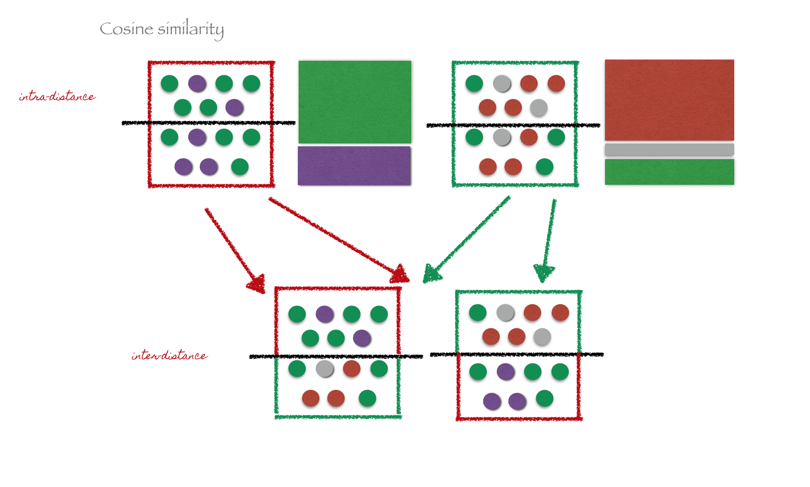
Evaluate Model

Slide 14
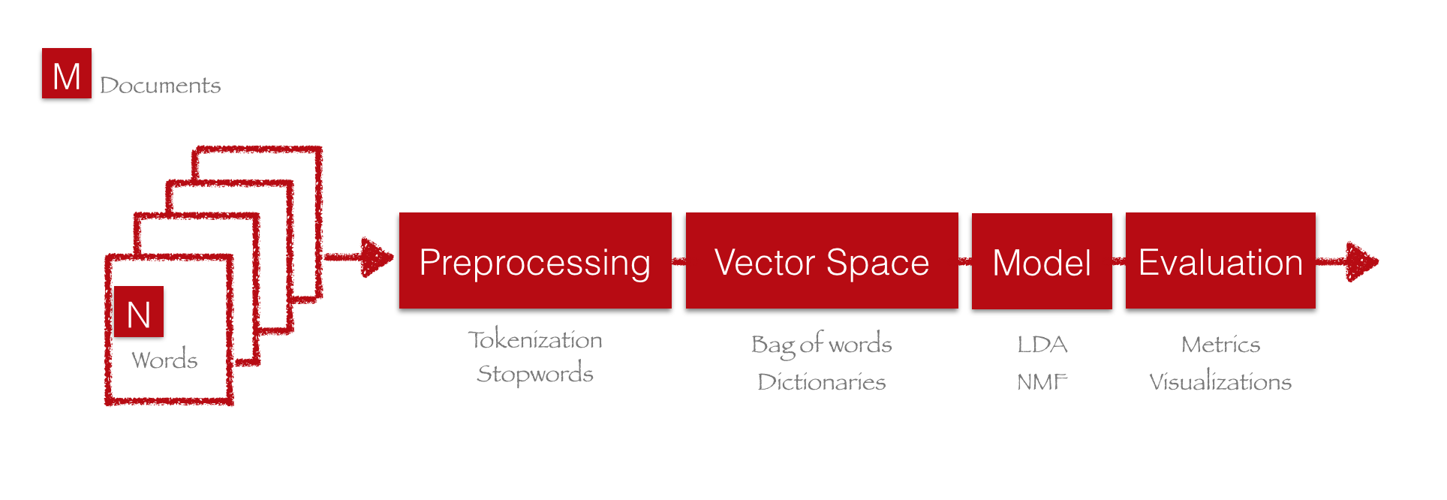
Pipeline

Slide 15
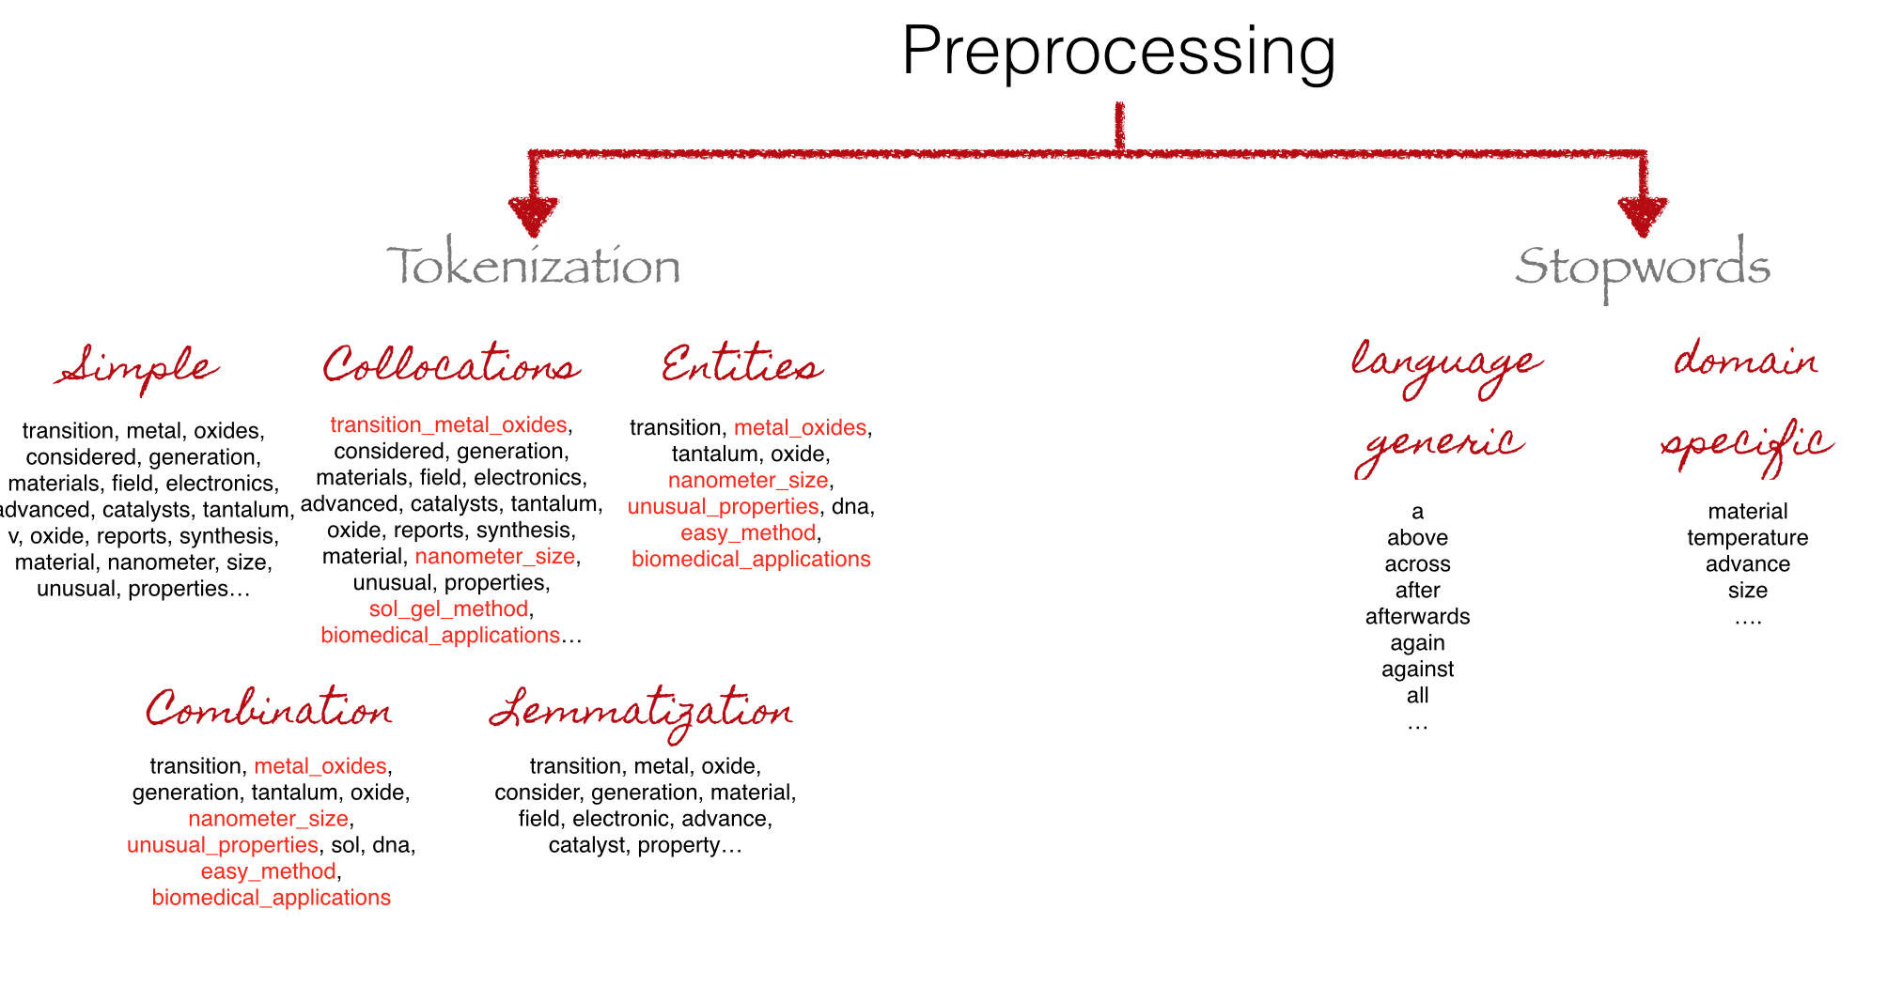
PreProcessing

Slide 16
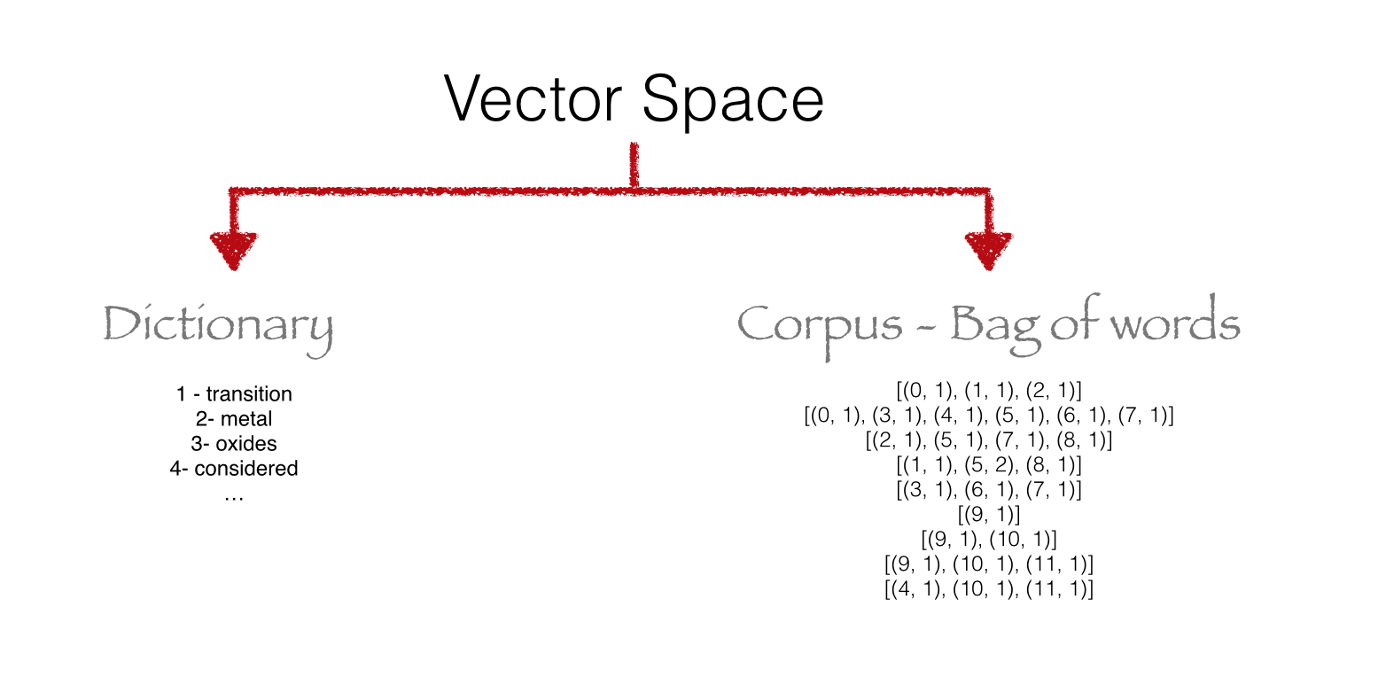
Vector Space

Slide 17
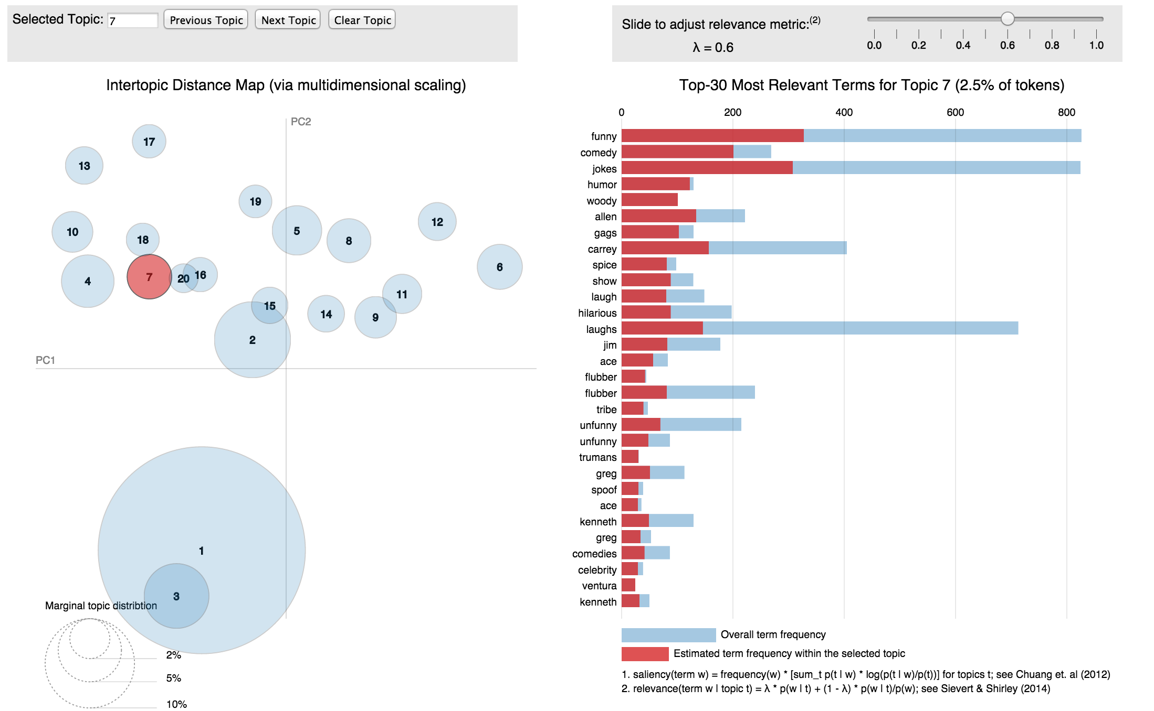
LDAViz

