Slide 1

LOGO

Slide 2

SIGN UP
LOG IN

Slide 3
Gmail
Username
Password
SIGN UP
LOG IN
SIGN UP
CANCEL

Slide 4
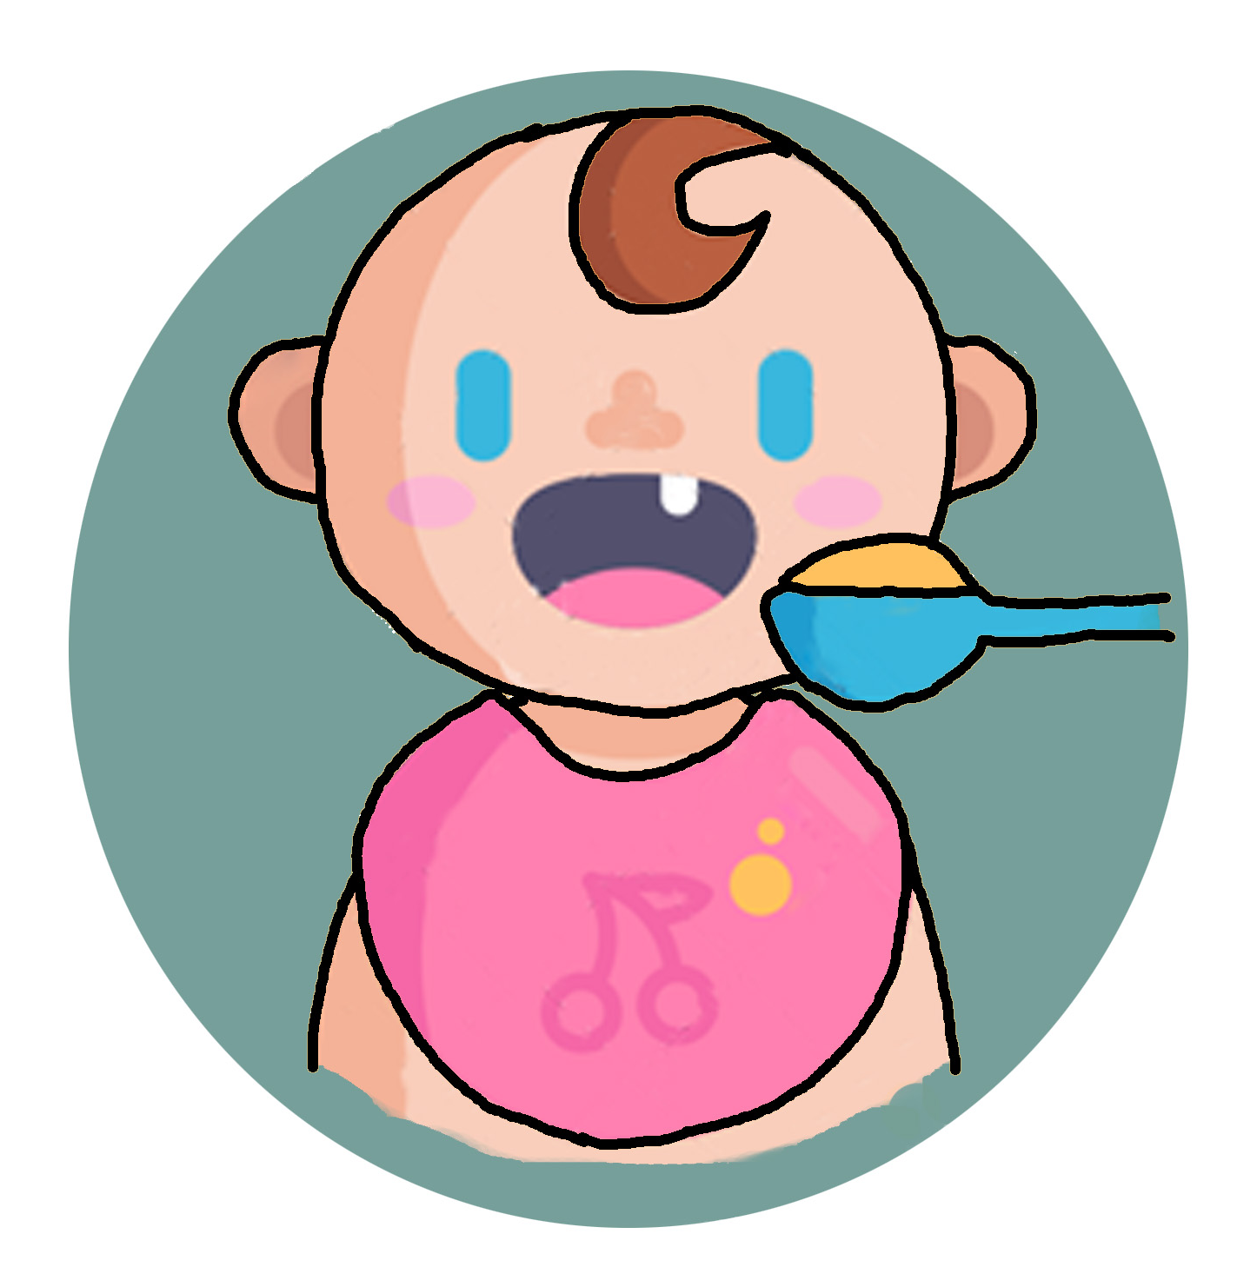
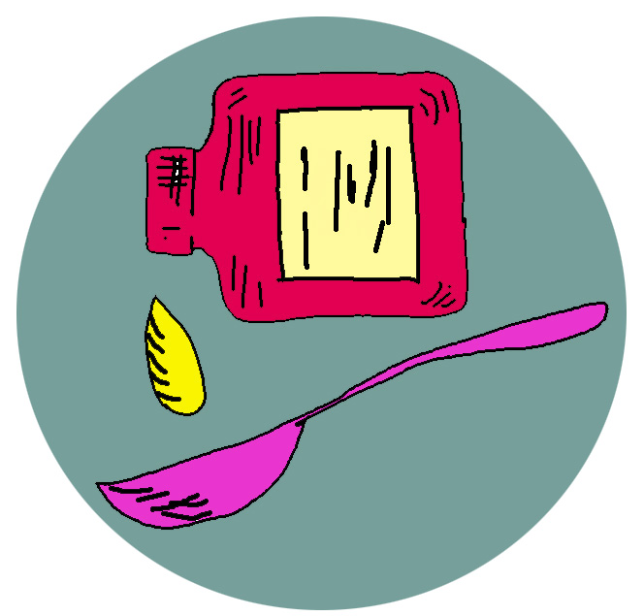

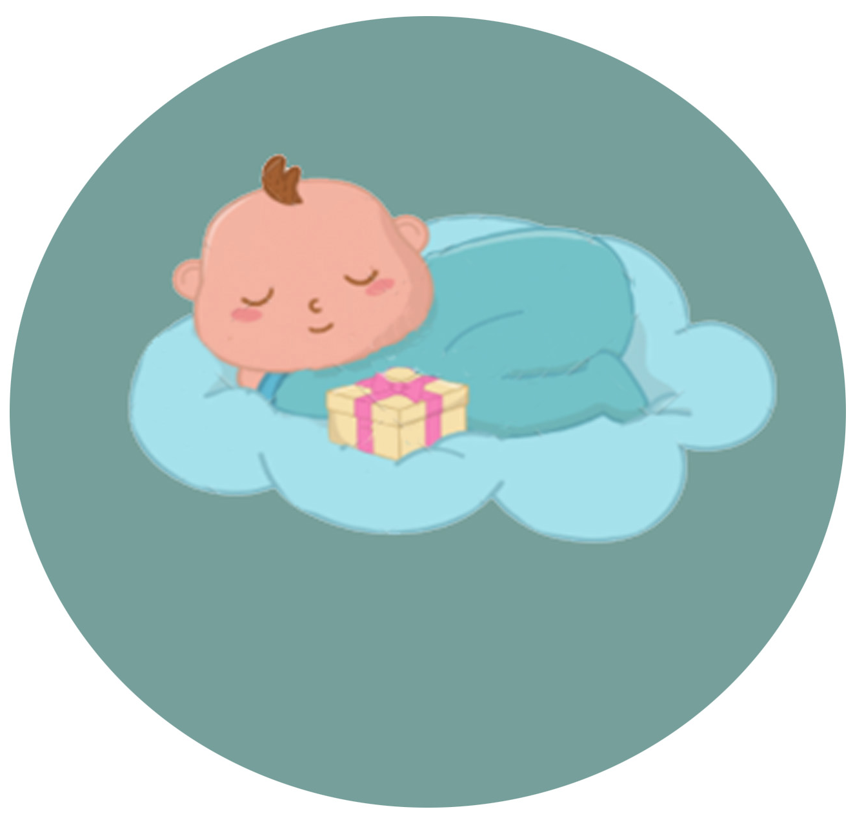

Slide 5

ADD
ADD

Slide 6
ADD
ADD

