Slide 1
Interface for access of the national security service of the Republic of KZ to the system of legal data interception
Akhmetova Bayan and Yerlankyzy Anel

Slide 2
CONTENT
INTRODUCTION
PROJECT GOAL
RELEVANCE, INTEREST, DEMAND, ACHIEVABILITY
MAIN FUNCTIONS AND PROPERTIES

Slide 3
INTRODUCTION
1

Slide 4
In the era of development of communication technologies, terrorism and extremism have moved to the digital world, where they carry out their illegal actions. In this regard, law enforcement agencies need modern and effective tools to deal with offenders who threaten our national security.

Slide 5
PROJECT GOAL
2
Provide law enforcement agencies with an intuitive and functional tool for more effective analysis and timely decision-making.

Slide 6
RELEVANCE, INTEREST, DEMAND, ACHIEVABILITY
3
LLP “SHIFT SYSTEMS”
Kazakhstan company that developed the first domestic certified SOSM(SORM) product.
COMMERCIAL PROJECT
We cooperate with this company. The customer has full control over the project in accordance with specific requirements.
SOSM systems are widely used in almost all developed countries of the world – access to private information by special services primarily allows you to ensure the safety of citizens.

Slide 7
MAIN FUNCTIONS AND PROPERTIES OF INTERFACE
4
receiving, processing, and executing various requests
provides access to electronic logs through the administration and supervision interfaces for viewing information
monitoring the condition of the Complex's equipment
protection against unauthorized access

Slide 8
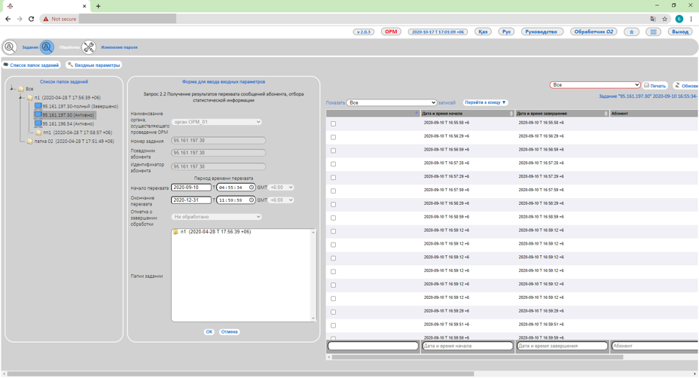
EXAMPLE OF
THE INTERFACE
Place your screenshot here

Slide 9
THANKS!

